Slide 1
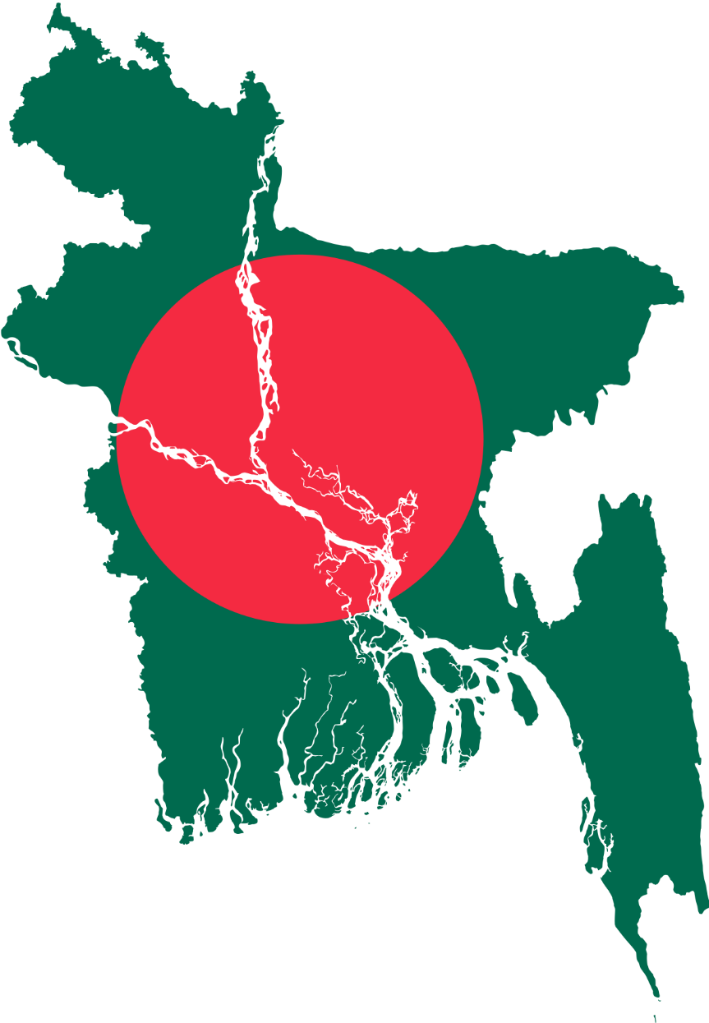
Smart Travel Planner for Bangladesh
Course Title: Algorithms Lab​
Course Code: CSE-206
Course Section: 223_D2
Presented to,​
Md. Abu Rumman Refat​
Lecturer
Green University of Bangladesh
Presented by,​
Md.Arif Billah Mubin
ID: 223002008

Slide 2
Content
1. Project Overview
2. Key Features
3. System Design
4. Program Demonstration
5. Future Scope
6. Conclusion

Slide 3
Project Overview(What is Travel Smart Planner?)
Objective:
1. Simplify travel planning across cities in Bangladesh.
2. Solve travel problems efficiently using algorithmic solutions.
Key Problems Solved:
Find the shortest route between cities.
Plan trips within a specific budget.
Create efficient multi-city travel plans.
Target Audience:
Tourists, business travelers, and transportation planners.

Slide 4
Features (Key Features of the Project)
Shortest Route Finder:
Finds the shortest path between two cities using Dijkstra's Algorithm.
Budget-Friendly Planner:
Suggests cities to visit within a given budget using Greedy Approach.
Multi-City Travel Planner:
Organizes efficient routes for multiple city visits using Divide-and-Conquer.
Interactive Menu Interface:
User-friendly options to select routes, budget, and cities dynamically.

Slide 5
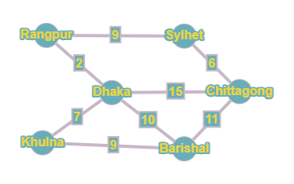
.
System Design (Technical Architecture)
Graph Representation:
Cities as nodes, distances as weighted edges in an adjacency matrix.
Key Algorithms:
Dijkstra
Greedy
Divide-and-Conquer
Modules:
Graph: Stores and processes route data
Menu: Facilitates user interaction

Slide 6
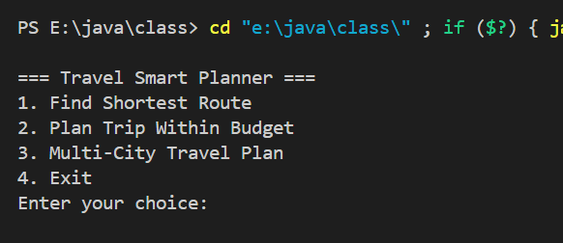
.
Program Demonstration(How It Works)
Menu Options:
Option 1: Find Shortest Route
Option 2: Plan Trip Within Budget
Option 3: Multi-City Travel Plan
Option 4: Exit

Slide 7
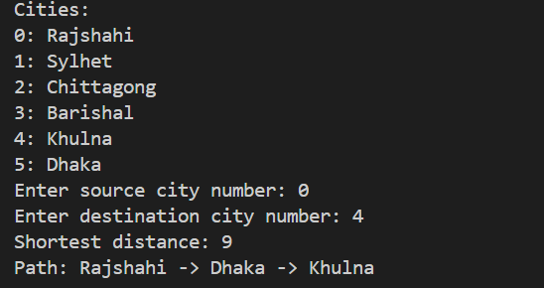
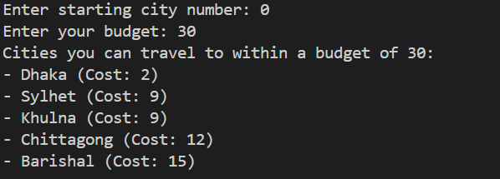
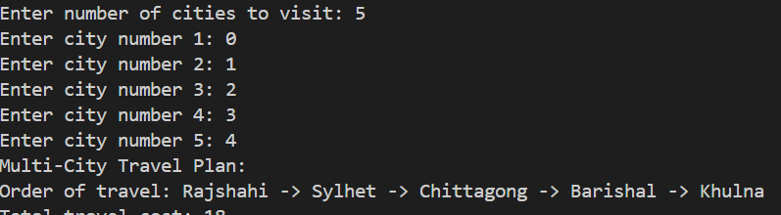
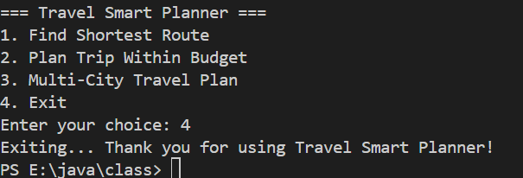
.
Example Demonstration
Option 1: Find Shortest Route
Option 2: Plan Trip Within Budget
Option 3: Multi-City Travel Plan
Option 4: Exit

Slide 8
.
Future Scope
Planned Enhancements:
Add dynamic pricing and real-time data integration.
Support for all major cities in Bangladesh.
Integration with real-world ticketing systems.
Vision:
Transform into a mobile or web application for travelers.

Slide 9
Conclusion
Summary:
Makes travel planning across Bangladesh easier and smarter
Takeaway:
Practical application of Graph Algorithms and Greedy Techniques.

Slide 10
Thank You

