Slide 1


Sales Drivers and Overstock Diagnosis
for a Multi-Store Bike Retailer
Completed orders, January 2016 to March 2018
Prepared by Arif Herfian Zaen Chartiko, Data Analyst
For Management, multi-store bike retailer (California, New York and Texas)
1 / 13

Slide 2
Executive Summary
Revenue grew strongly, but stock is in the wrong place and far too high
$6.66M
Net revenue, 27 months
+41%
Revenue growth in 2017
70.6%
Revenue from Baldwin Bikes (NY)
$19.8M
Stock value at list price
■ Growth came from pricier bikes. Orders rose only 8%, while Road and Electric bikes drove 55% of the growth.
■ One store carries the business. Baldwin brings 71% of revenue with 32% of the stock.
■ Stock is three times the revenue of 27 months. 2018 models hold 73% of it, and 35 products did not sell in a year.
■ The 20% discount does not pay off. It sells no more units than 5% but costs 48% of all discounts.
2 / 13

Slide 3
Questions and Scope
Seven questions on sales, stores, products, stock and discounts
# | Business question
Q1 | How has revenue developed over time?
Q2 | How does each store perform, and does its stock match its sales?
Q3 | How do sales staff compare within each store?
Q4 | Which categories and brands drive revenue?
Q5 | How concentrated is revenue across products?
Q6 | Where is stock too high compared with sales?
Q7 | How much do discounts cost, and do bigger discounts sell more?
■ Data: 9 tables, Kaggle Bike Store Sample Database, used in full.
■ Sales: completed orders, Jan 2016 to Mar 2018.
■ Net revenue: quantity x price x (1 - discount).
■ Stock: one snapshot vs last 12 months of sales.
■ Tools: PostgreSQL, Excel, Python, Power BI.
3 / 13

Slide 4
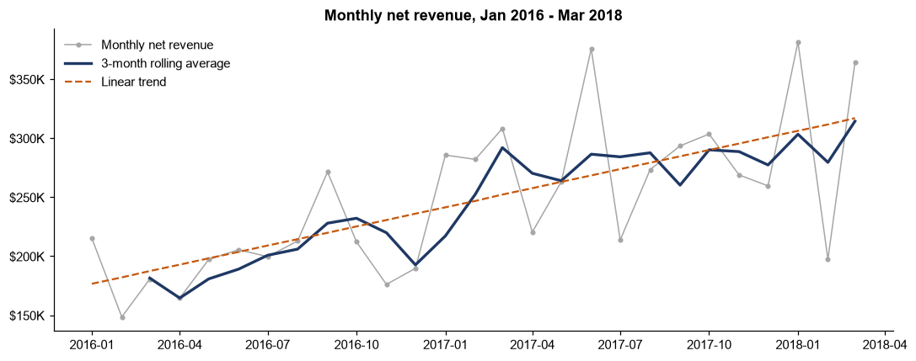
Q1 Revenue Trend
Revenue rose 41% in 2017 while orders rose only 8%
$2.37M
2016 net revenue
$3.35M
2017 net revenue
$943K
Q1 2018, best quarter
4 / 13

Slide 5
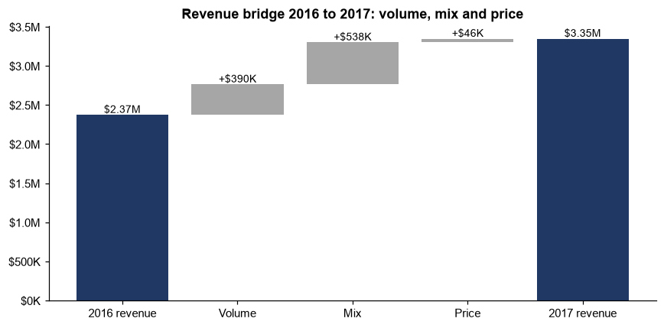
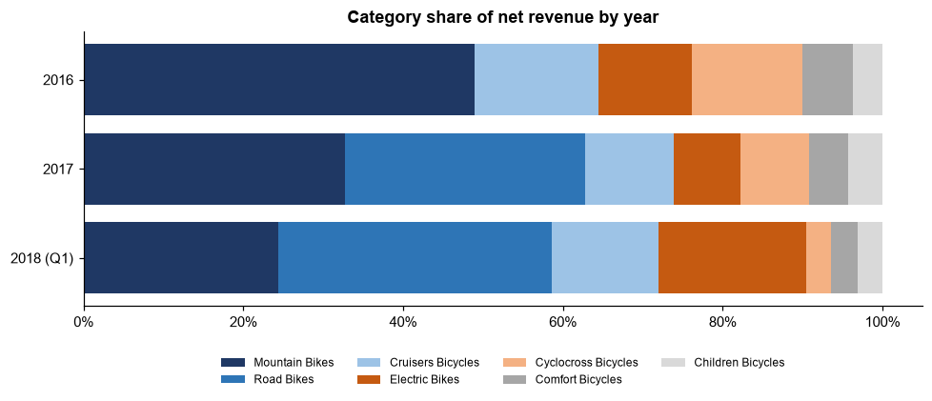
Q1 What Drove the Growth
55% of the growth came from the mix shift to Road and Electric bikes
+$538K
Mix effect, 2016 to 2017
12% to 53%
Road + Electric share of revenue
5 / 13

Slide 6
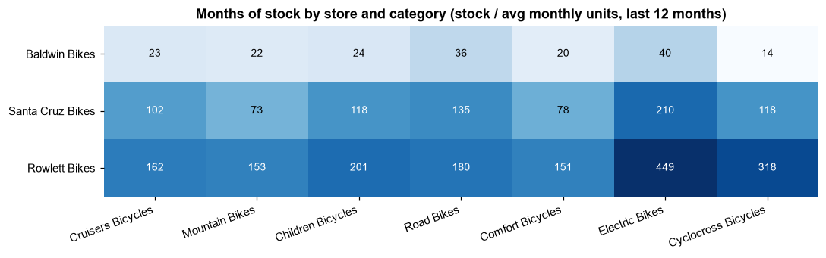
Q2 Stores vs Stock
Baldwin sells 71% of revenue, yet stock is split equally across stores
Store | % of revenue | % of stock | Months of stock
Baldwin Bikes (NY) | 70.6% | 32.3% | 25
Santa Cruz Bikes (CA) | 18.8% | 33.5% | 103
Rowlett Bikes (TX) | 10.6% | 34.2% | 181
5,328
Units to move to Baldwin
55
Months of stock in every store after the move
The same pattern shows in every category, so the issue is how stock is split between stores, not one product line.
6 / 13

Slide 7
Q3-Q4 Categories, Brands and Staff
Mountain Bikes and Trek lead, and staff results follow store size
Category | % of revenue | Avg price per unit
Mountain Bikes | 37.3% | $1,547
Road Bikes | 19.9% | $2,956
Cruisers Bicycles | 13.0% | $465
Electric Bikes | 11.0% | $2,911
Cyclocross Bicycles | 9.6% | $1,761
Comfort Bicycles | 5.2% | $473
Children Bicycles | 3.9% | $248
87%
Revenue from Trek, Electra, Surly
58.8%
Trek share of revenue
■ Cruisers and Children: 46% of units but only 17% of revenue.
■ Road and Electric: about $2,900 per unit, 6x Cruisers.
■ Staff: two sellers per store split sales about 50/50. Mireya Copeland has the highest late-shipment rate (43.8%).
7 / 13

Slide 8
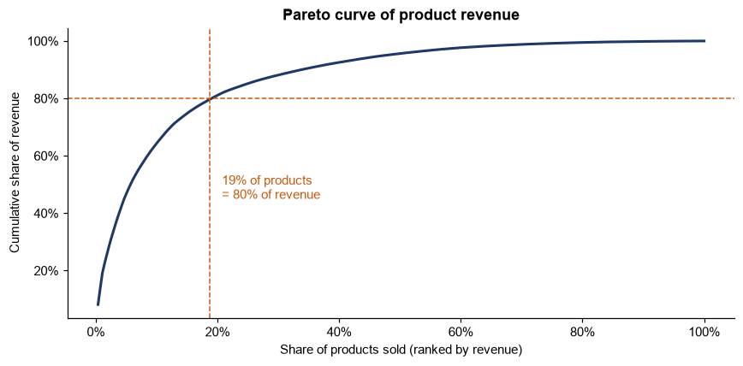
Q5 Product Concentration
52 products (19% of those sold) make 80% of revenue
Class | Products | % of revenue
A | 52 | 79.6%
B | 80 | 15.3%
C | 146 | 5.0%
0.76
Gini coefficient
2-3
Class A items out of stock per store
8 / 13

Slide 9
Q6 Stock vs Sales
Stock is worth 3x the revenue of 27 months, mostly in 2018 models
Model year | Stock value | % of stock value | Months of stock
2016 | $987,113 | 5.0% | 22
2017 | $4,428,514 | 22.3% | 24
2018 | $14,403,955 | 72.7% | 229
$19.8M
Stock value at list price
$2.2M
35 products, no sale in 12 months
■ Every category holds almost 4 years of stock or more, from 46 months (Comfort) to 102 months (Electric).
■ Part of the 2018 build-up is normal, because those models were new when the data ends, but it is still far above any sales rate.
■ Rebalancing helps Baldwin, but total stock stays high, so buying must slow down too.
9 / 13

Slide 10
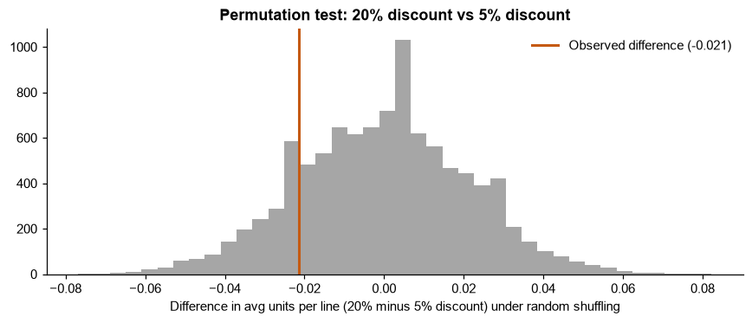
Q7 Discounts
A 20% discount sells no more units than 5% but costs 48% of discounts
Discount | Avg units / line | Discount cost
5% | 1.52 | $98,164
7% | 1.49 | $130,987
10% | 1.48 | $174,453
20% | 1.50 | $371,791
p = 0.32
No volume lift (permutation test)
$775K
Total discount cost, 10.4% of gross
10 / 13

Slide 11
Recommendations
Put stock where demand is, clear what does not move, and stop paying for 20% discounts
# | Action | Expected effect
1 | Move stock from Rowlett and Santa Cruz to Baldwin, and pause their new deliveries | Stock follows demand
2 | Clear the 35 products with no sale in 12 months ($2.2M) | Frees cash and space
3 | Buy new models in line with the sales rate, reviewed monthly by category | No repeat of the 2018 build-up
4 | Keep the 52 class A products always in stock in every store | Protects 80% of revenue
5 | Test removing the 20% discount level for one quarter | About $165K a year in discount cost
6 | Keep growing Road and Electric bikes, with stock in line with sales | Keeps the growth engine
7 | Start recording product cost and repeat-customer data | Enables margin and retention analysis
11 / 13

Slide 12
Limitations
What this data cannot tell us yet
No cost
Profit and margin cannot be measured
1 order
Completed orders per customer, no retention view
1 snapshot
Stock has no date, so no stock history
Mar 2018
Data ends, 2018 models had 3 months of sales
Discount levels, shipping times and order weekdays are spread almost evenly, which suggests generated sample data.
Patterns in these fields should be read with care.
12 / 13

Slide 13
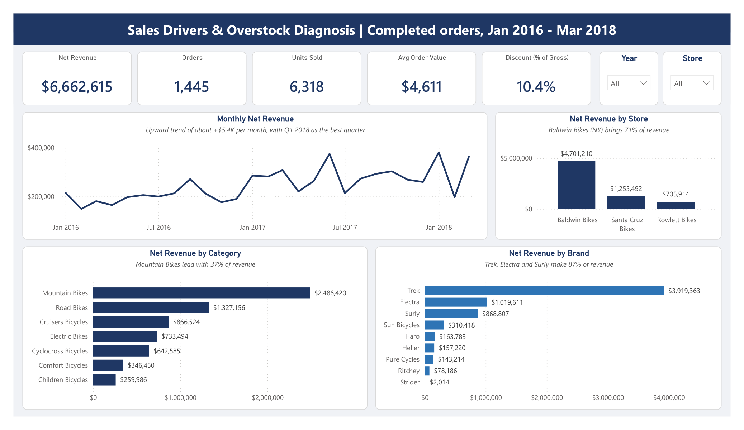
Explore the Dashboard
Every number in this deck can be filtered by year, store, category and brand
■ Power BI: deliverables/dashboard/ (.pbix and PDF)
■ Report: deliverables/ (PDF, Word and Markdown)
■ Excel: process/02_excel/
■ Python: process/03_python/
■ SQL: process/01_sql/
13 / 13

