Slide 1
Capstone Project –
The Battle of Neighborhoods
By-Arif Khan

Slide 2
Business Understanding
We want to open up a café near one of the metro stations of Mumbai. We will take into consideration different venues nearby each metro stations.
We have to recommend the most profitable metro station to open a café nearby, based on its nearby venues and their overall effect on the business.

Slide 3
Data
To complete my final project, I will need the following data
The List of Metro Stations of Mumbai:
Source-https://en.wikipedia.org/wiki/List_of_Mumbai_Metro_stations
Description- This data set contains the required information. And we will use this data set to find out all the metro stations of Mumbai city.
Restaurants/Cafe near each metro stations of Mumbai:
Source-Foursquare API
Description- By using this API we will get all the cafe/restaurants near metro stations of Mumbai city
The category id’s of venues in Foursquare- https://developer.foursquare.com/docs/resources/categories

Slide 4
Methodology
In order to do the analysis and suggest the best location, following are the steps we have to follow:
The Wikipedia page (https://en.wikipedia.org/wiki/List_of_Mumbai_Metro_stations) was scrapped using the BeautifulSoup to extract the list of metro stations of Mumbai.
The Foursquare API is used to get the latitude and longitude of each metro station of Mumbai, also to find out the nearby venues for all the metro stations.
Different venues are assigned different weightage based on its effect for the business of the café.
Once the weightage are assigned, each metro be allotted a score based on its nearby venues and its weightage.
As the scores are calculated the metro station having the highest score will be considered as the perfect spot to open up a café nearby.

Slide 5
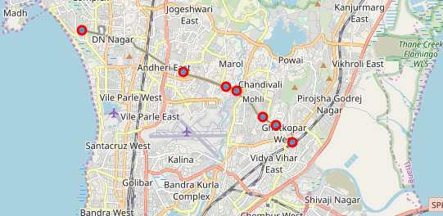
Plot of the Metro Stations of MUMBAI

Slide 6
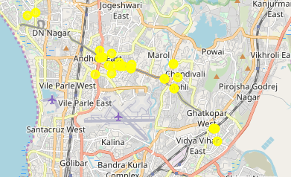
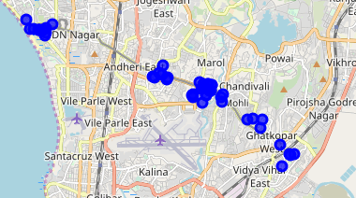
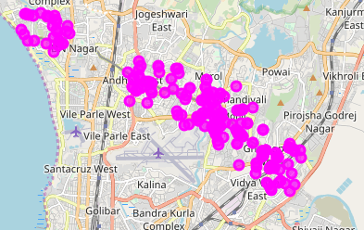
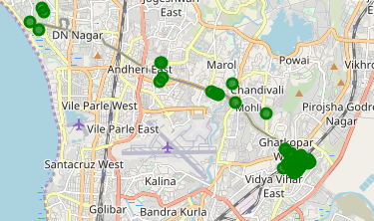
Plots of different venues near each metro station
THEATERS
CAFE
OFFICES
UNIVERSITY AND HIGH SCHOOLS

