Slide 1
SOFTWARE DEVELOPMENT PROJECT 400
Smart Campus Bus Tracking System
A real-time GPS-based bus tracking & campus transit management web application
Supervisor: Humayra Ahmed, Assistant Professor
Intake 51 | Section 3
Md Arif Khan • Karnia Binte Rafique • Suraiya Karim • Prosenjit Biswas • Proshanta Saha

Slide 2
Problem Statement & Project Objectives
02
Addressing campus transit inefficiencies through an automated, real-time tracking and communication ecosystem.
❌ Existing Challenges
🎯 Target Objectives & Solutions
1. Blind Waiting: No live bus location or arrival ETA available at campus stops.
2. Unreliable Schedules: Paper notices with unexpected delays cause missed classes.
3. Communication Gap: No passenger-driver coordination channel during breakdown events.
4. Administrative Blindness: Zero real-time fleet overview, speed metrics, or instant safety reports.
✓ Real-Time GPS Tracking: High-precision location updates broadcasted every 5s on Leaflet OSM.
✓ Haversine ETA Engine: Accurate stop-wise distance and arrival time calculations in real-time.
✓ Live Community Chat: Bus-specific instant communication grouped by active transit trips.
✓ Fleet Management Portal: Interactive route coordinator, user role controls, and visual analytics.

Slide 3
System Architecture & Tech Stack
03
A scalable, decoupled client-server architecture powered by ASP.NET Core and Firebase real-time sync.
🖥️ HTML5 / CSS3 / JS
Vanilla UI, Responsive & Dynamic
🟣 ASP.NET Core 8
C# REST Web API & JWT Auth
🔥 Firebase Firestore
NoSQL Real-Time Sync SDK
🗺️ Leaflet.js + OSM
Interactive GPS Mapping
Client Layer (Frontend UI)
Vanilla JS, Leaflet.js Mapping, Chart.js, HTML5 Geolocation API
Real-Time Layer (Firebase Web SDK)
Firestore Snapshot Listeners for real-time GPS location pan & live bus group chat
⬇️ REST API Queries & Real-Time Data Synchronization ⬇️
Backend API Layer (ASP.NET Core 8 C#)
REST Controllers, JWT Bearer Auth tokens, Role Authorization, Haversine Distance Engine
Data & Third-Party Services
Cloud Firestore NoSQL database + Brevo SMTP API for 6-digit OTP verification emails

Slide 4
Development Methodology & Workflow
04
Iterative Agile development process emphasizing high reliability, real-time synchronization, and modularity.
📋 Agile Phases (1 — 3)
🚀 Agile Phases (4 — 6)
✓ Phase 1: Architecture & NoSQL Schema: Designed normalized User, Bus, Route, and Notice models in Firestore with indexed queries.
✓ Phase 2: Responsive Prototyping: Built mobile-first interfaces with full multi-theme support (Classic Navy, Terracotta, Oceanic).
✓ Phase 3: Secure REST API: Implemented ASP.NET Core endpoints with Brevo SMTP 6-digit OTP verification and JWT claims.
✓ Phase 4: GPS Tracking & ETA Calculation: Integrated HTML5 Geolocation API with Leaflet pan and Haversine distance engine.
✓ Phase 5: Real-time Messaging & Broadcast: Built bus-wise community group chats and urgent notice board.
✓ Phase 6: Verification & Testing: Executed xUnit backend unit tests and Playwright E2E integration test suites.

Slide 5
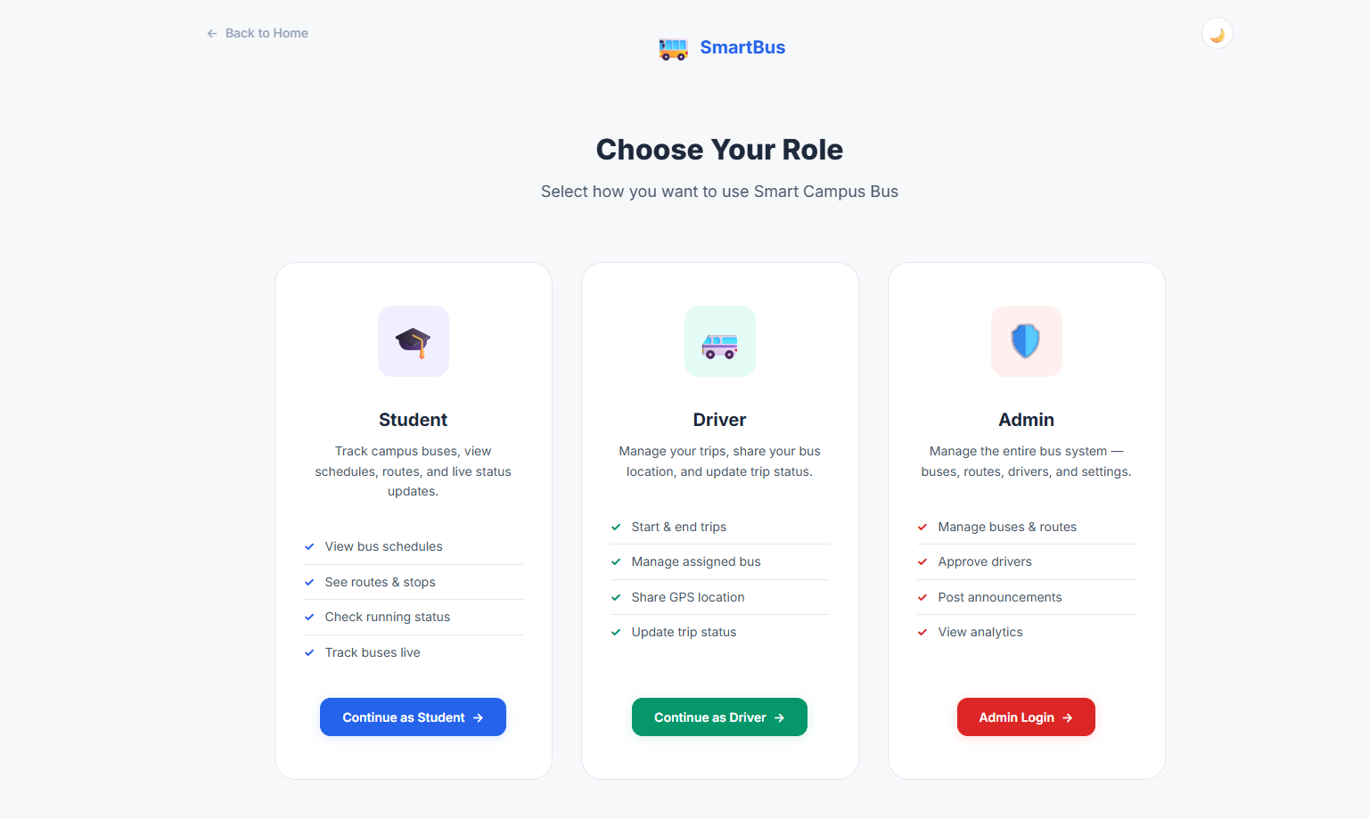
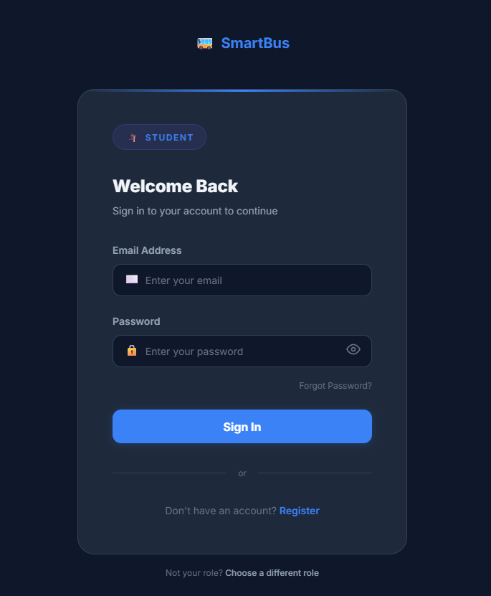
Walkthrough: Onboarding & Multi-Role Authentication
05
Role-based access system (Student, Driver, Admin) with secure registration, Brevo SMTP OTP verification, and JWT session handling.
ROLE SELECTION — STUDENT / DRIVER / ADMIN
SECURE MULTI-ROLE LOGIN SCREEN

Slide 6
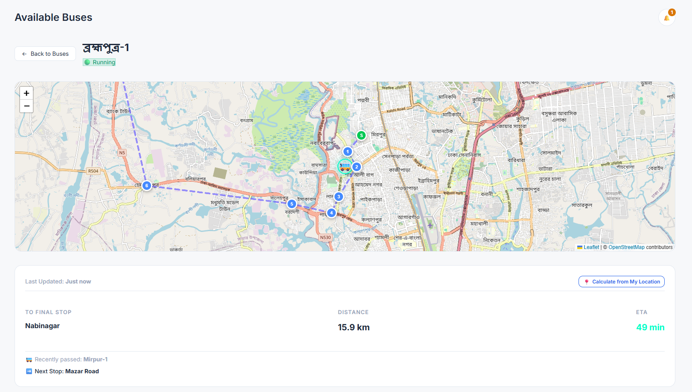
Walkthrough: Real-Time GPS Tracking & Dynamic ETA
06
Live Leaflet map pins bus coordinates updated every 5s. Haversine engine calculates exact stop distances and arrival estimates.
LIVE MAP TRACKING: REAL-TIME LOCATION & STOP ETA PANEL

Slide 7
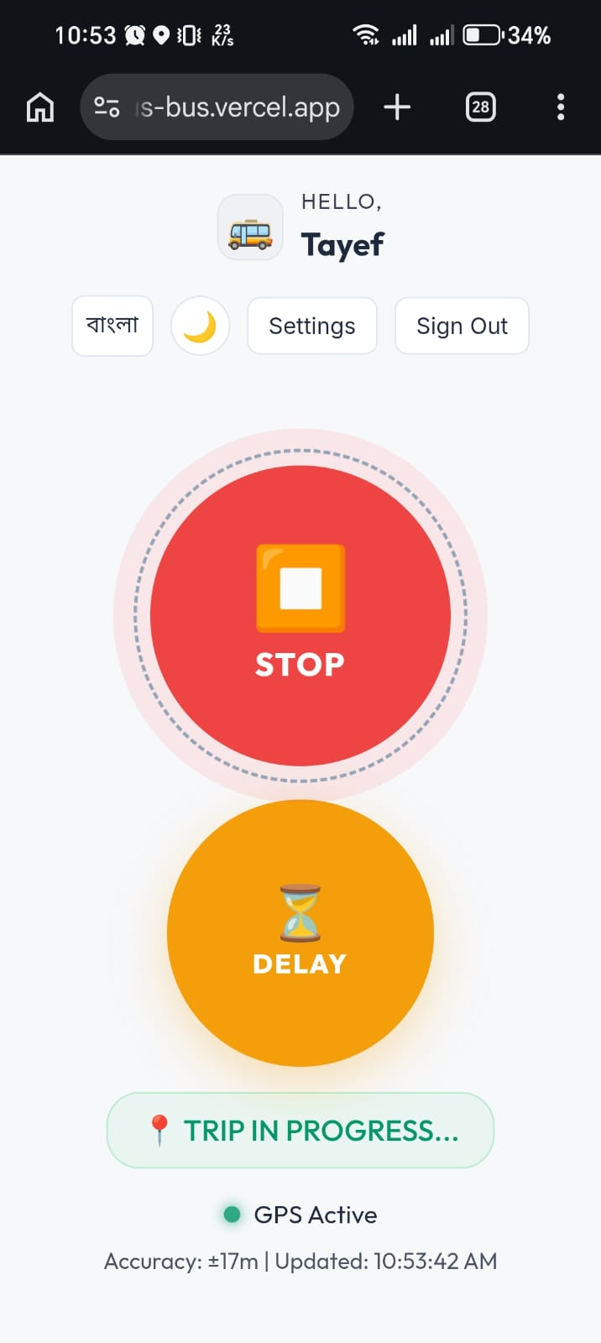
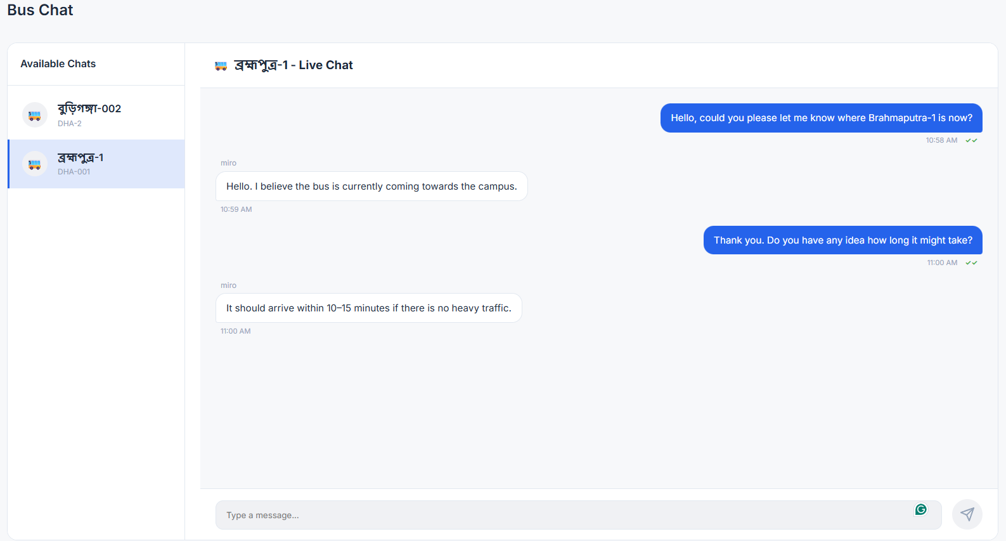
Walkthrough: Driver Console & Community Chat
07
Driver dashboard with single-tap trip start, delay broadcast, and bilingual UI, paired with real-time bus-wise group chat.
DRIVER TRIP CONTROLLER & DELAY ALERTS (MOBILE)
BUS-WISE REAL-TIME PASSENGER COMMUNITY CHAT

Slide 8
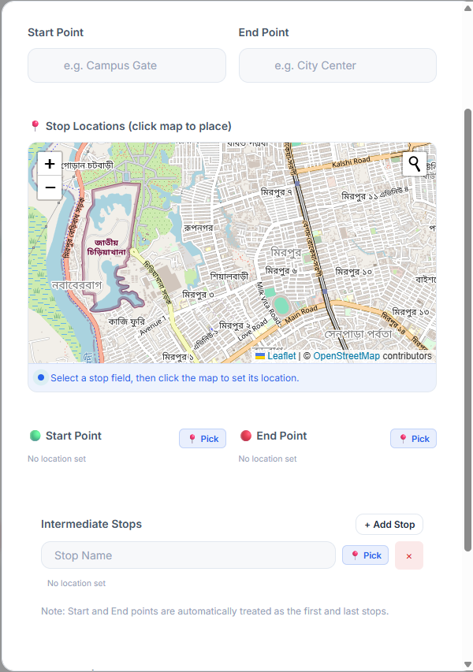
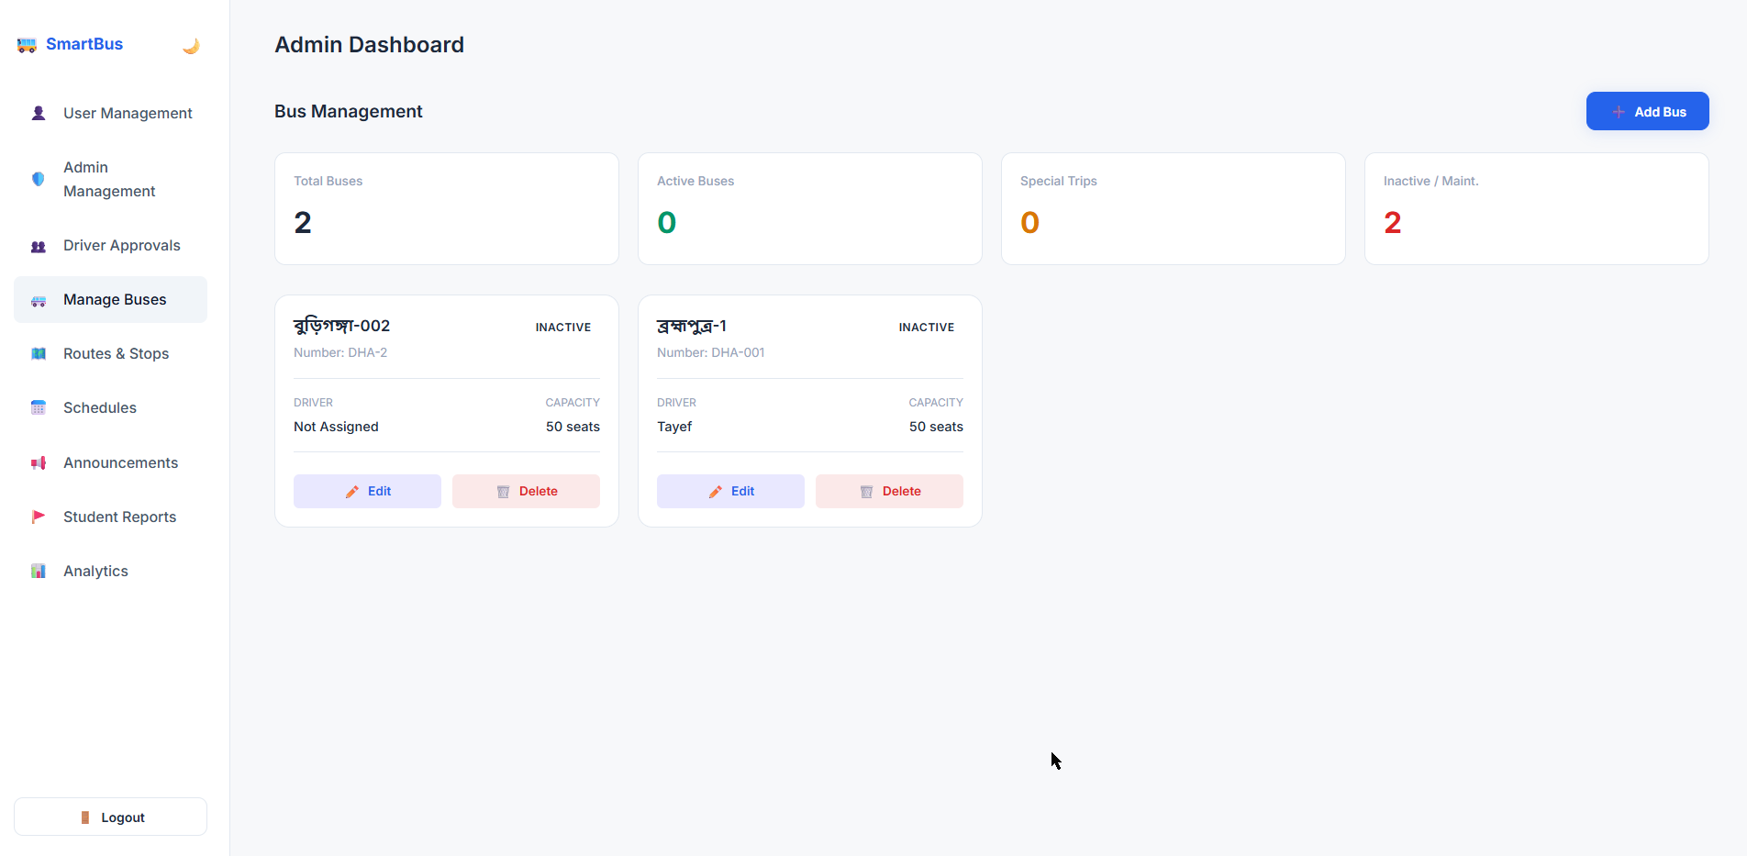
Walkthrough: Map Route Builder & Fleet Management
08
Admin map coordinator enables clicking and dragging stop coordinates directly on OSM, alongside complete bus fleet CRUD operations.
INTERACTIVE MAP ROUTE COORDINATOR & STOP EDITOR
BUS FLEET ADD / MODIFY / DELETE CRUD CONSOLE

Slide 9
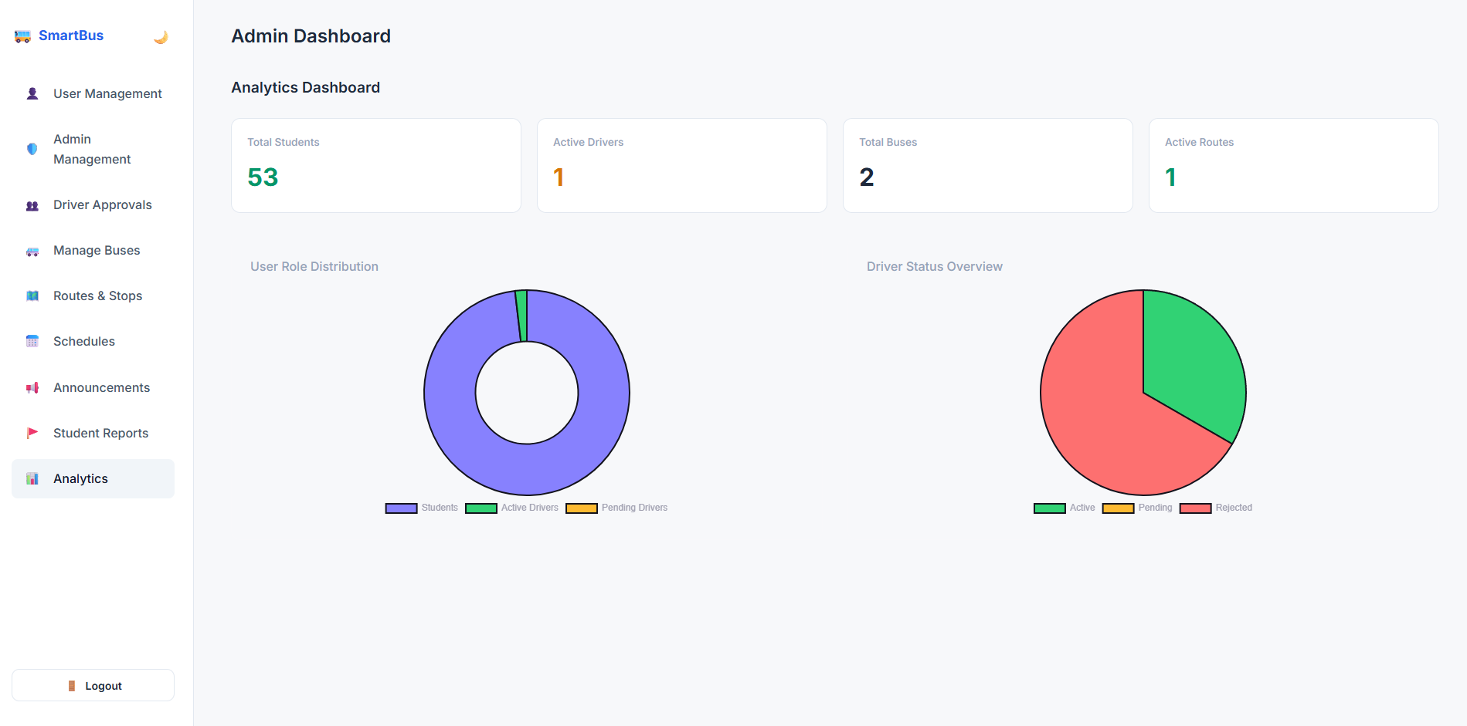
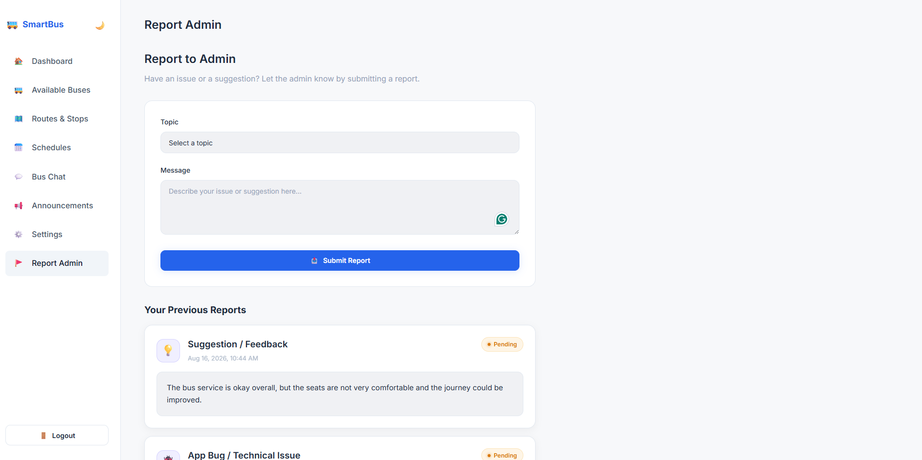
Walkthrough: Admin Analytics & Safety Management
09
Admins monitor user statistics with Chart.js, broadcast urgent notices, manage user roles, and resolve student safety reports.
CHART.JS VISUAL ANALYTICS DASHBOARD
STUDENT SAFETY & BUG REPORTING PIPELINE

Slide 10
Key Differentiators & Measurable Impact
10
SmartBus combines mathematical precision with seamless real-time interaction to deliver a superior campus commute.
✨ Key Differentiators
📈 Measurable Impact
🧮 Haversine Formula ETA: Mathematical calculation based on geographical GPS coordinates.
💬 Bus-Wise Chatrooms: Real-time Firestore communication per active bus.
🌐 Bilingual Driver UI: Full English & বাংলা localization for seamless driver usability.
🗺️ Visual Route Builder: Click-to-place stops directly on Leaflet OpenStreetMap.
⚡ Zero Blind Waiting: Students track bus locations before heading to stops, eliminating idle wait.
📢 Instant Delay Alerts: Push notices reduce campus confusion during unexpected traffic.
🛡️ Enhanced Student Safety: Direct reporting pipeline with immediate admin response.
📊 Data-Driven Transit: Analytics help optimize bus schedules and fleet allocation.

Slide 11
Business Model & Monetization Strategy
11
A high-margin B2B SaaS transit management platform converting university fleets into recurring subscription revenue.
🎯 Target Market
💎 Value Proposition
💰 Revenue Streams
📈 Unit Economics
✓ 150+ Universities: Public & Private campus networks (BUBT, NSU, BRAC, DU).
✓ K-12 Schools: Student safety & parental live tracking subscriptions.
✓ Corporate Fleets: IT & industrial employee shift shuttle fleets.
✓ Zero Hardware Cost: 100% Smartphone GPS based — no GPS tracker box needed.
✓ Zero Blind Waiting: Real-time ETA & live delay alerts eliminate idle wait time.
✓ 20-30% Fleet Savings: Route & schedule analytics optimize fuel & transit costs.
✓ B2B SaaS Subscription: $15 - $25 (৳1,500 - ৳2,500) / bus / month recurring fee.
✓ White-Label Solution: ৳50,000 custom campus setup & branded portal license.
✓ Hyperlocal Campus Ads: Targeted deals for local food courts, bookshops & cafes.
✓ 85%+ Gross Margin: Zero map licensing fee (Leaflet/OSM) & low server cost.
✓ Scalable ARR: 10 Universities (~150 buses) = ৳36 Lakhs / Year recurring.
✓ Rapid Onboarding: Full university campus fleet goes live in < 10 minutes.

Slide 12
Conclusion & Future Roadmap
12
A complete, tested, and reliable university transit solution with clear paths for future expansion.
🏁 Project Summary
🔮 Future Roadmap
✓ Successfully developed and integrated a real-time GPS transit platform for university campuses.
✓ Integrated ASP.NET Core REST API, Firestore real-time sync, and Brevo OTP authentication.
✓ Validated through comprehensive xUnit backend testing and Playwright E2E browser automation.
✓ IoT Passenger Crowding Sensor: Real-time bus seat occupancy tracking via smart sensors.
✓ Automated Speed Alerts: Instant notifications for bus overspeeding events to ensure safety.
✓ Offline SMS Fallback: Check bus timings and alerts via standard offline SMS queries.
✓ Digital Ticketing Engine: Integrated payment gateway for special inter-campus routes.

Slide 13
Thank You!
Smart Campus Bus Tracking System
Software Development Project 400
Intake 51 | Section 3
Supervised by Humayra Ahmed, Assistant Professor
Md Arif Khan • Karnia Binte Rafique • Suraiya Karim • Prosenjit Biswas • Proshanta Saha
Questions & Feedback Welcome 🙌

