Slide 1

Department of Computer Science and Engineering
Uttara University
AUTONOMOUS BORDER SURVEILLANCE SYSTEM - AN ENERGY EFFICIENCY DRONE SIMULATION PATH PLANNING USING HEURISTIC OPTIMIZATION
Student 1 ID: 2223081070
Supervisor
Student 1 Name: Mahmudul Hasan Khan
SHEBIKA RANI
Student 2 ID: 2223081071
Lecturer
Dept of CSE
Uttara University
Student 2 Name: Arif Khan

Slide 2

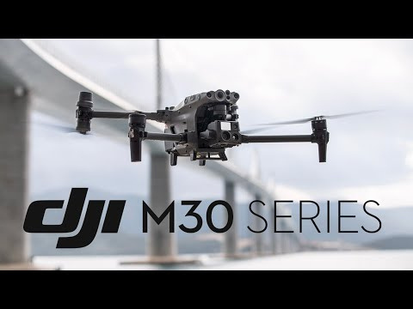
Department of Computer Science and Engineering
Uttara University
INTRODUCTION
Border surveillance is a critical requirement for national security and defense systems. Traditional border monitoring methods depend largely on human patrols and fixed surveillance infrastructure, which are costly, inefficient, and vulnerable to human error.
Figure 1
This research proposes an Autonomous Border Surveillance System that uses heuristic optimization and graph-based algorithms to enable intelligent, energy-efficient, and adaptive drone navigation in border areas.
Use this drone configuration in this thesis
Source: www.securitywholesalers.com.au

Slide 3




Department of Computer Science and Engineering
Uttara University
BACKGROUND STUDY
Multi-UAV Coverage Path Planning: A Distributed Online Cooperation Method
Border Patrol Using Multiple Unmanned Aerial Vehicles Based on Stackelberg Security Game (2024)
Energy-Efficient Internet of Drones Path-Planning Study Using Meta-Heuristic Algorithms (2024)
Divided this area into n groups
Monitoring within their own groups
Each agent can make their own decisions.
Create holes in dynamic environments
Avoiding obstacles and using the least amount of energy
Increases the stability and convergence speed of the drone's path
Not effective dynamic obstacles
Moving many possible paths
Target high-value zone first
Lack of Real-time Adaptivity
Static Battery Constraint

Slide 4



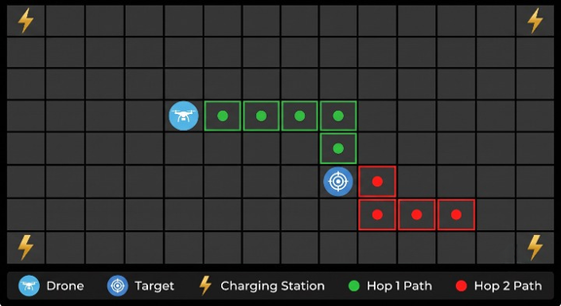


Department of Computer Science and Engineering
Uttara University
PROBLEM STATEMENTS
Predictability in Patrol Routes
Unrealistic Energy Consumption
Lack of Real-Time Adaptivity
Existing models rely on static, offline schedules and fail to adapt dynamically to sudden environmental changes or battery drainage.(2)
Fixed or predictable patrolling patterns allow intruders to bypass security, compromising the effectiveness of the surveillance.(3)
Traditional surveillance drones struggle with limited battery life and lack energy-optimized routing for large border areas. (1)
E
wind
= 0.5*ρ*v3 *A
*C
d
E
climb
= m*g*∆h
E
avionics
= Power* times
(systems running Energy)
E
E
wind
*
E
climb
mechanical
=
η
propulsion
(friction and heat lost energy )
Total Joules
=
E
mechanical
+
E
avionics
Joules *
η
internal Efficiency
Battery %=
Usable Capacity Joules

Slide 5

Department of Computer Science and Engineering
Uttara University
AIM OF THE RESEARCH
The primary aim of this research is to design and simulate an autonomous drone-based border surveillance system that ensures efficient area coverage, Continuous Surveillance, Realistic Energy Optimization, Game-Theoretic Security, Adaptive Learning and mission safety using heuristic optimization techniques.
Continuous Surveillance
Realistic Energy Optimization
Game-Theoretic Security
Adaptive Learning

Slide 6
Department of Computer Science and Engineering
Uttara University
Use Multi systems
Realistic Energy Optimization
01
Existing studies use single-drone or basic multi-drone patrol systems.
01
accurately calculate power consumption and ensure highly efficient battery management
Simple Energy Calculation
No Handoff System
02
Many works use simple battery consumption models.
02
No automatic relay handoff between drones.
Literature Review & Research Gap
Avoid obstacle
Adaptive Learning
03
Some studies consider obstacle avoidance and threat detection.
03
The drone learns from the environment and sets which areas should be given higher priority.
Use Game Theory
Real-Time Override
04
They uses game theory to generate many possible random and unpredictable flight paths.
08
When a threat is detected, the system overrides game theory and uses real-time safety logic.

Slide 7
Department of Computer Science and Engineering
Uttara University
PROPOSED METHODOLOGY
SMRS Framework Design
Game-Theoretic Decision Making
Executable Route Generation
Environment & Energy Modeling
Developing the Smart Multi Surveillance (SMRS) architecture.
Implementing autonomous relay-handoff for continuous coverage.
Applying Bayesian Stackelberg Security Games (SSE).
Expected Utility= (P1 * V1) + (P2+V2)
Catching the intruder (he gets +0.65)
The smuggling operation is causing a huge loss (0.35 * 4 = 1.4)
Countering bounded-rational attackers using SUQR models.
Using Metropolis-Hastings Markov Chain to map theoretical coverage into physical drone paths.
Integration of 3D SRTM terrain data..
Applying OWT-A* physics (wind drag, climb cost)
real-time battery drain calculation.

Slide 8
Department of Computer Science and Engineering
Uttara University
🌍 1. Environment & Input Module
3D SRTM Terrain Data & Wind Attributes
SYSTEM ARCHITECTURE
⚙️ 2. Physics & Energy Engine (OWT-A*)
Calculates Wind, Turn, and Climb Costs
🧠 3. Game-Theoretic Intelligence
This block diagram illustrates how the different modules of our proposed system interact with each other.
(Attacker Prediction)
🚁 4. SMRS Control & Path Planning
Markov Chain Route & Relay-Handoff
💻 5. Simulation & Output
GUI Execution & Performance Metrics

Slide 9



Department of Computer Science and Engineering
Uttara University
IMPLEMENTATION PROGRESS
Physics & Energy Engine (OWT-A*)
Simulation Environment
Security & Learning
Drone simulation
GUI visualization
Real/Synthetic terrain support
Drone Operations
Smart Multi Relay System (SMRS)
Physics-Based Energy Model
Game-Theoretic Security
Adaptive Learning
Wind effect calculation
Turning energy calculation
Terrain elevation energy calculation
Battery-aware decision making
Threat detection
Path planning
Implemented on a 30 × 30 Grid
SRTM Terrain Data Integration
Automatic drone handoff
Continuous border surveillance

Slide 10
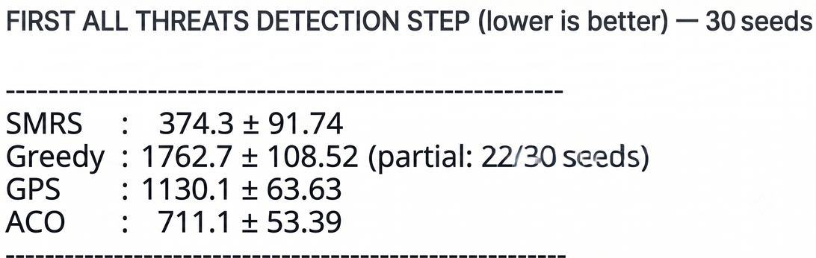
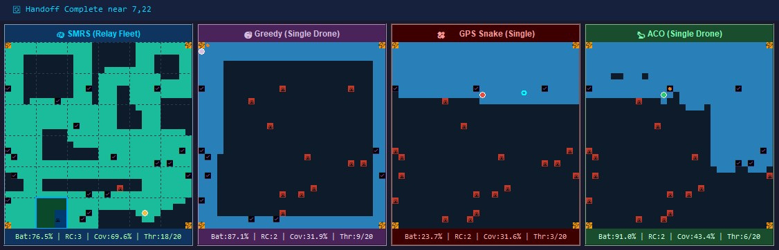
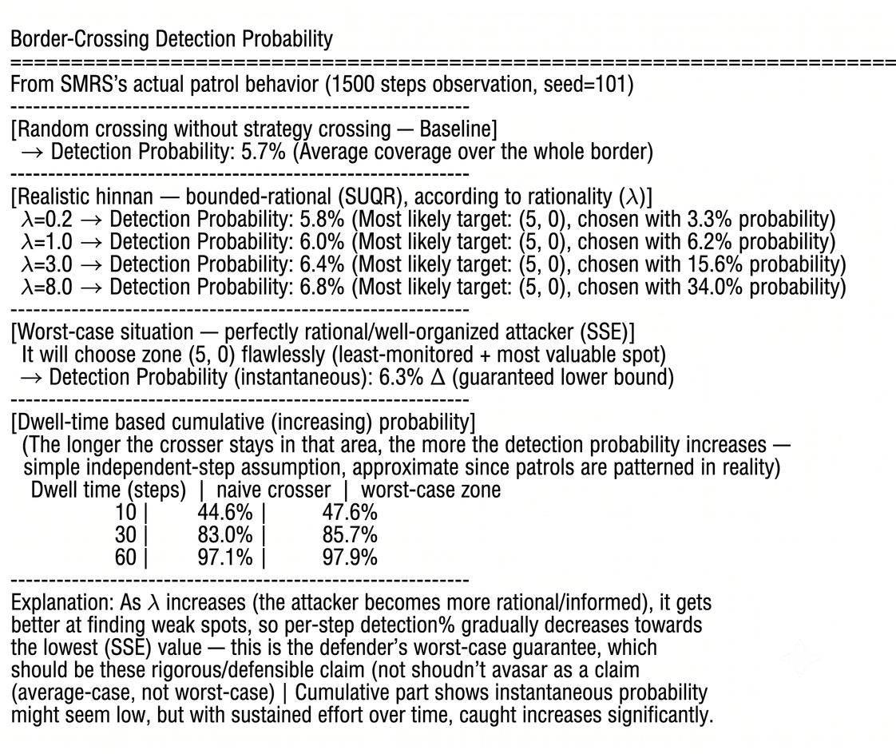
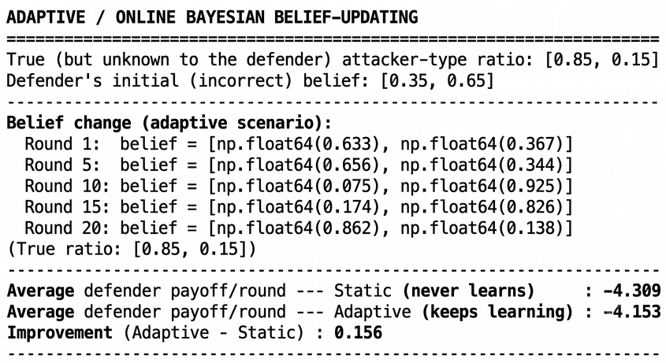
Department of Computer Science and Engineering
Uttara University
CURRENT RESULTS
Fig-2: Average all threat detect steps
Fig-3: Detection % using Game Theory
Fig-1: Comparison simulation (SMRS vs Greedy vs GPS vs ACO)
Smart Multi Relay System (SMRS) doesn't just focus on threats; it also provides effective coverage. In just 283 steps, SMRS covered 69% of the path and detect 18 threats. Ant Colony Optimization (ACO) covered 43% and detect 6 threats.
~ 3.62%
Fig-4: Improving Game Theory using Adaptive Learning

Slide 11
Department of Computer Science and Engineering
Uttara University
FUTURE WORK
Use Multi-Drone
Improve Adaptive Learning
01
Deploy multiple UAVs to increase the threat detection rate and area coverage.
03
Enable the UAV to adapt its game-theoretic strategy based on changing threats and environmental conditions.
Use Dynamic Threat
Dynamic Micro-Weather
02
Replace static threat values with real-time dynamic threat estimation for adaptive UAV patrol.
04
Upgrading the static wind model to dynamic micro-weather conditions

Slide 12

GANTT CHART
Time line
TASKS
FEBRUARY
MARCH
APRIL
MAY
JUNE
JULY
AUGUST
SEPTEMBER
Literature Review and Problem Analysis
System Design and Architecture
Algorithm Implementation
Simulation and Visualization Development
Testing and Performance Evaluation
Documentation and Thesis Writing

Slide 13


Department of Computer Science and Engineering
Uttara University
Do you have Any Questions ?

Slide 14

Department of Computer Science and Engineering
Uttara University
REFERENCE
01
Ref: Di Franco, C., & Buttazzo, G. (2015). Energy-aware coverage path planning of UAVs. 2015 IEEE International Conference on Robotics and Automation (ICRA), 7157-7162.
02
Ref: Aggarwal, S., & Kumar, N. (2020). Path planning techniques for unmanned aerial vehicles: A review, solutions, and challenges. Computer Communications, 149, 270-299.
03
New insights about customer interests refine targeting and personalization
Border Patrol Using Multiple Unmanned Aerial Vehicles Based on Stackelberg Security Game (2023)
04
Energy-Efficient Internet of Drones Path-Planning Study Using Meta-Heuristic Algorithms (2024)
Content Improve
05
Ref: Farr, T. G., et al. (2007). The shuttle radar topography mission. Reviews of Geophysics, 45(2), RG2004. (SRTM)
06
Ref: Lian, F., et al. (2024). WA-LPA*: An Energy-Aware Path-Planning Algorithm for UAVs in Dynamic Wind Environments. Drones, 9(12), 850. (OWT )
07
Ref: Basilico, N., Gatti, N., & Amigoni, F. (2009). Leader-follower strategies for robotic patrolling in environments with arbitrary topologies. IEEE Transactions on Robotics, 25(6), 1317-1331. (SSE)
08
Ref: Yang, R., Kiekintveld, C., Ordóñez, F., Tambe, M., & John, R. (2011). Improving resource allocation strategy against human adversaries in security games. IJCAI Proceedings-International Joint Conference on Artificial Intelligence, 22(1), 458-464. (SUQR)
09
Ref: Valavanis, K. P., & Vachtsevanos, G. J. (2015). Handbook of Unmanned Aerial Vehicles (Vol. 1). Springer Publishing Company, Incorporated. (Chapter: UAV Simulation and Visualization). (GUI)

