Slide 1

DEPARTMENT OF COMPUTER SCIENCE & ENGINEERING · UTTARA UNIVERSITY
Pneumonia Detection from Chest X-ray Images
Comparing five deep learning models and a weighted ensemble to classify Normal vs Pneumonia
PRESENTED BY
SUPERVISED BY
Humaira Akter Mim
ID: 2223081050
Sumiya Akter
ID: 2222081078
Shamima Nasrin
Senior Lecturer Dept. of CSE
Thesis Defense
2026
Notes:
Welcome the committee, introduce yourselves and the thesis title.

Slide 2

PRESENTATION OUTLINE
What We’ll Cover
01
Introduction & Background
02
Problem Statement
03
Research Objectives
04
Literature Review
05
Dataset & Preprocessing
06
System Design & Models
07
Ensemble Model
08
Results & Analysis
09
Comparison & Discussion
10
Conclusion & Future Work
Department of CSE · Uttara University
02 / 25
Notes:
Walk through the outline in one breath.

Slide 3
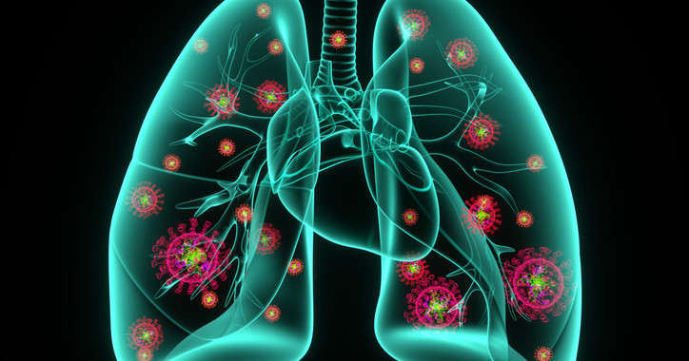
01 — INTRODUCTION
Introduction & Background
What is pneumonia?
A lung infection that inflames the air sacs. It can be caused by bacteria, viruses or fungi and is dangerous for children and the elderly.
Why chest X-ray?
Fast, low cost and widely available, so it is the first test used for diagnosis.
Our scope
Classify X-rays as Normal or Pneumonia with deep learning.
Chest X-ray showing pneumonia
Goal: detect pneumonia from chest X-rays automatically, with high accuracy. accurate screening aid for early detection.
Department of CSE · Uttara University
03 / 25
Notes:
Set the context: why pneumonia and why chest X-rays.

Slide 4
02 — PROBLEM STATEMENT
The Problem We Address
Manual reading of chest X-rays is slow and can be wrong, so we need an accurate automatic system to detect pneumonia early.
WHO IS AFFECTED
CURRENT LIMITATION
WHY NOW
Patients, especially children and the elderly, and radiologists with heavy workloads.
Pneumonia looks like other lung diseases, and one model alone may not be reliable.
Transfer learning and free GPUs make strong medical-image models possible.
Department of CSE · Uttara University
04 / 25
Notes:
State the gap in one sentence, then the three points.

Slide 5
03 — OBJECTIVES
Research Objectives
01
02
Train five models (CNN, DenseNet121, ResNet50, VGG16, EfficientNetB4) to classify Normal vs Pneumonia.
Compare the models using accuracy, precision, recall, F1-score and AUC.
03
04
Build a weighted-average ensemble to improve accuracy and reliability.
Find the most reliable system for supporting early pneumonia screening.
Department of CSE · Uttara University
05 / 25
Notes:
Each objective maps to a result shown later.

Slide 6
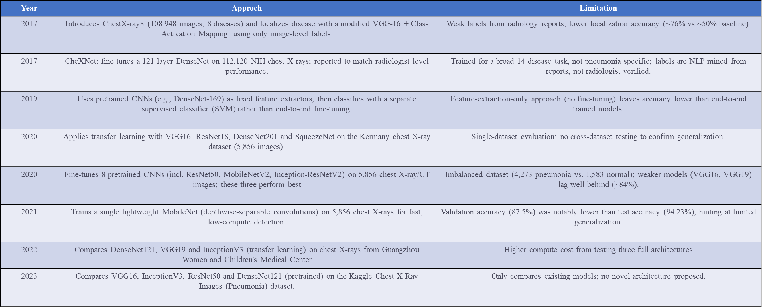
04 — LITERATURE REVIEW
Related Work
Notes:
Group by approach; end with our contribution.

Slide 7
05 — DATASET
Dataset & Class Distribution
Labels come from public chest X-ray data (NIH ChestX-ray14 metadata 112,000 images and Chest X-Ray Images (Pneumonia) 5,863 images, 2 categories). Images with other diseases were removed.
SPLIT | NORMAL | PNEUMONIA | TOTAL
Train | 3,687 | 2,901 | 6,588
Validation | 788 | 621 | 1,409
Test | 789 | 623 | 1,412
Total | 5,264 | 4,145 | 9,409
Department of CSE · Uttara University
07 / 25
Notes:
9,409 images split 70 / 15 / 15 with a fixed random seed.

Slide 8

05 — DATA PREPROCESSING
Preprocessing & Augmentation
1 Original X-ray
various sizes
2 Resize
224 × 224, RGB
(380 × 380 for EfficientNetB4)
3 Normalize
÷ 255 or model-specific preprocess_input
4 Augment
(train only)
AUGMENTATION SETTINGS
Rescale: 1/255
Rotation: 15°
Zoom: 0.2
Horizontal flip: True
Width / height shift: 0.1
Class weights: Normal 0.89, Pneumonia 1.14
Department of CSE · Uttara University
08 / 25
Notes:
Augmentation is applied to training images only.

Slide 9
06 — SYSTEM DESIGN
System Architecture
Chest X-ray
input
Preprocessing
resize · normalize · augment
Deep learning models
CNN
DenseNet121
ResNet50
VGG16
EfficientNetB4
Ensembles
A and B combine model outputs
Output
Normal / Pneumonia
Two ensembles: A = DenseNet121 + EfficientNetB4, B = weighted average of CNN, DenseNet121, ResNet50 and VGG16 (best).
Department of CSE · Uttara University
09 / 25
Notes:
Point to each block as you name it.

Slide 10
07 — IMPLEMENTATION
Implementation Details
TOOLS & TECHNOLOGIES
training setup (all models)
optimizer = Adam(lr = 1e-4)
loss = binary_crossentropy
batch_size = 128 (EfficientNetB4: 32)
epochs = 50 (max)
class_weight = "balanced"
callbacks:
ReduceLROnPlateau
ModelCheckpoint(best)
Python
TensorFlow / Keras
scikit-learn
Google Colab (GPU)
Matplotlib / Seaborn
All models use transfer learning from ImageNet (except the CNN) and a sigmoid output for the binary decision.
Department of CSE · Uttara University
10 / 25
Notes:
Mention only the settings the committee may ask about.

Slide 11
08 — MODEL 1 OF 5
CNN
Built from scratch, 4 convolution blocks
Input
224×224
Conv 32
BN · Pool
Conv 64
BN · Pool
Conv 128
BN · Pool
Conv 256
BN · Pool
Flatten
Dense 512
Dropout 0.5
Dense 1
Sigmoid
Normal / Pnumonia
97.45%
Test accuracy
97.72%
Precision
96.47%
Recall
97.09%
F1-score
PARAMETERS 19.27 M, all trainable
TRAINING From scratch, best epoch 18
SCALING Pixels ÷ 255
CONFUSION TN 775 · FP 14 · FN 22 · TP 601
Department of CSE · Uttara University
11 / 25
Notes:
Walk left to right through the blocks.

Slide 12
08 — MODEL 2 OF 5
DenseNet121
Pretrained densely connected network
Input
224×224×3
Pretrained DenseNet121
121 layers · dense blocks
(ImageNet, frozen)
Global Avg
Pooling
Dense 512
ReLU
Dropout
0.5
Dense 1
Sigmoid
Normal / Pnumonia
96.25%
Test accuracy
98.31%
Precision
93.10%
Recall
95.63%
F1-score
PARAMETERS 7.56 M (0.53 M trainable)
TRAINING Base frozen, best val. acc 95.39%
SCALING Pixels ÷ 255
CONFUSION TN 778 · FP 11 · FN 66 · TP 557
Department of CSE · Uttara University
12 / 25
Notes:
High precision, lower recall.

Slide 13
08 — MODEL 3 OF 5
ResNet50
Pretrained residual network
Input
224×224×3
Pretrained ResNet50
50 layers · residual blocks
(ImageNet, frozen)
Global Avg
Pooling
Dense 512
ReLU
Dropout
0.5
Dense 1
Sigmoid
Normal / Pnumonia
97.17%
Test accuracy
97.40%
Precision
96.15%
Recall
96.77%
F1-score
PARAMETERS 24.64 M (1.05 M trainable)
TRAINING Base frozen, best epoch 6, val. acc 97.23%
SCALING ResNet50 preprocess_input
CONFUSION TN 773 · FP 16 · FN 24 · TP 599
Department of CSE · Uttara University
13 / 25
Notes:
Residual connections help deep networks train.

Slide 14
08 — MODEL 4 OF 5
VGG16
Pretrained network with stacked 3×3 convolutions
Input
224×224×3
Pretrained VGG16
16 layers · 3×3 conv
(ImageNet, frozen)
Global Avg
Pooling
Dense layers
BN · Dropout
Dense 1
Sigmoid
Normal / Pnumonia
96.32%
Test accuracy
98.80%
Precision
92.78%
Recall
95.70%
F1-score
PARAMETERS About 14.9 M, only dense head trained
TRAINING Base frozen, best epoch 14, val. acc 95.60%
SCALING VGG16 preprocess_input
AUC 0.9963
Department of CSE · Uttara University
14 / 25
Notes:
Highest precision but lowest recall.

Slide 15
08 — MODEL 5 OF 5
EfficientNetB4
Pretrained network with compound scaling
Input
380×380×3
Pretrained EfficientNetB4
MBConv blocks
(ImageNet, frozen)
Global Avg
Pooling
Dense 512
ReLU
Dropout
0.5
Dense 1
Sigmoid
Normal / Pnumonia
97.10%
Test accuracy
98.18%
Precision
95.18%
Recall
96.66%
F1-score
PARAMETERS 18.59 M (0.92 M trainable)
TRAINING Base frozen, best epoch 8, val. acc 96.81%
INPUT SIZE 380×380, batch size 32
CONFUSION TN 778 · FP 11 · FN 30 · TP 593
Department of CSE · Uttara University
15 / 25
Notes:
Larger input size, so training is slower.

Slide 16
09 — ENSEMBLE MODEL 1 OF 2
Ensemble A: DenseNet121 + EfficientNetB4
Both networks see the same X-ray and their outputs are combined into one prediction
Pretrained DenseNet121
(ImageNet, GAP + Dense)
X-ray
380×380×3
Combined
output
Sigmoid
Normal /
Pneumonia
Pretrained EfficientNetB4
(ImageNet, GAP + Dense)
97.17%
Test accuracy
99.32%
Precision
94.22%
Recall
96.71%
F1-score
CONFUSION TN 785 · FP 4 · FN 36 · TP 587 INPUT 380×380, EfficientNet preprocessing
Department of CSE · Uttara University
16 / 25
Notes:
Two pretrained networks combined into one saved model.

Slide 17
09 — ENSEMBLE MODEL 2 OF 2
Ensemble B: Weighted Average (4 Models)
ResNet50 weight 0.2563
ResNet50 preprocess_input
X-ray
224×224
Weighted
average
p ≥ 0.5
Pneumonia
otherwise Normal
CNN weight 0.2573
pixels ÷ 255
DenseNet121 weight 0.2520
pixels ÷ 255
VGG16 weight 0.2344
pixels ÷ 255
p = Σ (weight × probability); weight = validation accuracy ÷ sum of the 4 accuracies
Department of CSE · Uttara University
17 / 25
Notes:
Weights come from validation accuracy.

Slide 18
10 — EVALUATION METRICS
Evaluation Metrics
Accuracy
(TP + TN) ÷ Total
Predicted Normal
Predicted Pneumonia
Actual
Normal
782
TN
7
FP
Precision
TP ÷ (TP + FP)
Recall
TP ÷ (TP + FN)
Actual
Pneumonia
20
FN
603
TP
Specificity
TN ÷ (TN + FP)
F1-score
2 × P × R ÷ (P + R)
Ensemble B confusion matrix (test set, n = 1,412)
Department of CSE · Uttara University
18 / 25
Notes:
TP = pneumonia found, TN = normal found.

Slide 19
11 — RESULTS & ANALYSIS
Results & Analysis
Department of CSE · Uttara University
19 / 25
Notes:
Lead with the headline number, then the chart.

Slide 20
12 — COMPARISON & DISCUSSION
How the Models Compare
Method | Accuracy | Precsion | Recall | F1-Scorse
CNN | 97.45 | 97.72 | 96.47 | 97.09
DeseNet121 | 96.25 | 98.31 | 93.10 | 95.63
ResNet50 | 97.17 | 97.40 | 96.15 | 96.77
VGG16 | 96.32 | 38.80 | 92.78 | 95.70
EfficirntNetB4 | 97.10 | 98.18 | 95.18 | 96.66
Ensemble A(DeseNet121+EfficientNetB4) | 97.17 | 99.32 | 94.22 | 96.71
Ensemble B(CNN+ResNet50+DeseNet121+VGG16) | 98.09 | 98.98 | 96.79 | 97.81
Department of CSE · Uttara University
20 / 25
Notes:
Highlight the row where the ensemble wins.

Slide 21
13 — CONCLUSION & FUTURE WORK
Conclusion & Future Work
CONCLUSION
FUTURE WORK
Single models reached 96.25% to 97.45% test accuracy.
The weighted ensemble reached 98.09% accuracy and 0.9981 AUC.
It missed 20 pneumonia cases and made 7 false alarms in 1,412 images.
Test on external hospital data.
Improve recall so fewer pneumonia cases are missed.
Add heat-map explanations and try Vision Transformers.
Deploy as a web or mobile screening tool.
Department of CSE · Uttara University
22 / 25
Notes:
Close the loop back to the objectives.

Slide 22
14 — REFERENCES
References
Kermany et al., 2020
Kermany, D. S., Zhang, K., & Goldbaum, M. (2020). Labeled Optical Coherence Tomography (OCT) and Chest X-Ray Images for Classification.
RSNA Pneumonia Dataset, 2021
Radiological Society of North America (RSNA). RSNA Pneumonia Detection Challenge Dataset.
Available on Kaggle.
Kaggle Chest X-ray Pneumonia Dataset, 2020
Mooney, P.Chest X-Ray Images (Pneumonia). Kaggle Dataset.
MobileNet-based Lightweight Model, 2021
Howard, A. G., et al. MobileNets: Efficient Convolutional Neural Networks for Mobile Vision Applications.
Guangzhou Women and Children’s Medical Center Dataset, 2022
Kermany, D. S., et al. Identifying Medical Diagnoses and Treatable Diseases by Image-Based Deep Learning.
Wang, X. et al. (2017). ChestX-ray8: Large-scale chest X-ray dataset for multi-disease classification. CVPR 2017.
Vosowiec, J. (2023). Comparative analysis of deep learning cooperation in pneumonia detection with class activation mapping (CAM) for disease localization without manual annotations. ResearchGate.
Liang, G., & Zheng, L. (2019). A transfer learning method with deep convolutional neural network for pneumonia diagnosis. IEEE Access.
Department of CSE · Uttara University
23 / 25
Notes:
No need to read these aloud.

Slide 23
15 — ACKNOWLEDGEMENT
Acknowledgement
We sincerely thank our supervisor for guidance and support throughout this thesis. We also thank the Department of Computer Science & Engineering, Uttara University, and our families and friends for their encouragement.
Department of CSE · Uttara University
24 / 25
Notes:
Keep this brief and sincere.

Slide 24
Thank You
Questions & Discussion
Humaira Akter Mim · Sumaiya Akter
Notes:
Invite questions from the committee.

