Slide 1

THESIS TITLE: Pneumonia Detection from Chest X-ray using Deep Learning
PRESENTED BY:
Student Name : Sumaiya Akter
Student id:2222081078
Student Name: Humaira akter Mim
Student id:2223081050
Supervisor:
Shamima Nasrin
Senior Lecture

Slide 2
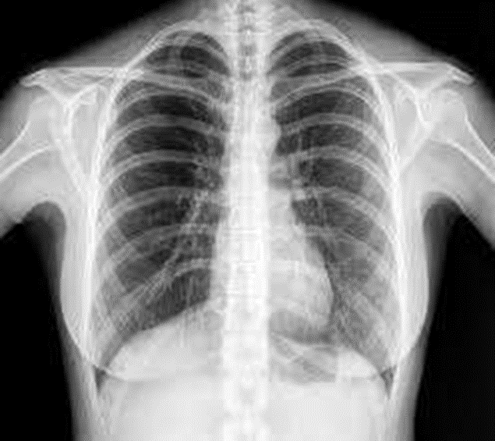
  Introduction:
  Pneumonia is a serious lung disease
  Chest X-ray is commonly used for diagnosis
  Manual diagnosis depends on expert radiologists
  Automated system can help in fast detection

Slide 3
Background Work
 | Year | Dataset | Architecture | Accuracy
1. | 2020 | Chest X-ray Pneumonia Dataset | VGG16, ResNet18, DenseNet201, SqueezeNet | 98%
2. | 2021 | Kermany Chest X-ray Dataset + RSNA Pneumonia Dataset | ResNet-18, DenseNet-121, GoogLeNet (Ensemble) | 99%
3. | 2020 | Chest X-ray Pneumonia Dataset | ResNet50, Inception-ResNet, MobileNetV2 | 96%
4. | 2021 | Chest X-ray Pneumonia Dataset (5,856 images) | MobileNet | 94.23%
5. | 2022 | Chest X-ray Pneumonia Dataset | DenseNet121, VGG19, InceptionV3 | 97.40%
6. | 2017 | NIH Chest X-ray (112,120 images) | DenseNet-121 | 84.30%
7. | 2020 | Chest X-ray Pneumonia Dataset | Custom CNN, LSTM-CNN, MobileNetV2, ResNet152V2 | 99.22%
8. | 2019 | Chest X-ray dataset from Kaggle | Custom Convolutional Neural Network (CNN) trained from scratch | 85.74%

Slide 4
  Research gap
Observation:
As you mentioned, the small binary datasets (5,856 images) consistently yield higher accuracies (94%–99%), while the large multi-label NIH dataset (112,120 images) gives significantly lower accuracy (84.30%). This confirms the trade-off between dataset size/complexity and model performance.
Use small, clean datasets if only binary pneumonia detection is needed.
Use large, diverse datasets if developing a real-world, multi-disease diagnostic system
Balance data size and complexity to avoid overfitting on small datasets and underfitting on large ones

Slide 5
  Aims of the research
To propose a more effective deep learning model for pneumonia detection from NIH chest X-ray images compared to existing single-model approaches.
To improve pneumonia detection accuracy by addressing the limitations of the DenseNet-121 baseline model used in earlier studies.
To develop an ensemble deep learning model by combining multiple CNN architectures (such as DenseNet-201, EfficientNet-B4, and ResNet-50).
To reduce the impact of class imbalance present in the NIH Chest X-ray dataset and improve pneumonia classification reliability.

Slide 6
  Objective
To study existing pneumonia detection methods using chest X-ray images.
To design and develop a deep learning model for pneumonia detection.
To test the model and check its accuracy.
To test the model and check its accuracy.To compare the proposed model with existing models.

Slide 7
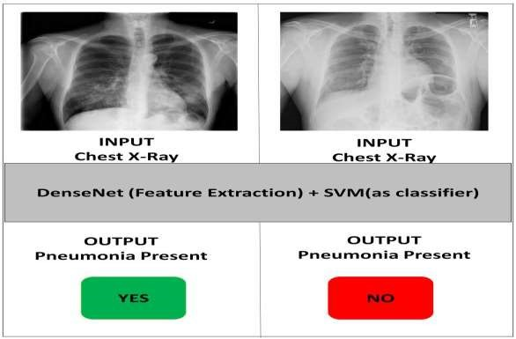
Propose Solution
Use CNN-based deep learning models
Apply pre-trained transfer learning models
Automatically classify X-ray images
Output: Normal or Pneumonia

Slide 8
Requirements:
DATASET DESCRIPTION
Dataset collected from Kaggle
• Publicly available chest X-ray images
Used for training and testing

Slide 9
Requirements:
TOOLS & TECHNOLOGIES
Programming Language: Python
Framework: TensorFlow, Keras
Platform: Pycharm
Libraries: NumPy, OpenCV, NumPy, Pandas, PyTorch, scikit-learn, Matplotlib.

Slide 10
Requirements:
PROPOSED MODELS
DenseNet-201
EfficientNet-B4
ResNet-50
Ensemble Model (combination of DenseNet-201, EfficientNet-B4, and ResNet-50)

Slide 11
Scope of the research
The study uses only chest X-ray images from the NIH dataset for pneumonia detection.
Deep learning-based CNN models, particularly DenseNet architecture, are applied for multi-label disease classification.
The research addresses the challenge of detecting pneumonia among multiple thoracic diseases present in a single image.
Image preprocessing techniques such as resizing and normalization are included to improve model performance.

Slide 12
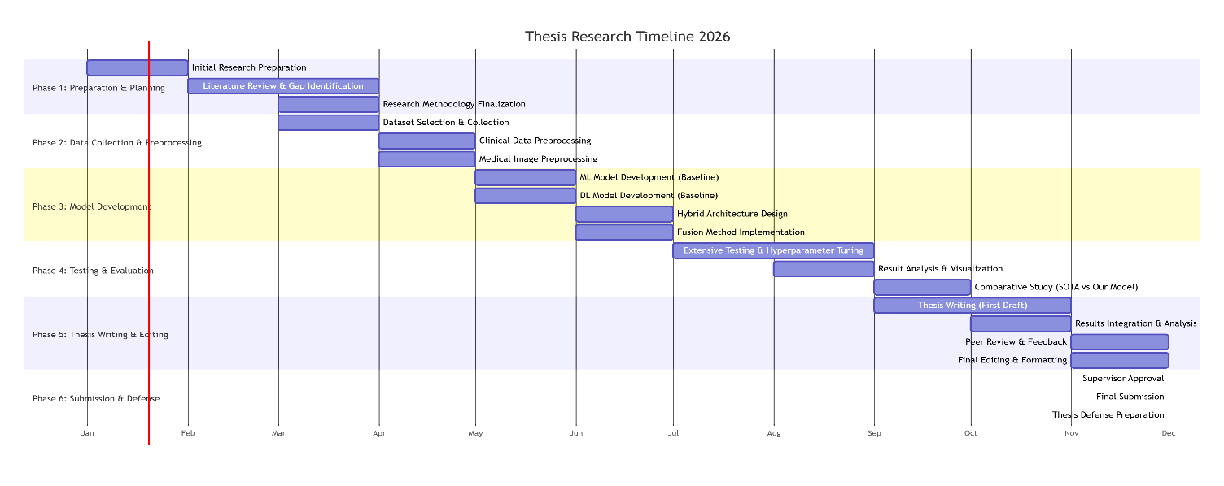
Timeline
Gantt chart.

Slide 13
References
Kermany et al., 2020
Kermany, D. S., Zhang, K., & Goldbaum, M. (2020). Labeled Optical Coherence Tomography (OCT) and Chest X-Ray Images for Classification.
RSNA Pneumonia Dataset, 2021
Radiological Society of North America (RSNA). RSNA Pneumonia Detection Challenge Dataset.
Available on Kaggle.
Kaggle Chest X-ray Pneumonia Dataset, 2020
Mooney, P.Chest X-Ray Images (Pneumonia). Kaggle Dataset.
MobileNet-based Lightweight Model, 2021
Howard, A. G., et al. MobileNets: Efficient Convolutional Neural Networks for Mobile Vision Applications.
Guangzhou Women and Children’s Medical Center Dataset, 2022
Kermany, D. S., et al. Identifying Medical Diagnoses and Treatable Diseases by Image-Based Deep Learning.
Wang, X. et al. (2017). ChestX-ray8: Large-scale chest X-ray dataset for multi-disease classification. CVPR 2017.
Vosowiec, J. (2023). Comparative analysis of deep learning cooperation in pneumonia detection with class activation mapping (CAM) for disease localization without manual annotations. ResearchGate.
Liang, G., & Zheng, L. (2019). A transfer learning method with deep convolutional neural network for pneumonia diagnosis. IEEE Access.

