Slide 1
Applied Data Science with R Capstone project
<YETIK, ARIF>
<Nov 3, 2022>

Slide 2

Outline
Executive Summary
Introduction
Methodology
Results
Conclusion
Appendix

Slide 3

Executive Summary
Many cities all over the world have implemented the public bike-sharing system, and it leads to the necessity of predicting the rental bike demand. This research paper presents a regression model for rental bike demand prediction. With these model evaluation metrics, the prediction-performance of the regression model is measured.
The rental bike-sharing system has been popular globally to solve problems such as traffic jams and environmental pollutions in urban areas.
We seek to examine bike-sharing data, joined with daily Seoul, Suzhou, London, New York, and Paris weather data, to study the impact of weather on shared bike usage and generate a predictive model which can estimate the number of trips that would be taken on each day.
The goal is to estimate future demand which would enable the system operator to make expansion plans.
The dataset includes Seoul Bike sharing system data and weather information corresponding to each hour of the year. Several model evaluation metrics are utilized such as R2, Root Mean Squared Error, and Mean Absolute Error.
The finding shows that the random forest regression, the ensemble learning technique, explained about 73.4% of the Variance (R2) in the testing set of Seoul Bike data.

Slide 4

Introduction
The bike-sharing market is growing to all countries globally.
The bike sharing companies have started to realize the importance of data driven decision making. One of the major aspects that can be addressed by data analysis is to predict the demand of bikes on any given day. Knowing the demand would help us in creating a better supply and subsequently reduce the gap between supply and demand.
Point3
We did various Regression machine learning algorithms have been applied on the dataset to get the best fit model and possible prediction.
polynomial regression
interaction terms model
Ridge (L2) regularization model
Lasso (L1) regularization model
Elastic Net (L1 and L2) Regularization

Slide 5

Methodology
Perform data collection
Perform data wrangling
Perform exploratory data analysis (EDA) using SQL and visualization
Perform predictive analysis using regression models
How to build the baseline model
How to improve the baseline model
Build a R Shiny dashboard app

Slide 6
Methodology

Slide 7
Data collection
Describe how data sets were collected.
We obtained data from two source
Web scrape a Global Bike-Sharing Systems Wiki Page
Extract bike sharing system data from a Wiki page and convert the data to a data frame
OpenWeather APIs Calls
Get 5-day weather forecast for a list of cities using OpenWeather API
Download datasets in csv files from cloud storage
You need to present your data collection process use key phrases and flowcharts
Add screenshots of Notebook code cell and cell output used for OpenWeatherAPI and Webscrping to the Appendix section for peer-review

Slide 8
Data wrangling
We have collected required bike-sharing data for further exploratory, visual, and predictive analysis tasks. However, some data may contain missing, mis formatted and/or unexpected noises. Such sources of noise may downgrade the analysis performance significantly. Thus, we need to perform data wrangling before further analyzing the data.
Data wrangling aims to remove the noise from data and convert the undesired data format to a format that is likely to be better for analysis.
Data wrangling with stringr and regular expressions
Standardize column names for all collected datasets
Remove undesired reference links using regular expressions
Extract numeric values using regular expressions
Lab: Data wrangling with dplyr
Detect and handle missing values
Create indicator (dummy) variables for categorical variables
Normalize data
You need to present your data wrangling process using key phrases and flowcharts
Add the screenshots of data wrangling code cell and output for regular expressions, missing values handling, generating indicator columns to the Appendix section for peer-review

Slide 9
EDA with SQL
Summarize performed SQL queries using bullet points
Add screenshots of all required SQL queries to the Appendix section

Slide 10
EDA with data visualization
Summarize what charts were plotted using bullet points
Add the screenshots of your ggplot2 code snippets to the Appendix section

Slide 11
Predictive analysis
Load a new library and import the datasets required for the prediction.
Both train and test data are introduced into the application to arrange the categorical levels.
Additionally, I loaded the random forest model to collect the mean absolute error value.

Slide 12
Build a R Shiny dashboard
R Shiny dashboard into two parts
Filter for the histogram plot
Numerical variables
Temperature, Humidity, wind speed, casuals etc.
Filter for the frequency plot
Categorical variables
Weather, seasons, years, month etc.

Slide 13
Results
The amount of new registration in the bike-sharing system is considerably higher than the casual registrations.
The result obtained from the prediction was a value of 228 total number of registrations for that specific date and weather condition.
Additionally, the forecast also reveals the range in which the prediction value can vary.

Slide 14
EDA with SQL

Slide 15
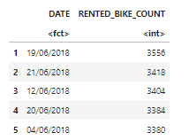

Busiest bike rental times
Find dates and hours which had the most bike rentals
Present your query result with a short explanation here

Slide 16
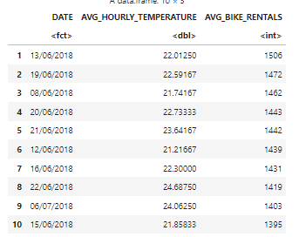

Hourly popularity and temperature by seasons
Find hourly popularity and temperature by season
Present your query result with a short explanation here

Slide 17
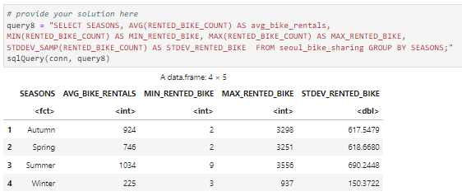
Rental Seasonality
Rental Seasonality
Present your query result with a short explanation here

Slide 18
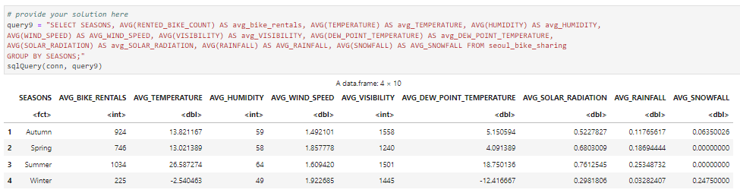
Weather Seasonality
Weather Seasonality
Present your query result with a short explanation here

Slide 19
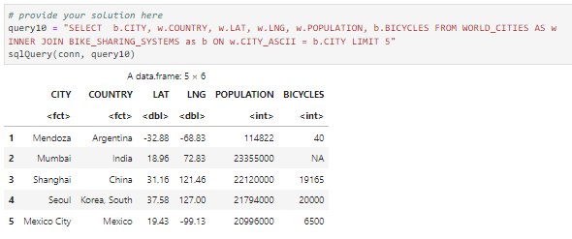
Bike-sharing info in Seoul
Find the total Bike count and city info for Seoul
Present your query result with a short explanation here

Slide 20
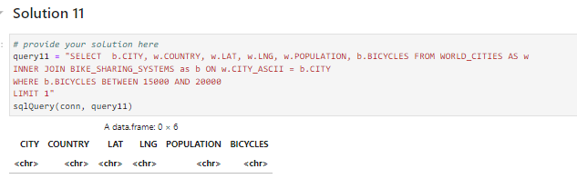
Cities similar to Seoul
Find all city names and coordinates with comparable bike scale to Seoul's bike sharing system
Present your query result with a short explanation here

Slide 21
EDA with Visualization

Slide 22
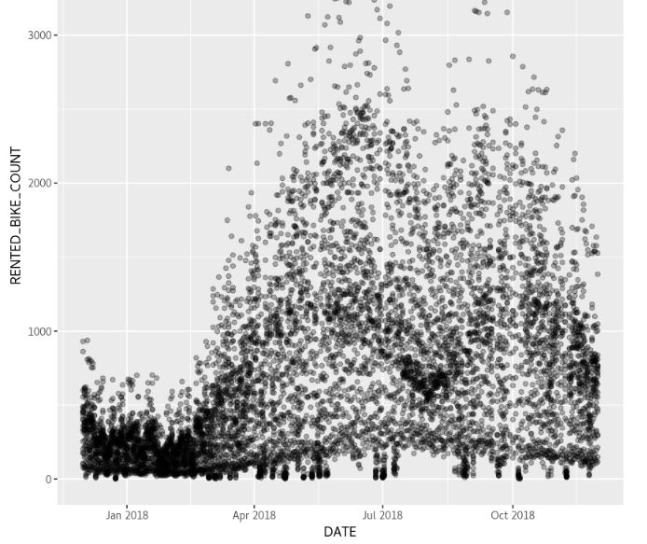
Bike rental vs. Date
Show a scatter plot of RENTED_BIKE_COUNT vs. DATE
(ggplot(seoul_bike_sharing, aes(DATE, RENTED_BIKE_COUNT)) + geom_point(alpha = 0.3))
Show the screenshot of the scatter plot with explanations

Slide 23
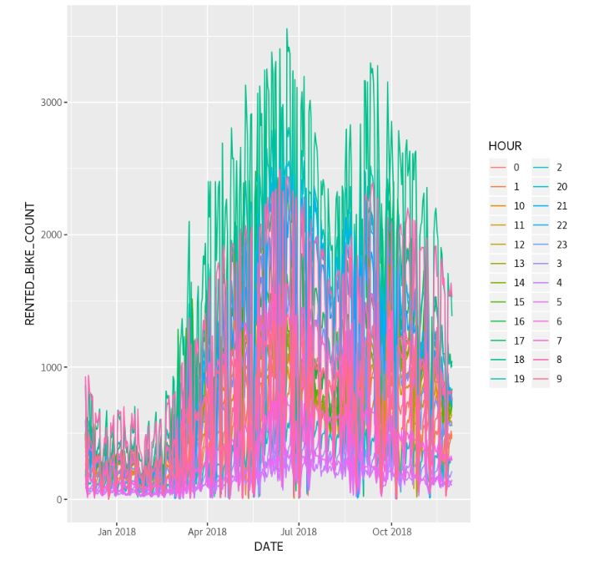
Bike rental vs. Datetime
Show the same plot of the RENTED_BIKE_COUNT time series, but now add HOURS as the colour
(ggplot(seoul_bike_sharing, aes(DATE, RENTED_BIKE_COUNT, color = HOUR)) + geom_line())
Show the screenshot of the scatter plot with explanations

Slide 24
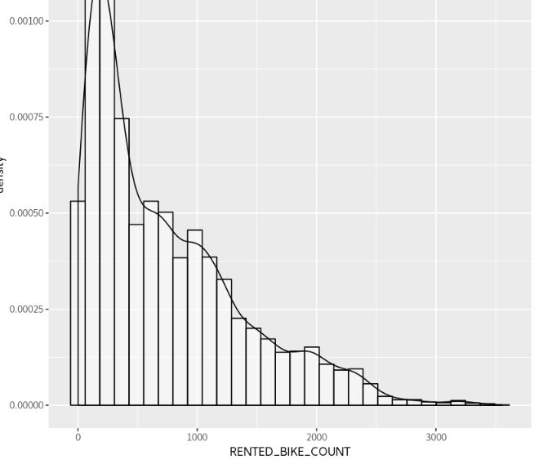
Bike rental histogram
Show a histogram overlaid with a kernel density curve
(ggplot(seoul_bike_sharing, aes(RENTED_BIKE_COUNT)) + geom_histogram(aes(y = ..density..), colour = "black", fill = "white", alpha = 0.5) + geom_density())
Show the screenshot of the histogram with explanations

Slide 25
Daily total rainfall and snowfall
Show a barchart calculating the daily total rainfall and snowfall
Show the screenshot of the box plot with explanations

Slide 26
Predictive analysis

Slide 27
Ranked coefficients
Show a screenshot of the ranked coefficients bar chart for the baseline model
Try to tell a story why some variables are important while some are not for predicting bike-sharing demand

Slide 28
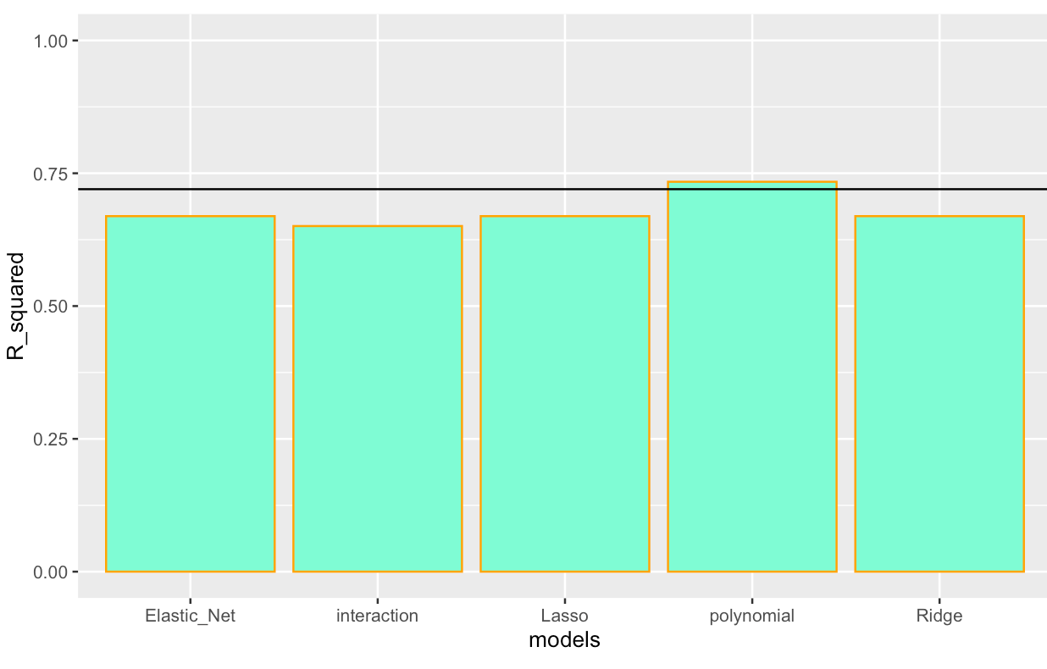
Model evaluation
Built at least 5 different models using polynomial terms, interaction terms, and regularizations
Visualize the refined models’ RMSE and R-squared using grouped bar chart

Slide 29
Find the best performing model
Select the best performing model with:
RMSE must be less than 330
R-squared must be larger than 0.72
Shown a screenshot of the model performance
Show its model formula here (RENTED_BIKE_COUNT ~ x1 + x2 + x3 ….)
You could optionally present their final coefficients here

Slide 30
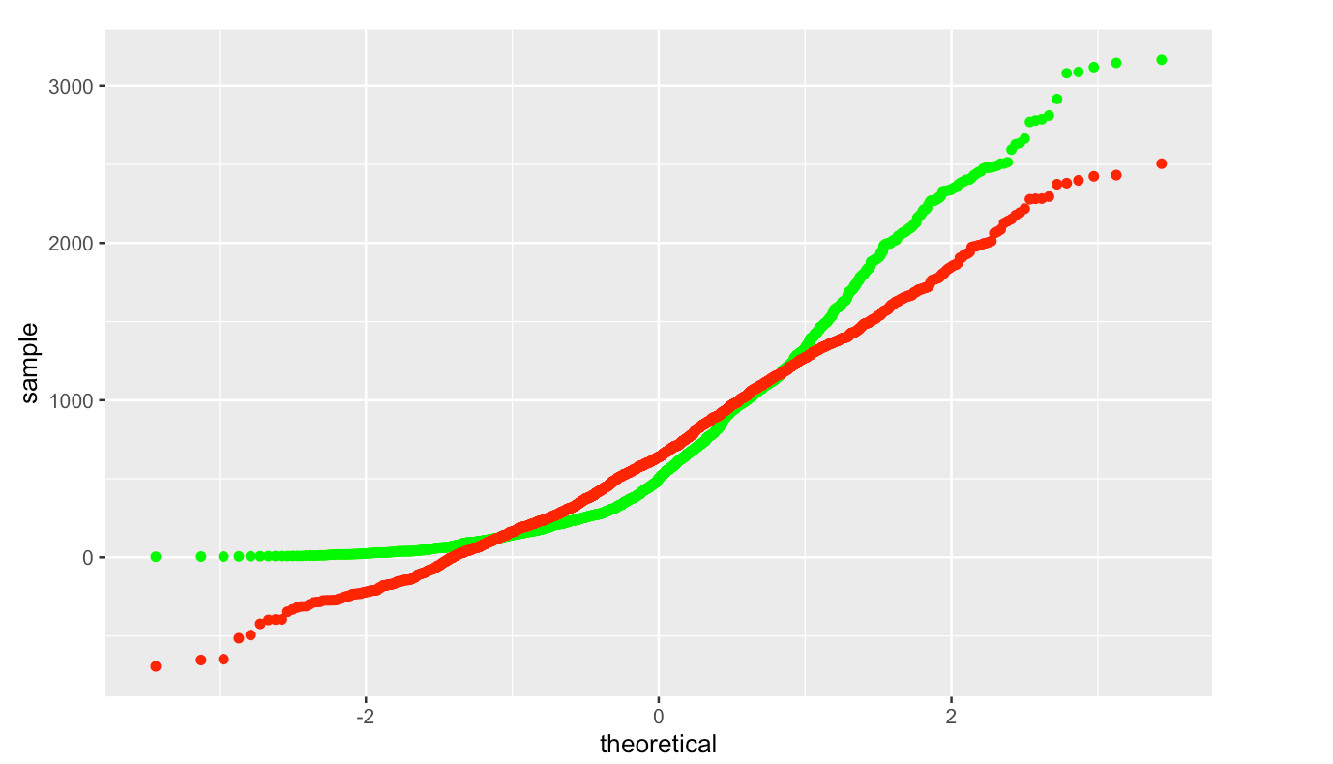
Q-Q plot of the best model
Plot the Q-Q plot of the best model’s test results vs the truths

Slide 31
Dashboard

Slide 32
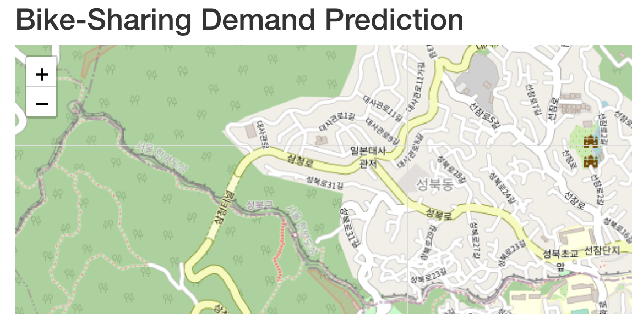
<Dashboard screenshot 1>
Replace <Dashboard screenshot 1> title with an appropriate title
Show the screenshot for cities’ max bike-sharing prediction on a map
Explain the important elements on the screenshot

Slide 33
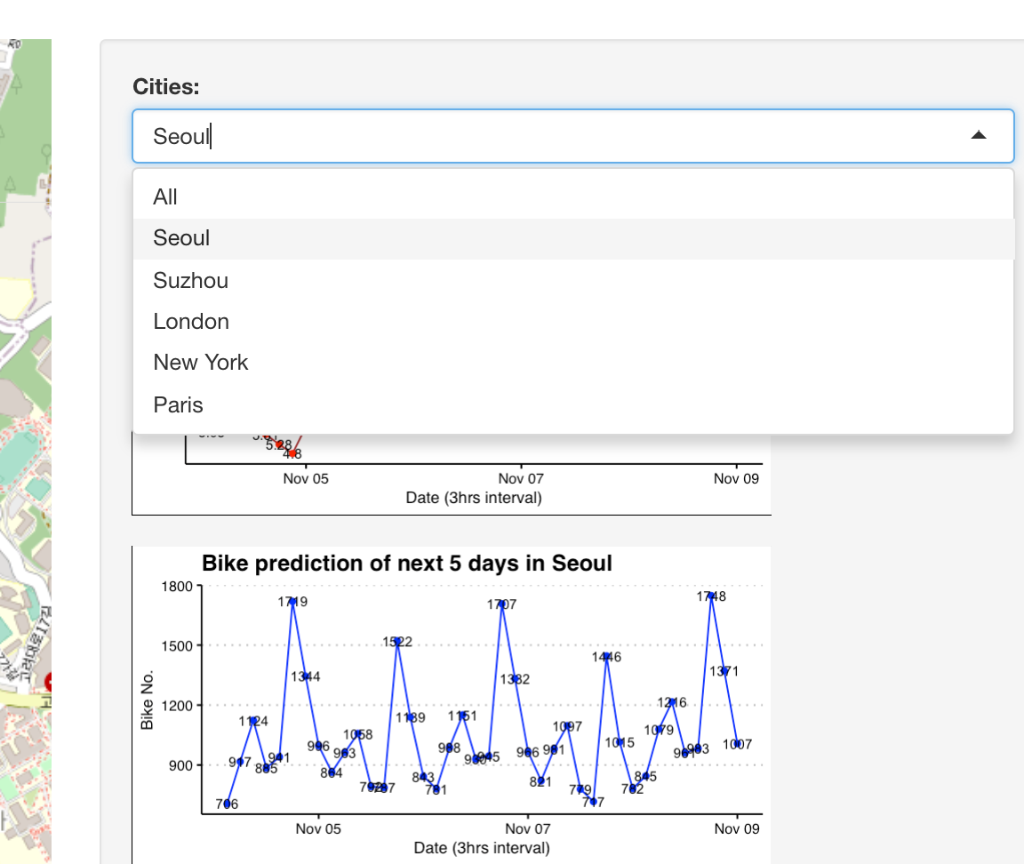
<Dashboard screenshot 2>
Replace <Dashboard screenshot 2> title with an appropriate title
Show the screenshot when one specific city is selected
Explain the important elements on the screenshot

Slide 34
<Dashboard screenshot 3>
Replace <Dashboard screenshot 3> title with an appropriate title
Show the screenshot when another specific city is selected
Explain the important elements on the screenshot

Slide 35

CONCLUSION
In June and October, the number of bicycles rented was higher than in other months. Less bicycles are rented from December to March.
◦ Bikes are usually rented mostly around 8am or 6 pm, and very few in the middle of the night into the early hours of the morning.
◦ 100 - 300 bicycles are commonly rented per day.
◦ Rainfall, humidity, and temperature greatly affect the number of bicycles rented every day. Meanwhile , seasons and holidays don't really matter.
◦ The number of bike - sharing demand can be predicted using a polynomial regression model using weather forecast data.

Slide 36

APPENDIX
Include any relevant assets like R code snippets, SQL queries, charts, Notebook outputs, or data sets that you may have created during this project

Slide 37
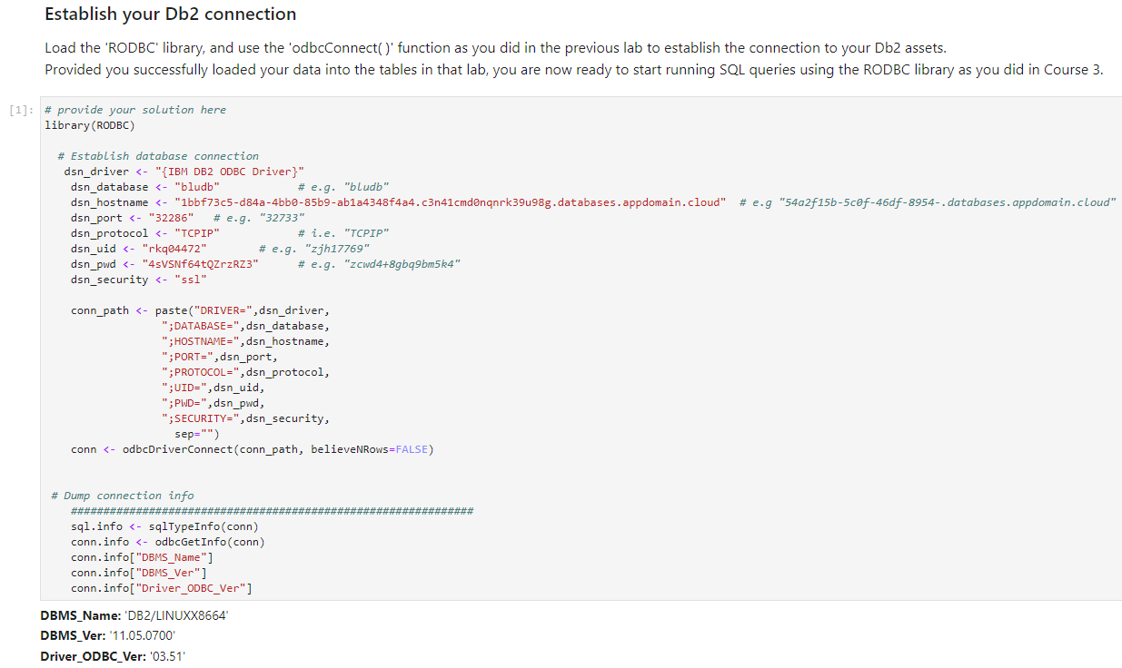
APPENDIX:
EDA with SQL

Slide 38
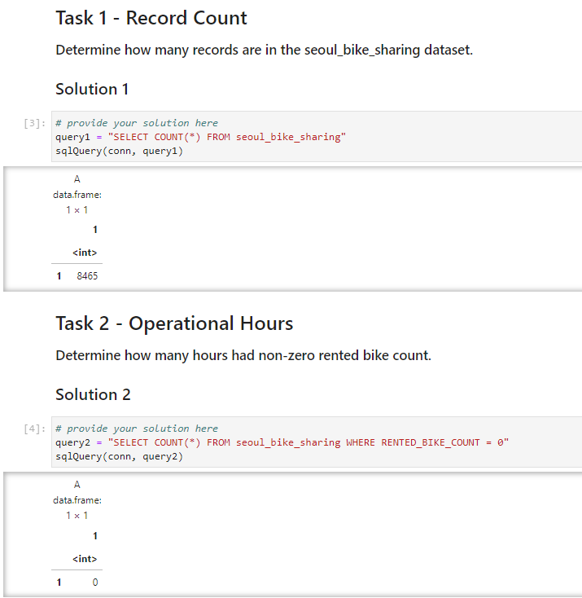
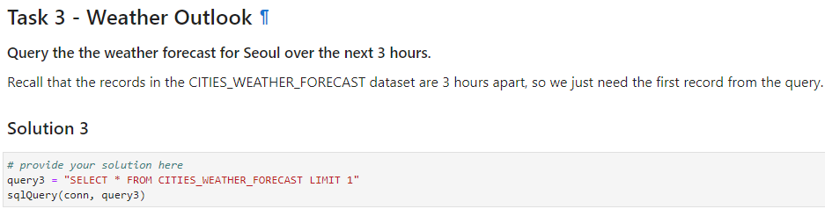
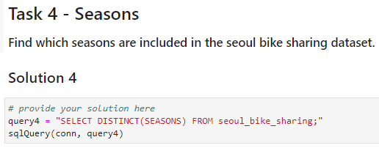
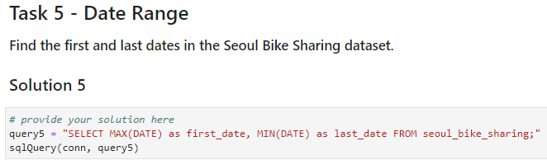
APPENDIX:EDA with SQL

Slide 39
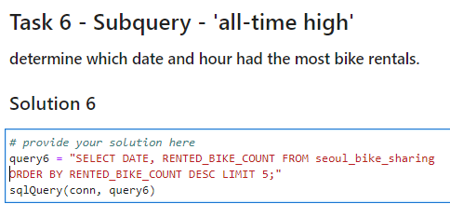
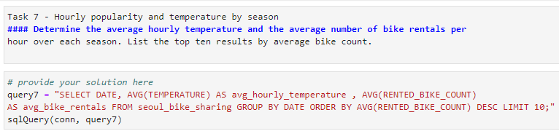
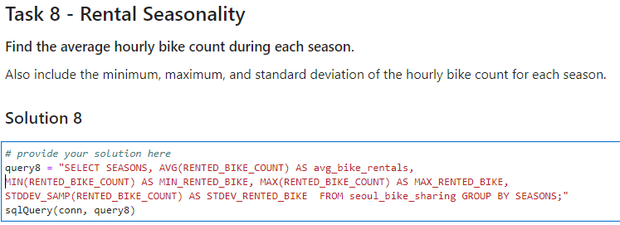
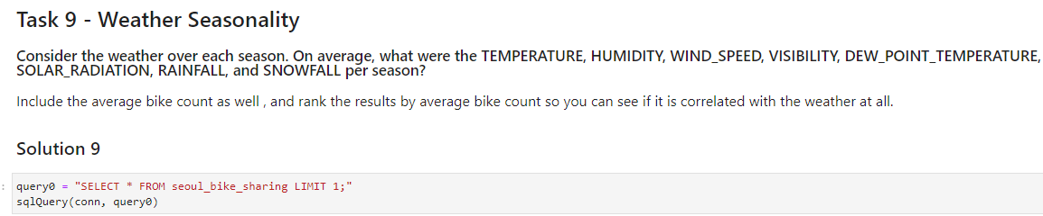
APPENDIX: EDA with SQL

Slide 40
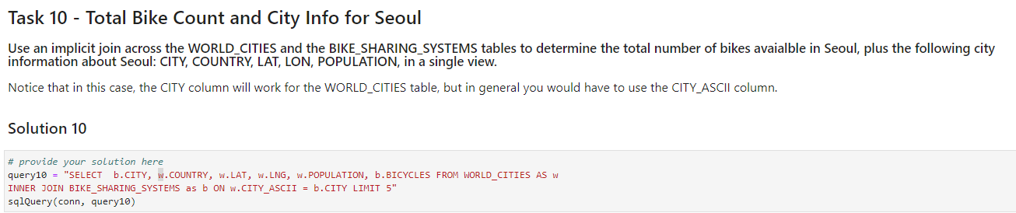
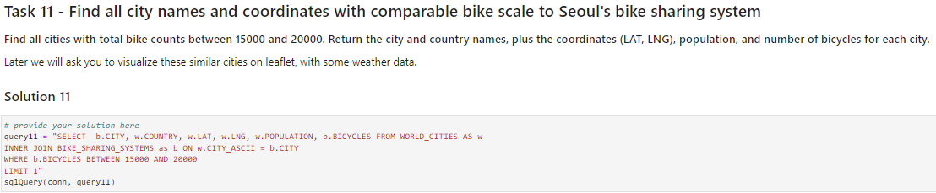
APPENDIX: EDA with SQL

Slide 41
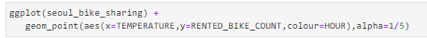
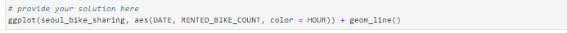
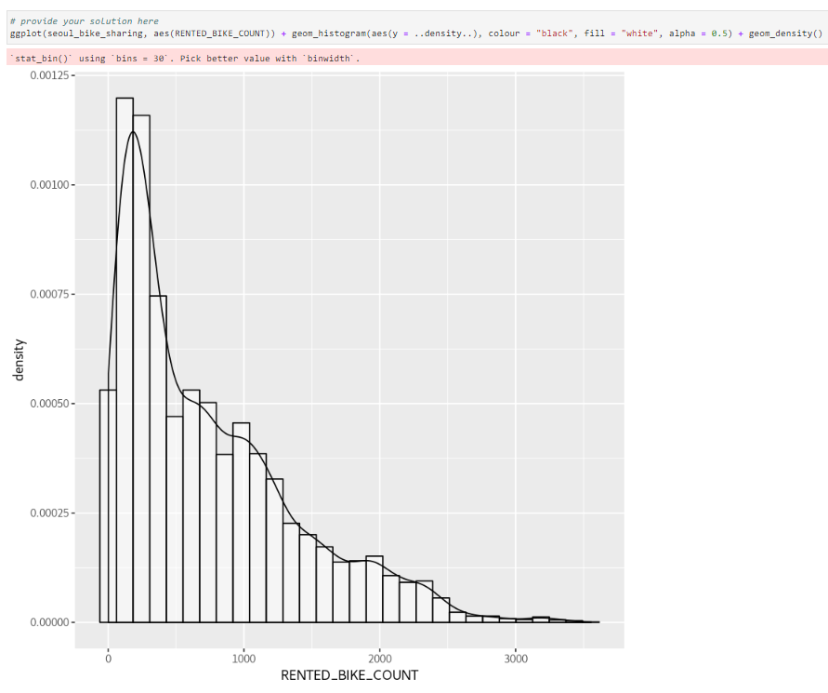
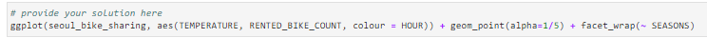
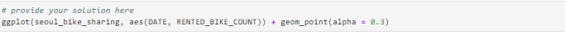
APPENDIX: EDA with data visualization
Create a scatter plot of RENTED_BIKE_COUNT vs DATE.
Create the same plot of the RENTED_BIKE_COUNT time series, but now add HOURS as the colour.
Create a histogram overlaid with a kernel density curve
Use a scatter plot to visualize the correlation between RENTED_BIKE_COUNT and TEMPERATURE by SEASONS.
Comparing this plot to the same plot below, but without grouping by SEASONS, shows how important seasonality is in explaining bike rental counts.

Slide 42
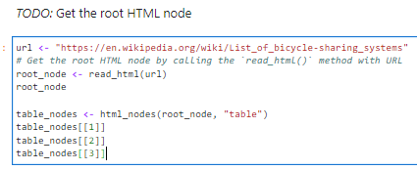
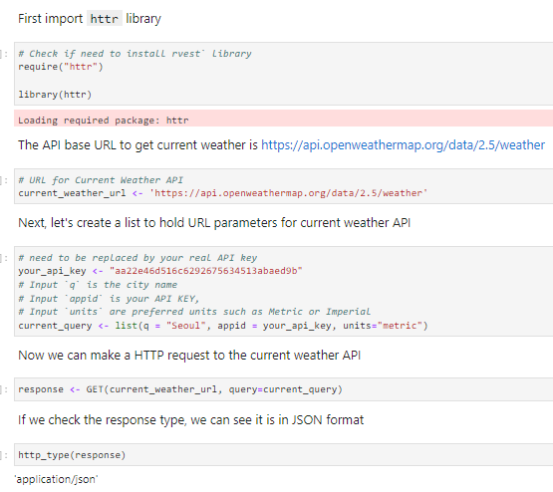
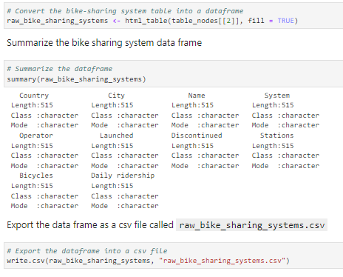
APPENDIX: Data collection

Slide 43
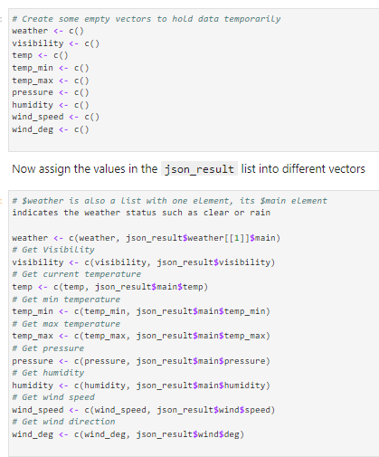
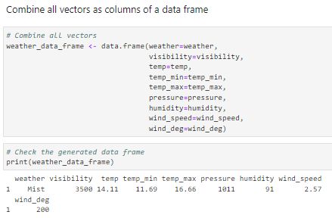
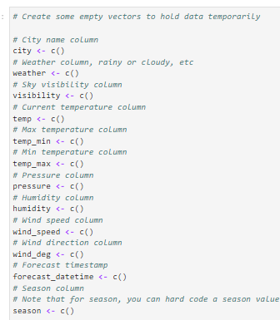
APPENDIX: Data collection

Slide 44
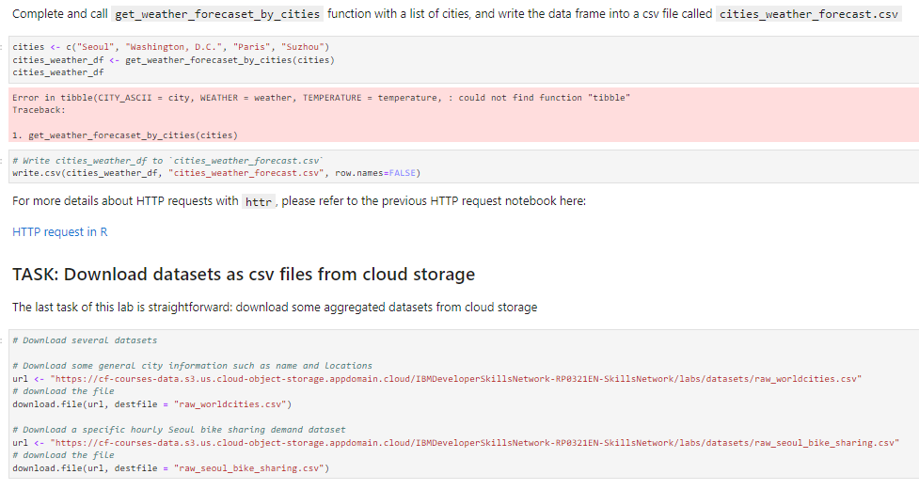
APPENDIX: Data collection

Slide 45
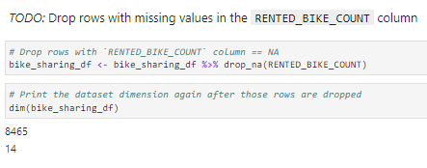
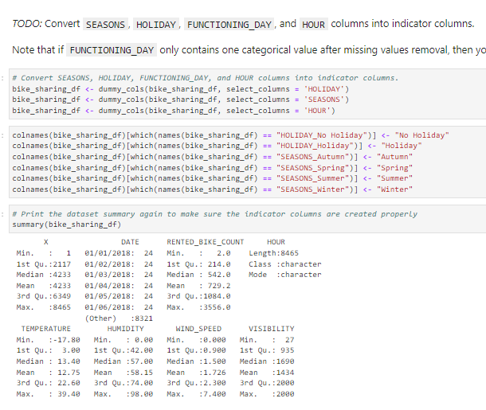
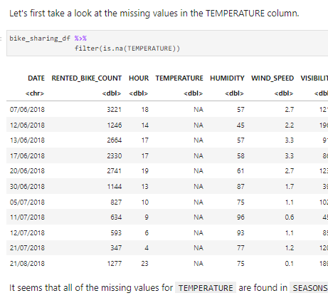
APPENDIX: Data wrangling

Slide 46
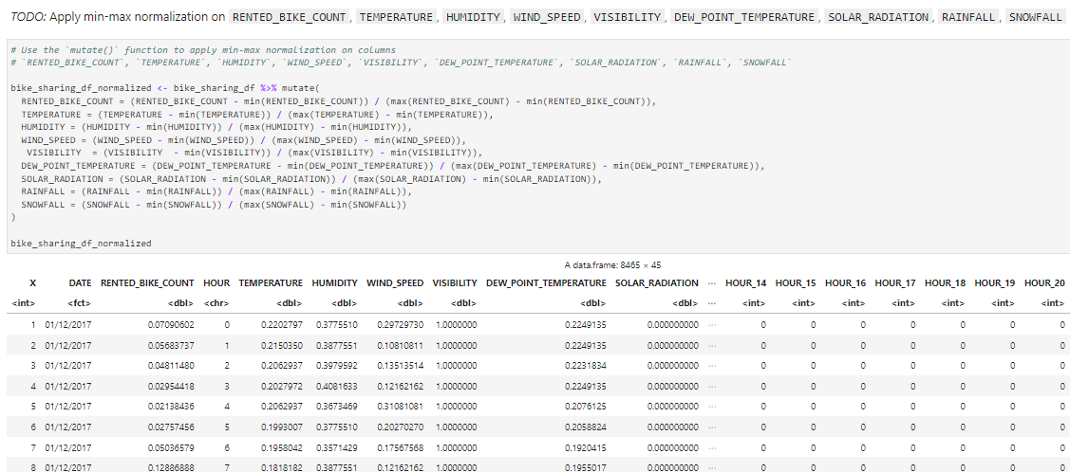
APPENDIX: Data wrangling

