Slide 1


Test Approaches on
DRIVER
Image Placeholder
Full Name | 26-September-2023

Slide 2
DRIVER
Project Summary-
DRIVER - Data for Road Incident Visualization Evaluation and Reporting.
To enhance road safety by efficiently collecting, analyzing, and reporting road crash data incidents.
Developed, deployed, and piloted by the World Bank and GRSF (Global Road Safety Facility).
Test plan,Test case estimation,Test case preparation and Design,Test case execution,QA Report

Slide 3
DRIVER
Test Estimation
Link : Test Estimation
Estimated Testcase Number :102
Test Case Writing : 99
Duration estimated for test case Preparation :5.1 (Total Man Day)

Slide 4
DRIVER
Test Plan in a brief-
Link :Test Plan
Test objectives for Driver.
Test strategy.
Test environment.
Entry and exit criteria for Testing.
Test deliverables.

Slide 5
DRIVER
Test case Preparation and area of coverage
Link : Testcase Preparation
Test Case Preparation
Requirements analysis.
Test case documentation.
Review and validation of test cases.
The areas covered by testing:
Functional areas.
UI areas.

Slide 6
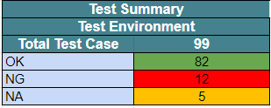
DRIVER
Test Execution and coverage
Link : Test Execution

Slide 7
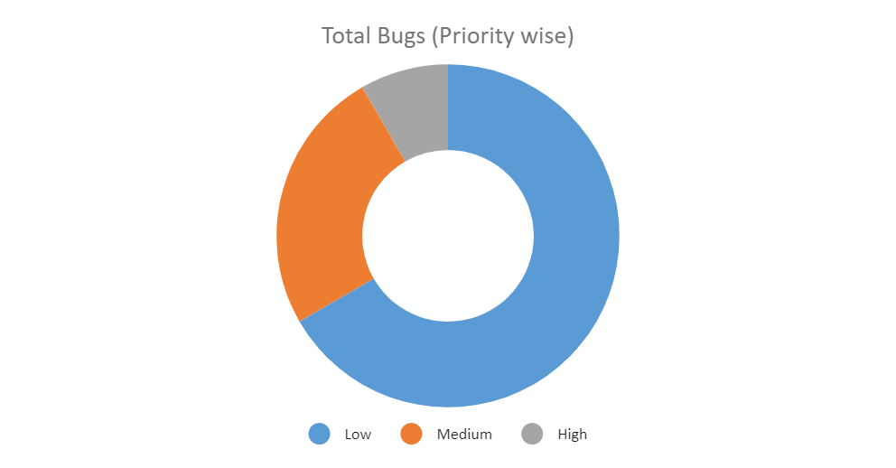
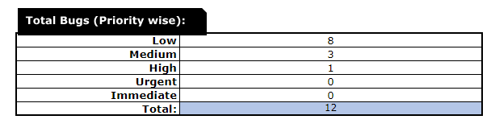
DRIVER
Test Report/Bug Reporting
Link : Bug Report

Slide 8
Thank you

