Slide 1

Secure Multi Owner Data Sharing For Dynamic Groups in Cloud
Project Guide
Asst.Professor, CSE Department.
Batch-B8
S.Raghunath - 143
M.Komali - 102
P.Raviteja -133
Sk.Ashraf Rasool - 140

Slide 2
Table of Contents
ABSTRACT
SYSTEM CONFIGURATION
EXISTING SYSTEM
PROPOSED SYSTEM
MODULES
CONCLUSION
REFERENCE

Slide 3
ABSTRACT
With the character of low maintenance, cloud computing provides an economical and efficient solution for sharing group resource among cloud users.
Unfortunately, sharing data in a multi-owner manner while preserving data and identity privacy from an untrusted cloud is still a challenging issue, due to the frequent change of the membership.
In this paper, we propose a secure multi owner data sharing scheme , secured data sharing for dynamic groups in the cloud.
By leveraging group signature and dynamic broadcast encryption techniques, any cloud user can anonymously share data with others.

Slide 4
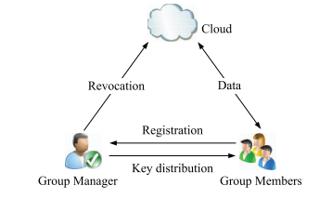
ARCHITECTURE

Slide 5
SYSTEM CONFIGURATION
HARDWARE REQUIREMENTS:-
Processor -Pentium –III
Speed - 1.1 Ghz
RAM - 256 MB(min)
Hard Disk - 20 GB
Floppy Drive - 1.44 MB
Key Board - Standard Windows Keyboard
Mouse - Two or Three Button Mouse
Monitor - SVGA

Slide 6
SYSTEM CONFIGURATION
SOFTWARE REQUIREMENTS:-
Operating System : Windows07/08
Application Server : Tomcat5.0/6.X
Front End : Java, JSP
Script : JavaScript.
Server side Script : Java Server Pages.
Database : MYSQL

Slide 7
EXISTING SYSTEM
In the existing Systems, identity privacy is one of the most significant obstacles for the wide deployment of cloud computing.
Without the guarantee of identity privacy, users may be unwilling to join in cloud computing systems because their real identities could be easily disclosed to cloud providers and attackers.
On the other hand, unconditional identity privacy may incur the abuse of privacy. For example, a misbehaved staff can deceive others in the company by sharing false files without being traceable.
Only the group manager can store and modify data in the cloud.
The changes of membership make secure data sharing extremely difficult the issue of user revocation is not addressed

Slide 8
PROPOSED SYSTEM
A secure multi-owner data sharing scheme is provided. It implies that any user in the group can securely share data with others by the un trusted cloud. Our proposed scheme is able to support dynamic groups efficiently.
Specifically, new granted users can directly decrypt data files uploaded before their participation without contacting with data owners.
User revocation can be easily achieved through a novel revocation list without updating the secret keys of the remaining users.
The size and computation overhead of encryption are constant and independent with the number of revoked users.
A secure and privacy-preserving access control to users, which guarantees any member in a group to anonymously utilize the cloud resource, is provided.

Slide 9
gram
ADVANTAGES OF PROPOSED SYSTEM
Any user in the group can store and share data files with others by the cloud.
The encryption complexity and size of cipher texts are independent with the number of revoked users in the system.
User revocation can be achieved without updating the private keys of the remaining users. A new user can directly decrypt the files stored in the cloud before his participation

Slide 10
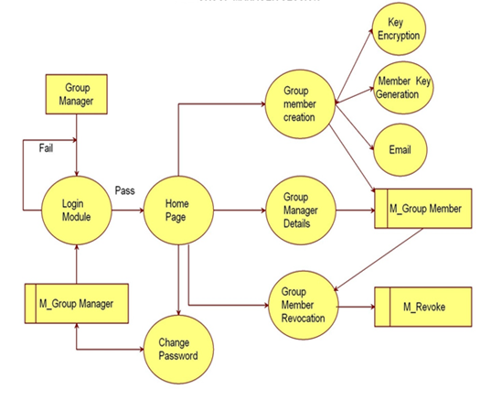
Data Flow Diagram

Slide 11
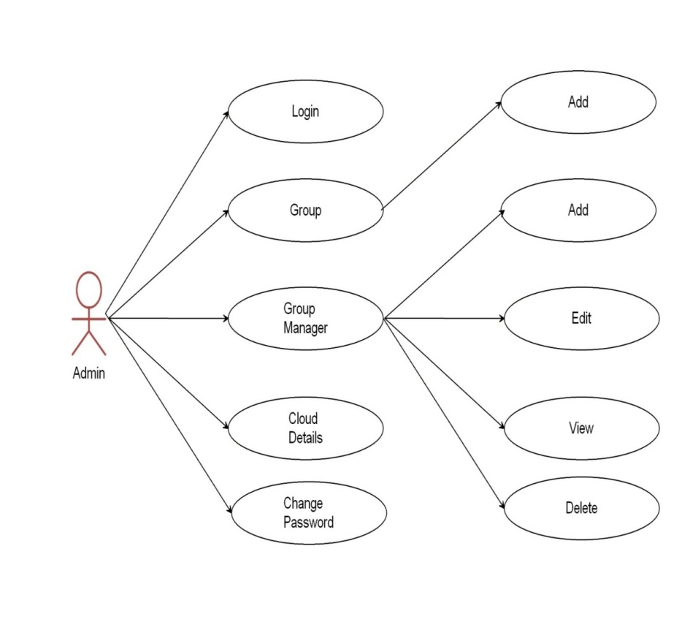
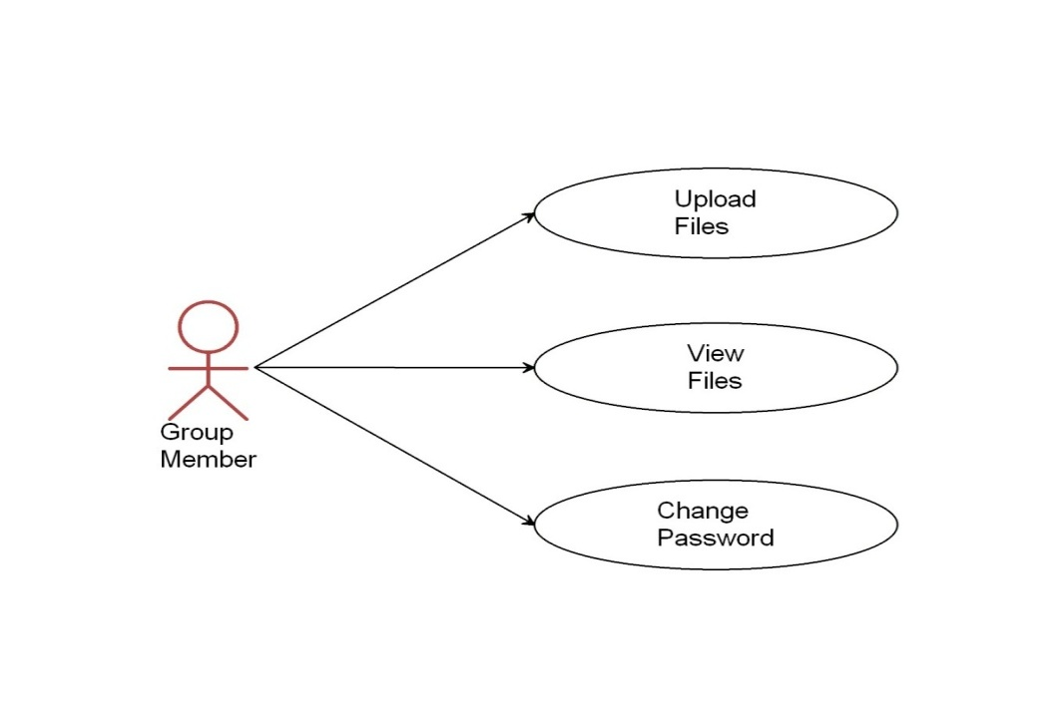
Use Case Diagram

Slide 12
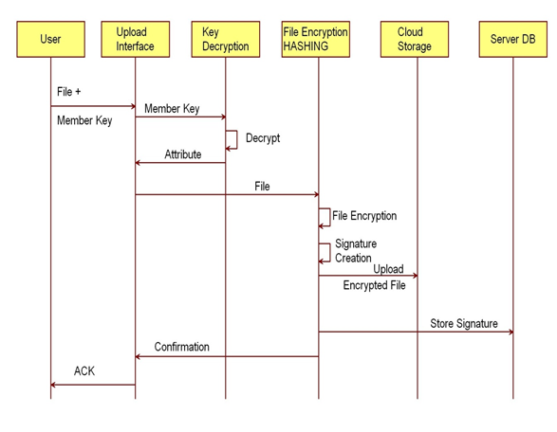
Sequence Diagram

Slide 13
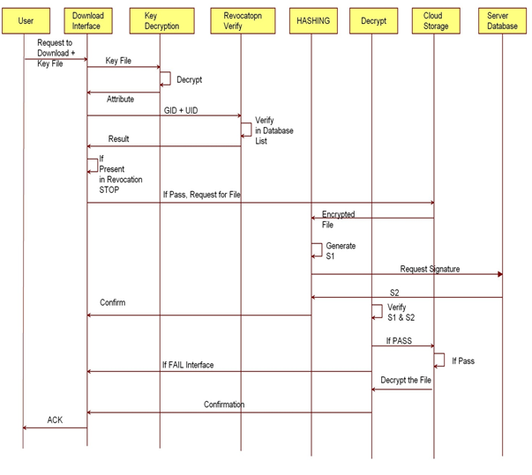
Sequence Diagram

Slide 14
MODULES
Cloud Module
Group Manager Module
Group Member Module
File Security Module
Group Signature Module
User Revocation Module.

Slide 15
Conclusion
In this research paper, I designed a scheme for dynamic groups to share their data with others securely in an untrusted cloud. A registered user is able to share data with others in the group by preserving his identity privacy in the cloud. It is to be understood that this scheme invariably supports efficient user revocation and new user joining. To be more clear and specific, efficient user revocation can be achieved through a public revocation list without updating the private keys of the remaining users and new users can directly decrypt files stored in the cloud before their actual involvement. However, it is established that the storage overhead and the encryption computation costs are constant. Elaborate study and analysis show that proposed scheme is upto the setter security requirements and assures total efficiency in the fullest perspective

Slide 16
References
Hsiao-Ying Lin, and Wen-Guey Tzeng, “A Secure Erasure Code-Based Cloud Storage System with Secure Data Forwarding” IEEE TRANSACTIONS ON PARALLEL AND DISTRIBUTED SYSTEMS, VOL. 23, NO. 6, JUNE 2012.

