Slide 1

Connect’sit : College App
NISHANT DAKUA (23106014)
ARIF CHOUDHARY (23106054)
RUSHI CHORAGHE(23106033)
ARYAN KOTUR(23106094)
Project Guide: Prof.Sayali Badhan
Notes:
1

Slide 2
Outline
Introduction
Literature Survey of the Existing Systems
Limitations of the Existing Systems
Problem Statement
System Design
Technologies and Methodologies
Implementation Screenshots(Partial )
Conclusion
References
Notes:
2

Slide 3
Introduction
Real-time Issue:
Traditional methods of distributing academic resources, like emails and LMS platforms, often lead to disorganized materials and manual processes that are time-consuming and prone to errors.
Students must manually download, sort, and manage files, which can be time-consuming and prone to errors.
Motivation:
Difficulty in organizing and accessing files from multiple platforms, leading to disorganization and missed resources.
Fragmented distribution of materials makes it challenging to have all study resources in one place.
Notes:
3

Slide 4
Objective:
Primary Goal:
Create a mobile app that automates file downloads and organizes them by branch, division, subject, and topic
Secondary Goals:
Improve accessibility with cloud storage integration (e.g. Google Drive.
Ensure students can access all materials in a structured and organized way.

Slide 5
Literature Survey of the Existing System
Existing Systems:
Google Classroom and Moodle offer file sharing but lack automation in organization.
Limitations:
Manual file management is time-consuming and prone to disorganization.
Expected Improvements:
Automated file downloads, structured organization, and cloud integration (e.g. Google Drive)
Notes:
5

Slide 6
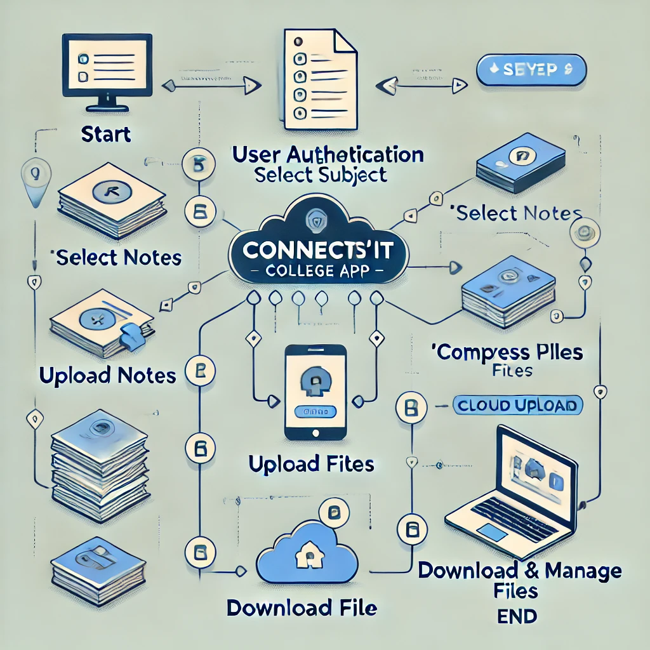
System Design
Notes:
6

Slide 7
Problem statement
Traditional File Distribution Issues:
Manual distribution and scattered resources hinder efficient file management.
Challenges for Students:
Difficulty in accessing and locating materials due to disorganization.
Increased risk of missing deadlines due to confusion over file versions or updates.

Slide 8
Technologies and Methodologies
Frontend:
Jetpack Compose for building a modern, responsive, and declarative UI.
Kotlin and Java for app logic and integration with UI components.
Backend:
Spring Boot for handling file compression, storage, and API management.
Cloud Storage:
Google FIREBASE for storing and retrieving compressed files, ensuring secure and accessible storage.
Notes:
8

Slide 9

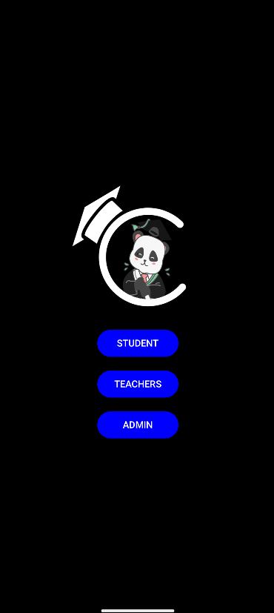
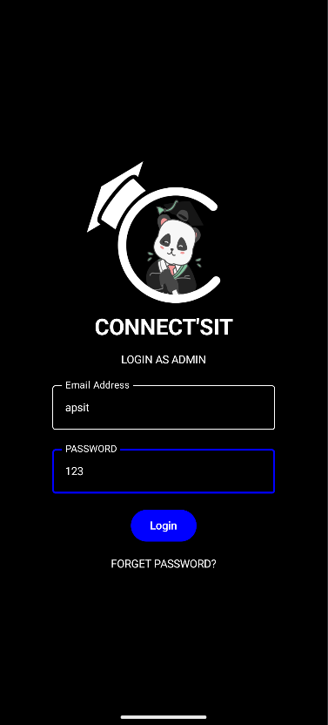
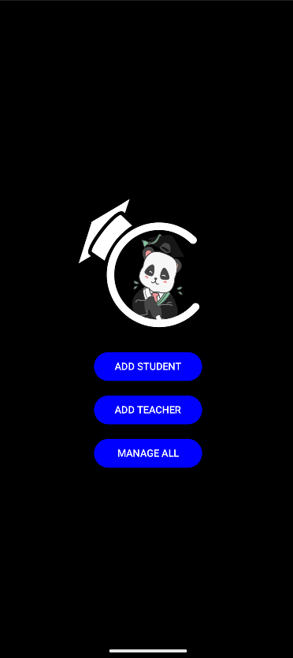
Implementation
SPLASH SCREEN
DETERMINER SCREEN
LOGIN SCREEN
ADDING SCREEN
Notes:
9

Slide 10
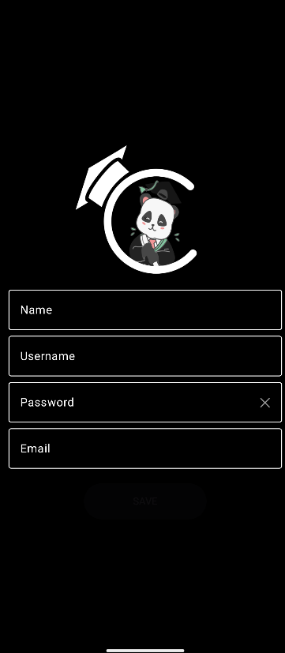
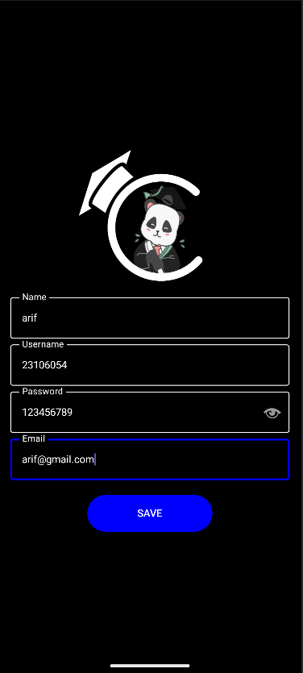
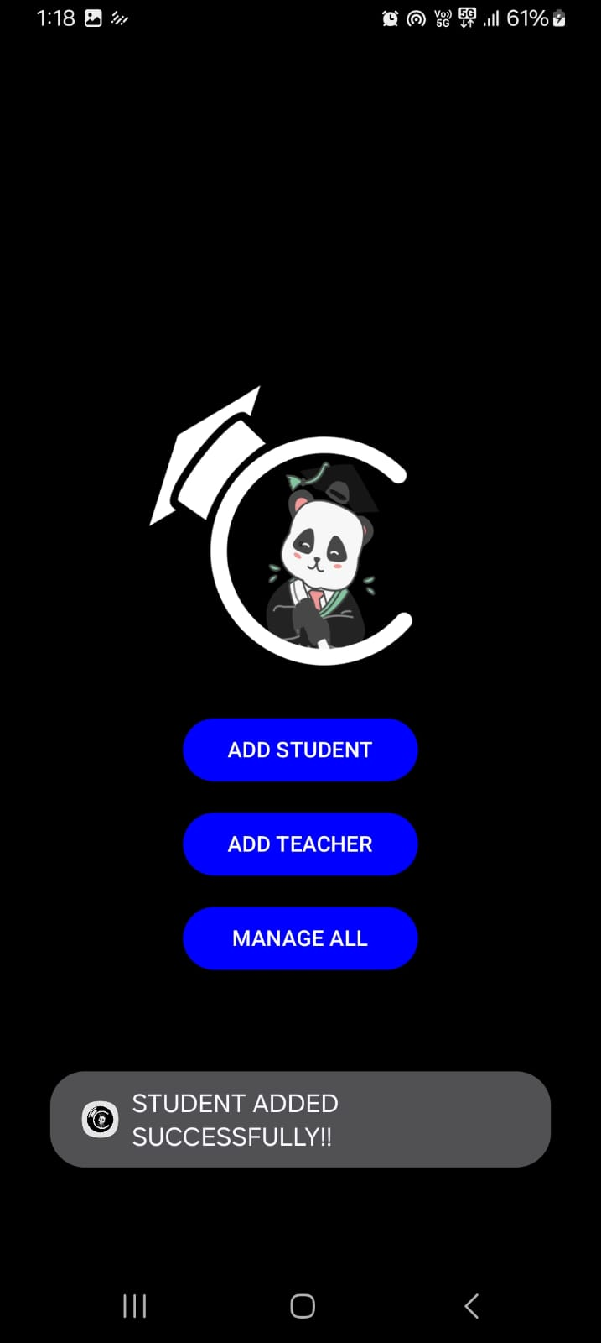
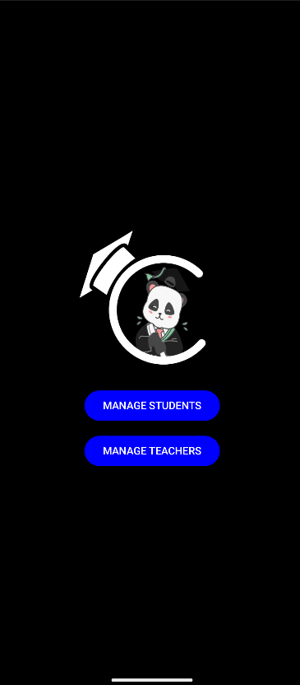
Implementation
REGISTER SCREEN
REGISTER SCREEN
CONFIRMATION SCREEN
MANAGE SCREEN
Notes:
10

Slide 11
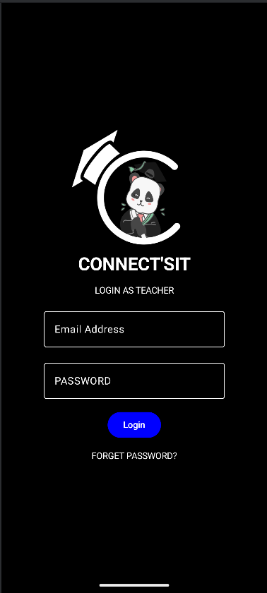
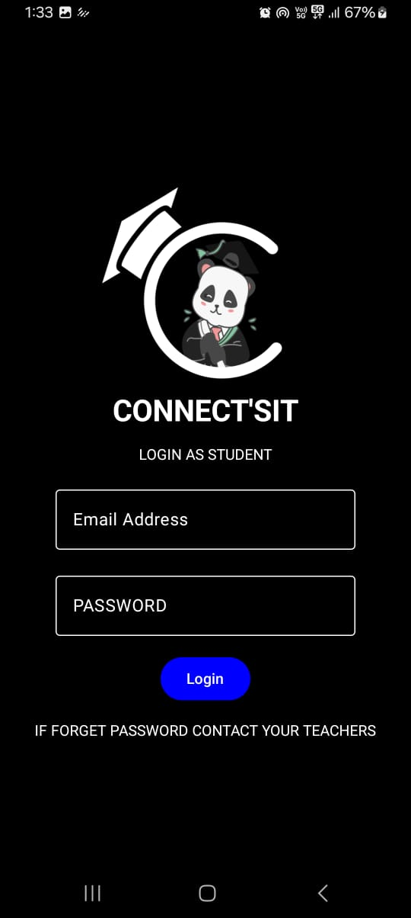
Implementation
DETEREMINER SCREEN
LOGIN SCREEN
Notes:
11

Slide 12
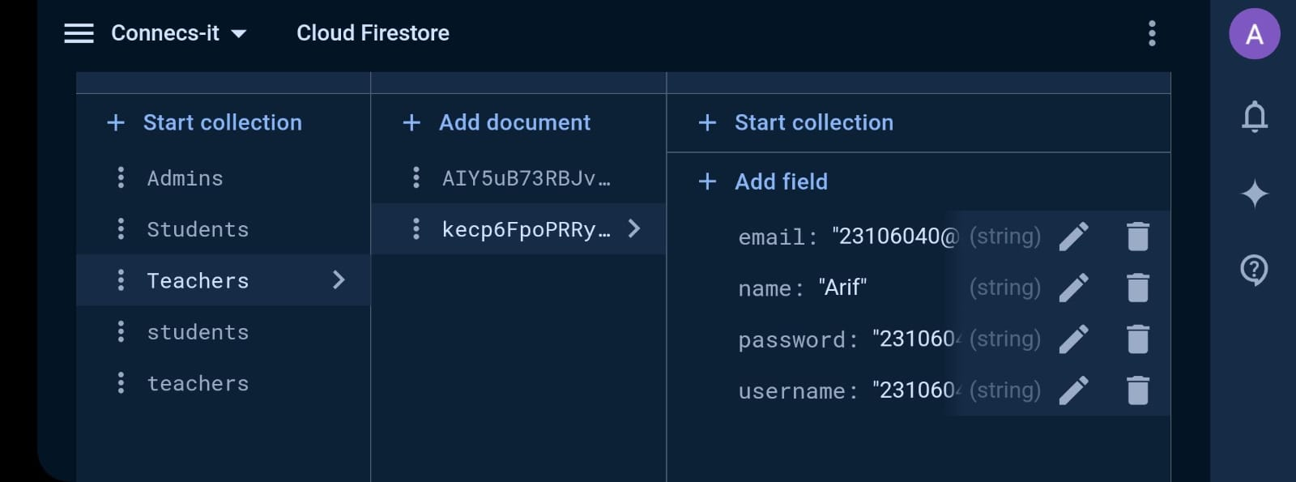
BACKEND SCREEN

Slide 13
Conclusion
Connectsit offers an inovative solution to comman problems in
Academic resource management.The apps automation features
Streamlime both student and teacher workflow.
Notes:
13

Slide 14
References
1] "Educational content management systems: A literature review" by Watson, W. R., & Watson, S. L. (2007) in Journal of Educational Technology Systems.
[2] "User experience design for mobile-based educational applications" by Parsazadeh, N., et al. (2018) in Computers in Human Behavior.
[3] Google Classroom Official Documentation.
[4] Spring Boot Documentation for Backend Services.
[5] Relevant academic papers and technical documentation.
Notes:
14

Slide 15
Thank You...!!
Notes:
15

