Slide 1
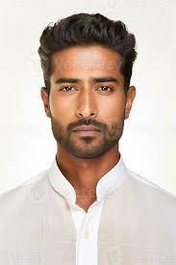
“ALL I want is fresh foods, vegetarian and can order anytime anywhere .”
Add image that represents this persona
Goals
Want to get food anytime and anywhere
Can track food easily
Want fresh food
Scheduled delivery
Frustrations
Not clear vegetarian or non-vegetarian marks
The delivery boy didn’t pick the call
Wrong food delivered
WORKING LONG HOURS, hard to find food
zulaizat
Age: 28
Education: Degree
Hometown: k. kinabalu
Family:single
Occupation: Teacher
ZulAIZAT IS A TEACHER. HE IS Vegetarian AND ALWAYS BUSY. HE NEEDS FOODs which he no need to go to the restaurant. HE WANTS TO MAKE SURE ALL THE FOODS ARE VEGETARIAN AND FRESH. ALSO, HE WANTS TO order food anytime and anywhere he wants

