Slide 1
Automated Inventory Data Entry through Intelligent Character and Document Structure Recognition
CSE 498A: Capstone Project/Thesis

Slide 2
Group Member: 01
Arifur Rahman
ID : 20234103222
Section : 52 / 06
Group Member: 02
Meer Mushfiqur Rahman
ID : 20234103240
Section : 52 / 06
Group Member: 03
Fatema Akter Akhi
ID : 20234103212
Section : 52 / 06
Group Member: 04
Sheikh Ramisha Zubaydah
ID : 20234103236
Section : 52 / 06
Supervisor:
Md. Mijanur Rahman
Assistant Professor, Department of CSE, BUBT

Slide 3
Outline
Problem Overview
Objectives
Contributions
Background Study
System Architecture
Pipeline
Dataset
Recognition & Verification Design
Evaluation Plan
Proposed Data Model
Tools and Technologies
Methodology
Limitations
Conclusion & Future Works

Slide 4
Problem Overview
Small shops and fulfilment centres receive purchase and sale records as unstructured documents: printed invoices, thermal receipts, and handwritten chits.
No common layout — every supplier's document looks different.
A person currently has to read each document and manually enter its contents into the inventory system.
This manual step is slow and error-prone, so records fall behind or are skipped altogether.
Existing inventory software assumes clean, structured input already exists — it does not solve this problem.
Plain OCR alone is not enough either: it reads text but cannot tell what kind of document it is looking at.

Slide 5
Objectives
Build a document recognition pipeline combining character recognition (OCR) with document structure and type recognition.
Design a schema-constrained extraction component in which a language model converts recognized content into structured line items.
Engineer a verification step that cross-checks extracted numeric fields against the document's own arithmetic and flags low-confidence records.
Design the digitization service as a stateless, idempotent API, so retried or duplicate submissions cannot produce conflicting output.
Evaluate the system on character/structure recognition accuracy, document-type classification accuracy, and extraction accuracy.

Slide 6
Contributions
A character and document structure recognition pipeline for heterogeneous, English-language supplier documents.
A schema-constrained extraction and verification layer with arithmetic self-validation and confidence scoring.
A stateless, idempotent digitization API design that guarantees no duplicate or conflicting output on retried submissions.
An evaluation methodology covering recognition accuracy, extraction accuracy, and the rate at which self-validation catches errors.

Slide 7
Background Study
Approach | Examples | What it does | Gap vs. this project
General cloud document-AI | AWS Textract, Google Document AI, Azure AI Document Intelligence | Strong character recognition; field/table extraction for invoices and receipts. | Does not treat document-type classification as a first-class output.
Purpose-built invoice extraction APIs | Nanonets, Mindee, Veryfi, Docsumo, Affinda, Klippa | Invoice-specific field extraction with a human-review interface for low-confidence fields. | General-purpose tools, not structure-recognition-first for this document taxonomy.
Inventory / ERP-side platforms | Finale Inventory, HandiFox, Apptricity | Mobile-capture-to-cloud-to-API integration for supplier invoices. | Document capture is one step inside a larger owned inventory system, not a standalone gateway.

Slide 8
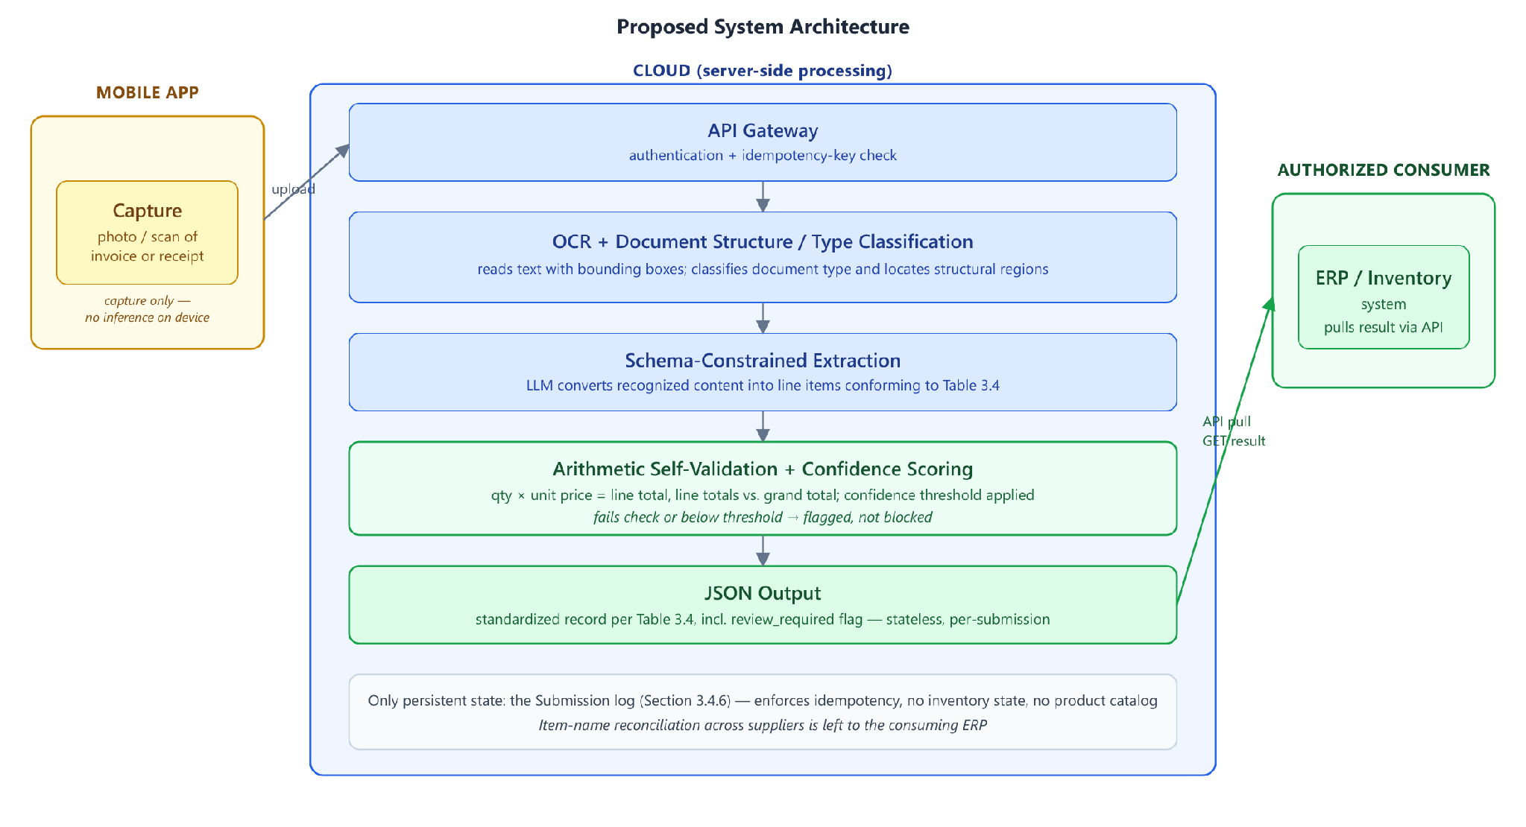
System Architecture
Proposed System Architecture

Slide 9
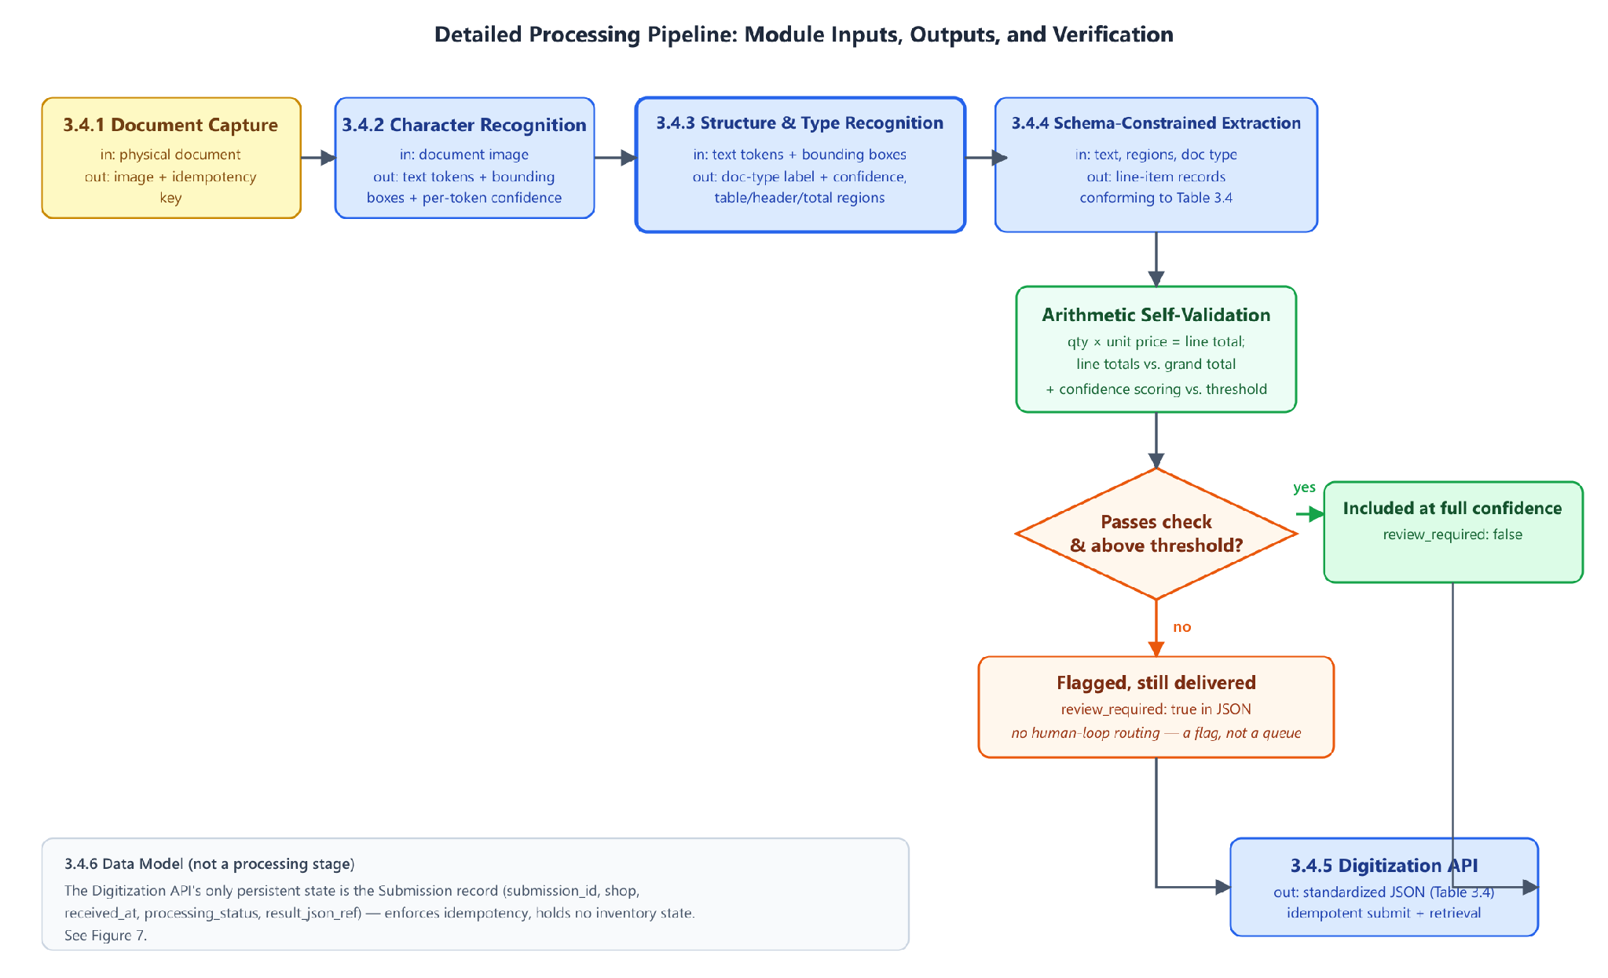
Pipeline
Detailed Pipeline Diagram

Slide 10
Dataset
Corpus has not yet been collected -- this is the proposed collection plan.
Small shops and fulfilment centres will be approached to contribute supplier documents they have already received.
Stratified along two axes: production method (printed, thermal-printed, handwritten) and document type (purchase order, customer copy, delivery note, receipt).
Target: a minimum of 30 documents per document-type class.
Documents captured through the same mobile capture path the system will use in production.
Public benchmarks (SROIE, CORD, FUNSD) used for pretraining and sanity-checking.

Slide 11
Recognition & Verification Design
Character recognition -- a cloud OCR service reads document text with bounding boxes.
Document structure and type recognition -- classifies the document as purchase order, customer copy, delivery note, or receipt.
Schema-constrained extraction -- a language model converts recognized text into structured JSON line items.
Arithmetic self-validation -- extracted quantity, unit price, and line total are cross-checked against each other.
Confidence scoring -- records falling below a threshold are flagged for review rather than silently finalized.

Slide 12
Evaluation Plan
Module | What will be measured
Character recognition | Character / Word Error Rate
Document type & structure | Classification accuracy, confusion matrix
Schema-constrained extraction | Schema-validity rate, field-level precision/recall
Verification | Silent-error rate at varying confidence thresholds
Digitization API | Latency, correctness under duplicate submission

Slide 13
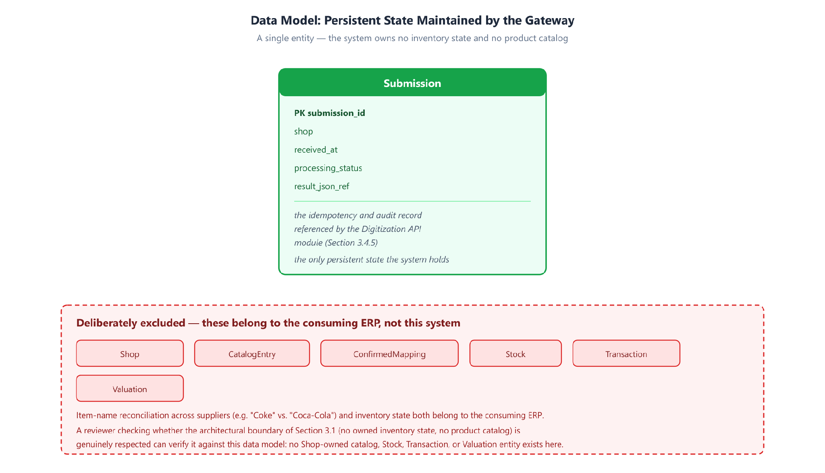
Proposed Data Model

Slide 14
Tools and Technologies
OCR / document-AI service: open decision, pending a pilot on collected documents.
Language model for extraction: open decision, evaluated on schema-conformance and field accuracy.
Constrained-decoding mechanism: provider-native JSON mode preferred, library fallback otherwise.
Confidence signal source: token log-probabilities where available, sampled-consistency otherwise.
Document-type classifier: few-shot prompting first, fine-tuned model after corpus collection.
Result delivery: synchronous response by default.

Slide 15
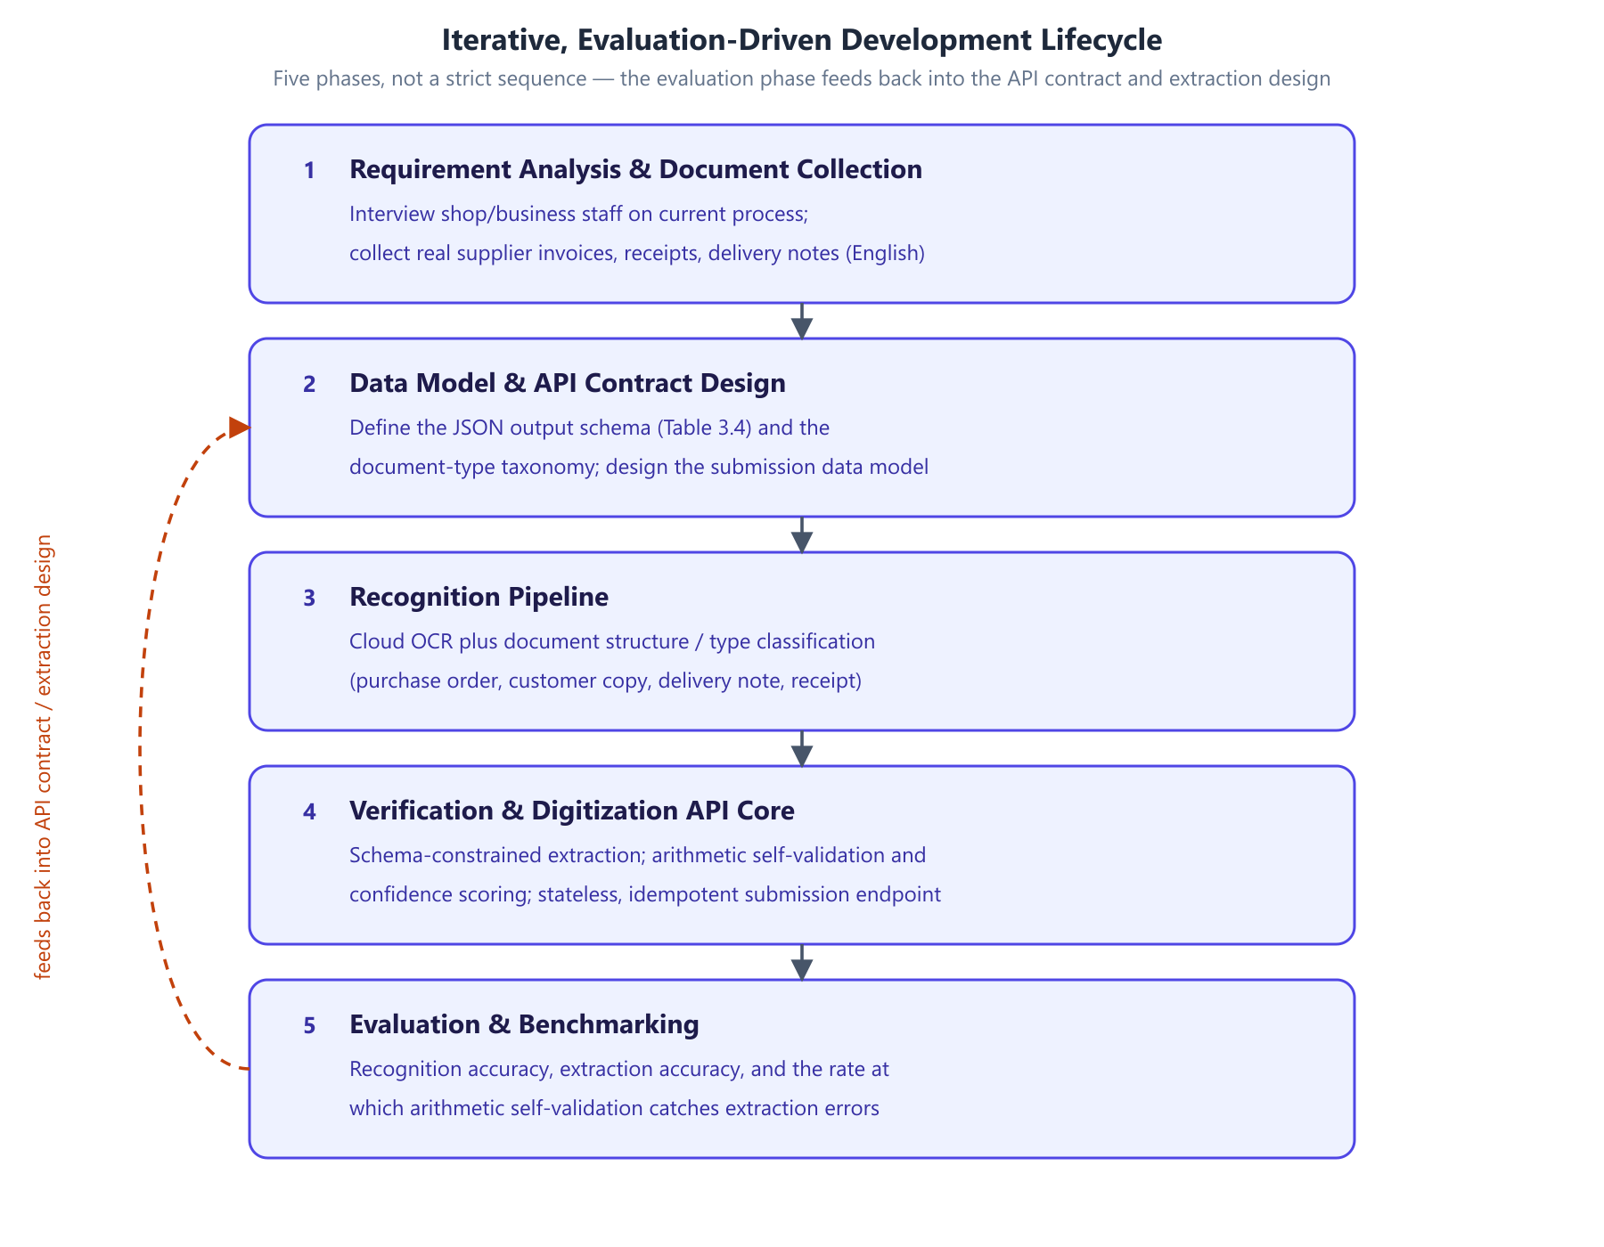
Methodology

Slide 16
Limitations
Design-stage submission: no corpus collected yet, no implementation, no evaluation results.
Several core decisions remain open: OCR provider, LLM provider, and the confidence-signal source.
Item-name reconciliation across suppliers (e.g. "Coke" vs. "Coca-Cola") is left to the consuming ERP.
No human-in-the-loop review queue -- verification is fully automatic.
No inventory ownership -- no stock levels, transactions, or product catalog stored in this system.
English-language documents only, in this version.

Slide 17
Conclusion and Future Works
Conclusion:
This report presents the design of a mobile-to-cloud document digitization gateway for supplier invoices, receipts, and delivery notes.
Four contributions: a recognition pipeline, a schema-constrained extraction and verification layer, a stateless idempotent API design, and an evaluation methodology.
This is a design-stage submission (CSE 498A) -- implementation and results are the subject of CSE 498B.
Future Work:
Collect and annotate the proposed document corpus.
Resolve the open algorithm and model decisions through a pilot on collected documents.
Implement the six pipeline modules and the digitization API.
Run the evaluation plan and report recognition, extraction, and verification accuracy.

