Slide 1
Project name: Atm Management
Prepared by: Ariful Islam Khokon
Round: 34 Id: 1238456

Slide 2
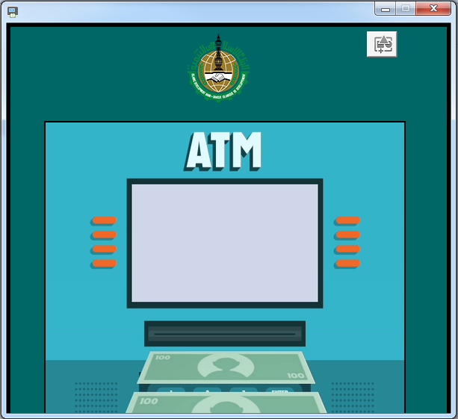
Starting Window

Slide 3
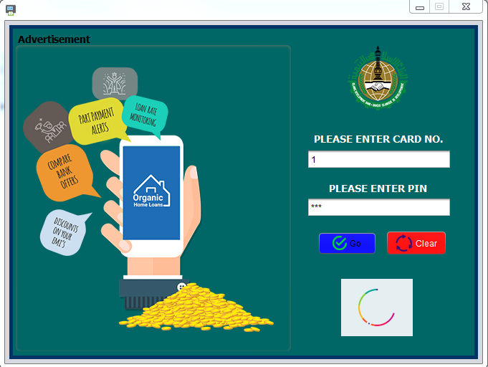
Authentication form

Slide 4

Loading Window
It will show progress with a welcome note of system time and show the user name

Slide 5
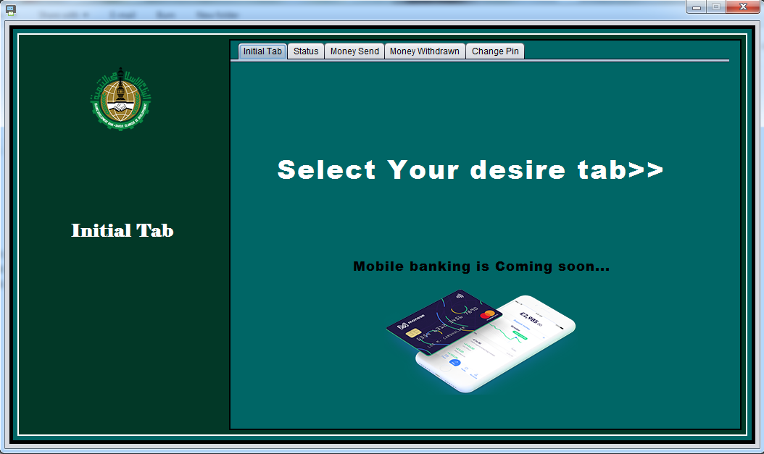
Main Window
It will come with Initial, Status, Money Send, Money Withdraw, Change Pin Tabs

Slide 6
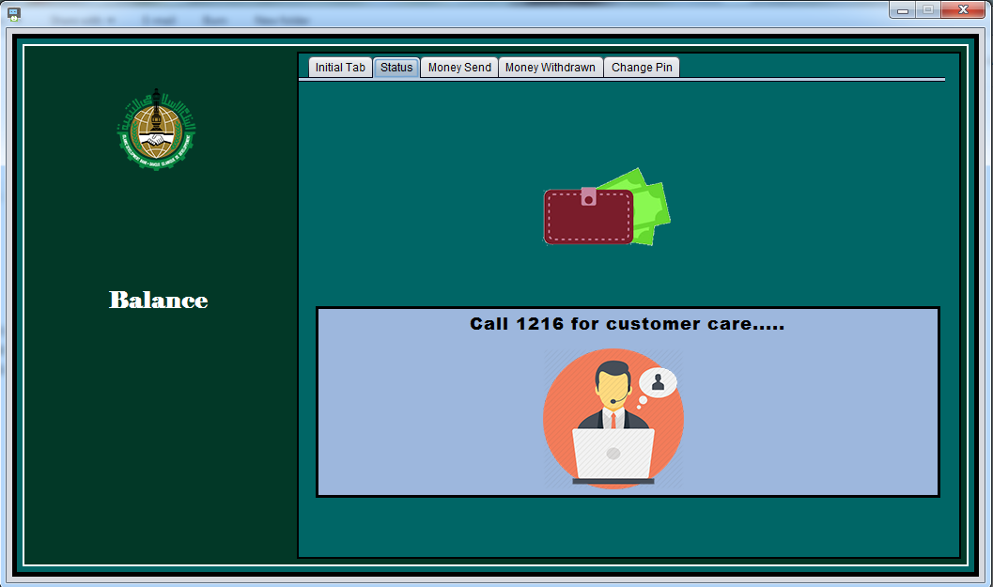
Status Tab

Slide 7
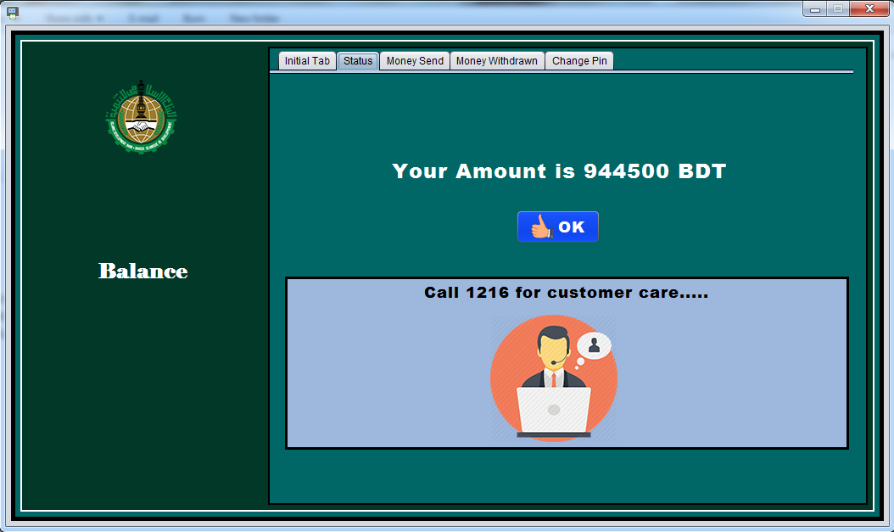
Status Tab After Clicking

Slide 8
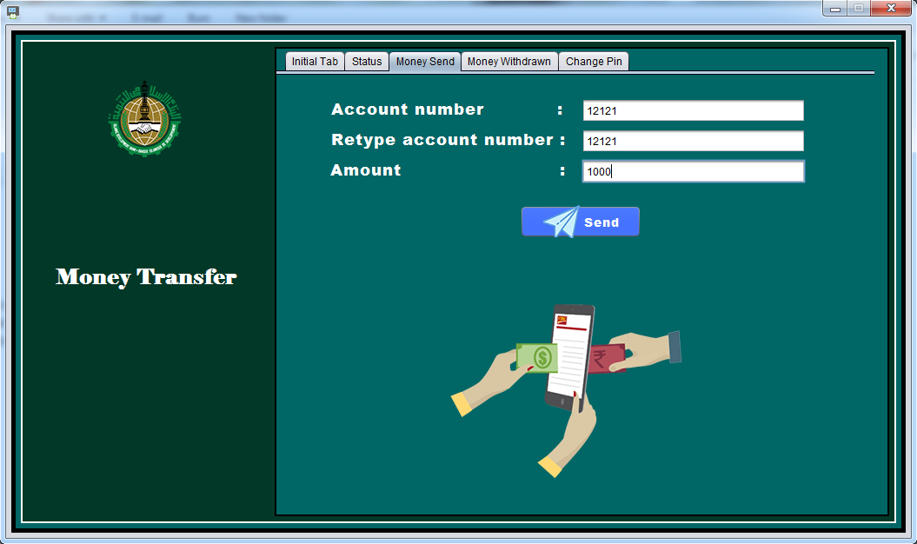
Money Send Tab

Slide 9
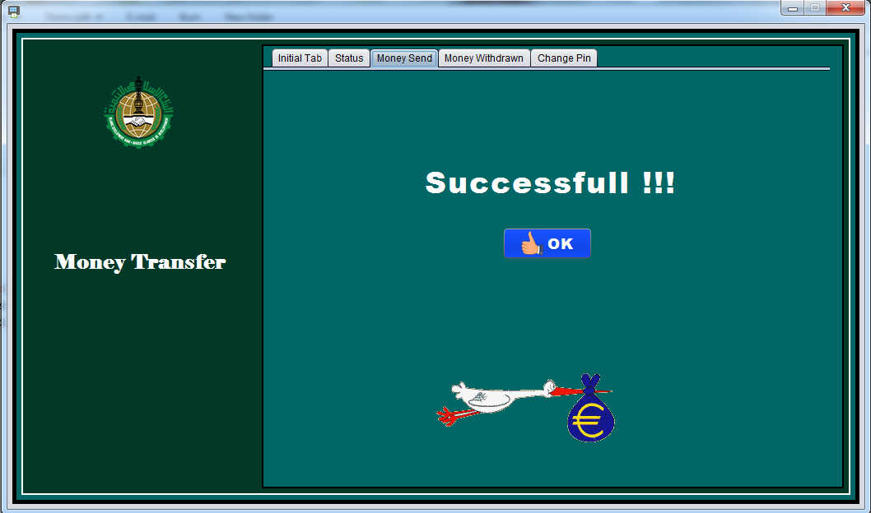
Money Send Tab After Clicking

Slide 10
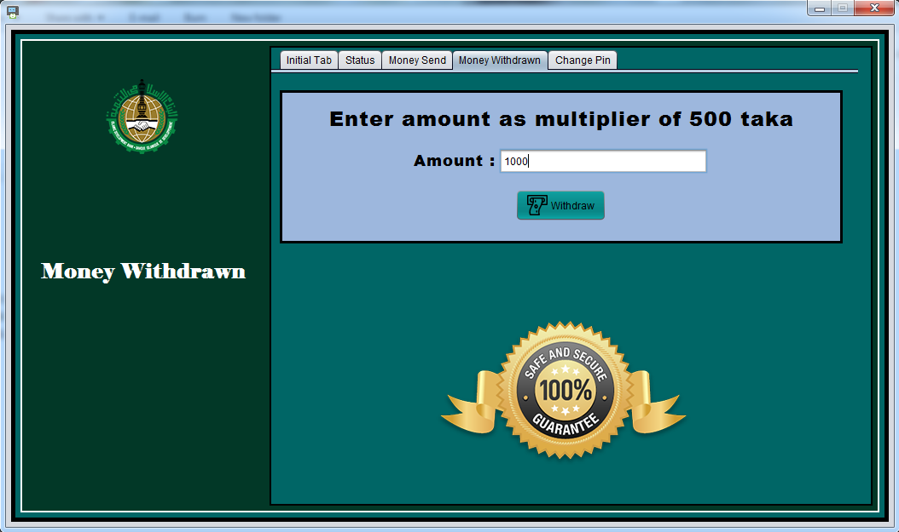
Money Withdraw Tab

Slide 11
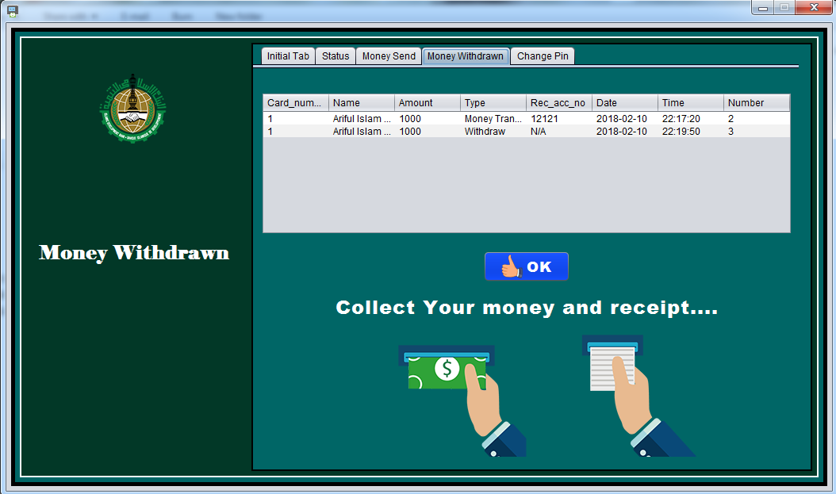
Money Withdraw Tab After Clicking

Slide 12
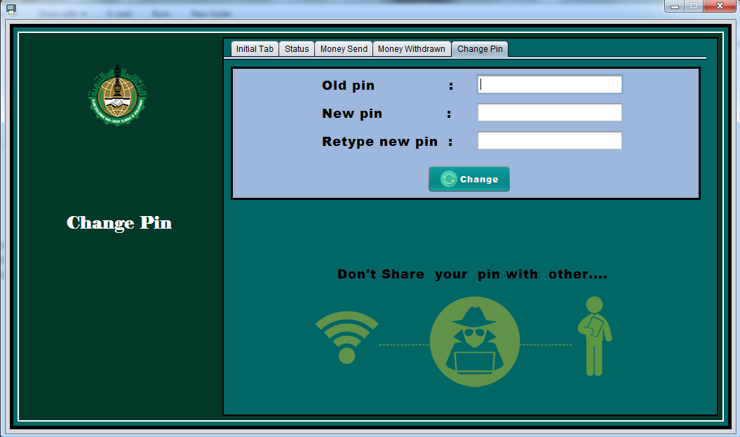
Change Pin Tab

Slide 13
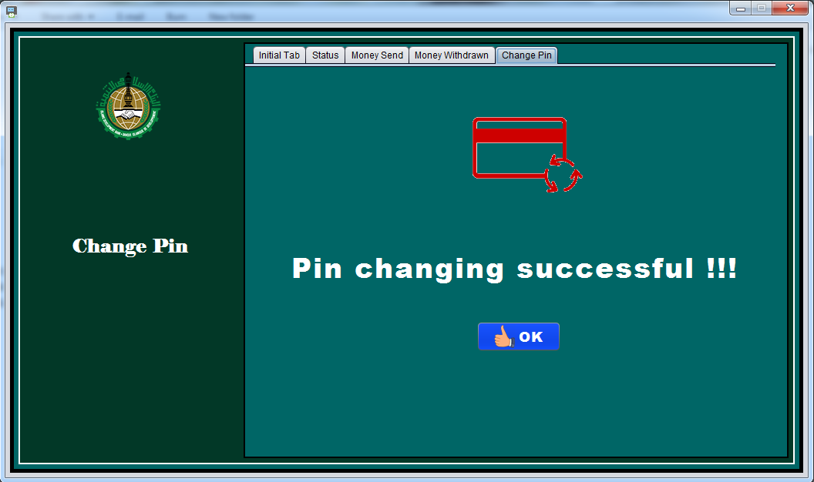
Change Pin Tab After Clicking

Slide 14
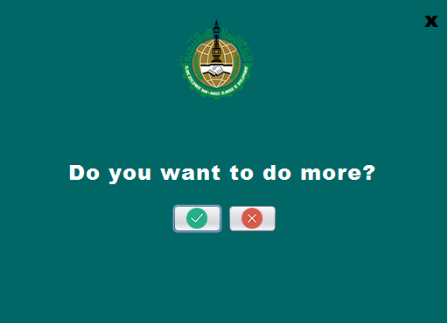
Message Window
It will appear in every tab when task completed and clicked a ok Button

Slide 15
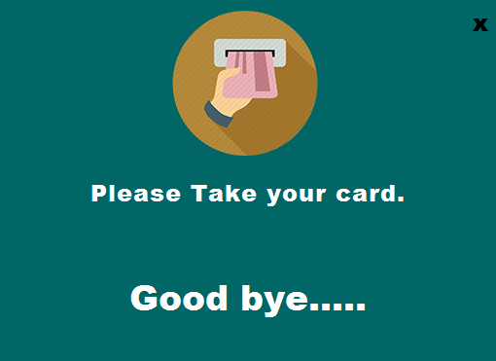
No

Slide 16
Yes

