Slide 1
🌿
QuitMate
তামাকমুক্ত জীবনের AI সহায়ক
SPL-2 Final Project Presentation
Department of Computer Science & Engineering
Submission Date: August 2026
1 / 23

Slide 2
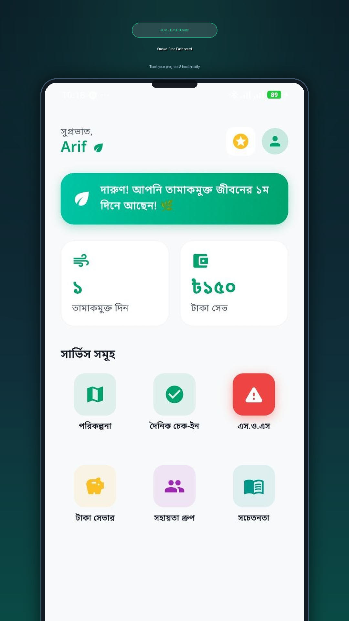
Project Overview
What is QuitMate and why does it matter?
Key Highlights:
• A Flutter-based mobile app to help people quit tobacco
• Personalized AI-generated quit plans via Groq AI
• Daily mood & craving tracking with gamification
• Real-time peer support community forum
• SOS craving-distraction with 4-7-8 breathing
• Financial savings tracker (Money Saver)
• Educational health awareness content
2 / 23

Slide 3
Problem Statement
Why do people struggle to quit tobacco?
• Bangladesh has 37.8 million tobacco users (WHO, 2021) — one of the highest globally
• Tobacco causes 100,000+ deaths annually in Bangladesh
• No accessible, localized digital tool exists for Bengali-speaking quit-smoking support
• Existing apps lack AI personalization, peer support, and gamification in Bangla
• Financial impact: avg. smoker spends BDT 3,000–5,000/month on tobacco
• Craving management is the #1 reason for relapse — no instant SOS tool available
3 / 23

Slide 4
Project Objectives
What QuitMate aims to achieve
• Provide AI-personalized day-by-day quit plans (7/14/30/60 days)
• Enable daily check-ins to track mood, craving level and tobacco use
• Build real-time peer support community for mutual motivation
• Create an SOS emergency screen to handle sudden cravings instantly
• Track and display money saved since quitting in real-time
• Motivate users through gamified tree-growth progress visualization
• Educate users with health facts and tobacco awareness content
• Provide admin panel for monitoring user data and community moderation
4 / 23

Slide 5
System Architecture
Technology stack and component overview
Mobile App (Frontend)
Backend Server
External Services
Admin Panel
Flutter + Dart Riverpod State Management Hive Local Cache Flutter Local Notifications
Node.js + Express.js REST API + Socket.IO PostgreSQL Database JWT Authentication
Firebase (Auth) Groq AI (Quit Plan) Google Sign-In Cloudinary (Images)
HTML + Vanilla JS Express Static Server CSV Data Export Password Protected
Real-time Communication: Socket.IO | Auth: Firebase | AI: Groq API
App Version: 1.0.9 | Flutter SDK ^3.10.8 | Backend: Node.js + PostgreSQL
5 / 23

Slide 6
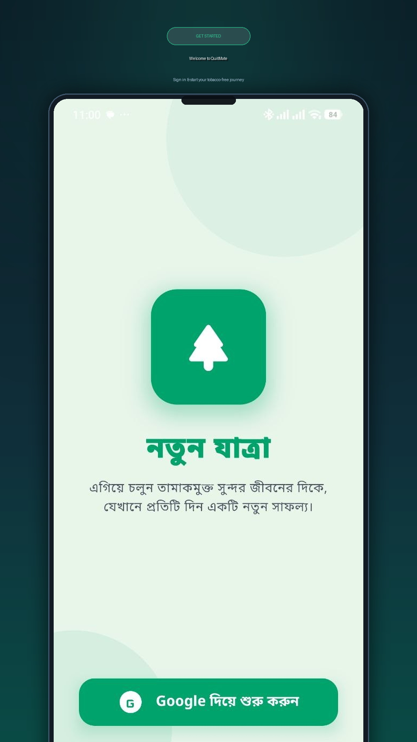
Feature 1: Google Sign-In
Secure, password-free authentication
• Uses Google OAuth 2.0 via Firebase Authentication
• No separate username/password registration needed
• Animated login screen with pulse effect logo
• Auto-detects new vs returning users
• New users -> Profile Assessment | Returning users -> Dashboard
• Comprehensive error handling (network, timeout, server errors)
6 / 23

Slide 7
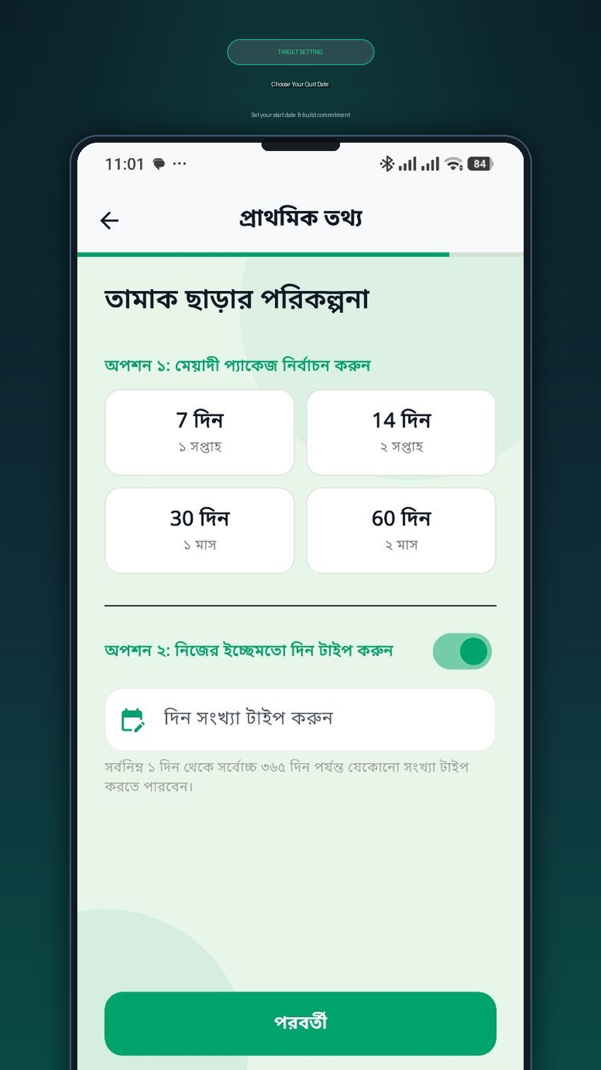
Feature 2: Profile Assessment & AI Quit Plan
Personalized onboarding + AI plan generation
• 5-step onboarding wizard: Name, Education, Age, Gender, Plan Setup
• User selects quit duration: 7 / 14 / 30 / 60 days
• User sets their Quit Date (future or immediate)
• Profile data sent to Groq AI (LLaMA model) for plan generation
• AI generates day-by-day quit plan with goals, descriptions & tasks
• Plan stored in PostgreSQL and displayed daily in Quit Plan screen
7 / 23

Slide 8
Feature 3: Home Dashboard
Central hub with real-time stats
• Time-based personalized Bengali greeting (Morning/Noon/Evening/Night)
• Motivational strip: 'আপনি তামাকমুক্ত জীবনের Nth দিনে আছেন!'
• Stat Cards: Tobacco-free days counter + Money saved (BDT)
• 3x2 Feature Grid: Quit Plan, Check-In, SOS, Money Saver, Community, Education
• Pull-to-refresh: all 3 data sources load in parallel (optimized)
• Gamification badge shortcut (⭐) and Profile avatar in top bar
8 / 23

Slide 9
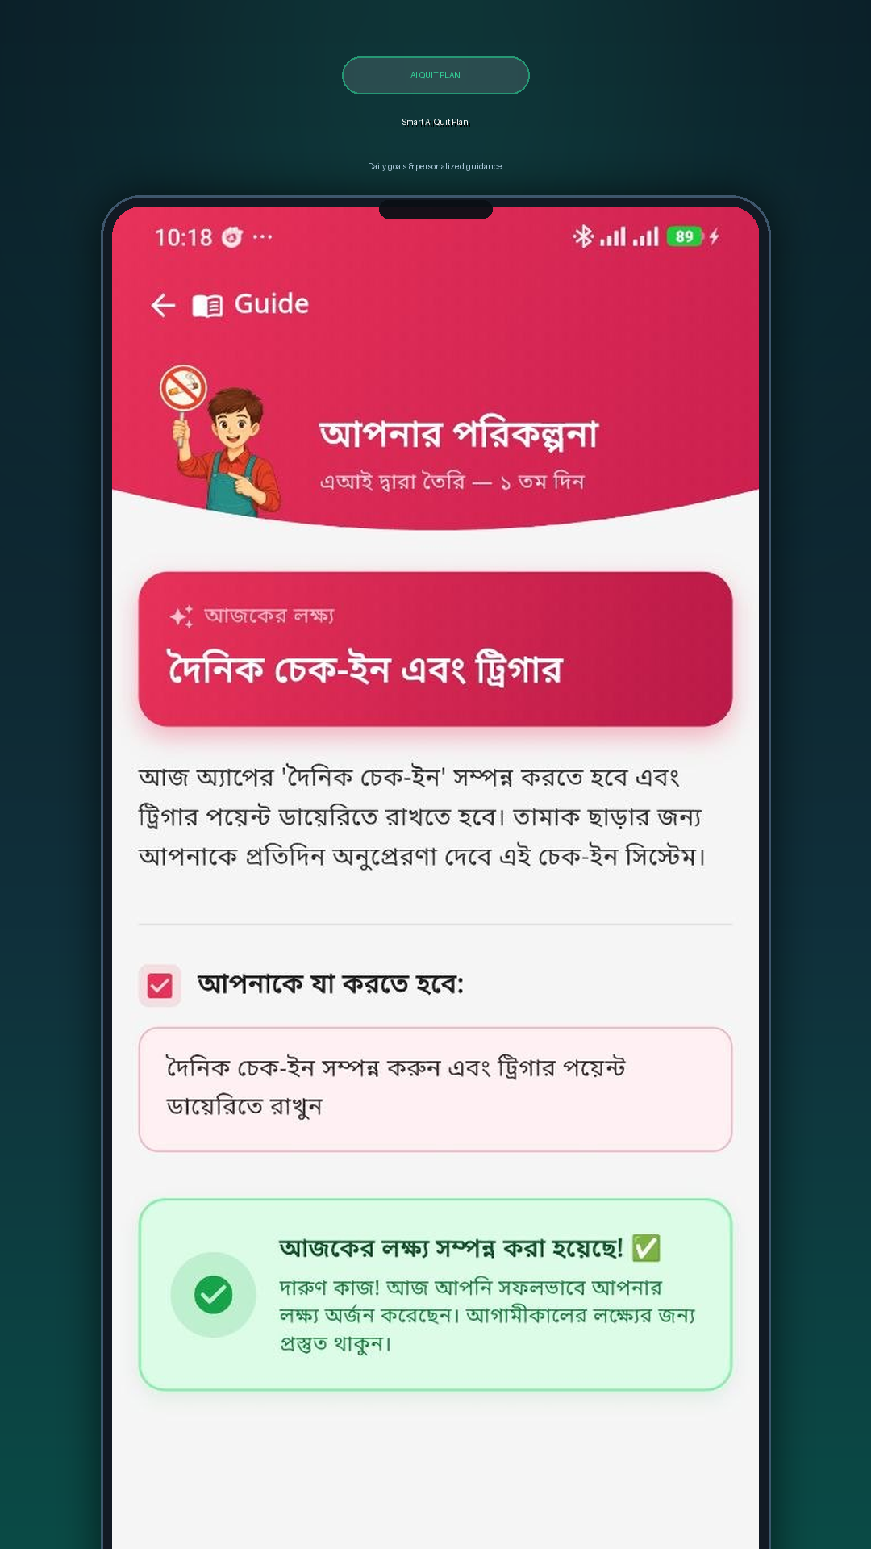
Feature 4: AI Quit Plan
Day-by-day personalized plan
• Displays current day's AI-generated goal and description
• Shows daily user task: 'আপনাকে যা করতে হবে' section
• Countdown banner if plan hasn't started yet
• Daily completion question: Completed? (Yes/No) – once per day
• After answering: shows status card (completed or not)
• Custom curved header with gradient and hero image
9 / 23

Slide 10
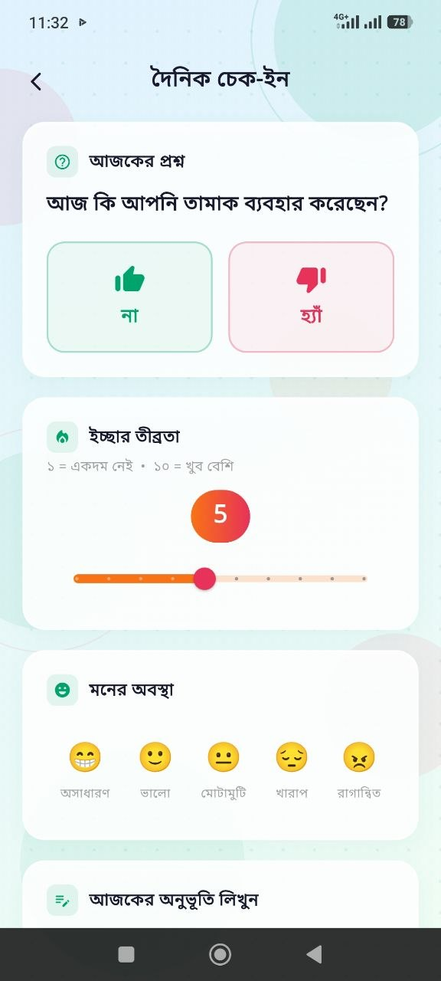
Feature 5: Daily Check-In
Mood, craving and streak tracking
• 5-level mood selection: emoji-based (Excellent to Angry)
• Craving level slider (1–5 intensity)
• Tobacco use today? (Yes / No) — drives gamification tree state
• Optional reflection/journal note text field
• One check-in allowed per day (streak system)
• Animated fade-in UI with decorative background
• Updates gamification tree and streak counter upon submission
10 / 23

Slide 11
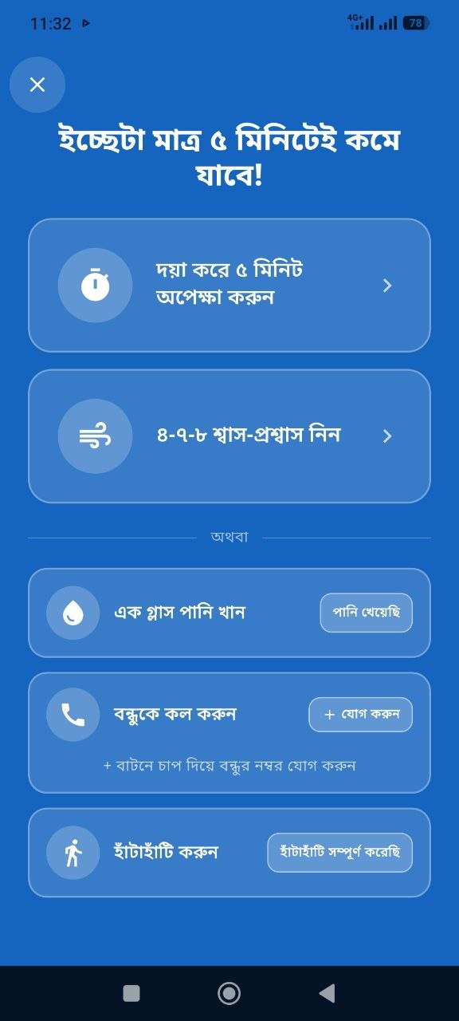
Feature 6: SOS Emergency – Craving Support
Instant help when cravings hit
• Triggered by red SOS button on Home Dashboard
• Mode 1: 5-Minute Wait Timer — countdown to outlast the craving
• Mode 2: 4-7-8 Breathing Technique — animated breathing guide + audio
• Water intake tracker and walking activity toggle
• Emergency contact: 'Call a Friend' with stored phone numbers
• SOS events logged to backend for tracking relapse patterns
• Clinically-backed techniques to reduce craving intensity
11 / 23

Slide 12
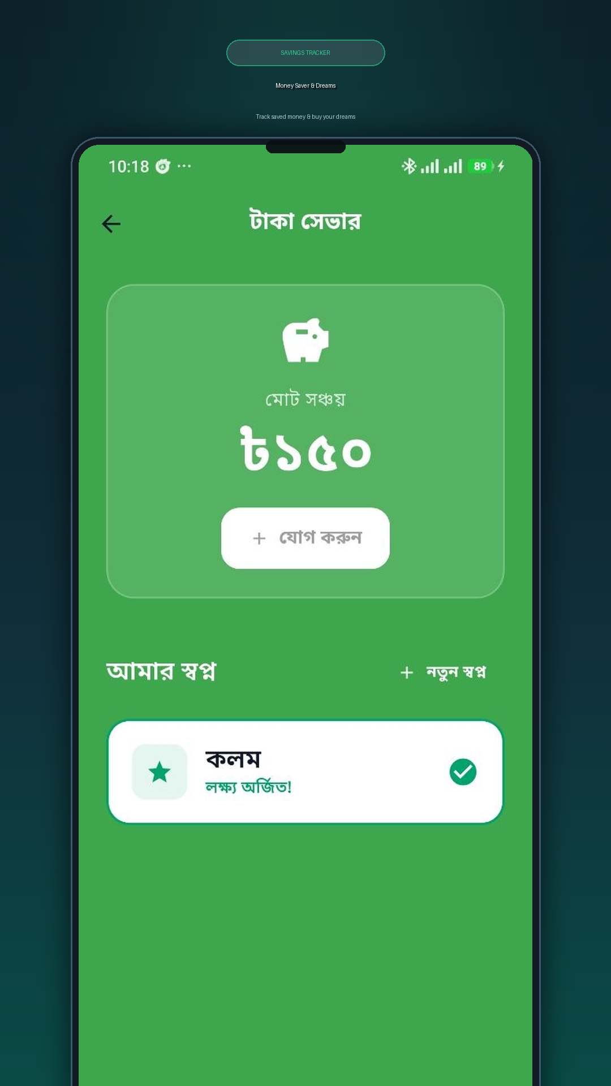
Feature 7: Money Saver & Dream Goals
Visualize financial benefits of quitting
• Calculates total money saved since quit date in real-time (BDT)
• Displays savings breakdown: daily / weekly / monthly projections
• Dream Goals: set personal financial goals (e.g., 'Buy a bicycle – BDT 5,000')
• Progress bar shows savings toward each goal
• Add manual savings entries
• Motivates users by showing tangible financial benefit of quitting
12 / 23

Slide 13
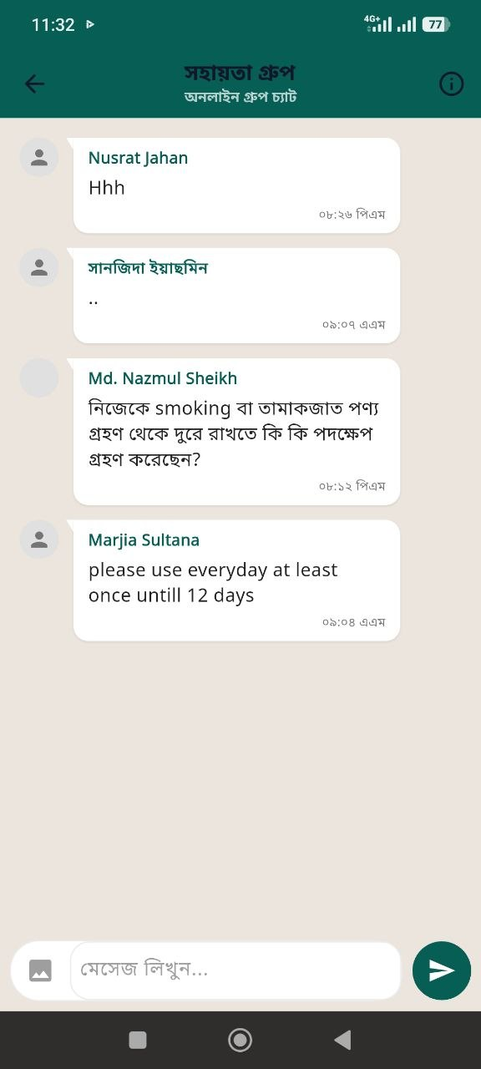
Feature 8: Peer Support Community Forum
Real-time community motivation
• Real-time chat powered by Socket.IO
• Users share quit journey, tips and encouragement
• Text messages and image sharing from gallery
• AI-powered content moderation (inappropriate content blocking)
• Users can delete their own posts
• Admin panel can monitor and moderate all posts
• Scrollable feed with message timestamps and user names
13 / 23

Slide 14
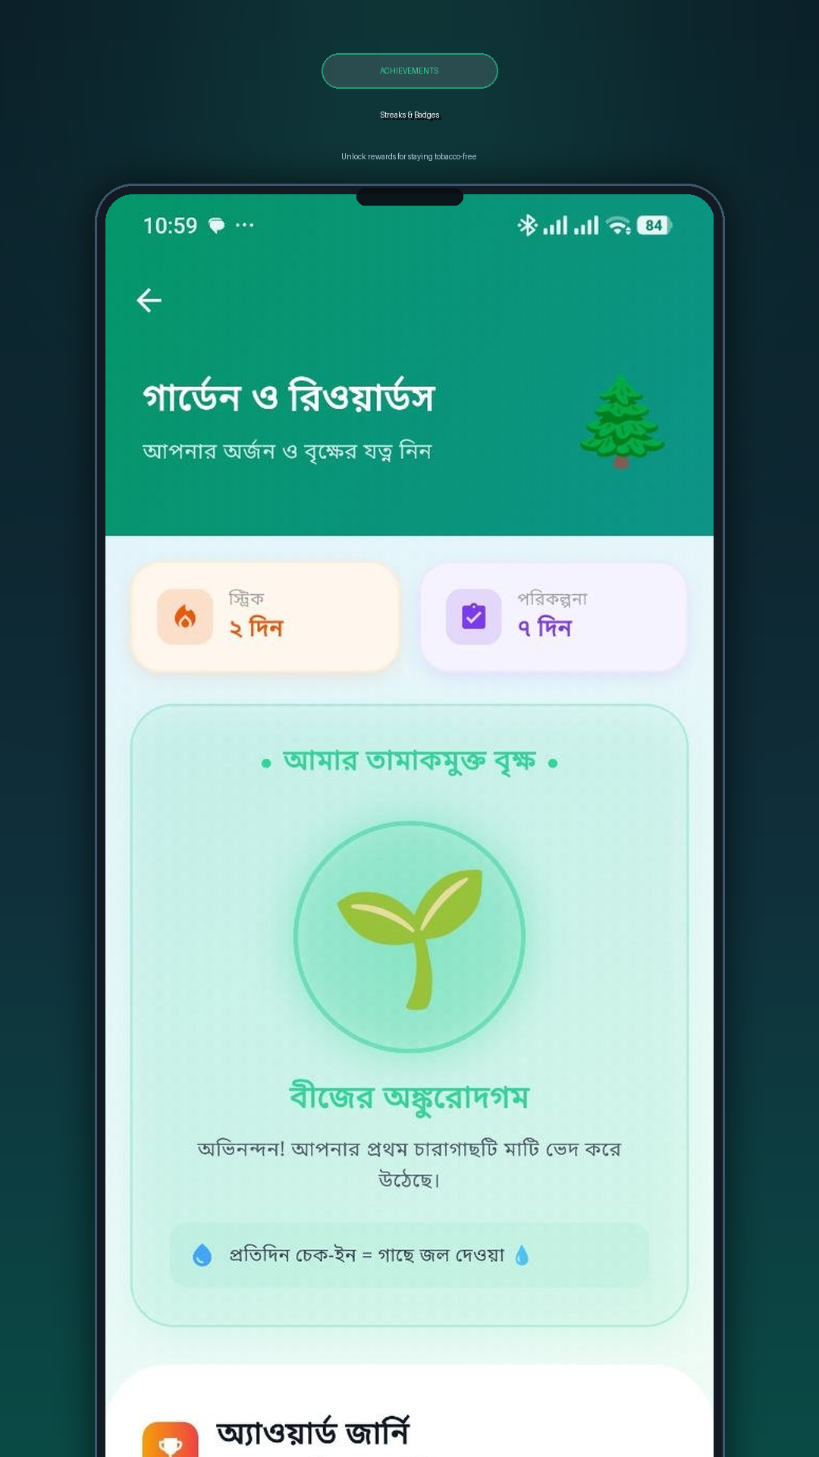
Feature 9: Gamification – Tree Growth
Visualize quit progress as a growing tree
• Virtual tree grows with each daily tobacco-free check-in
• 6 growth stages: Empty Pot → Seed → Sapling → Leaves → Young Tree → Full Tree
• Tree turns 'pest-infected' (cactus) if tobacco is used
• Recover tree: complete 3 consecutive tobacco-free check-ins
• Garden view: shows all past trees as a motivational gallery
• Animated tree display with stage-based color theming
• Deeply motivates users through visual metaphor of personal growth
14 / 23

Slide 15
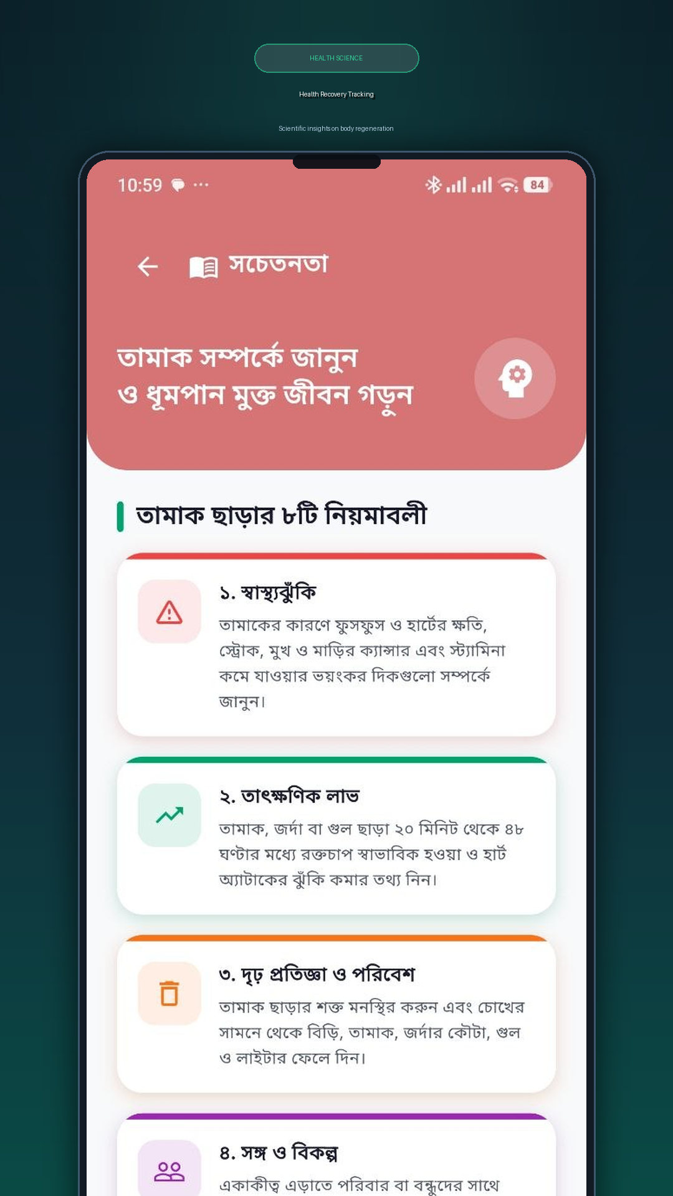
Feature 10: Educational Content / Awareness
Health facts and tobacco awareness
• Categorized health articles about tobacco effects
• Health recovery timeline after quitting (20 min → 15 years)
• Fact cards with key statistics on tobacco harm
• User-friendly Bengali language content
• Coral pink themed UI with expandable article cards
• Accessible even to first-time smartphone users
15 / 23

Slide 16
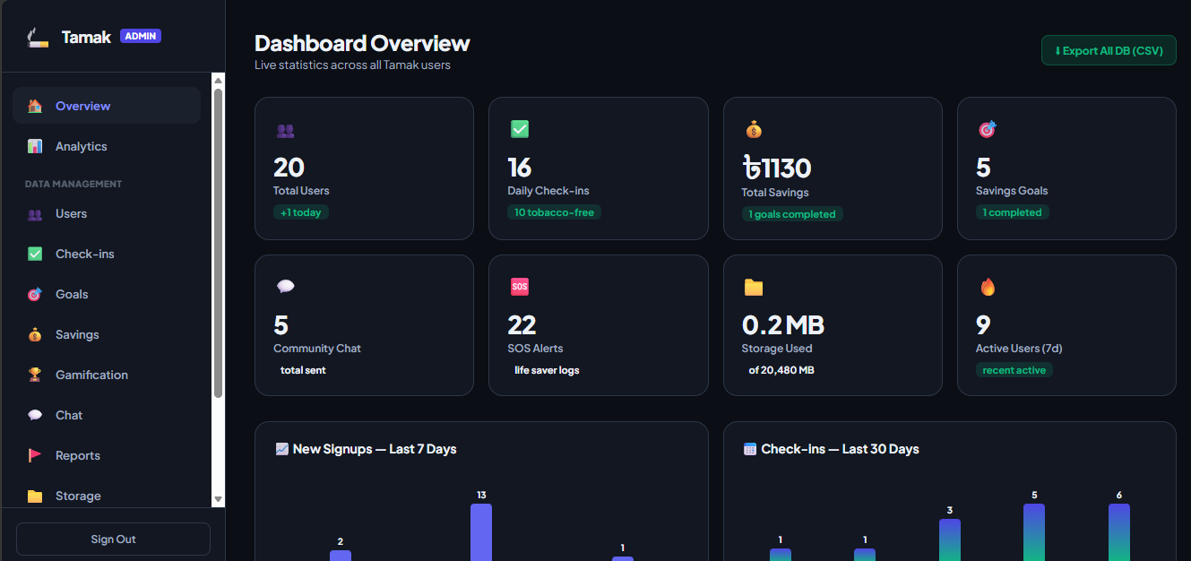
Feature 11: Admin Dashboard & Web Panel
Centralized management & platform monitoring
• Password-protected web dashboard for system administrators
• Real-time analytics: tracks registered users, check-ins & money saved
• User management view to monitor user profiles and quit progress
• Community moderation tool to inspect and delete inappropriate posts
• Data export feature to download system reports in CSV format
• Lightweight web interface served directly via Node.js Express server
16 / 23

Slide 17
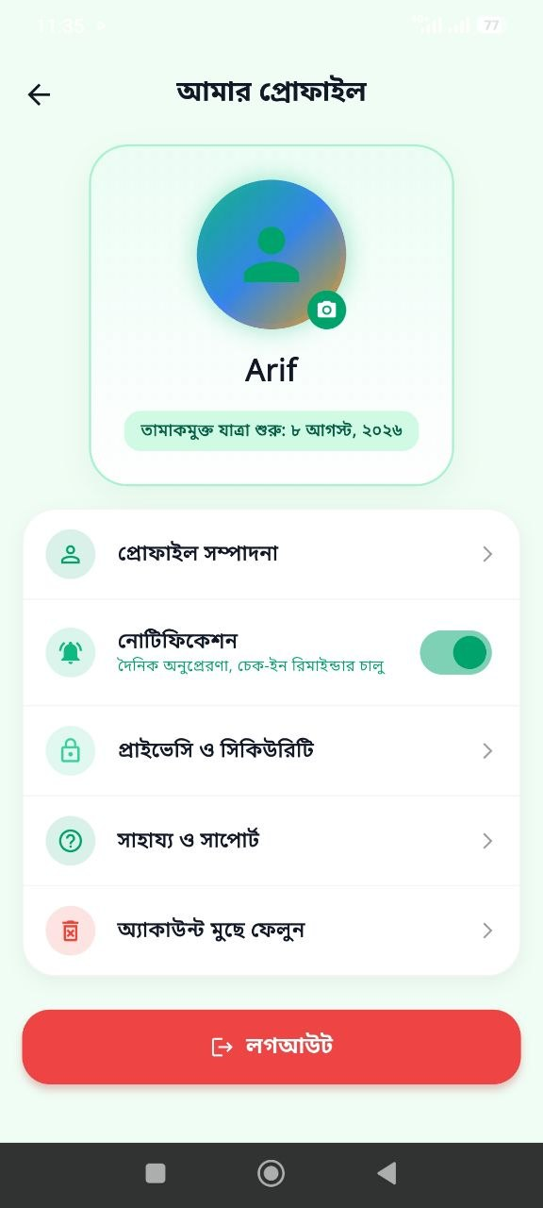
Technology Stack
Complete technical implementation
Mobile App
Flutter 3.x + Dart, Riverpod, Hive, Socket.IO client
Authentication
Firebase + Google Sign-In OAuth 2.0
Backend
Node.js + Express.js REST API
Database
PostgreSQL (users, plans, check-ins, savings, chat)
AI Engine
Groq AI API — LLaMA 3 model for quit plan generation
Real-time
Socket.IO (peer support live chat)
Admin Panel
HTML + Vanilla JS + Express static server
Notifications
Flutter Local Notifications + Timezone
Media
Cloudinary CDN (image upload for community posts)
17 / 23

Slide 18
LIVE DEMO
QuitMate Application Demo
Showing: Login → Profile Setup → Dashboard → Quit Plan → SOS → Community → Admin Panel
18 / 23

Slide 19
Implementation Results
What was successfully achieved
• 11 key feature modules (10 mobile app screens + Web Admin Panel): Login, Profile Assessment, Dashboard, Quit Plan, Daily Check-In, SOS Emergency, Money Saver, Peer Support, Gamification, Education, Admin Dashboard
• Daily Check-In, SOS Emergency, Money Saver, Peer Support, Gamification, Education
• AI integration: Groq AI generates personalized quit plans within seconds
• Real-time community forum with image sharing and content moderation
• Backend: Node.js server with 15+ REST API endpoints + Socket.IO
• Admin panel with user management, stats dashboard, and CSV export
• Cross-platform: tested on Android; iOS-compatible codebase
• Firebase authentication with 100% secure Google Sign-In flow
• Offline support: cached data display via Hive local storage
19 / 23

Slide 20
Limitations & Challenges
Known constraints and challenges faced
• Requires active internet for most features (AI, community, sync)
• Currently tested primarily on Android — iOS needs further testing
• AI-generated quit plans depend on Groq API availability
• One daily check-in limit — cannot log multiple entries per day
• Medical disclaimer: not a replacement for professional addiction counseling
• Backend requires server uptime (hosted Node.js — may have downtime)
• Language: Bengali-only UI limits international usability
20 / 23

Slide 21
Future Work & Scope
Potential enhancements for QuitMate
• Play Store / App Store deployment for wider public access
• Multi-language support (English + Bengali)
• Doctor/Counselor integration for professional medical guidance
• Wearable integration: track heart rate changes during cravings
• Leaderboard and social challenges among friends
• AI chatbot for 24/7 quit support conversations
• Government health organization partnership and data insights
• Push notification improvements with personalized reminders
21 / 23

Slide 22
Conclusion
Summary and impact
• QuitMate successfully delivers a comprehensive, AI-powered tobacco quit support app
• Addresses a critical public health need in Bangladesh with a localized Bengali solution
• Combines AI personalization, gamification, peer support and real-time tracking
• 11 fully implemented feature modules with a robust Node.js + PostgreSQL backend & Web Admin Panel
• The gamified tree metaphor and financial savings tracker provide strong motivation
• SOS emergency tool provides clinically-backed craving management techniques
• Ready for real-world deployment and user testing with target demographic
22 / 23

Slide 23
?
Questions & Answers
Thank you for your attention!
QuitMate — তামাকমুক্ত জীবনের AI সহায়ক
23 / 23

