Slide 1
Mandelbrot set image processing

Slide 2
Presented By
Md. Ariful Islam, ID: 2016-1-60-019
Tasfia Tourin Meem, ID: 2016-1-60-087
Shamima sultana, ID: 2016-1-60-085

Slide 3

What is Mandelbrot set
A particular set of complex numbers which has a highly convoluted fractal boundary when plotted
- a swirling, feathery, seemingly organic landscape that is reminiscent of the natural world, but is nonetheless completely virtual.

Slide 4
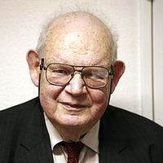
Who invented?
The set is named after Benoit B. Mandelbrot, a mathematician at the IBM Thomas J. Watson Research Center. He is best known for coining the term fractal to describe phenomena (such as coastlines, snowflakes, mountains and trees) whose patterns repeat themselves at smaller and smaller scales.
He quoted “Clouds are not spheres, mountains are not cones, coastlines are not circles, and bark is not smooth, nor does lightning travel in a straight line.”

Slide 5
Project Purpose
1. To generate interesting visual image
2. Understand the basic activities of multi process and multi threads.

Slide 6
APPLICATION
There are no non-artistic application of the Mandelbrot set. It is just a mathematical curiosity that creates beautiful images.

Slide 7

How Mandelbrot set works
Recurrence equation
If c is a complex number
Z_{n+1} = Z_{n}² + C

Slide 8
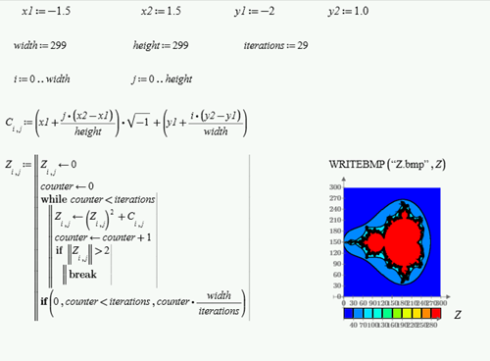
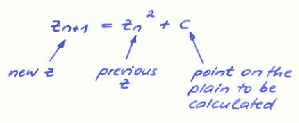

Slide 9
implementation
Using for loop
Using multi processors
Using multi threads

Slide 10
‘For’ loop
1. 50 images are created using a single loop
2. This method is slower

Slide 11
Multi processing
Fork(): system call fork() is used to create processes
fork() returns a zero to the newly created child process.
fork() returns a positive value, the process ID of the child process, to the parent.
50 processes are created for 50 images
This method is much faster

Slide 12


