Slide 1
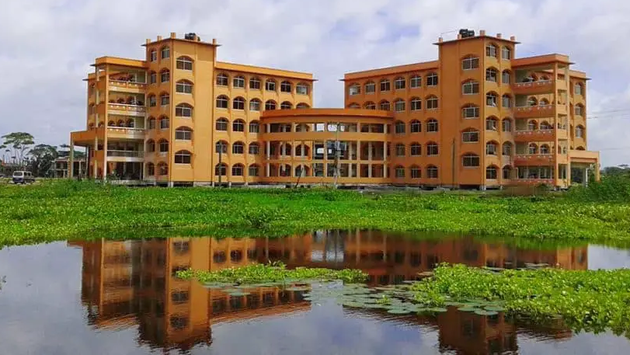
UNIVERSITY of BARISHAL
a

Slide 2
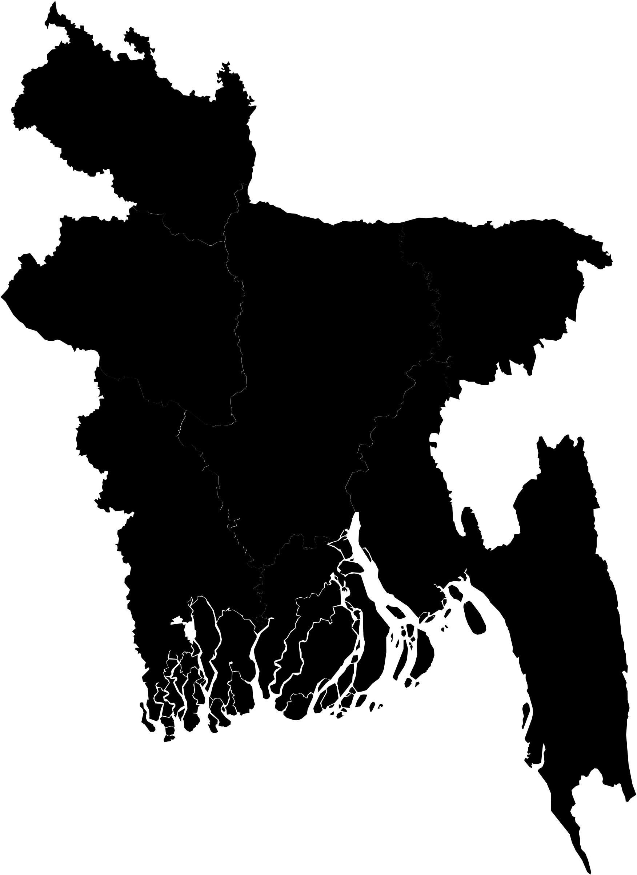
Location
University of Barishal is a public university located in Barishal, a divisional city in southern Bangladesh. It is the country's 33rd public university. The university was established in 2011 and began academic activities at undergraduate level in six departments under four faculties on 24 January 2012. The university offers degrees at undergraduate and postgraduate levels. The university houses 25 academic departments under six faculties, where 24 departments are currently providing postgraduate degrees.
UNIVERSITY Oof BARISHAL

Slide 3
University Income

Slide 4
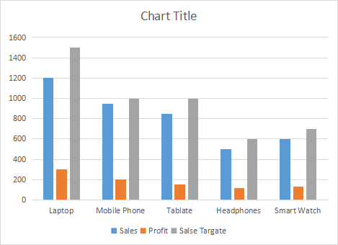
University Income Graphically

Slide 5
FACULTY FLOW CHART
FACULTY
BUSINESS
SOCIAL SEIENCE
AIS
MKT
MGT
FIB
ECO
POL
SL
PAD

Slide 6
UNIVERSITY SMART ART
A
B
C
D
E

Slide 7
THANK YOU

