Slide 1
Unsupervised Anomaly Detection
Shahrear Iqbal
Research Officer, NRC

Slide 2
What Are Outliers?
Outlier: A data object that deviates significantly from the normal objects as if it were generated by a different mechanism
Ex.: Unusual credit card purchase
Outliers are different from the noise data
Noise is random error or variance in a measured variable
Noise should be removed before outlier detection
Outliers are interesting: It violates the mechanism that generates the normal data
Outlier detection vs. novelty detection: early stage, outlier; but later merged into the model
Applications:
Credit card fraud detection
Telecom fraud detection
Customer segmentation
Medical analysis

Slide 3
Dataset
Unified Host and Network Dataset
https://csr.lanl.gov/data/2017.html
M. Turcotte, A. Kent and C. Hash, “Unified Host and Network Data Set”, in Data Science for Cyber-Security. November 2018, 1-22
Network connection logs
Time, Duration, SrcDevice, DstDevice, Protocol, SrcPort, DstPort, SrcPackets, DstPackets, SrcBytes, DstBytes
Host logs

Slide 4
Host Log Data
EventID Description
4768 Kerberos authentication ticket was requested (TGT)
4769 Kerberos service ticket was requested (TGS)
4770 Kerberos service ticket was renewed
4774 An account was mapped for logon
4776 The domain controller attempted to validate the credentials for an account
4624 An account was successfully logged on
4625 An account failed to logon on
4634 An account was logged on
4647 User initiated logon
4648 A logon was attempted using explicit credentials
4672 Special privileges assigned to a new logon
4800 The workstation was locked
4801 The workstation was unlocked
4802 The screensaver was invoked
4803 The screensaver was dismissed
4688 Process start
4689 Process end
4608 Windows is starting up
4609 Windows is shutting down
1100 Event logging service has shut down (often recorded instead of EventID 4609)

Slide 5
Host Log Data
Time: The epoch time of the event in seconds.
EventID: Four digit integer corresponding to the event id of the record.
LogHost: The hostname of the computer that the event was recorded on. In the case of directed authentication events, the LogHost will correspond to the computer that the authentication event is terminating at (destination computer).
LogonType: Integer corresponding to the type of logon, see Table 2.
LogonTypeDescription: Description of the LogonType, see Table 2.
UserName: The user account initiating the event. If the user ends in $, then it corresponds to a computer account for the specified computer.
DomainName: Domain name of UserName.
LogonID: A semi-unique (unique between current sessions and LogHost) number that identifies the logon session just initiated. Any events logged subsequently during this logon session should report the same Logon ID through to the logoff event.
SubjectUserName: For authentication mapping events, the user account specified by this field is mapping to the user account in UserName.
SubjectDomainName: Domain name of SubjectUserName.

Slide 6
Host Log Data
SubjectLogonID: See LogonID.
Status: Status of the authentication request. “0x0” means success otherwise failure.
Source: For authentication events, this will correspond to the the computer where the authentication originated (source computer), if it is a local logon event then this will be the same as the LogHost.
ServiceName: The account name of the computer or service the user is requesting the ticket for.
Destination: This is the server the mapped credential is accessing. This may indicate the local computer when starting another process with new account credentials on a local computer.
AuthenticationPackage: The type of authentication occurring including Negotiate, Kerberos, NTLM plus a few more.
FailureReason: The reason for a failed logon.
ProcessName: The process executable name, for authentication events this is the process that processed the authentication event. ProcessNames may include the file type extensions (i.e exe).
ProcessID: A semi-unique (unique between currently running processes AND LogHost) value that identifies the process. Process ID allows you to correlate other events logged in association with the same process through to the process end.
ParentProcessName: The process executable that started the new process. ParentProcessNames often do not have file extensions like ProcessName but can be compared by removing file extensions from the name.
ParentProcessID: Identifies the exact process that started the new process. Look for a preceding event 4688 with a ProcessID that matches this ParentProcessID.

Slide 7
Host Log Data: JSON
{"EventID": 4769, "UserName": "User624729", "ServiceName": "Comp883934$", "DomainName": "Domain002", "Status": "0x0", "Source": "Comp309534", "Computer": "ActiveDirectory", "Time": 2}
{"EventID": 4776, "UserName": "Scanner", "DomainName": "Domain002", "Status": "0x0", "Computer": "ActiveDirectory", "AuthenticationPackage": "MICROSOFT_AUTHENTICATION_PACKAGE_V1_0", "Time": 2}
{"EventID": 4672, "UserName": "ActiveDirectory$", "LogonID": "0x2e66398d", "DomainName": "Domain002", "Computer": "ActiveDirectory", "Time": 2}

Slide 8
Load into a db to analyze
90 days of data
90 zip files
Each zip is around 100 mb
When you unzip, becomes more than a gb of textual json data
Difficult to read
What I did
Read the zipped files, unzipping chunk by chunk in memory
Converted the chunk of json to csv
Bulk load the csv stream into a postgres
Parallelize the code (working on 90 files parallelly, limit: postgres insertion limit/sec)
Took 3 days still

Slide 9
Volume of data
Row count in day1: 55,609,151
Simple count(*) takes 1 min 15s in postgres
Comp607982$ | 4688 | Comp607982 | 0x3e7 | Domain001 | services | 0x2ac | svchost.exe | 1 | 0x1418
Comp991643$ | 4688 | Comp991643 | 0x3e7 | Domain001 | services | 0x334 | rundll32.exe | 1 | 0xc0c
Comp736087$ | 4688 | Comp736087 | 0x3e7 | Domain001 | services | 0x2e8 | svchost.exe | 1 | 0x2074
Comp093128$ | 4688 | Comp093128 | 0x3e7 | Domain001 | services | 0x2d4 | vssvc.exe | 1 | 0x2200
Comp006850$ | 4688 | Comp006850 | 0x3e7 | Domain001 | services | 0x278 | svchost.exe | 1 | 0x498
system | 4624 | Comp828729 | 0x3e7 | nt authority |  |  | services.exe | 1 | 0x29c | Service | Negotiate | 5
system | 4672 | Comp828729 | 0x3e7 | nt authority |  |  |  | 1
system | 4672 | Comp423597 | 0x3e7 | nt authority |  |  |  | 1
Comp466209$ | 4688 | Comp466209 | 0x3e7 | Domain001 | services | 0x354 | vssvc.exe | 1 | 0x2d20
Comp688526$ | 4688 | Comp688526 | 0x3e7 | Domain001 | services | 0x2b8 | svchost.exe | 1 | 0x1ac0
Comp107561$ | 4688 | Comp107561 | 0x3e7 | Domain001 | services | 0x2cc | rundll32.exe | 1 | 0x18c
system | 4624 | Comp050550 | 0x3e7 | nt authority |  |  | services.exe | 1 | 0x2ec | Service | Negotiate | 5
Comp939275$ | 4624 | Comp661433 | 0x23a8696 | Domain001 |  |  |  | 1 |  | Network | Kerberos | 3 | Comp939275
Comp939275$ | 4672 | Comp661433 | 0x23a86bc | Domain001 |  |  |  | 1
Comp939275$ | 4624 | Comp661433 | 0x23a86bc | Domain001 |  |  |  | 1 |  | Network | Kerberos | 3 | Comp939275
AppService | 4672 | EnterpriseAppServer | 0x8ce8976 | Domain001 |  |  |  | 1
Comp939275$ | 4672 | Comp661433 | 0x23a86cb | Domain001 |  |  |  | 1
Comp093220$ | 4688 | Comp093220 | 0x3e7 | Domain001 | services | 0x2c8 | svchost.exe | 1 | 0x1434
AppService | 4634 | EnterpriseAppServer | 0x8ce8976 | Domain001 |  |  |  | 1 |  | Network |  | 3
AppService | 4648 | EnterpriseAppServer | 0x2847f68 | Domain001 |  |  | Proc746489.exe | 1 | 0x17e0 |  |  |  |  | Comp457365 | AppService | 0x2847f68 | Domain001

Slide 10
Python code to generate initial features
for j in (4768,4769,4770,4774,4776,4624,4625,4634,4647,4648,4672,4800,4801,4802,4803,4688,4689,4608,4609,1100):
if j in (4624,4625,4634): for k in (0,2,3,4,5,7,8,9,10,11,12):
postgres_select_query = """ select count(*) from {} where loghost = '{}' and eventid={} and logontype={};""".
format(tablename,hostname,j,k)

Slide 11
Subset of the data
For 400 hosts
Took 5 days
Comp329292 | 1 |  | 0,0,0,0,0,0,0,0,0,0,0,0,0,0,0,0,0,0,0,0,0,0,0,0,0,0,0,0,0,0,0,0,0,0,0,0,0,0,0,0,0,0,0,0,0,0,0,0,0,0
Comp697547 | 1 |  | 0,0,0,0,0,0,0,17,0,52,0,0,0,0,0,0,0,0,0,0,0,0,0,0,0,0,0,0,0,17,0,0,0,0,0,0,0,0,0,3,69,0,0,0,0,1013,0,0,0,0
Comp307034 | 1 |  | 0,0,0,0,0,1,1,19,0,36,2,0,0,0,0,0,0,0,0,0,0,0,0,0,0,0,0,0,0,18,0,0,2,0,0,0,0,0,1,6,54,1,1,0,0,1368,0,1,0,1
Comp089593 | 1 |  | 0,0,0,0,0,0,0,29,0,21,16,0,0,0,0,0,0,0,0,0,0,0,0,0,0,0,0,0,0,29,0,0,16,0,0,0,0,0,0,24,58,4,4,0,0,964,0,0,0,0
Comp952193 | 1 |  | 0,0,0,0,0,0,0,0,0,0,0,0,0,0,0,0,0,0,0,0,0,0,0,0,0,0,0,0,0,0,0,0,0,0,0,0,0,0,0,0,0,0,0,0,0,0,0,0,0,0
Comp329292 | 2 |  | 0,0,0,0,0,1,2,12,0,54,22,0,0,0,0,0,0,0,0,0,0,2,0,0,0,0,0,0,0,11,0,0,22,0,0,0,0,0,0,14,77,7,6,5,4,1283,0,1,0,0
Comp952193 | 2 |  | 0,0,0,0,0,0,0,0,0,0,0,0,0,0,0,0,0,0,0,0,0,0,0,0,0,0,0,0,0,0,0,0,0,0,0,0,0,0,0,0,0,0,0,0,0,0,0,0,0,0
Comp697547 | 2 |  | 0,0,0,0,0,0,0,16,0,50,0,0,0,0,0,0,0,0,0,0,0,0,0,0,0,0,0,0,0,16,0,0,0,0,0,0,0,0,0,3,66,0,0,0,0,1041,0,0,0,0
Comp307034 | 2 |  | 0,0,0,0,0,0,0,17,0,28,6,0,0,0,0,0,0,0,0,0,0,0,0,0,0,0,0,0,0,17,0,0,6,0,0,0,0,0,0,9,45,3,3,0,0,1232,0,0,0,0

Slide 12
The problem of anomaly detection
Per day
Considering 50 dimensional data
Noise reduction
Feature engineering/Dimensionality reduction
Choose algorithm
Considering the data as multi-seasonal
Noise reduction
Feature engineering
Choose algorithm
Per host
Mamun

Slide 13
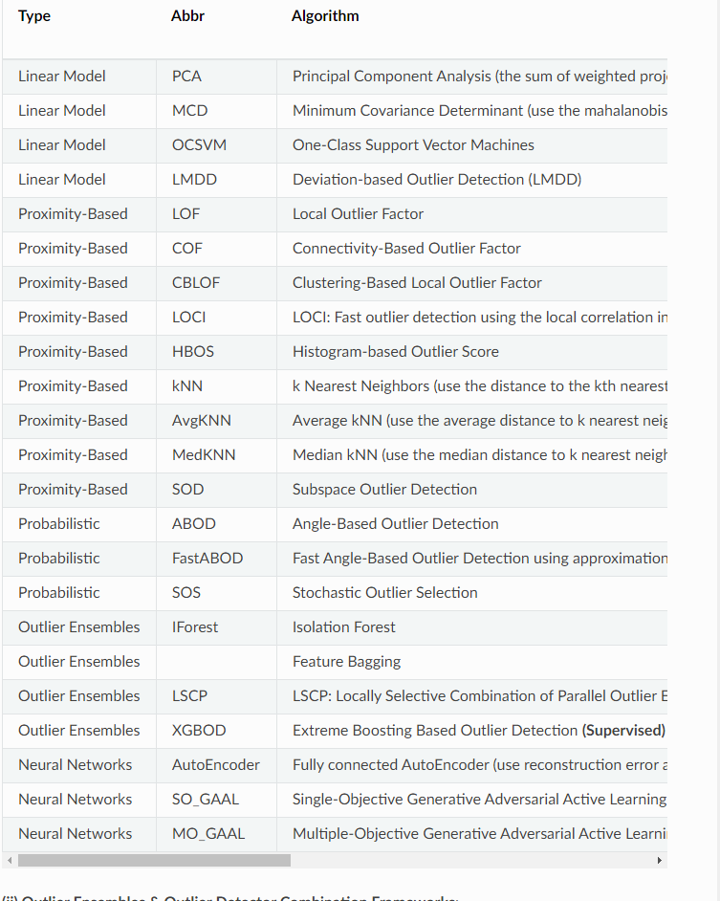
Algorithms to choose
Pyod
https://pyod.readthedocs.io/en/latest/

Slide 14
Sequence clustering
Sequence of
System calls/ file names/ process names
Uneven lengths
How to cluster them into normal and anomalous

Slide 15
Lessons learned
Process large text files
Parallelize things when I can
Read around 15 papers on unsupervised anomaly detection
Things I have:
Python code base to process dataset

