Slide 1
Website

Slide 2





3D printing
Design of static/dynamic systems
Pneumatic control
Testing and prototyping
Lean Manufacturing/six sigma
Sheet metal fabrication process
Engineering material knowledge in sheet metal industry
Leadership
CNC programming
ERP
CAD Modeling
Detailed design
Vendor management
Statistical Analysis (Excel/Matlab)
Characterization: SEM, Optical microscope
Data extraction and analysis
Mathematical Modeling
Experimentation
Wet processing
Academic writing and presentation
Teaching and mentoring experiences
CFD & LES Tools: PyroSim, CONTAM
https://www.ebay.ca/itm/361405800391

Slide 3
3D printing
Design of static/dynamic systems
Pneumatic control
Testing and prototyping
Lean Manufacturing/six sigma
Sheet metal fabrication process
Engineering material knowledge in sheet metal industry
Leadership
CNC programming
ERP
CAD Modeling
Detailed design
Vendor management
Statistical Analysis (Excel/Matlab)
Characterization: SEM, Optical microscope
Data extraction and analysis
Mathematical Modeling
Experimentation
Wet processing
Academic writing and presentation
Teaching and mentoring experiences
CFD & LES Tools: PyroSim, CONTAM
https://www.ebay.ca/itm/361405800391

Slide 4
CFD & LES Tools: PyroSim, CONTAM
Statistical Analysis (Excel/Matlab)
Characterization: SEM, Optical microscope
Data extraction and analysis
Mathematical Modeling
Experimentation
Wet processing
Academic writing and presentation
Teaching and mentoring experiences
Sheet metal fabrication process
Engineering material knowledge in sheet metal industry
Leadership
CNC programming
ERP
3D printing
Design of static/dynamic systems
Pneumatic control
Testing and prototyping
Lean Manufacturing/six sigma
CAD Modeling
Detailed design
Vendor management
https://www.ebay.ca/itm/361405800391

Slide 5

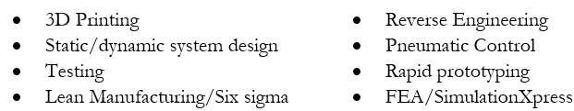
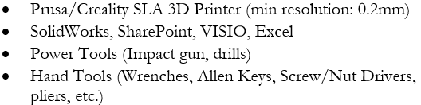
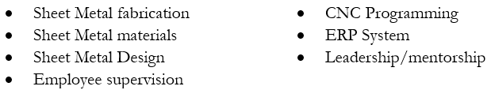
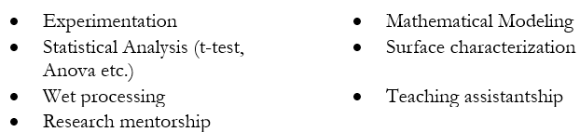
Industry
Time
Frame
Skills
Tools/Instruments
Manufacturing Engineer
2024-2025
Manufacturing Specialist
2023-2024
ML
Manufacturing Engineering Specialist| Team Lead
2021-2023
Entrepreurship
Product Development
Python
Academia
Graduate Research assistant
2018-2020
Self-Study
Undergrad researcher| Research Assistant
2016-2018

Slide 6

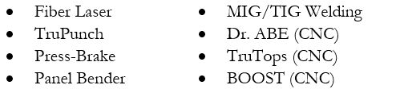
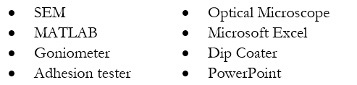
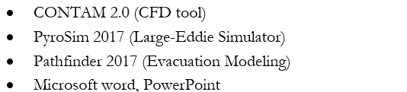
Industry
Time
Frame
Skills
Tools/Instruments
Manufacturing Engineer
2024-2025
Manufacturing Specialist
2023-2024
ML
Manufacturing Engineering Specialist| Team Lead
2021-2023
Entrepreurship
Product Development
Python
Academia
Graduate Research assistant
2018-2020
Self-Study
Undergrad researcher| Research Assistant
2016-2018

Slide 7




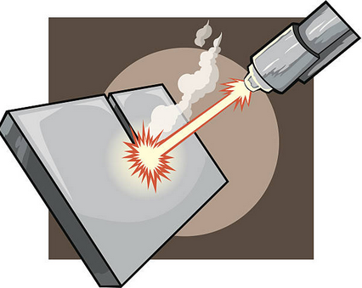



Industry
Time
Frame
Skills
Tools/Instruments
Manufacturing Engineer
2024-2025
Manufacturing Specialist
2023-2024
ML
Manufacturing Engineering Specialist| Team Lead
2021-2023
Entrepreurship
Product Development
Python
Academia
Graduate Research assistant
2018-2020
Self-Study
Undergrad researcher| Research Assistant
2016-2018

Slide 8


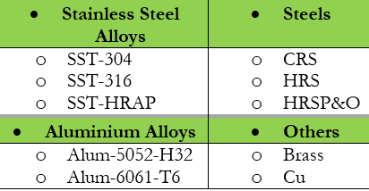
Material Knowledge
Material Knowledge
Process Knowledge
Product Knowledge
Power Equipment
Construction
Sheet Metal

Slide 9


