Slide 1
Presentation on
A program to take hex input from user and display it in decimal on the next line. Please continue this until user presses n/N to the question-Do you want to continue.

Slide 2
Group members:
Emamul Islam 192-15-13333
Julkar Nayeem 192-15-13295
Tareq Aziz Uday 192-15-13310
Sadrin Rahman Bhuiyan Piya 192-15-13269
Arifuzzaman 192-15-13338
Muntasir Emon 192-15-13141

Slide 3
Algorithm of the code
Step 1: Start
Step 2: Initialize DS
Step 3: Set a Label named “START_1”
Print “Enter a HEX digit:”
Step 4: Set a Label named “START_2”
Read a character
Save the character into BL
If (BL<A)
Jump to Label “SINGLE_DIGIT”
If (BL>F)
Jump to Label “ILLEGAL_CHARACTER”
Jump Label “GREATER_THAN_NINE”
Step 5: Set a Label named “SINGLE_DIGIT”
If (BL<0)
Jump to Label “ILLEGAL_CHARACTER”
If (BL>9)
Then also jump to Label “ILLEGAL_CHARCATER”
Jump to “LESS_THAN_TEN” Label

Slide 4
Algorithm of the code
Step 6: Set a Label named “ILLEGAL_CHARACTER”
Execute linefeed and carriage return
Print “Illegal Character.”
Jump to Label “START_2”
Step 7: Set a Label named “LESS_THAN_TEN”
If the input number is from 0 to 9
Then execute the linefeed and carriage return and print the same number as Decimal
Jump to “CONTINUE” Label
Step 8: Set a Label named “GREATER_THAN_NINE”
If the input number is greater than 9 :
Then execute linefeed and carriage return
Display the digit 1 as Decimal
Subtract 11H from BL to find 2nd digit
Display the 2nd digit as Decimal
Step 9: Set a Label named “CONTINUE”
Read a character
If the character is equal to n or N :
It will jump to “END” Label
jump “START_1” Label
Step 10: END

Slide 5
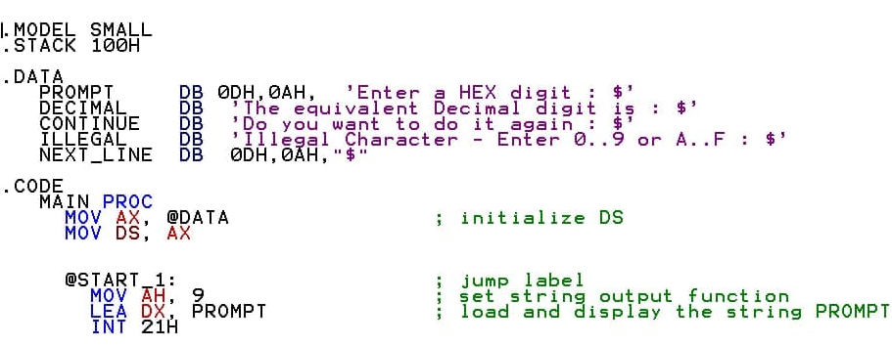
Code of the problem

Slide 6
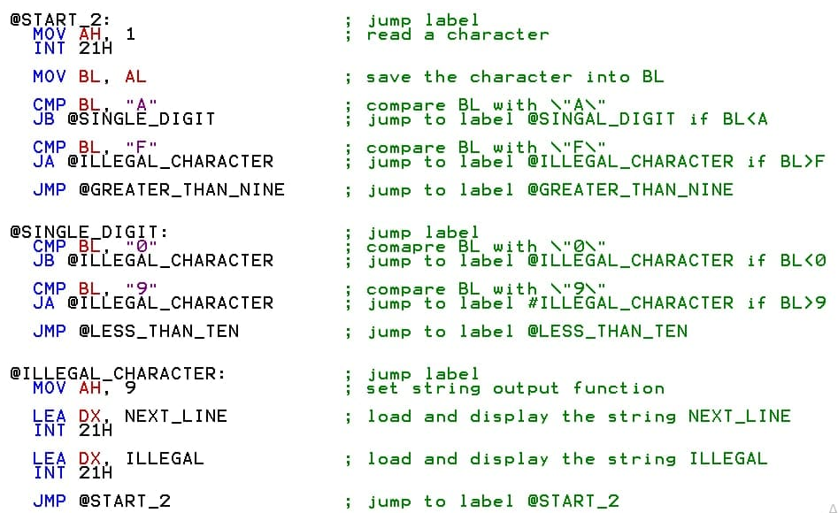
Code of the problem

Slide 7
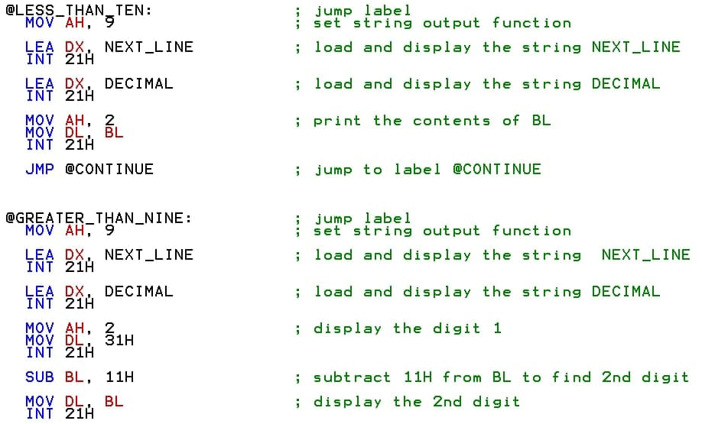
Code of the problem

Slide 8
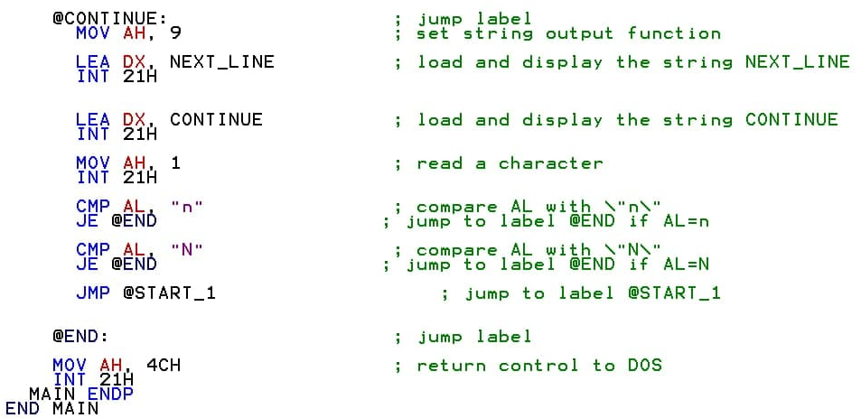
Code of the problem

Slide 9
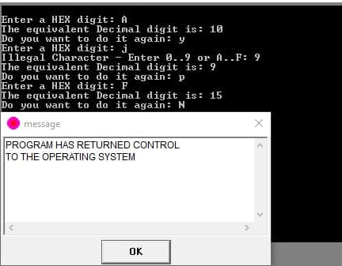
Output of the code:

Slide 10
Thank you

