Slide 1
UNSUPERVISED ML
AI-Powered
Customer
Intelligence
PLATFORM
Strategic
Decision
Making
Discovering Hidden Customer Segments
Through Machine Learning

Slide 2
01
Problem
Statement
📊
🎯
⚡
Data Without Direction
Invisible Top Customers
Silent Attrition
Businesses amass enormous customer datasets but lack the tools to extract actionable patterns from unlabeled records.
High-value segments go unrecognized, causing missed premium engagement opportunities and revenue leakage.
At-risk customers quietly disengage before businesses can intervene — a costly and entirely preventable outcome.

Slide 3
02
01
Behavioral Analysis
Examine purchasing patterns using recency, frequency, and monetary spend data.
02
Cluster Discovery
Project
Objectives
Deploy unsupervised algorithms to reveal natural groupings within customer data.
03
Model Benchmarking
Five goals driving this intelligence platform
Compare K-Means, DBSCAN, GMM, and Hierarchical methods for robustness.
04
Visual Interpretation
Use PCA and t-SNE to compress dimensions and generate interpretable cluster maps.
05
Actionable Strategy
Convert segment findings into targeted marketing and retention playbooks.

Slide 4
03
Dataset & RFM Features
Customer purchasing records are distilled into three dimensions that capture the complete picture of buyer behavior:
R
F
M
Recency
Frequency
Monetary
Days since last purchase
Total number of transactions
Cumulative spend value
Fresh buyers are primed for engagement — recency is the strongest predictor of campaign response rates.
Repeat purchasers signal loyalty and habit — they anchor your retention strategy.
Revenue contribution identifies VIP customers and guides budget allocation for maximum ROI.

Slide 5
04 — Clustering Algorithms
K-Means
CENTROID PARTITIONING
Hierarchical
AGGLOMERATIVE NESTING
Segments customers into K distinct groups by iteratively minimizing the distance between each point and its cluster center. Ideal for large datasets requiring speed and interpretability.
Builds a nested cluster tree without requiring a preset K, exposing the natural similarity hierarchy among customers at multiple granularity levels.
DBSCAN
DENSITY-BASED SPATIAL
GMM
PROBABILISTIC MIXTURE
Groups customers based on point density, automatically detecting outliers as noise. Excels at identifying irregular cluster shapes and fringe behavioral patterns.
Assigns soft membership probabilities using Gaussian distributions, capturing customers who straddle multiple segments — a nuanced, real-world approach.

Slide 6
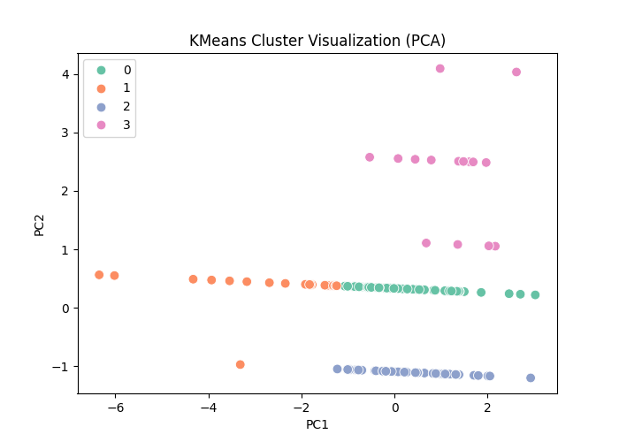
05 — Cluster Visualization
4 Segments Found
K-Means identified four clearly separated customer groups in 2D PCA space.
PC1 = Value Axis
Movement along PC1 correlates with overall customer spending and purchase frequency.
PC2 = Recency Axis
PC2 separates recently active customers from those who have become disengaged.
Tight Clusters
Minimal overlap between groups validates the algorithm's segmentation quality.

Slide 7
06
Customer Segments
High-Value
Frequent · High-Spend · Recently Active
~20% of base
→ VIP loyalty programs, early product access, personalized premium offers
Budget Shoppers
Moderate Frequency · Price-Sensitive · Consistent
~35% of base
→ Flash sales, value bundles, loyalty points, discount-led campaigns
Occasional Buyers
Infrequent · Event-Driven · Moderate Spend
~30% of base
→ Seasonal re-engagement, curated recommendations, reminder journeys
At-Risk Customers
Long Lapse · Declining Engagement · Low Recency
~15% of base
→ Automated win-back sequences, exclusive reactivation discounts

Slide 8
07
Precision Marketing
VIP Nurturing
Shift from mass-broadcast to segment-specific messaging that speaks directly to each group's motivations.
Concentrate relationship investment on the top 20% of customers generating the majority of revenue.
Business
Impact
4×
Campaign lift
Proactive Retention
Revenue Optimization
↓35%
Identify at-risk customers before they churn and trigger automated win-back journeys at optimal moments.
Align pricing, recommendations, and promotions to each segment's demonstrated spending behavior.
Churn rate
+28%
Revenue/segment

Slide 9
08
Thank You
AI-Powered Customer Intelligence Platform
Segmentation transforms raw data into genuine customer understanding — enabling smarter decisions, stronger relationships, and sustainable growth.
Strategic Intelligence · Data-Driven Growth · Customer-First Thinking

