Slide 1
Contents
8 | Dataset Metrics
9 | Network Architecture
10 | Network Metrics
11 | Network Architecture
12 | Training Metrics
13 | Graphs
14 | Gantt Chart
15 | References
1 | Problem Statement
2 | Project Objectives
3 | Motivation
4 | Literature Review
5 | Proposed Methodology
6 | Score Generator
7 | Recurrent Neural Networks

Slide 2
Problem statement
This application presents a recurrent adaptation of the neural network for labeled data comprised of pairs of variable-length sequences. This model is applied to assess semantic similarity between sentences, where we exceed state of the art, outperforming carefully handcrafted features and proposed neural network systems of greater complexity. This model provides word embedding vectors supplemented with synonymic information to the network artifacts. This is a framework-oriented application for maintaining the plagiarism of any artifacts or documents.

Slide 3
Project Objectives
To determine a score for each sentence using a Semantic Similarity framework
To compute a reduced form of documents for quick retrieval and comparison

Slide 4
motivation
As somebody who has been interested in deep learning since my early teens, I knew I wanted to do a project in deep learning. After going through all the problem statements relating to the topic, I finally settled on this project because it allows me to learn about Recurrent Neural Networks as well as allow me to prepare a project that pertains to a very serious real-life issue. While there are several methods that exist already for detecting plagiarism in documents, I feel I can bring something new to the table and put forth a solution that is novel, but also builds upon the successful results of others.

Slide 5
Literature Review
SR. NO. | PAPER | PROS | CONS
1. | A Multi-Level Plagiarism Detection System Based on Deep Learning Algorithms | Determines The Overall Degree Of Plagiarism Using SoftMax Classifier | Unable To Provide Exact Location And Amount Of Plagiarism
2. | Semantic Similarity Between Sentences | Determines Similarity Between Pairs Of Sentences Using Several Methods | Only Provides A Partial Picture Regarding Plagiarism Due To Complexity of Natural Language
3. | Semantic Plagiarism Detection System For English Texts | Detects Paraphrasing Between Documents using BiLSTM RNN | Uses Linear Thresholding To Recognize Plagiarism Which May Fail To Recognize Split Sentences, Reshuffled Content, etc.

Slide 6
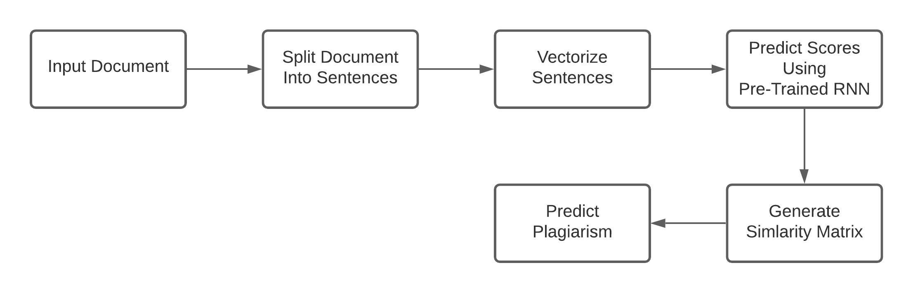
Proposed methodology

Slide 7
Score generator
The project requires generation of scores for each sentence in both source documents as well as suspected documents. The score for a sentence is generated through an RNN using LSTM cells and dense layers. The network is trained on the STSBenchmark dataset which contains pairs of sentences and their similarities. The network inputs a sentence in word vector form and produces an output vector. As the network itself doesn’t produce similarity scores, we can use the generated vector for score calculations without any issues.

Slide 8
Recurrent Neural network
There are many types of neural networks that we use in deep learning, one of them being Recurrent Neural Networks (RNN), These kinds of networks are specialized in order to learn over iterations of time rather than space. Therefore, RNNs are uniquely equipped to learn patterns in sequence data such as audio and natural language. In this project I shall be using an RNN that is composed of Long Short-Term Memory (LSTM) cells as well as fully connected linear regression cells.

Slide 9
Dataset metrics
Type Of Example | Number Of Examples | Percentage Of Total
Train | 8,935 | 90%
Dev | 496 | 5%
Test | 496 | 5%
Total | 9,927 | 100%
SOURCE: STSBenchmark

Slide 10
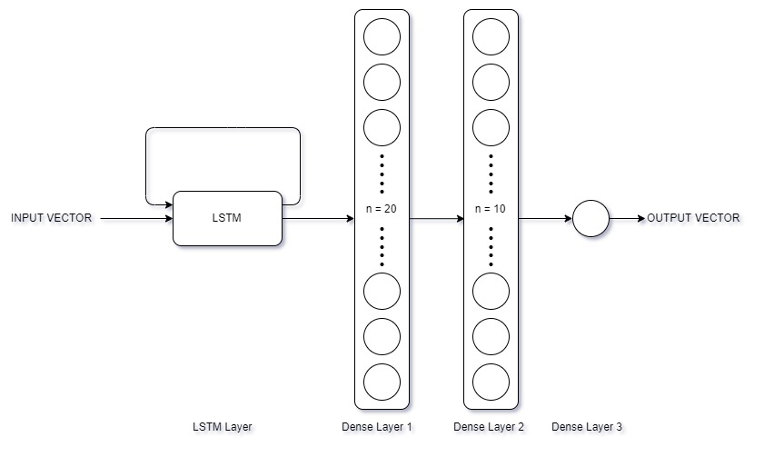
Network architecture

Slide 11

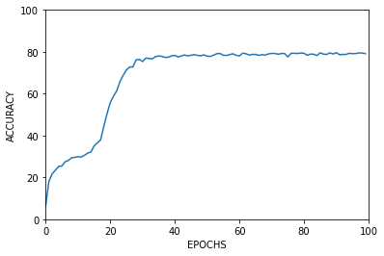
Network Metrics
Data Type | Accuracy
Training | 80.15%
Dev | 79.69%
Test | 79.49%
STSBenchmark offers metrics for models developed by other people based on this dataset as well

Slide 12
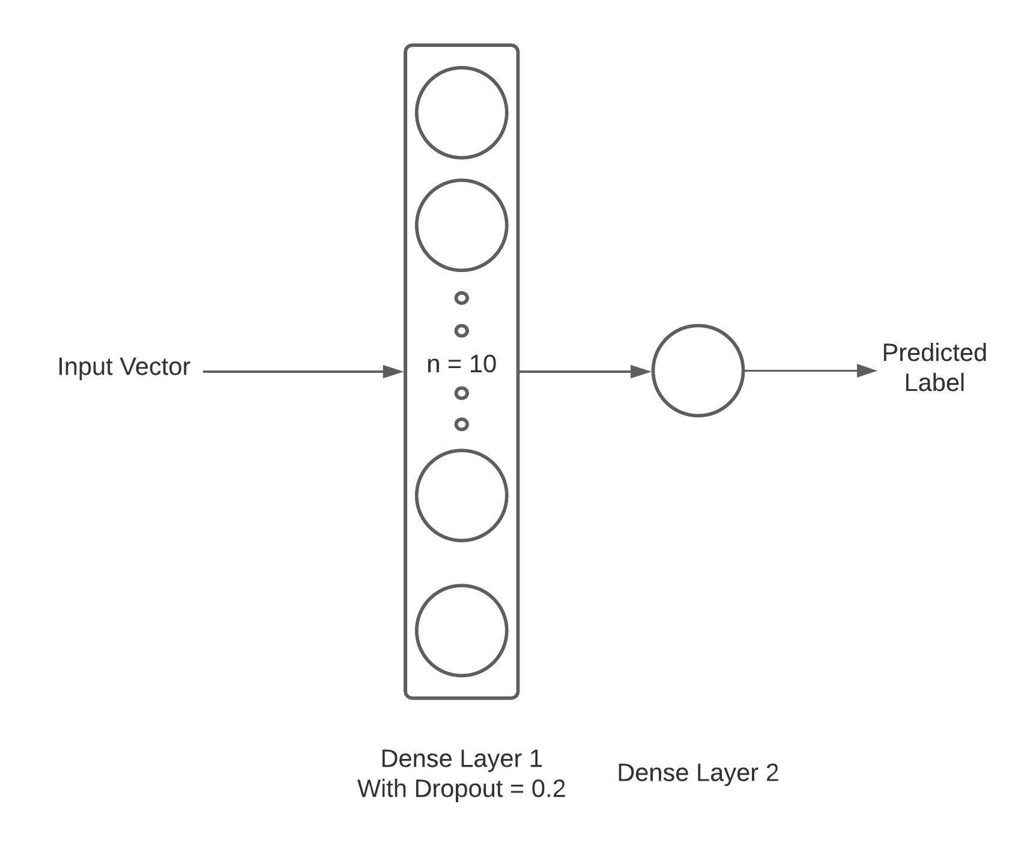
Network architecture

Slide 13
TrainINg Metrics
Data Type | Accuracy
Training | 91.39%
Test | 68.21%
Data Type | Accuracy
Training | 80.15%
Test | 79.49%
Without Dropout
With Dropout = 0.2

Slide 14
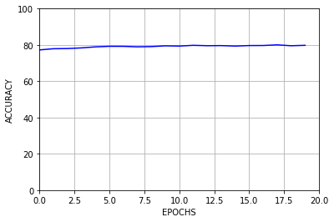
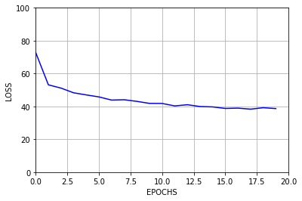
Graphs

Slide 15
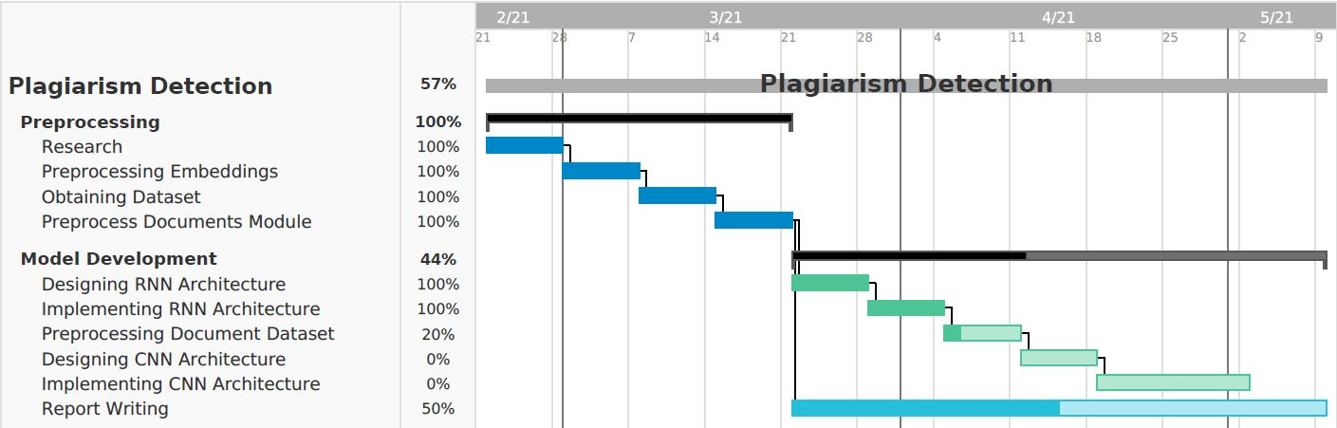
Gantt Chart

Slide 16
References
Stanford (GloVe Embeddings)
STSBenchmark (Dataset for sentence similarity)
PAN Corpus (Dataset for plagiarism detection)
A Multi-Level Plagiarism Detection System Based on Deep Learning Algorithms
Semantic Similarity Between Sentences
Semantic Plagiarism Detection System For English Texts

