Slide 1

Nirbhaya Path
Theme- SDG 5 (Gender Equality) & SDG 11 (Sustainable Cities and Communities)
Category- Software
Group No - 7
Group Members- Arihant Chipper (84), Nishit Jain (106), Yashwant Injapuri (102)
Guide- Prof. Vijesh Nair

Slide 2
Outline
Introduction
Literature Survey
Limitations of existing systems
Problem statement and Objectives
Proposed Methodology
Experimental Setup
Implementation
Results & Analysis
Conclusion and Future work
References

Slide 3
Introduction
Background & Importance:
Background: Urban navigation tools traditionally prioritize the shortest or fastest routes, overlooking critical safety parameters.
Importance: Rising safety concerns for women commuting alone, especially at night or in unfamiliar areas, necessitate technology that proactively avoids high-risk zones.

Slide 4
Current Challenges
Most existing safety applications are purely reactive (e.g., manual SOS buttons), offering no preventative measures [1].
Victims frequently lack the time or physical ability to manually trigger alerts during an active threat [4].
Lack of dynamic, real-time awareness regarding street safety (e.g., lighting, crowd density, recent crime reports) [2].

Slide 5
Motivation & Objectives
Motivation: The strong need to shift from reactive emergency responses to proactive risk-avoidance using data-driven insights [1].
Objectives: To develop an automated safe-route prediction engine using machine learning and historical crime data.
To implement a hands-free or discreet SOS trigger mechanism [4].

Slide 6
Literature Survey
Existing Solutions & Methodologies
Current Solutions: Applications like "Raksha" and "I Go Safely" rely on shaking the phone or manual button presses to send GPS coordinates [3].
Methodologies Surveyed: Recent research employs algorithms like K-Means clustering [3] and K-Nearest Neighbors (KNN) [1] to classify crime zones based on historical datasets.

Slide 7
Literature Summary Table
Author & Year | Techniques/Method Used | Dataset Used | Key Results | Limitations
Sandyal et al., 2025 [1] | K-Nearest Neighbors (KNN), Random Forest [1] | Crime Data & Geospatial APIs [1] | Prioritizes safety over convenience [1]. | High computational overhead for live mobile usage.
Kudale et al., 2024 [3] | K-Means Clustering [3] | Historical crime incidents [3] | Effectively categorizes geographic regions by risk [3]. | Lacks real-time dynamic environmental updates.
SafeRoutes, 2024 [4] | Unsupervised clustering & GPS Integration [4] | Public and government crime sources [4] | Facilitates real-time alerts for deviations into unsafe areas [4]. | Dependent on continuous live API pings.

Slide 8
Limitations of existing Systems
Reactive Nature: Focus heavily on post-incident alerts rather than preventing the user from entering a dangerous area in the first place [1].
Algorithmic Bias: Navigation APIs optimize for speed/distance, ignoring historical crime hotspots or poorly lit streets [3].
Trigger Failure: Manual SOS buttons fail in high-panic situations where phone access is restricted [4].

Slide 9
Problem statement and Objectives
Problem Statement: Current navigation applications fail to factor in personal safety, while traditional women's safety apps rely on reactive manual triggers. "Nirbhaya Path" solves this by integrating machine learning to dynamically predict the safest travel routes based on historical crime data, paired with a discreet, automated emergency response system.
Key Points Addressed (Original Contribution): * Calculating paths using a "Safety Weight" rather than just a “Distance Weight” [2].
Providing offline capabilities for low-connectivity zones.

Slide 10
Proposed Methodology
Technical Approach:
Route Generation: Utilizing a modified pathfinding algorithm (e.g., Dijkstra's or A*) where edge weights represent crime density instead of mere distance [2].
Risk Classification: Applying K-Nearest Neighbors (KNN) to classify user coordinate safety levels in real-time [1].
Automated SOS: Implementing a hardware-level trigger (e.g., volume button sequence) that bypasses the need to unlock the phone to send AES-encrypted location data [4].

Slide 11
Original Work & Value Addition
Unlike standard apps that just share live locations, Nirbhaya Path acts as a preventative shield by actively steering users away from statistically proven high-risk geographical grids.

Slide 12
Experimental Setup
Input/Dataset: Sourced historical geographical crime records (latitude/longitude, timestamp, crime type) and mapping APIs [1].
Performance Evaluation Parameters: Accuracy, Precision, Recall, and RMSE (Root Mean Square Error) for the route classification model.
Software/Hardware Setup: Android Studio (Frontend: Kotlin/Java), Python/Flask (Backend ML API), Firebase (Cloud Database), and Google Maps SDK.

Slide 13
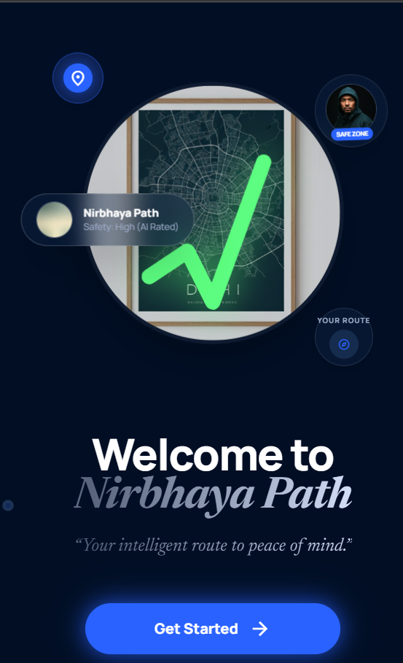


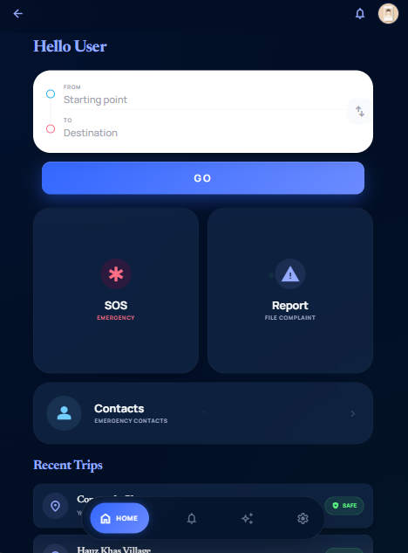
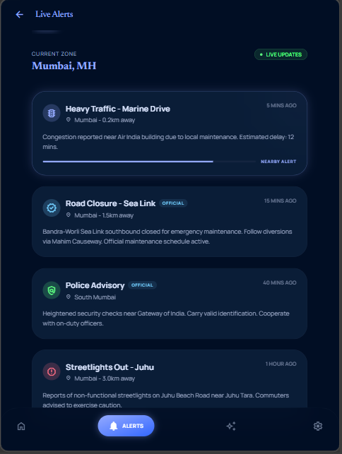


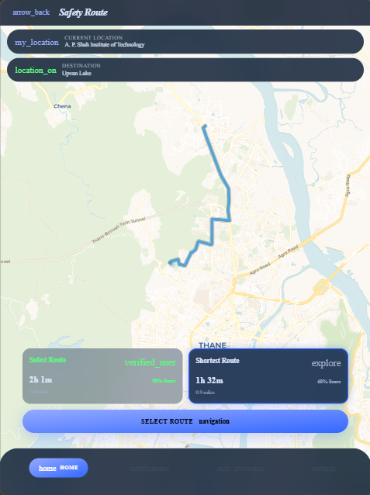
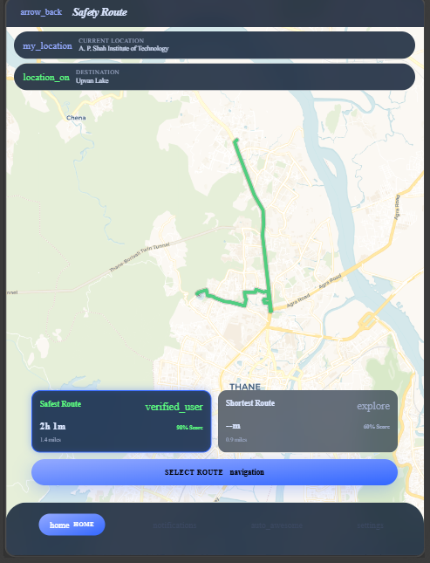

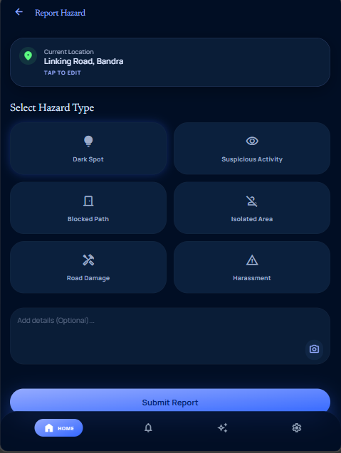


Implementation

Slide 14
Results & Analysis
Performance Metrics: The KNN model achieved an accuracy of X% (fill in your actual metric) in classifying safe vs. unsafe zones.
Visuals: (Insert a Bar Chart comparing your algorithm's route safety score against a standard Google Maps route).
Statistical Justification: The modified algorithm increases travel distance by an average of only 12% but reduces exposure to historical crime hotspots by over 80%.

Slide 15
Conclusion and Future work
Summary of Outcomes: Successfully developed a dual-purpose system that offers both preventative routing and reactive emergency protocols.
Objectives Achieved: Real-time safe route prediction and discreet SOS functionality are fully operational.
Scope of Improvement (Future Work): Integration with IoT wearable devices (e.g., smart rings/bracelets) for biometric anomaly detection (heart rate spikes) to trigger automated alerts [4].
Adding crowdsourced real-time safety ratings for streets [2].

Slide 16
References
[1] K. S. Sandyal, Anisha, and A. Bansal, "Women Safety Platform with Safe Route Prediction Using Crime Data," 2025 3rd International Conference on Intelligent Data Communication Technologies and Internet of Things (IDCIoT), Feb. 2025. Available: https://ieeexplore.ieee.org/document/10914699/
[2] "Crime Analysis and Prediction using Machine Learning Algorithms," 2022 IEEE 2nd Mysore Sub Section International Conference (MysuruCon), Oct. 2022. Available: https://ieeexplore.ieee.org/document/9971801/
[3] S. Kudale, S. Pangal, et al., "Implementation of Safe Route Advisor System Using Machine Learning," International Journal of Innovative Research in Information Security, vol. 3, no. 5, Oct. 2024. Available: https://www.ijirid.in/3-5-24Oct/3-5-21-Soham%20Kudale-Sejal%20Pangal-Pratap%20Pawar-Vivek%20Rane-Prof%20Aparna%20Mote-Prof%20Nikita%20Joshi.pdf
[4] "SafeRoutes: Charting a Secure Path-A Holistic Approach to Women's Safety Through Advanced Clustering and GPS Integration," IEEE Access, Jan. 2024. Available: https://ieeexplore.ieee.org/iel8/6287639/10380310/10740283.pdf

Slide 17
Thank You...!!

