Slide 1

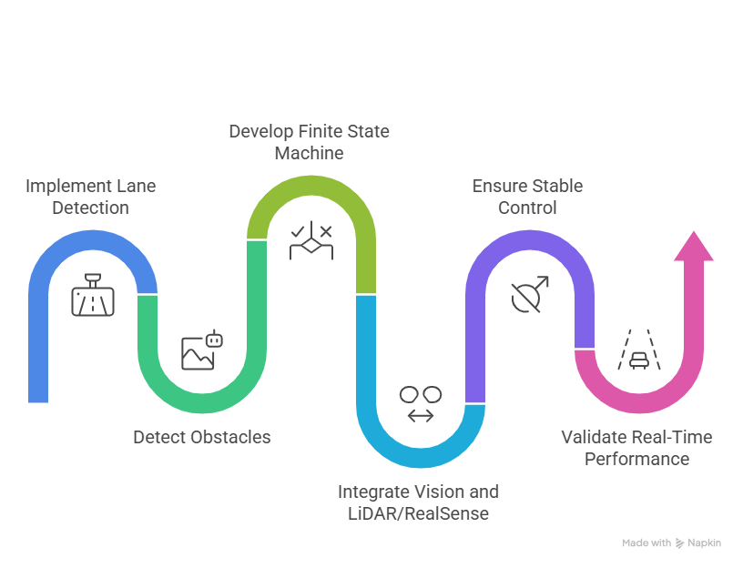
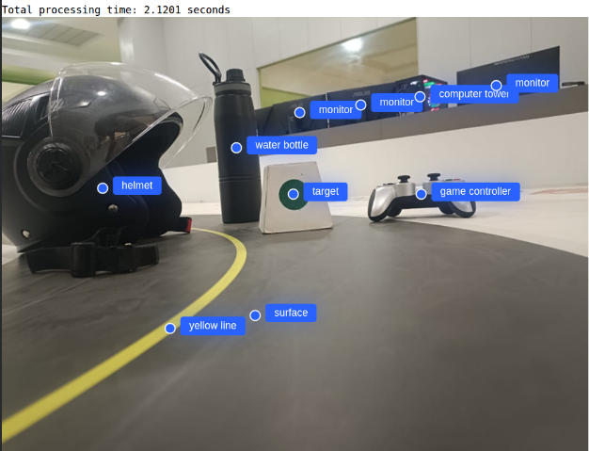
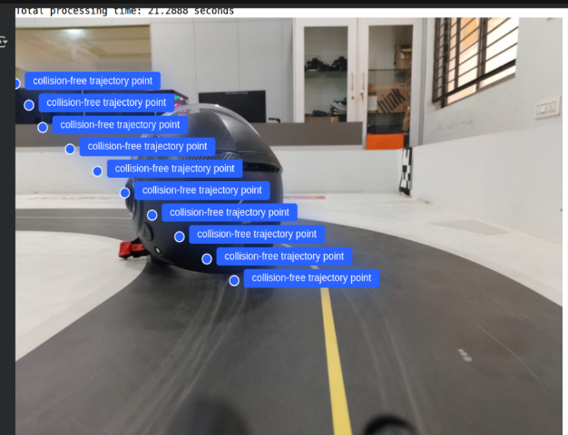
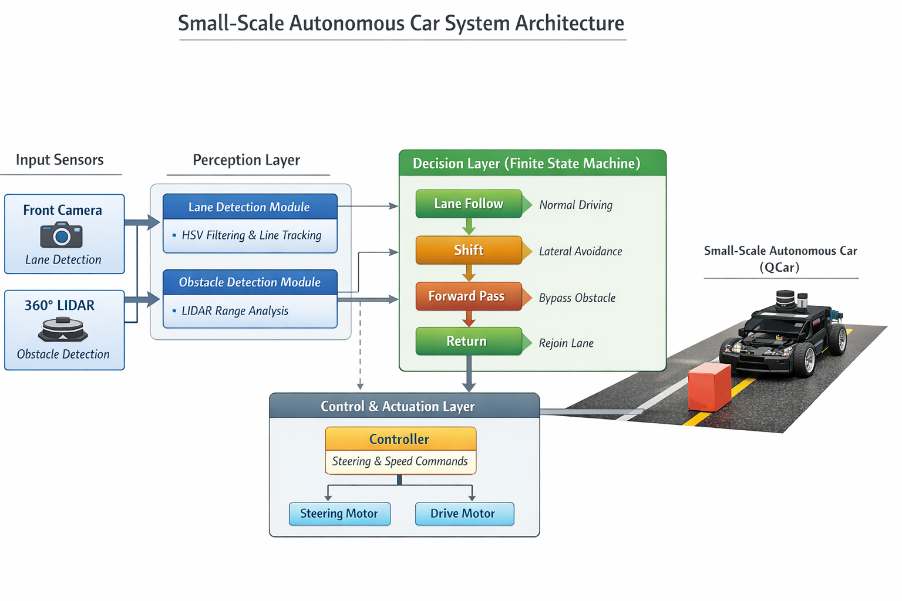
Lane Detection and Obstacle Avoidance using Q-Car
TEAM : Arihant, Shivani, Radhika
School of Electronics and Communication Engineering
Email ID : 01fe22bei048@kletech.ac.in ,01fe22bec293@kletech.ac.in ,01fe22bec296@kletech.ac.in
Institutional Research Project-2025-26
Problem statement
Proposed Methodology
Results and inferences
To develop a low-latency lane detection and obstacle avoidance framework for safe autonomous driving using the Quanser Q-Car.
Objectives
To develop a real-time vision-based lane detection system for the Q-Car.
To integrate LIDAR-based obstacle detection for accurate environment sensing.
To implement a Finite State Machine for systematic obstacle avoidance.
To ensure smooth and stable lane following during navigation.
To enable safe left and right obstacle bypassing.
To deploy and test the system on the Quanser Q-Car platform.
To evaluate system performance under different obstacle scenarios.
To improve overall safety and reliability of autonomous navigation.
The results show that combining vision-based lane detection, LIDAR-based obstacle sensing, and FSM-based control enables reliable autonomous navigation on the Q-Car. The vehicle maintained lane following while safely avoiding obstacles, demonstrating the effectiveness of the proposed system. This approach is suitable for educational and experimental autonomous driving applications.
Design and Optimization details
Literature survey
Author/Year | Focus | Method | Result
Katona et al.(2024) | Obstacle Avoidance | Path Planning | Safe Navigation
Suder et al.(2021) | Lane Detection | HSV Vision | Accurate Lanes
Quanser (2023) | Q-Car Platform | Camera-LIDAR | Real Time Control
Feature | Details
Lane Detection | Camera-based lane tracking.
Obstacle detection | LIDAR-based obstacle sensing.
Direction Analysis | Identifies left or right obstacles.
Control Logic | FSM-based navigation.
System Platform | Implemented on QCar.
Contributions
Designed and implemented a real-time vision-based lane detection module for accurate lane tracking.
Integrated 360° LIDAR sensing to detect obstacles and determine their position relative to the vehicle.
Developed an FSM-based control strategy to perform systematic and safe obstacle avoidance.
Achieved stable lane following with automatic left and right obstacle bypassing.
Conclusions
The project successfully implemented a vision and LIDAR based navigation system on the Quanser Q-Car. The vehicle was able to follow lanes and avoid obstacles using FSM-based control. The results show that the system provides stable and reliable autonomous driving in an indoor environment.
Semester: VII Under the guidance of: Dr. Basawaraj

