Slide 1
JS
The JavaScript Event Loop
Call Stack · Web APIs · Callback Queue · Job Queue

Slide 2
THE PROBLEM
Why We Need an Event Loop
JavaScript is single-threaded and synchronous — it executes one task at a time, in order.
Without an Event Loop...
If JS waited (blocked) for every fetch() or setTimeout() to finish before moving on, the entire UI would freeze until each async task completed.
You're chopping vegetables (main script running)
The microwave dings — pasta is done (async task completes)
You don't stop chopping — you finish, then handle the pasta
The Event Loop lets async work happen in the background, then rejoins the main thread only when it's ready — keeping JS non-blocking.
An assistant (the Event Loop) hands off the pasta at the right time

Slide 3
PREREQUISITE RECAP
The Call Stack: LIFO Execution
Every function call is pushed onto the call stack; when it finishes, it's popped off. Last In, First Out.
1
f3() is called → pushed to stack
2
Inside f3, it calls f2() → f2 pushed (f3 still waiting)
Call Stack
f3()
Inside f2, it calls f1() → f1 pushed (f2, f3 still waiting)
3
f2()
f1 finishes → popped. Then f2 finishes → popped. Then f3 → popped.
4
f1()
↑ pushed first, popped last

Slide 4
WHERE ASYNC COMES FROM
Async Triggers in JavaScript
Timers
Network
Events
setTimeout, setInterval — run code after a delay
fetch() and other API calls — wait for a response
Click handlers & other DOM events — run on user action
These functions are handled by Web APIs (browser), not the JS engine's call stack — so they never block execution.

Slide 5
THE BIG PICTURE
Five Pieces of the Puzzle
1
Call Stack
Executes functions, one at a time, LIFO
2
Web APIs
Browser-provided: setTimeout, fetch, DOM events
3
Callback Queue
Holds finished async callbacks (FIFO), e.g. setTimeout
4
Job / Microtask Queue
Holds Promise handler callbacks
5
Event Loop
Checks if the stack is empty, then pulls the next task

Slide 6


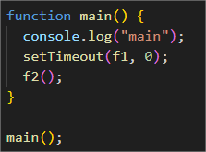
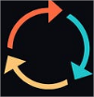
THE BIG PICTURE IN DETAILS
main
OUTPUT
hello f2
Call back function
hello f1
Web API => f1
main()
f1()
Call Stack
Browser APIs
Event Loop
setTimeout, Fetch API calls, Event callback
Call back function => that pass as argument or the parameter to another function
f1
Callback Queue/ Task Queue
Temporary storage for keeping the callback

Slide 7
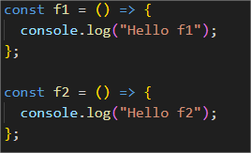
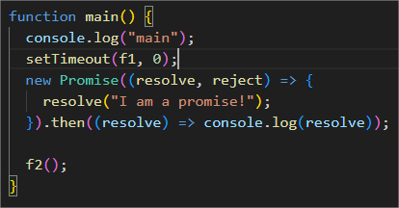
Call Stack
Event Loop
Browser APIs
Callback Queue/ Task Queue
First Priority
main
Hello f2
Job Queue / Micro Tasks (Promise)
I am a promise
Hello f1

Slide 8
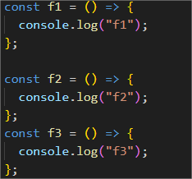
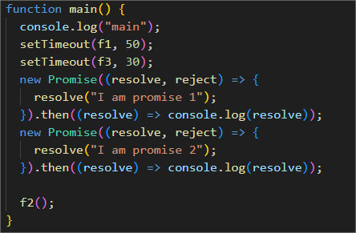
Main
F2
I am promise 1
I am promise 2
F3
F1

Slide 9
ADDING PROMISES
The Job Queue (Microtask Queue)
Promise handler functions don't go to the Callback Queue — they get their own line: the Job Queue (a.k.a. Microtask Queue).
Same non-blocking rule
A promise executor doesn't halt the call stack — synchronous code keeps running first
Separate queue
Promise handlers wait in the Job Queue, not the Callback Queue
Higher priority
The Event Loop always checks the Job Queue before the Callback Queue

Slide 10
MEMORIZE THESE
The Event Loop Rules
1
Call stack code always runs first, in strict LIFO order.
2
Web API tasks (timers, fetch, events) never enter the call stack directly — their callbacks queue up instead.
3
setTimeout / event callbacks → Callback Queue (FIFO). Promise handlers → Job Queue (FIFO).
4
The Event Loop acts only when the call stack is empty.
5
If both queues have items: the Job Queue always goes first.
6
If the Job Queue has multiple items, ALL of them run before the Event Loop touches the Callback Queue again.

Slide 11
WORKED EXAMPLE 2
Timers + Promises Together
function f1() { console.log("f1"); }
function f2() { console.log("f2"); }
function main() {
console.log("main");
setTimeout(f1, 0);
Promise.resolve("I am a promise")
.then(msg => console.log(msg));
f2();
}
main();
1
main() logs "main" (sync)
2
setTimeout(f1, 0) → f1 → Callback Queue
3
Promise resolves → .then handler → Job Queue
4
f2() runs (still sync) → logs "f2"
5
Stack empty → Job Queue wins → logs "I am a promise"
6
Job Queue empty → Callback Queue → logs "f1"
Output: main → f2 → "I am a promise" → f1

Slide 12
THE TRICKIEST RULE
Multiple Items in Both Queues
When the Callback Queue AND the Job Queue both have several items waiting, the Event Loop drains the entire Job Queue before touching the Callback Queue again — even across multiple turns.
Job Queue (drained fully first)
Callback Queue (handled after)
1. "...f3 really"
1. f3() — resolves first (timer order)
2. "...after promise"
2. f1() — resolves second
Full trace order: main → f2 → both promise messages → f3 → f1 (setTimeout order can differ from write order once delays are involved)

Slide 13
CHEAT SHEET
Event Loop — One-Page Summary
Call Stack
Synchronous code. LIFO. Runs first, always.
Web APIs
Browser handles timers, fetch, DOM events off-thread.
Callback Queue
FIFO. Holds setTimeout / event callbacks.
Job Queue
FIFO. Holds Promise .then handlers. Higher priority.
Event Loop
Waits for empty stack, drains Job Queue fully, then pulls one Callback Queue item.

Slide 14
Practice & What's Next
Practice: trace event-loop output for tricky code snippets (write the explanation, not just the answer)
Coming next: a mini project combining everything from async JavaScript
After that: the Object-Oriented Programming module begins

