Slide 1
social media project

Slide 2
app topic
this app is designed for individuals who love to express themselves through words, photos, and videos. With our app, users can easily create an account, sign in, and start publishing posts on a variety of topics that interest them.

Slide 3
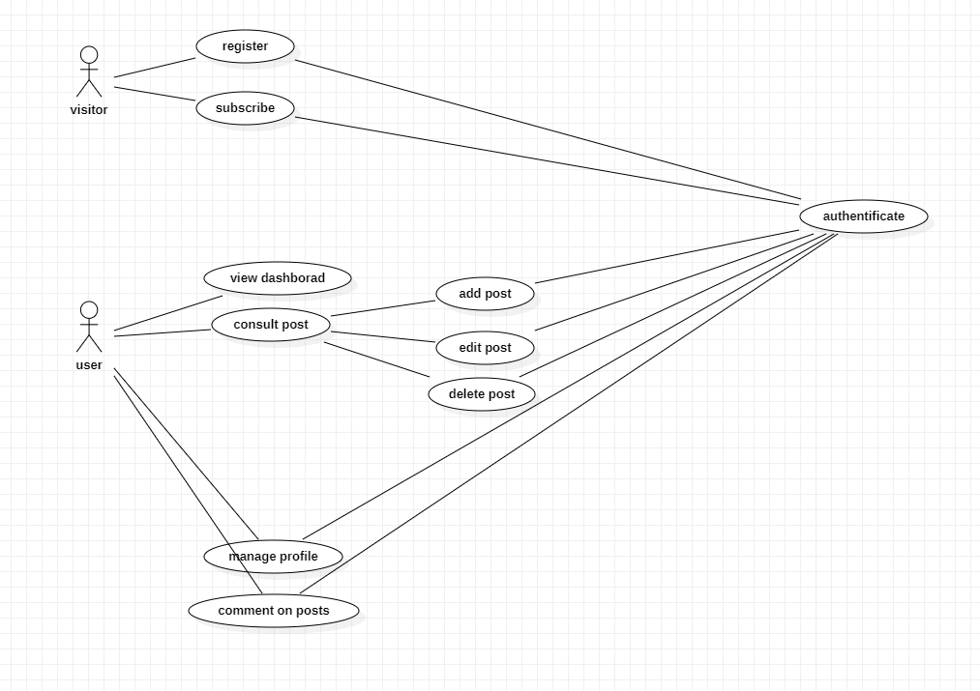
Conception diagram

Slide 4
description
With our app, users can create and customize their profile to reflect their personality and interests. They can also follow other users, like, and comment on their posts, and engage in meaningful conversations. Our app also offers advanced privacy settings, allowing users to control who sees their posts and who can interact with them.

Slide 5
features
the app features a user-friendly interface that makes it easy to navigate and interact with other users. Whether you want to share your thoughts on the latest news, showcase your creative skills, or connect with like-minded individuals, our app provides the perfect platform to do so.

