Slide 1


Liver Tumor Segmentation
By: Arijeet Sinha (E16CSE121)
Notes:
Add Caption : Expect More

Slide 2
Liver Tumor Segmentation
Liver tumor segmentation has huge potential in the medical imaging domain with lot of commercial value.
This is a very helpful project in today's world where technology is our new friend and health problems are increasing.
The goal of this project is to identify the segments between liver and tumor

Slide 3
Liver Tumor Segmentation
I used a Re-sUNet model on the 3D-IRCADb01 dataset which contains CT slices for patients along with masks for liver, tumors and other body organs.
We have added few scan images as of now Trial results show that different scan images can be classified with a good accuracy.
We try to add more scan images but as of now due to lack of training data we have trained on basic activities.

Slide 4
Problem Statement
Healthcare Segment is the important sector compared to other
business segments. Progressively, large number of individuals
needs abnormal state of consideration and administrations.
Liver sickness is a worry for huge chunk of human population.
There is an immense number of tumor patients expanding day by day.
Processing and many other applications is Convolutional Neural
Networks (CNNs). Ourtarget is to build a CNN model to segment the
Liver and detect the Region Of Interest (ROI) from neighbouring organs
using a CNN then use the ROI and detect liver tumors using another
CNN.

Slide 5
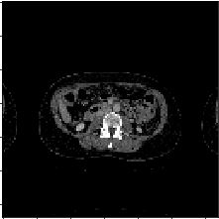
Working
I used 3D-IRCADb01 data and for every slice, I need to preprocess every slice in order to distinguish liver from neighbouring organs.
This figure is One of the random samples that I achieved after augmentation.

Slide 6
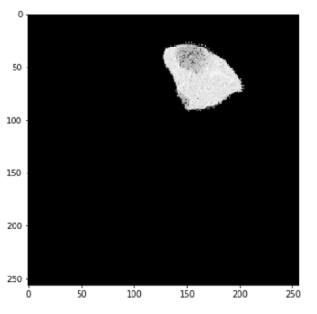
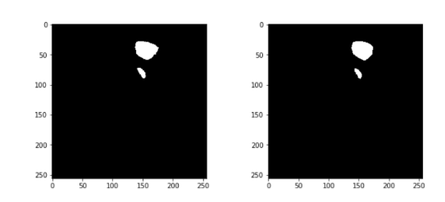
Result
CT slice of the first random sample with the liver mask applied upon it before tumor segmentation
Result of tumor segmentation for the first random slice.True label on the left and predicted on the right, white is pixels with tumor and black is pixels with no tumor

Slide 7
Thank You

