Slide 1
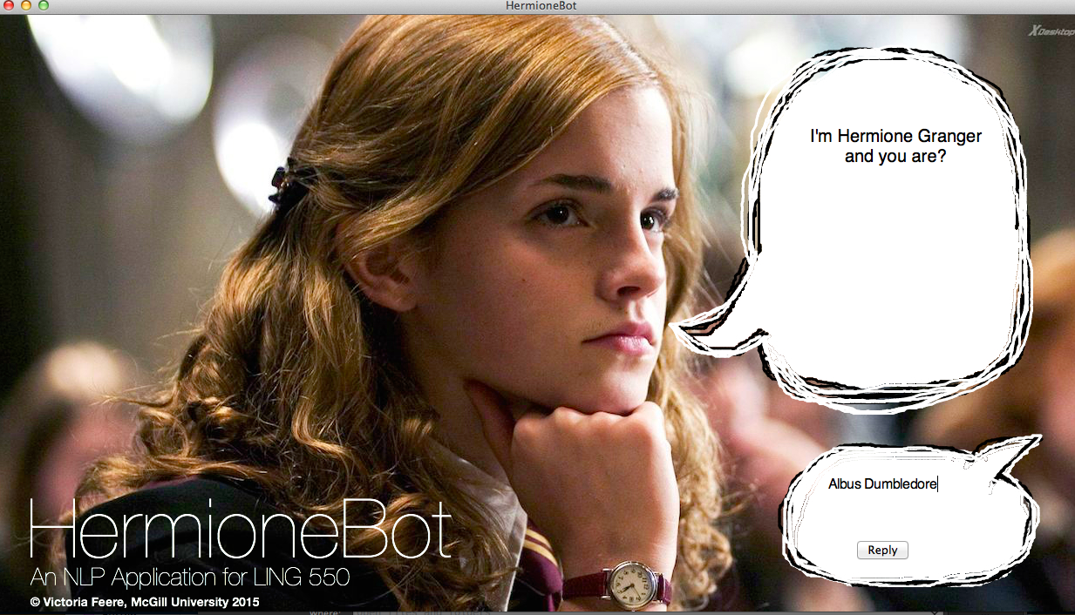
HermioneBot
A Harry Potter trivia chatbot using nltk

Slide 2
Wikia API
An API used to grab the content of articles on the Harry Potter wiki as json
url: http://www.harrypotter.wikia.com/api/v1
Used various encoded URI fragments to search and retrieve article content

Slide 3
Understanding Queries
Tokenized input using nltk’s Punkt Tokenizer Models and word_tokenize(userInput)
Example:
‘What is Quidditch?’ -> [‘What’, ‘is’, ‘Quidditch’]

Slide 4
Understanding Queries
Performed POS-tagging on the query using Treebank POS Tagger and pos_tag(tokenizedInput)
Example: [‘What’, ‘is’, ‘Quidditch’] ->
[(‘What’, ‘WP’), (‘is’, ‘VBZ’,), (‘Quidditch, ‘NNP’)]

Slide 5
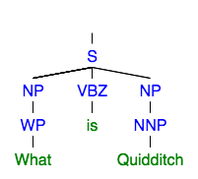
Understanding Queries
Analyzed sentence structure using a regex parser generated using a specified grammar for NP-chunking
grammar = nltk.data.load(‘file:hp.cfg’)
parser = RegExpParser(grammar)
Parsed query:
parser.parse(taggedInput)

Slide 6
Understanding Queries
Strategy: Choose a subset of questions to handle based on sentence structure:
<WH-NP> <Aux> <NP>
Who was Albus Dumbledore? / Where is Hogwarts school located?
<WH-NP> <Aux> <NP> and <NP> <Aux> <WH-NP>
Who is the love of Hermione’s life? / The spell Wingardium Leviosa does what?
<WH> <Aux> <NP> <VP>
When did Bellatrix Lastrange escape from Azkaban?

Slide 7
HermioneBot Algorithm
Using Tkinter, the built-in python GUI package, generate text bubbles and prompt the user for their name.
Store the user’s name and allow user to ask questions.
On receiving input determine the user’s intent based on syntactical structure of input:
Intents = {QUERY, STATEMENT, UNKNOWN}
If QUER Y or STATEMENT – determine S, V, O, search wiki comparing against word sequence similarity
If UNKNOWN – return sassy quip, Hermione style

Slide 8
Spell Checking
If no matching article found on wikia perform spell check
Calculate edit-distance against pre-defined vocabulary
Vocab consists of spells, characters, etc. (domain-specific)
Uses split, insert, replace, transpose & delete
if min edit-distance < x, return suggestion

Slide 9
Demo!

