Slide 1
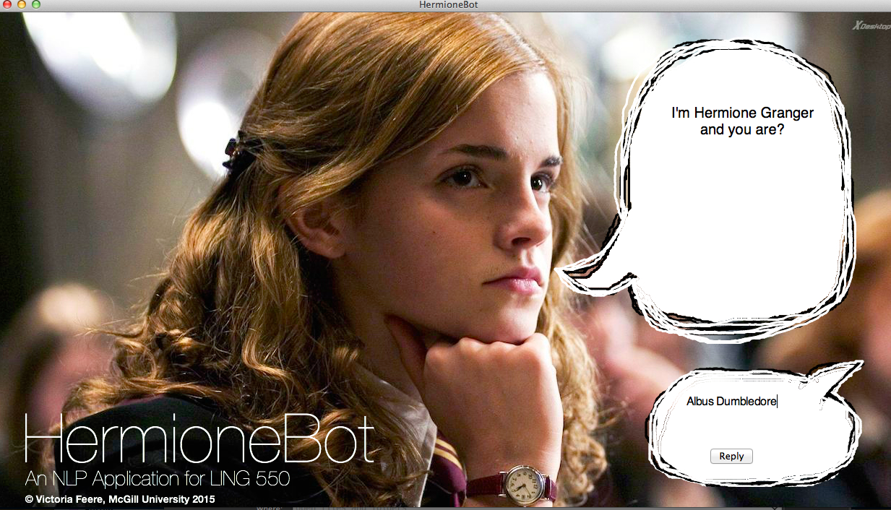
HermioneBot
A Harry Potter trivia chatbot using nltk

Slide 2
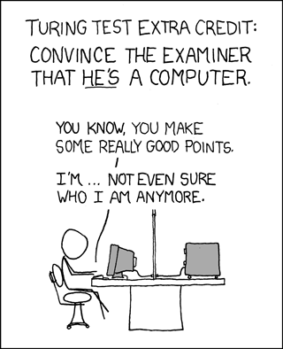
Motivation & Brief History

Slide 3
Wikia API
An API used to grab the content of articles on the Harry Potter wiki as json
url: http://www.harrypotter.wikia.com/api/v1
Used various encoded URI fragments to search and retrieve article content

Slide 4
Understanding Queries
Tokenized input using nltk’s Punkt Tokenizer Models and word_tokenize(userInput)
Example:
‘What is Quidditch?’ -> [‘What’, ‘is’, ‘Quidditch’]

Slide 5
Understanding Queries
Performed POS-tagging on the query using Treebank POS Tagger and pos_tag(tokenizedInput)
Example: [‘What’, ‘is’, ‘Quidditch’] ->
[(‘What’, ‘WP’), (‘is’, ‘VBZ’,), (‘Quidditch, ‘NNP’)]

Slide 6
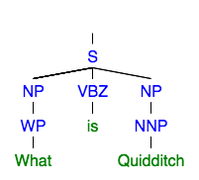
Understanding Queries
Analyzed sentence structure using a regex parser generated using a specified grammar for NP/VP/PP-chunking
Subset of rules for NP-chunking:
grammar = “NP: {<DT>?<JJ>*<NN|NNS>+}”
parser = RegExpParser(grammar)
Parsed query:
parser.parse(taggedInput)

Slide 7
Understanding Queries
Strategy: Identify queries based on sentence structure
1. (S (WH-NP) (VP))
Who was Albus Dumbledore?
Where is Hogwarts located?
Who is the love of Hermione’s life?
When did Bellatrix Lastrange escape from Azkaban?
2. (S (NP) (VP … (WH-NP)))
The spell Wingardium Leviosa does what?
3. (S (Aux) (NP) (VP| AdjP))
Does every spell require a wand?
Are you friends with Harry Potter?

Slide 8
HermioneBot Algorithm
Using Tkinter, the built-in python GUI package, generate text bubbles and prompt the user for their name.
Store the user’s name and allow user to ask questions.
On receiving input determine the user’s intent based on syntactic structure of input:
Intents = {QUERY, UNKNOWN}
If QUER Y:
Perform spell check, if spelling error detected return suggestion
Given parse, select primary queries (simplified NP) and additional keywords (verbs)
Query wikia for articles relating to queries
Iterate through article text predicting relevance given queries and keywords
Return most relevant 1 – 2 sentences
If UNKNOWN or empty – return sassy quip, Hermione style

Slide 9
Spell Checking
Before searching & scanning articles on wikia perform spell check
Calculate edit-distance against pre-defined vocabulary
Vocab consists of spells, characters, etc. (domain-specific)
Uses insert, replace, transpose & delete
if min edit-distance < length(word) , return suggestion

Slide 10
Demo!

