Slide 1
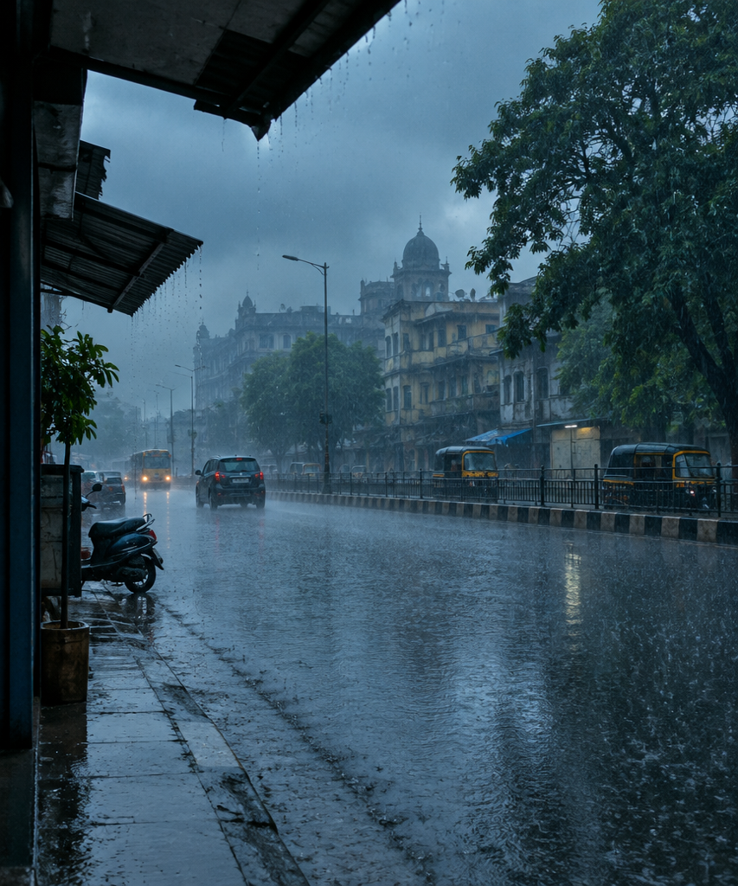

Forecasting
Indian Floods
FROM RAIN TO RIVER
Undergraduate Project (CS496)
Arijit Vishwakarma (240175)
Supervisor: Prof. Preeti Malakar

Slide 2
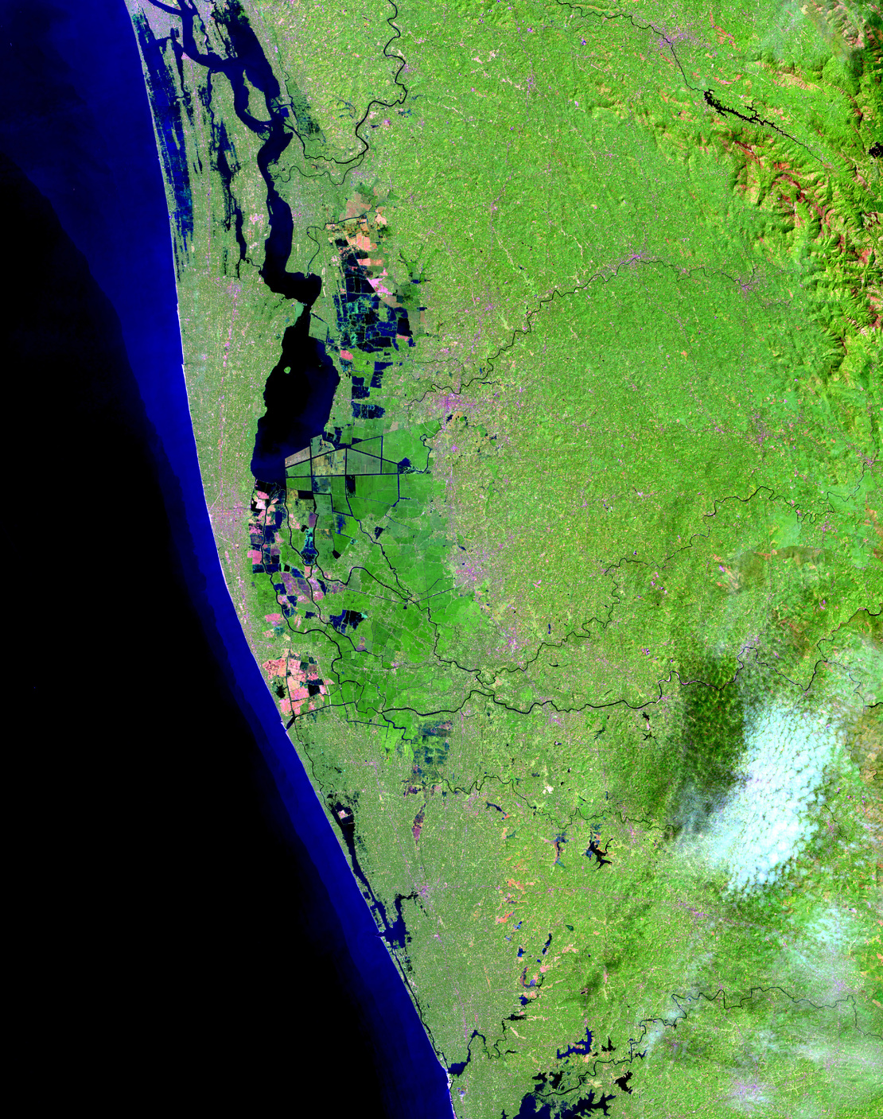
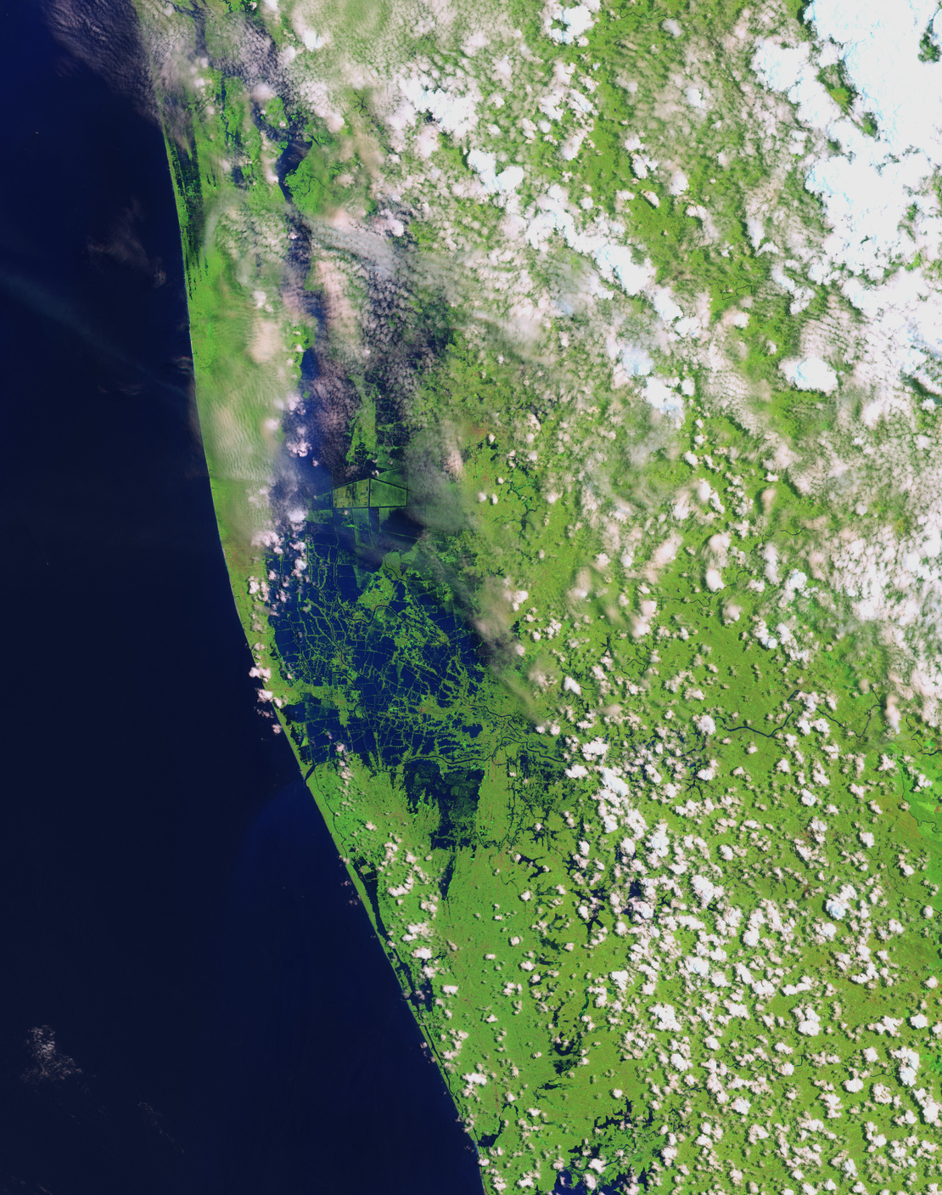
WHY FORECAST FLOODS?
483
PEOPLE DIED IN THE KERALA FLOODS OF AUGUST 2018.
Nearly a million people had to leave their homes, and Kochi airport closed when water reached the terminal.
A forecast a day or two ahead gives time to move people to safety and to plan dam releases. For that we need to forecast both the rain and the river flow.
Before: 6 Feb 2018
Flood: 22 Aug 2018 (dark blue = water)
A warning days ahead saves lives: Cyclone Fani, Odisha, May 2019
7 days
1.2 million
64 deaths
IMD was tracking the storm before it hit land
people moved to safety in Odisha
against about 10,000 in the similar 1999 Odisha cyclone

Slide 3
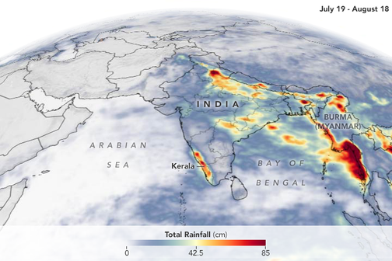
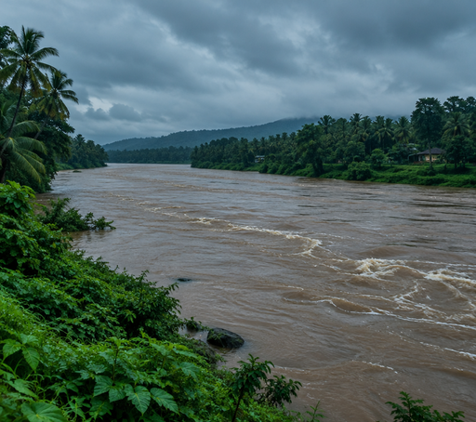
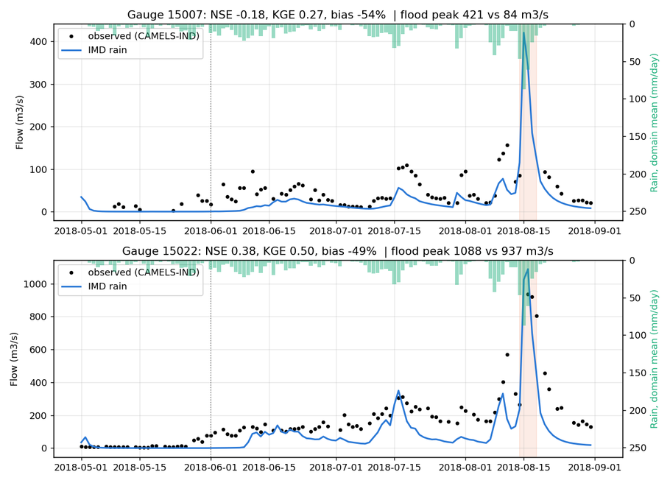
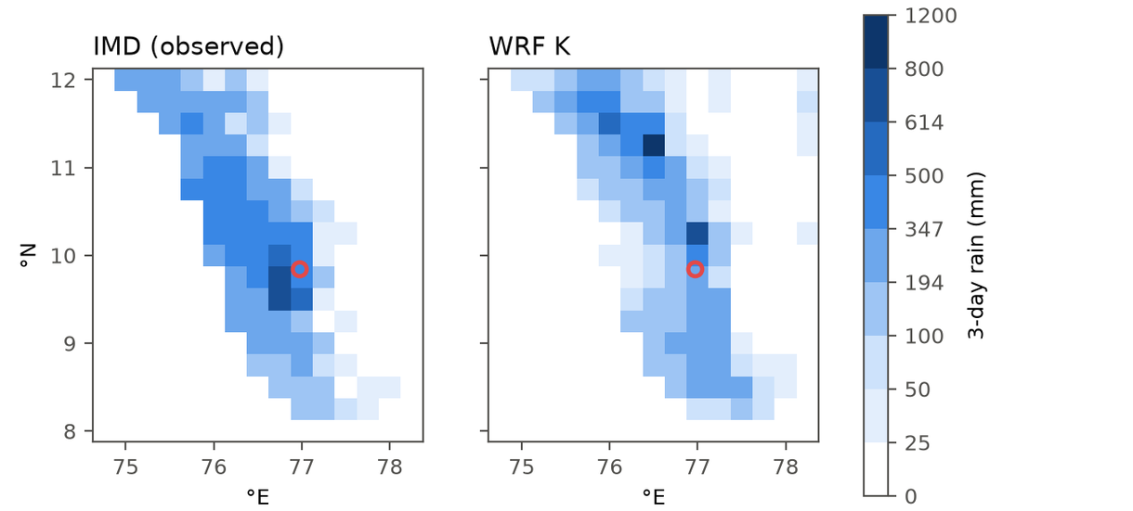
HOW A FLOOD FORECAST IS MADE
Two models work one after the other: a weather model forecasts the rain, then a river model turns that rain into river flow.
Rain measured from space, Jul–Aug 2018 (NASA)
Real rain (IMD) vs our WRF forecast, Kerala 2018
Our WRF-Hydro flow vs measured, Kerala 2018
STEP 1
STEP 2
STEP 3
STEP 4
Measure the weather
Forecast the rain
Rain to river flow
Warn people in time
Satellites, weather stations and balloons measure the air. ERA5 joins all of it into one map of the whole Earth.
A weather model moves that map forward in time and tells how much rain will fall, and where.
A river model sends the rain through the soil and over the land into the rivers.
We get the water flow at a river gauge, hour by hour. If it will cross the danger level, people get a warning.
Data: ERA5, IMD rain
Ours: FourCastNet, Pangu, WRF
Ours: LSTM, WRF-Hydro
Output: river flow in m³/s
How we check: forecast rain against IMD rain gauges, and forecast flow against CWC river gauges (CAMELS-IND).

Slide 4
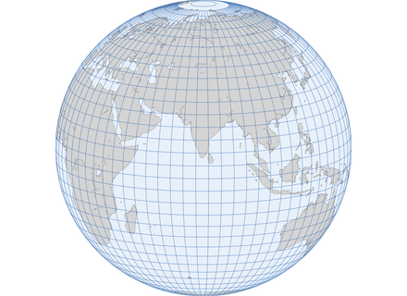
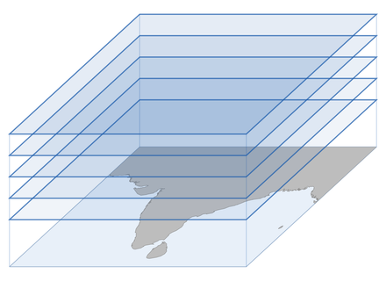
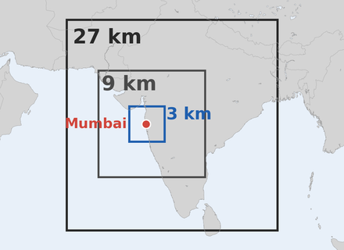
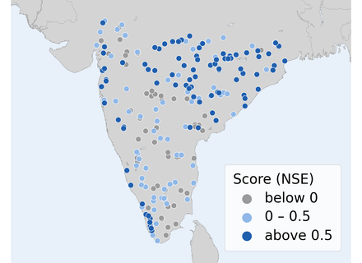
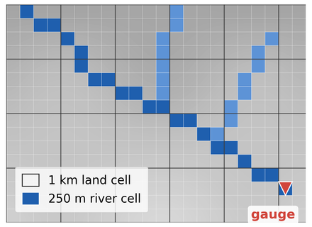
THE MODELS WE WORKED ON
Three models forecast the rain. Two models turn the rain into river flow.
RAIN: WEATHER MODELS
RIVER FLOW: RIVER MODELS
FourCastNet
Pangu-Weather
WRF
LSTM
WRF-Hydro
AI · NVIDIA, 2022
AI · Huawei, 2023
Physics · NCAR, USA
AI · NeuralHydrology
Physics · NCAR, USA
Learned the weather from decades of ERA5 data. Forecasts the whole Earth on a 25 km grid in 6-hour steps, rain included. 3 days took 41 s on a free GPU.
Sees the air in 3D: the surface plus 13 heights. Strong for wind, pressure and temperature, but gives no rain. Too big for the free GPU, so we split it over GPU and CPU.
Solves the equations of air, heat and water. We put boxes inside boxes (27, 9 and 3 km) for Mumbai 2005 and Kerala 2018. Takes hours on CPU cores.
Reads the last 365 days of rain, temperature and other weather of a basin, and gives today's river flow. One model learned 202 Indian basins (CAMELS-IND).
Moves rain through the soil, over the land and along the rivers, on a 1 km land grid and a 250 m river grid. Gives hourly flow at a gauge. Built for the Kallada river.

Slide 5
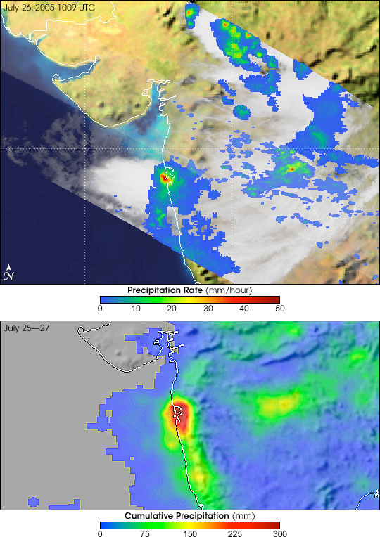
WHERE IT STARTED
Rain rate, 3:39 pm, 26 July 2005
944 mm
Seen by the rain radar on NASA's TRMM satellite. Up to about 50 mm in one hour over the city.
FELL IN MUMBAI ON
26 JULY 2005.
New AI weather models can forecast the whole world in under a minute. So we asked: can they warn us about floods like this?
We tested FourCastNet (it forecasts rain) and Pangu-Weather (no rain) on five floods: Mumbai 2005, Chennai 2015, Idukki 2018, Delhi 2023 and Mumbai 2024.
Total rain, 25–27 July 2005
From several satellites together. Dark red = the most rain, right over Mumbai.
Images: NASA Earth Observatory (Hal Pierce, NASA GSFC), TRMM data (NASA/JAXA).

Slide 6

Study 1: We ran the AI models
We used the trained models published by their authors and ran them for each flood.
Trained model
FourCastNet, Pangu
ERA5 weather
2 days before
Forecast
the flood days
  Tool: ECMWF's ai-models, run on a free Google Colab GPU (T4)
  FourCastNet made a 3-day global forecast in 41 seconds
  Pangu-Weather did not fit in GPU memory, so we kept one part on the GPU and moved the other to the CPU

Slide 7
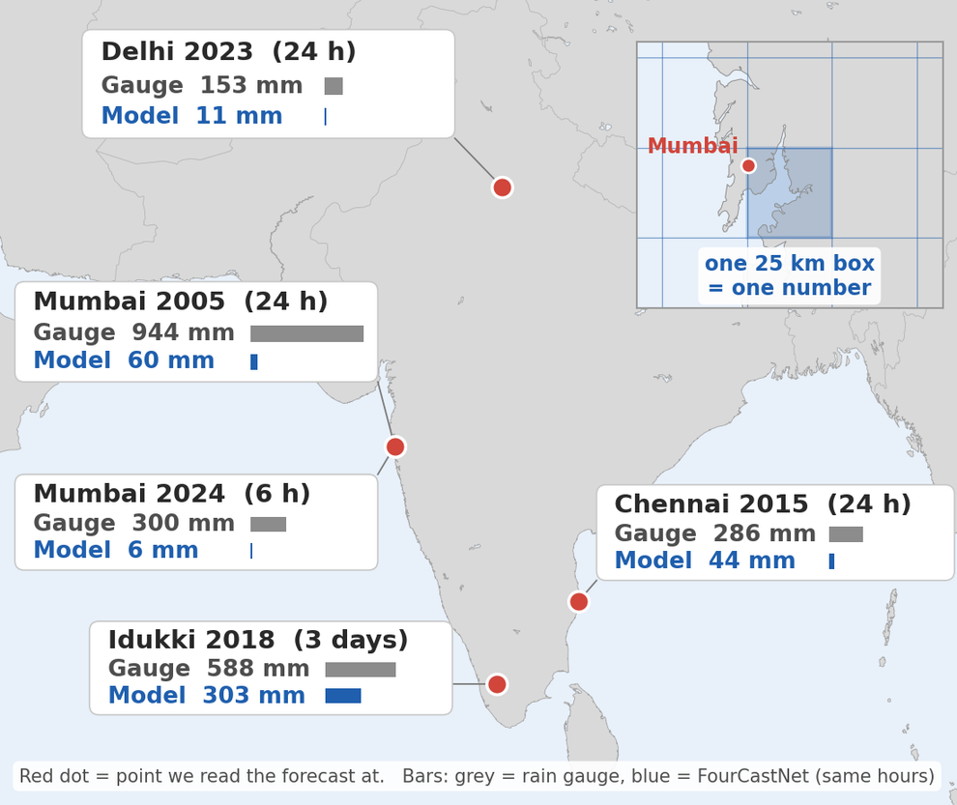
FOURCASTNET
NVIDIA's AI weather model, the one that also forecasts rain. We ran it for the 5 floods on the map.
WHAT IT IS
  NVIDIA's AI model (2022), trained on ERA5 from 1979 to 2015
  Whole Earth on a 25 km grid, about 1 million points
  6-hour steps; a second network turns each step into rain
WHAT WE DID
  Started from ERA5 1–2 days before each flood, 60–102 h ahead
  Free Colab T4 GPU with ECMWF's ai-models: about 3 s per 6 h step
  Read the rain at the grid point nearest each city (red dots), for the same hours as the gauge
  Compared with the rain gauge, IMD gridded rain and ERA5
WHAT WE FOUND
  49% to 98% too little rain in all 5 floods
  Mumbai 2005: 944 mm fell, the model gave 60 mm
  Starting 1, 2, 3 or 5 days early gave 41–67 mm: the start day was not the problem
Our runs: rain gauge (grey) vs FourCastNet (blue) at each flood. Inset: the 25 km box that gets one number.
Numbers from our notebook 1_ai_models/fourcastnet.ipynb. Map: our own drawing.

Slide 8
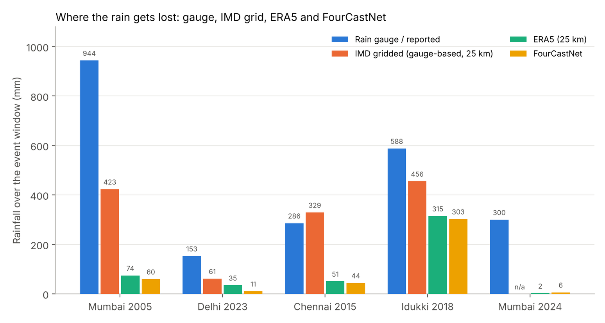
The result
FourCastNet saw that rain was coming, but missed how much.
49% TO 98%
TOO LITTLE RAIN
  Mumbai 2005: 944 mm fell, the model gave 60 mm.
  Mumbai 2024: 300 mm fell, the model gave 6 mm.
  Starting 1, 2, 3 or 5 days earlier did not help.
Drag in your chart: slide05_rain_too_little.png

Slide 9
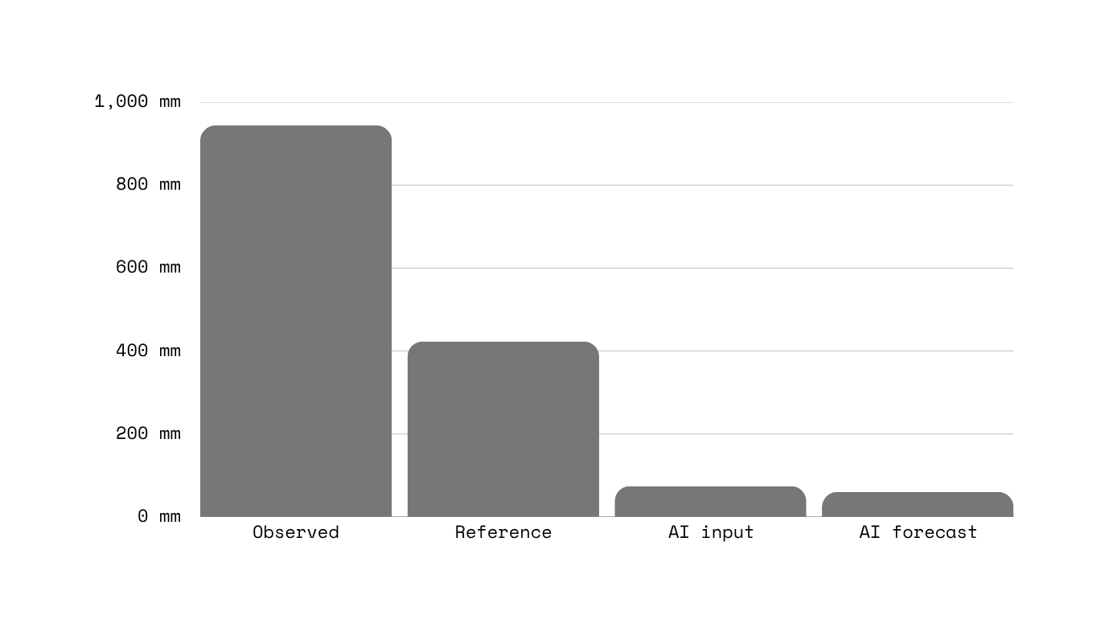
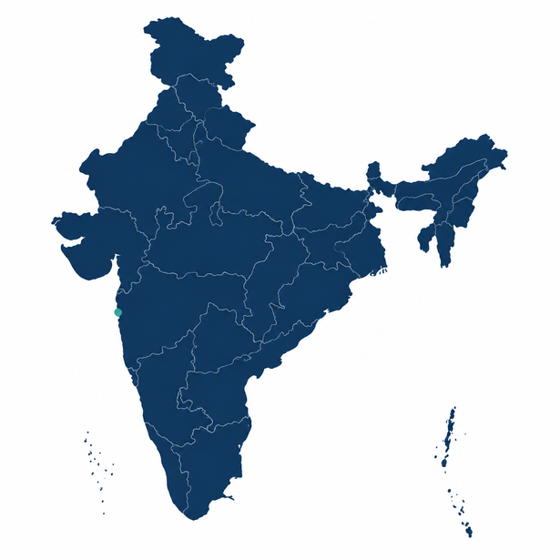
Study 2: Where did the rain go?
We followed the Mumbai 2005 rain through each data source.
Most of the rain was already missing in ERA5, the model's training data.
Rain gauge 944 mm → IMD grid 423 mm → ERA5 74 mm → FourCastNet 60 mm

Slide 10
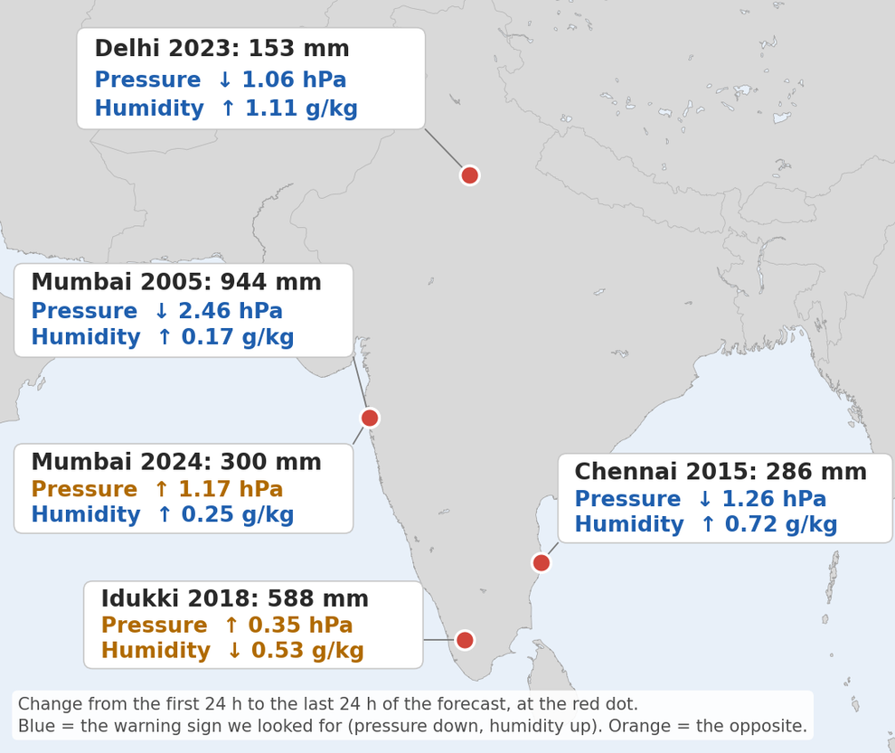
PANGU-WEATHER
Huawei's AI weather model. It gives wind, pressure, temperature and humidity, but no rain, so we looked for warning signs.
WHAT IT IS
  Huawei's AI model (Nature, 2023), trained on ERA5 from 1979 to 2017
  Sees the air in 3D: the surface plus 13 heights, on a 25 km grid
  Separate 1, 3, 6 and 24 h models; ai-models uses the 6 h and 24 h ones
WHAT WE DID
  Same 5 floods, started 2 days before, 60–96 h ahead
  Too big for the T4 GPU: 6 h model on GPU, 24 h model on CPU
  At each red dot: sea-level pressure and humidity at 850 hPa (1.5 km up), every 6 h
  Warning sign = last 24 h minus first 24 h, vs flood size (Pearson r)
WHAT WE FOUND
  Biggest pressure drop (2.46 hPa) came before the biggest flood, Mumbai 2005
  Across 5 floods: pressure r = −0.45 (p = 0.45); humidity r = −0.61 (p = 0.27), the wrong way
  These signs can't tell big floods from small ones. We need rain, so: WRF

Slide 11
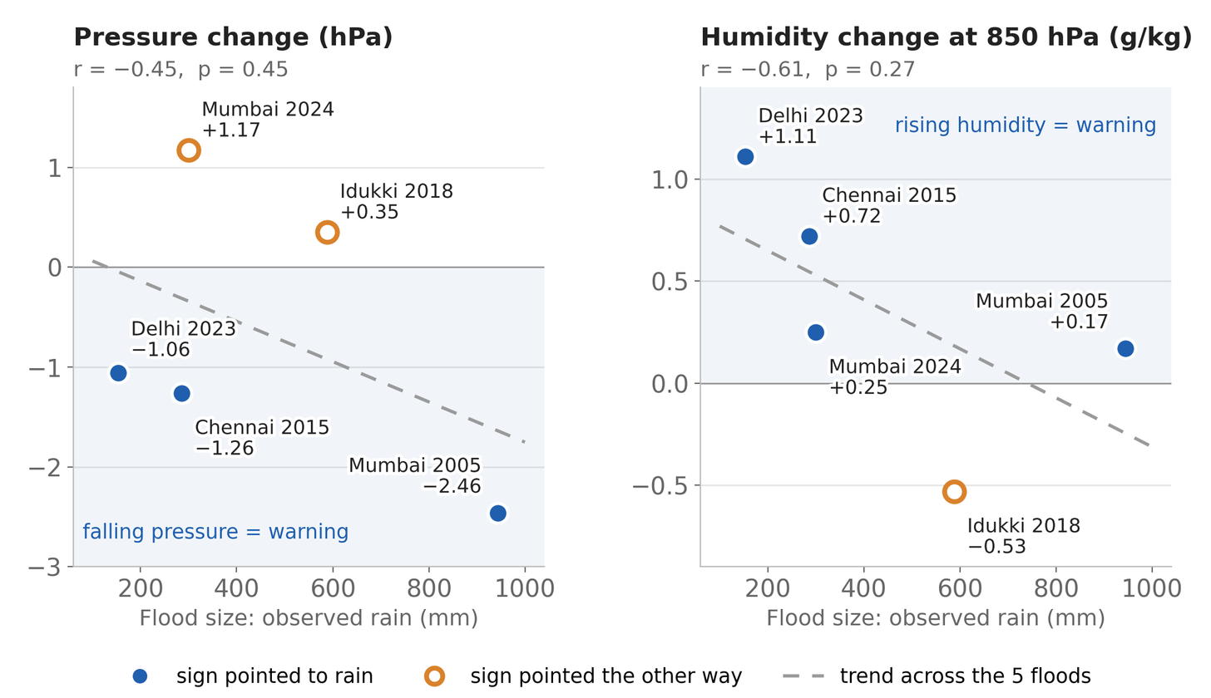
The result
Pangu saw the weather change before each flood, but the size of the change did not match the size of the flood.
NO CLEAR LINK
between Pangu's warning signs and how big each flood was (5 floods)
  The biggest pressure drop (2.46 hPa) came before the biggest flood, Mumbai 2005.
  But pressure rose before Mumbai 2024 (+1.17 hPa) and Idukki 2018 (+0.35 hPa).
  Humidity rose most before the smallest flood, Delhi 2023, and fell before Idukki.
  With only 5 floods, neither link is significant (p = 0.45 and 0.27).
Without rain, Pangu cannot tell a big flood from a small one. So we moved to WRF, which makes its own rain.

Slide 12
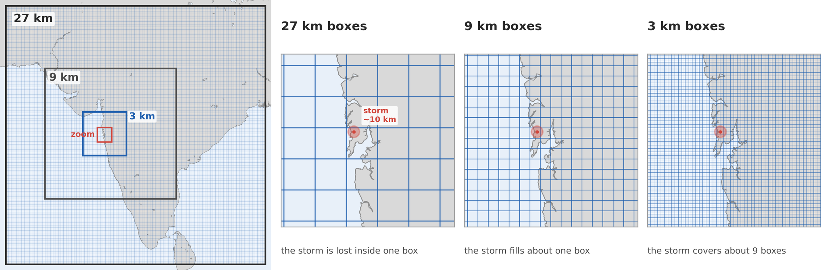
Study 3: Zooming in with WRF
The AI models see India in 25 km boxes, but the Mumbai storm was only 5–10 km wide. So we used WRF and zoomed in: boxes inside boxes.
WHAT WRF IS
WHAT IT PREDICTS
WHY WE NEED IT
A physics weather model from NCAR. It solves the equations of air, heat and water, step by step: every 15 s in the 3 km box.
Rain, wind, temperature and humidity in every box, every hour. ERA5 gives the starting weather and the edges every 6 h.
A 25 km box blurs a 5–10 km storm. At 3 km, WRF builds the storm clouds itself, with no cumulus formula.

Slide 13
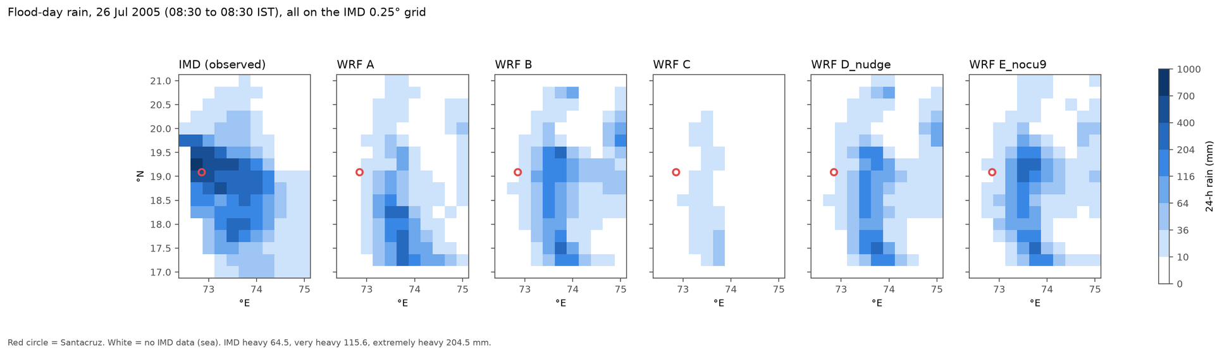

Where the rain fell: real vs WRF
Flood-day rain on 26 July 2005, all on IMD's 25 km grid. Red circle = Santacruz gauge in Mumbai. Darker blue = more rain.
RUNS A, B, D: THE HEAVY RAIN SITS ON THE GHATS TO THE SOUTH-EAST, 136–221 KM AWAY. RUN C HAS ALMOST NO HEAVY RAIN.
RUN E (NO CUMULUS ON 9 KM): THE DARK BOXES MOVE NORTH TO MUMBAI'S LATITUDE, 84 KM AWAY, BUT STILL INLAND AND LIGHTER (236 MM).
IMD (REAL): THE DARKEST BOXES SIT RIGHT ON MUMBAI AND THANE, UP TO 732 MM.

Slide 14
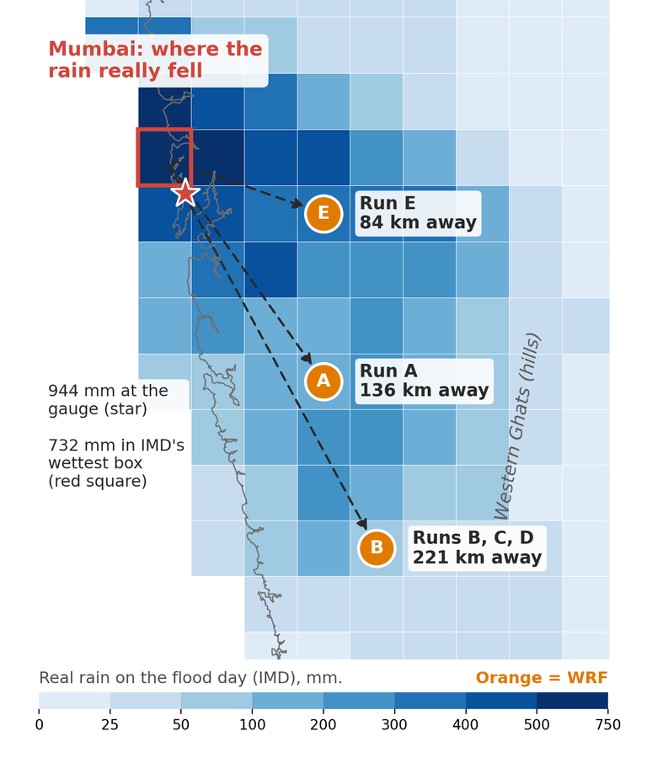
Why was the rain in the wrong place?
Our first runs put the heaviest rain on the hills, not on Mumbai. Runs D and E tested two possible reasons.
Runs A, B, C: our first tries
A starts on 25 July. B starts a day later. C uses a different cloud and rain scheme. All three put the heaviest rain on the hills, 136–221 km from Mumbai.
Run D: was the big weather wrong? (nudging)
Big weather = the monsoon winds and the low-pressure system, hundreds of km wide, that bring the rain clouds. Nudging = during the run we gently pull the 27 km box's winds back towards ERA5. Result: rain still 221 km away, so the big weather was already right.
RUN E: WAS IT THE CUMULUS FORMULA?
One storm cloud is smaller than a 9 km box, so WRF guesses its rain with a shortcut (the cumulus formula). Run E switched it off in the 9 km box, so storms grow on their own. Result: the rain moved north, from 221 to 84 km away.
Mumbai: what worked, what is still wrong
Worked: at 3 km the storm rain was the right size (up to 573 mm), and run E brought it to Mumbai's latitude.
Still wrong: 60% too little rain (236 vs 732 mm), and 84 km away, inland near the hills instead of on the coast.

Slide 15
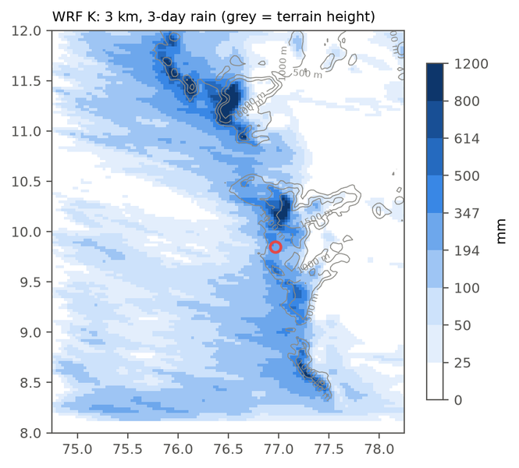
KERALA 2018: DOES IT WORK ELSEWHERE?
We moved the same three boxes (27, 9, 3 km) to Kerala and used the run E settings. Start 13 Aug 2018; rain compared with IMD for 15–17 Aug.
−18%
3-day rain vs IMD (Mumbai: −60%)
0.41
Idukki
Idukki
Idukki
pattern match with IMD
197 km
from WRF's peak to the real peak
Real rain (IMD) vs our WRF: WRF's 3 km rain averaged onto IMD's 25 km grid, 3-day total. Red circle = Idukki (9.8°N, 77.0°E).
WRF at 3 km: rain piles up on the hilltops (grey lines = height).
Kerala: what worked, what is still wrong
Worked: the total rain (only 18% too low) and the rain band along the Ghats, like the real one.
Still wrong: too much rain on the hilltops (up to 2023 mm at one point), and the heaviest rain 197 km north of the real peak near Idukki.
Both floods: a 3 km grid gives rain of the right size, but the physics settings decide where it falls.

Slide 16
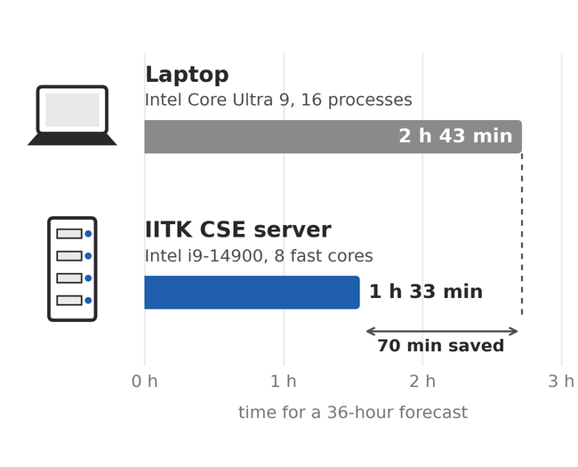
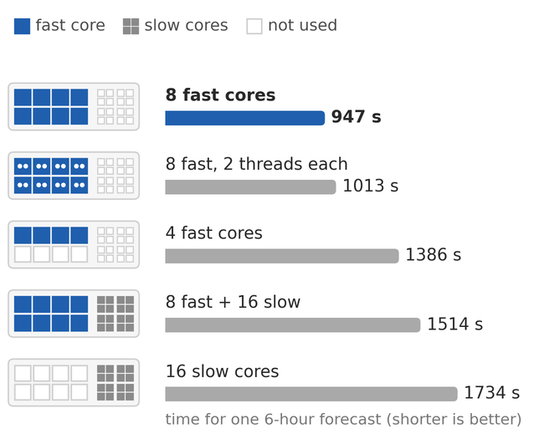
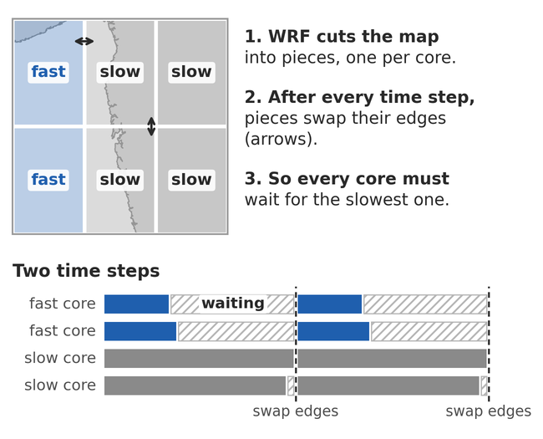
Study 4: Performance of WRF on different machine
We built WRF on the IIT Kanpur server and timed the same forecast on different cores.
1.8×
947 s
60%
faster than the laptop for the same 36-hour forecast (run B)
fastest 6-hour forecast: only the 8 fast cores. All 24 cores took 1514 s.
slower when the 16 slow cores join in, because every core waits for the slowest
Lesson: more cores help only when every core is equally fast.
So runs D, E and the Kerala run used the 8 fast cores only. The 102-hour Kerala forecast took 4 h 50 min on the server.

Slide 17
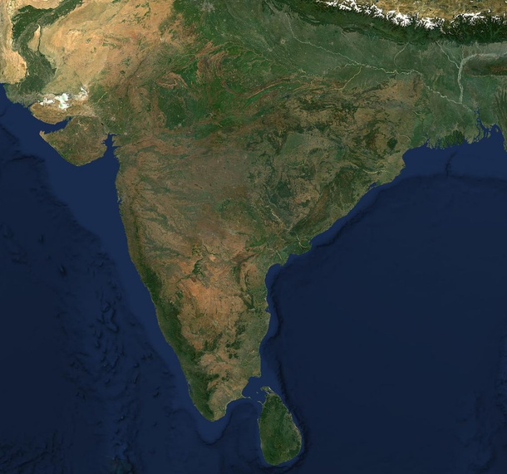
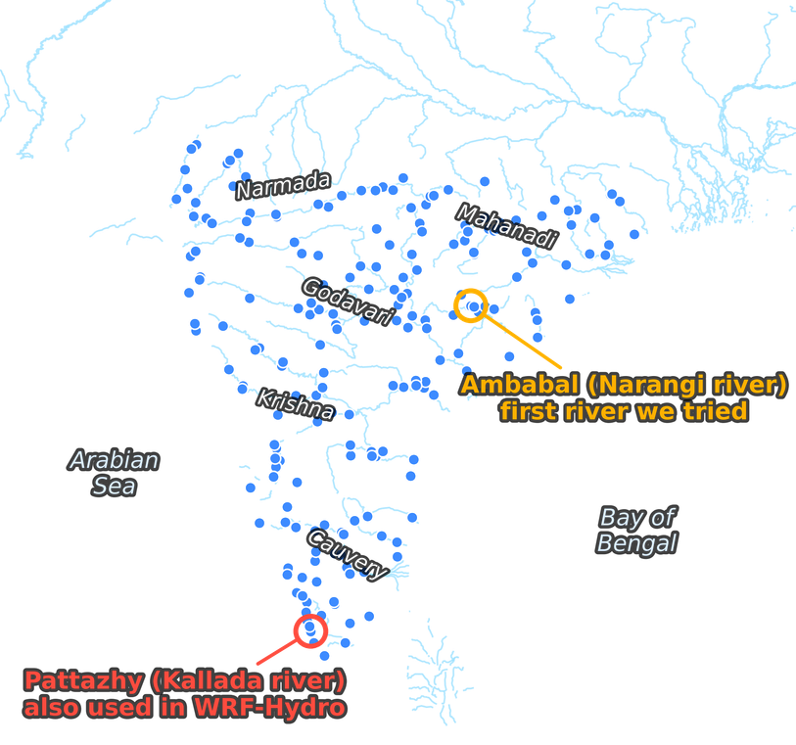
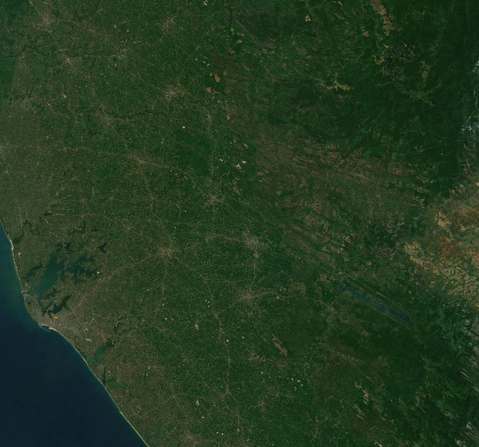
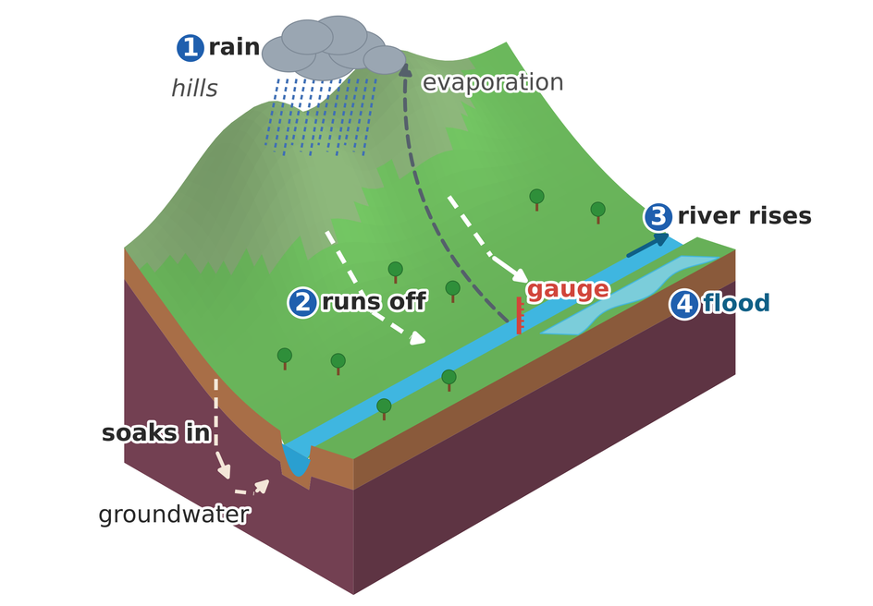
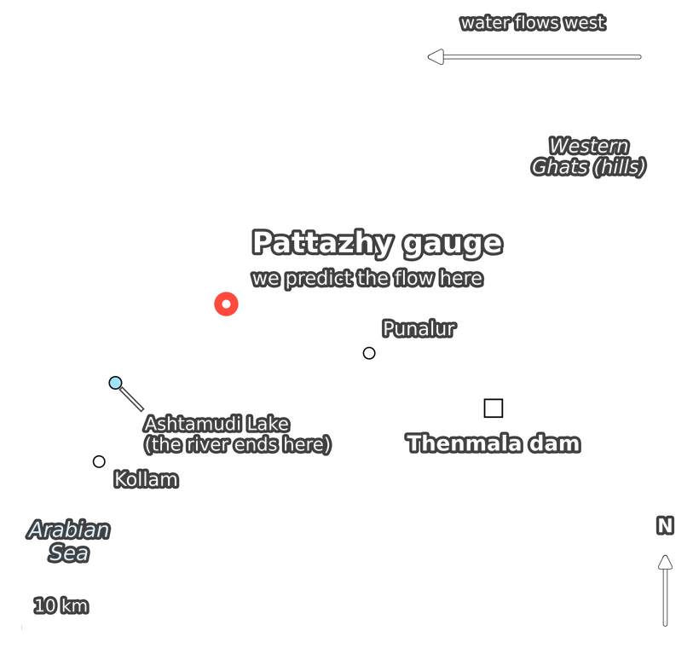
FROM RAIN TO FLOODS
Up to now we predicted rain. But rain becomes a flood only when it reaches a river and the river overflows its banks. So now we predict river flow.
HOW RAIN BECOMES A FLOOD
LSTM: 202 rivers across India
WRF-Hydro: the Kallada river, Kerala
Each blue dot is a river gauge in the CAMELS-IND data.
Pattazhy gauge: 1210 km² of land drains into the river above it.
Two ways to predict river flow
LSTM learns from 40 years of past rain and flow at 202 gauges. WRF-Hydro follows the water through soil, land and river with physics.
Before Indian rivers, we checked both tools on US test rivers: the Narraguagus River, Maine (LSTM) and the Croton River, New York (WRF-Hydro).

Slide 18
Study 5: NeuralHydrology LSTM
Floods happen in rivers, so we predicted daily river flow with an LSTM using NeuralHydrology.
WHAT WE DID
1
Tested the setup on NeuralHydrology's own US tutorial river: NSE 0.776, the same as the reference (0.777).
365 days of weather
18 numbers for every day: rain, temperature, sunlight, wind, humidity, evaporation and soil moisture (4 layers)
2
First model on one Indian river (Ambabal, basin 3002): NSE about 0. The flow data had an impossible 946 mm/day on five days.
River flow
LSTM
on day 365 (mm per day)
3
Cleaned the data: removed negative flows, repeated extreme values and flow far above the rain (527 values in 40 basins). Kept 202 of 242 basins.
27 catchment facts
that never change: area, height, slope, soil, rocks, crops, towns, dams, how rainy the place is
4
Trained one model for all 202 basins: learn on 1981–2004, tune on 2005–2009, test on 2010–2020. 30 passes over the data, 169 min on a Colab T4 GPU.
5
Also trained one model per basin for 11 basins, to see if sharing one model helps.
Then it moves one day ahead and repeats. Its memory cells let it remember things like how wet the soil was weeks ago, which matters for floods.

Slide 19
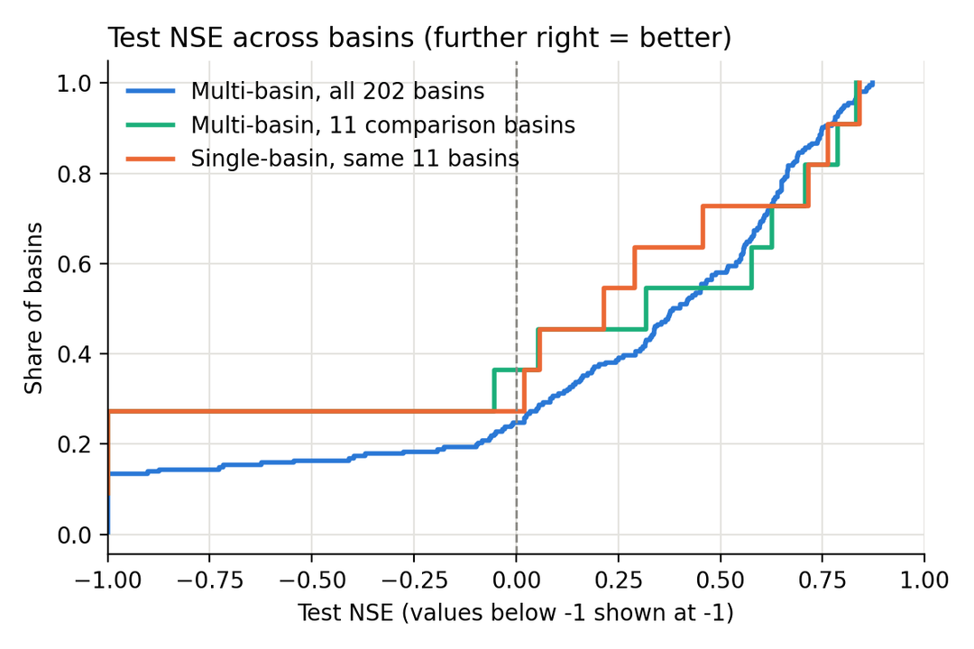
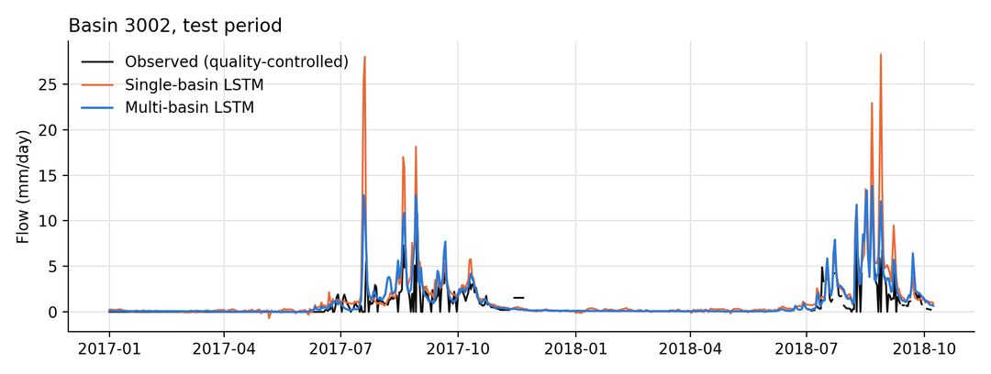
LSTM: HOW WELL DID IT WORK?
Tested on 2010–2020.
0.39
42%
median NSE over all 202 basins
of basins score above 0.5 (good)
0.61 vs ~0
0.32 vs 0.21
wettest third vs driest third of the basins
one model for all vs one model per basin (same 11 basins)
Each line shows the share of basins (up) that score below a value (across). Further right = better. Blue = one model for all 202 basins.
One shared model learns from all rivers, so it beats separate models. It works well in wet basins but not yet in dry ones.
Ambabal (3002), test years: the shared model (blue) follows the real flow (black) better than the one-basin model: NSE 0.58 vs 0.29.

Slide 20

Training the LSTM faster
Training the LSTM on a laptop is slow, so we split it over many CPU workers (PyTorch DDP) and tried a free GPU.
8.4×
20×
faster LSTM training with PyTorch DDP (24 workers), same accuracy
faster LSTM training on a free Colab T4 GPU than on the laptop
Speed-up vs number of DDP workers
Training speed (laptop = 1×)
8.4×
20×
fast cores only
7.7×
6.7×
6.5×
3.7×
1.9×
4.2×
1.0×
1×
1
2
4
8
16
24
32
Laptop
CSE server
Colab GPU
workers
Speed-up grows well up to the 8 fast cores, then the slow cores hold it back.
1 epoch, 10 basins: 272 s laptop, 65 s server, 13 s GPU.

Slide 21
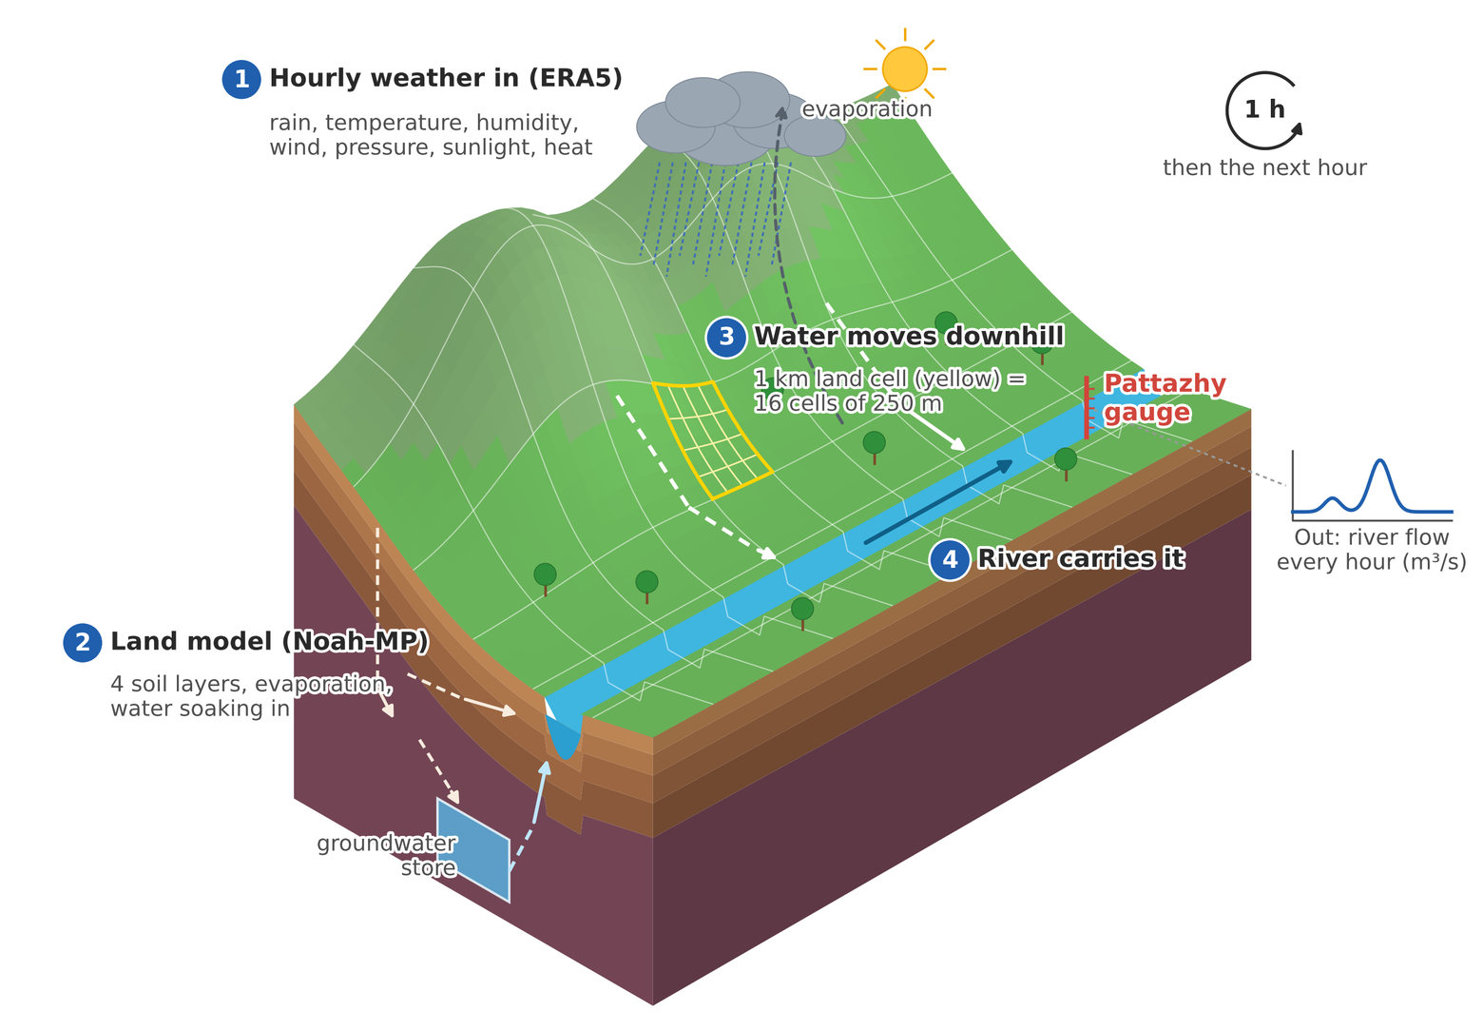
Study 6: Building a flood model with WRF-Hydro
We built WRF-Hydro from scratch for the Kallada river and ran it hour by hour, 1 May – 31 Aug 2018.
What goes in
Hourly weather from ERA5 on a 1 km grid: rain, temperature, humidity, wind, air pressure, sunlight and heat. A second run used IMD rain instead of ERA5 rain.
What it calculates
In every 1 km cell, the land model (Noah-MP) works out how much rain evaporates, soaks into 4 soil layers or runs off. Then, on the 250 m grid, the water flows downhill over and under the ground, fills a groundwater store and is carried along the river.
What it predicts
River flow in m³/s, every hour, at the Pattazhy gauge (1210 km² of land upstream). We check it against the measured daily flow.
How it moves forward
One hour at a time: take that hour's weather, update the soil, groundwater and river, write the flow, then go to the next hour. The model state is saved every day, so a run can restart from any day.
Dates
1–31 May 2018: warm-up, so the soil and groundwater fill up (not scored). 1 Jun – 31 Aug: scored. Flood: 14–18 Aug, peak on 16 Aug 2018.

Slide 22
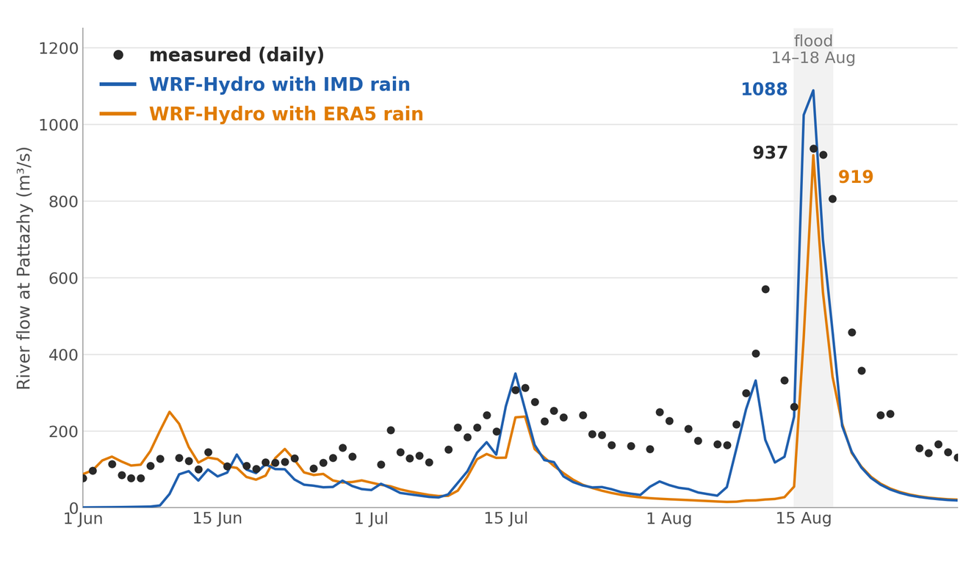
DID IT CATCH THE 2018 KERALA FLOOD?
YES
The flood peak came on the right day: 16 Aug 2018.
Peak at Pattazhy (m³/s)
measured 937
IMD rain 1088
ERA5 rain 919
IMD rain follows the real flow better through the season (correlation 0.88 vs 0.70). ERA5 rain missed some storms.
Weak spot: between storms both runs give only about half the real flow. Groundwater is not tuned and the Thenmala dam is not in the model.

Slide 23
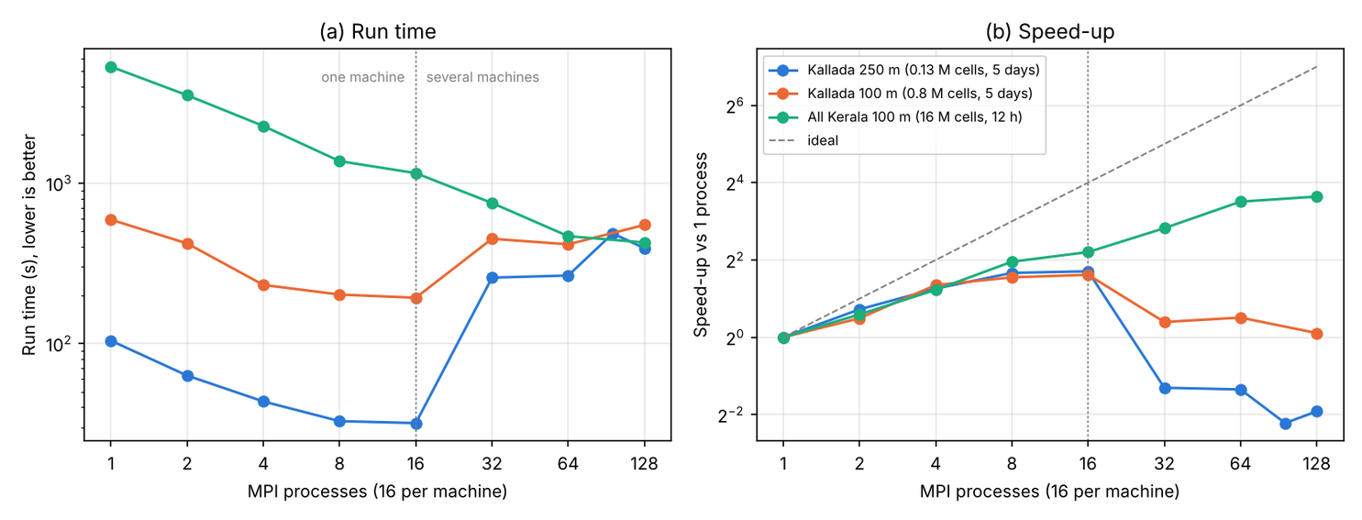
STUDY 7: ONE MODEL ON EIGHT MACHINES
We joined 8 lab machines (16 cores each) with a hostfile and ran mpirun with up to 128 processes.
12.5×
faster for all of Kerala
(16 million cells)
5314 s → 426 s
  Small river: 32 s on 1 machine, but 257 s on 2 machines.
  Why: a message takes 0.5 µs inside a machine but 108 µs between machines (1 Gbit network).
  More machines help only when each process has a lot of work.

Slide 24
Conclusion
We followed the rain from the weather model all the way to the river. Here is what we found.
AI weather models miss most of the flood rain.
They learn from ERA5, which already has 31–85% less rain than IMD. Mumbai 2005: 944 mm fell, FourCastNet gave 60 mm.
WRF at 3 km makes storms the right size, but puts them in the wrong place.
Kerala 2018: total rain only 18% low, but the peak landed 197 km away. One physics change moved the Mumbai peak from 221 to 84 km.
River-flow models can catch a flood.
One LSTM for 202 basins (median NSE 0.39) beat one model per basin. WRF-Hydro caught the 16 Aug 2018 Kerala peak on the right day (919 vs 937 m³/s).
More computers help only when used the right way.
WRF ran fastest on the 8 fast cores, not all 24. The LSTM trained 20× faster on a GPU. WRF-Hydro ran 12.5× faster on 128 cores, but only for the big Kerala run.
Main lesson: a flood forecast is only as good as the rain that goes into it.

Slide 25

References
Where every picture in this talk comes from.
PICTURES FROM OTHER SOURCES
OUR OWN CHARTS AND DRAWINGS
Kerala before and during the 2018 floods (slide 2)
Every other chart, map and drawing (slides 3, 4, 7–9 and 11–23) was made by us in Python (matplotlib) or drawn in Canva, from the data and models below.
NASA Earth Observatory, “Before and After the Kerala Floods”, 25 Aug 2018. Images by Lauren Dauphin, using Landsat 8 data (USGS) and modified Copernicus Sentinel-2 data (ESA).
Satellite rain map, 19 Jul – 18 Aug 2018 (slide 3)
  IMD gridded rain: Pai et al., Mausam 65, 1–18, 2014
  ERA5: Hersbach et al., Q. J. R. Meteorol. Soc. 146, 1999–2049, 2020
  CAMELS-IND v2.2: Mangukiya et al., Earth Syst. Sci. Data 17, 461–491, 2025
  FourCastNet: Pathak et al., arXiv:2202.11214, 2022
  Pangu-Weather: Bi et al., Nature 619, 533–538, 2023
  WRF v4: Skamarock et al., NCAR Tech. Note NCAR/TN-556+STR, 2019
  WRF-Hydro v5: Gochis et al., NCAR Technical Note, 2020
  NeuralHydrology: Kratzert et al., J. Open Source Softw. 7(71), 4050, 2022
  Coastlines and borders: GSHHG, Wessel & Smith, J. Geophys. Res. 101, 8741–8743, 1996
NASA Earth Observatory, “A Flood for the Century in India”, 22 Aug 2018. Image by Joshua Stevens, using GPM IMERG data (NASA/GSFC).
Satellite rain over Mumbai, 25–27 Jul 2005 (slide 5)
NASA Earth Observatory, “Record Rainfall over Bombay”, 29 Jul 2005. Images by Hal Pierce (NASA GSFC), using TRMM data (NASA/JAXA).
Satellite images of India and the Kallada river (slide 17)
Sentinel-2 cloudless, s2maps.eu, by EOX IT Services GmbH. Contains modified Copernicus Sentinel data 2020.
Idea for our catchment drawings (slides 17 and 21)
NeuralHydrology blog, “A data-centric perspective on the information needed for hydrological uncertainty predictions”, 12 Sep 2024. Paper: Auer et al., HESS 28, 4099–4126, 2024.
Street, river and India map pictures (slides 1, 3 and 10)
Code and Implementation: git@github.com:Arijit030701/Flood-Forecasting-using-AI-LSTM-and-Simulation.git
Made with Canva’s AI image tool when the deck was created. They are not real photos.
IIT Kanpur logo (all slides)
Indian Institute of Technology Kanpur.

Slide 26
Thank You

