Slide 1
Stock Market Predictor
Arijit Chakrabarti arijit.c01@gmail.com
Project Submission towards Machine Learning Intermediate

Slide 2
Background
I have been investing in the stock market over the last couple of years. This year with the Covid 19 Pandemic - there has been bloodbath across the Indian stock market, however there are multiple stocks which have managed to prosper during this time. My idea was to create a tool which would allow me to understand for the short term say between 7 days to 90 days how a particular stock would fare. Such that I can make better informed judgment on whether to hold or sell the stock. Also in the case of new information received on expected high performing stocks - be able to make a better than average market profits.

Slide 3
The Process – TSA for ACC
Collecting historical data from NSEpy
EDA on the downloaded data
Seasonal Decomposition
Transformations for Stationarity
Plotting the ACF and PACF
Models on AR, ARMA & ARIMA
Automated Approaches
Using Gridsearch S-ARIMA
Using Facebook Prophet
Conclusion and way forward

Slide 4
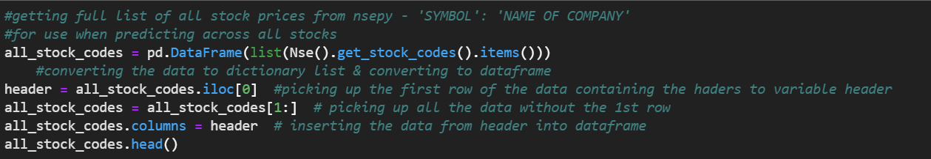
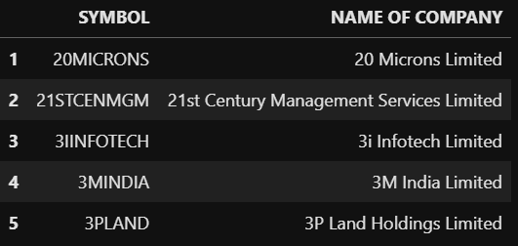
Getting details of All Stocks

Slide 5
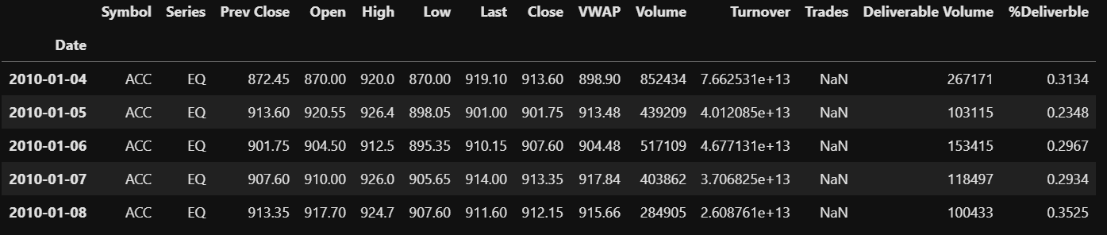
Getting the historical data
Interestingly yahoo finance was providing incorrect or differently formatted data
Hence used NSEpy to get historical data.
Converted to date-time format for further EDA
Included missing holidays with mean forward fill to prevent gaps in data

Slide 6
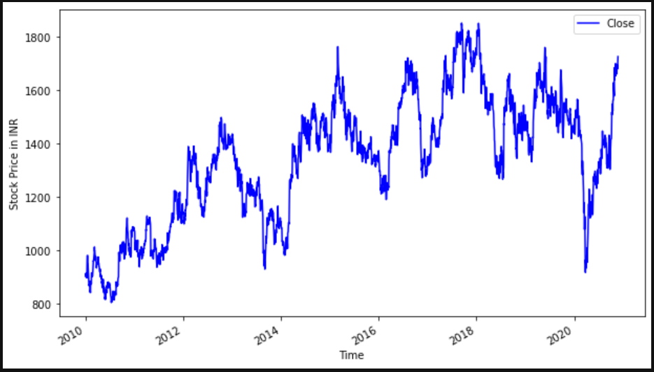
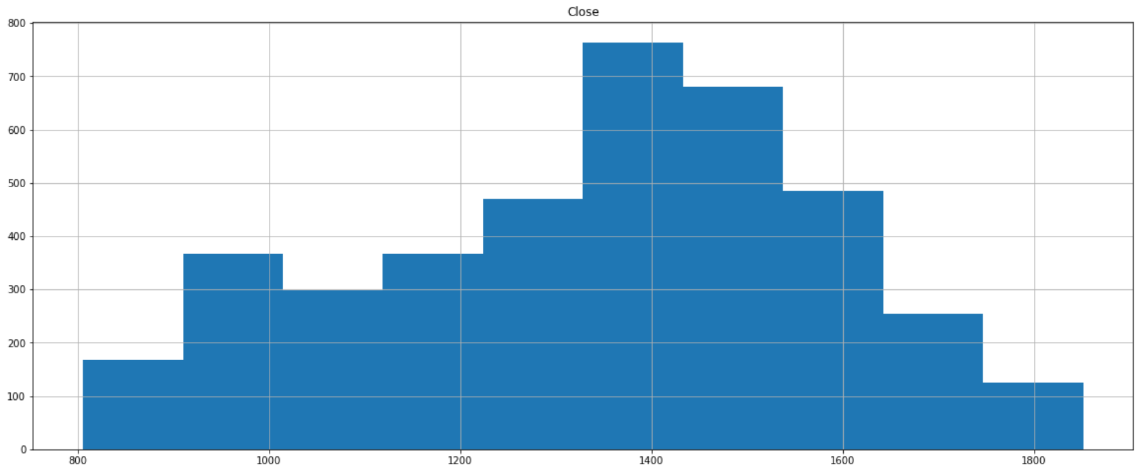
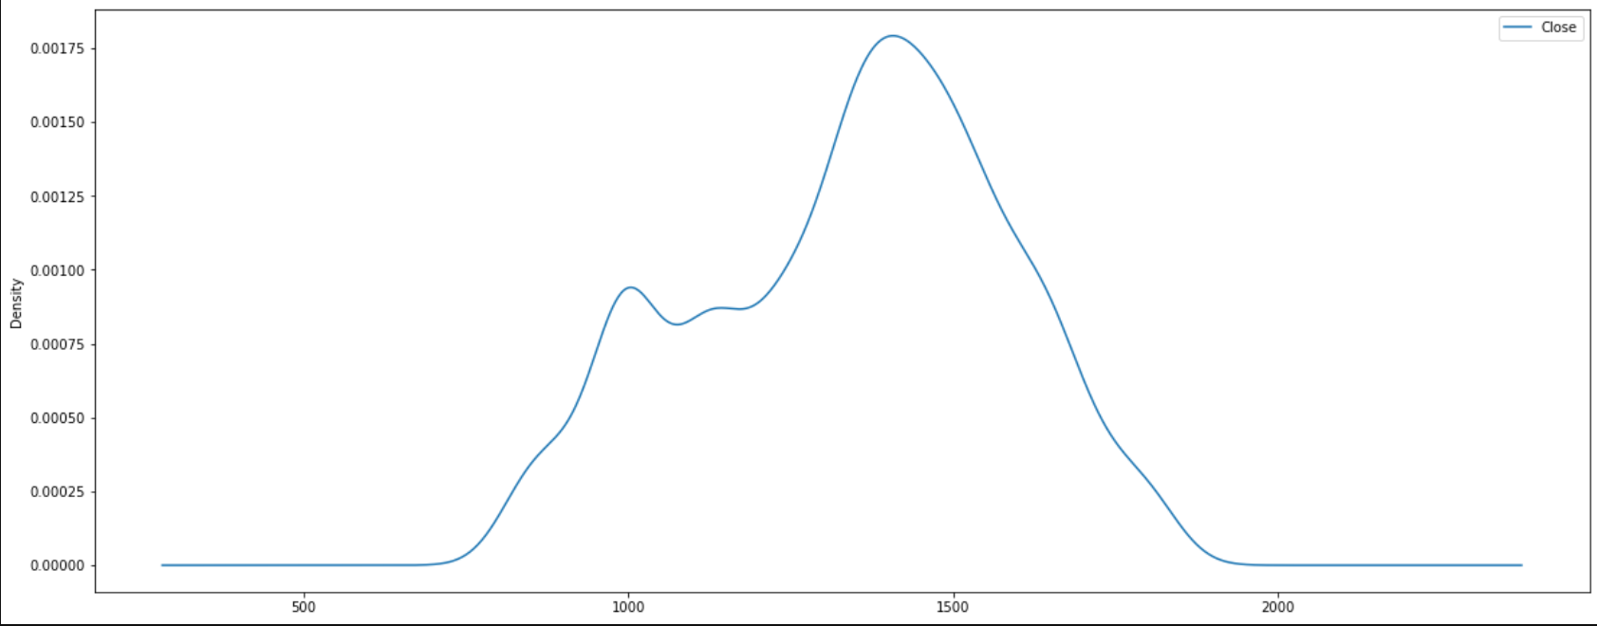
EDA
The mean for the stock is INR 1,337, with a standard deviation of 18%
The mean is lower than the 50th percentile meaning a right shifted gaussian distribution

Slide 7
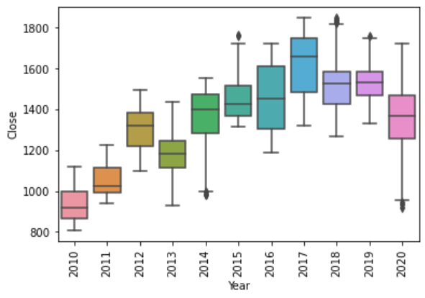
Year-wise Box Plot confirms few outliers

Slide 8
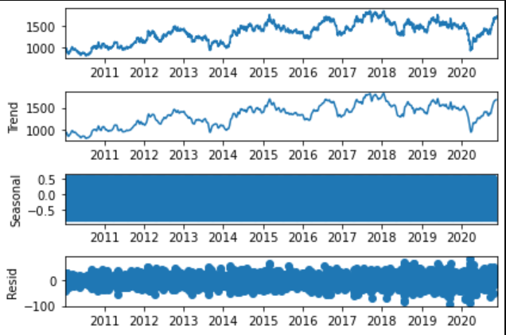
Seasonal decomposition shows no clear trends

Slide 9
Stationarity Checks

Slide 10
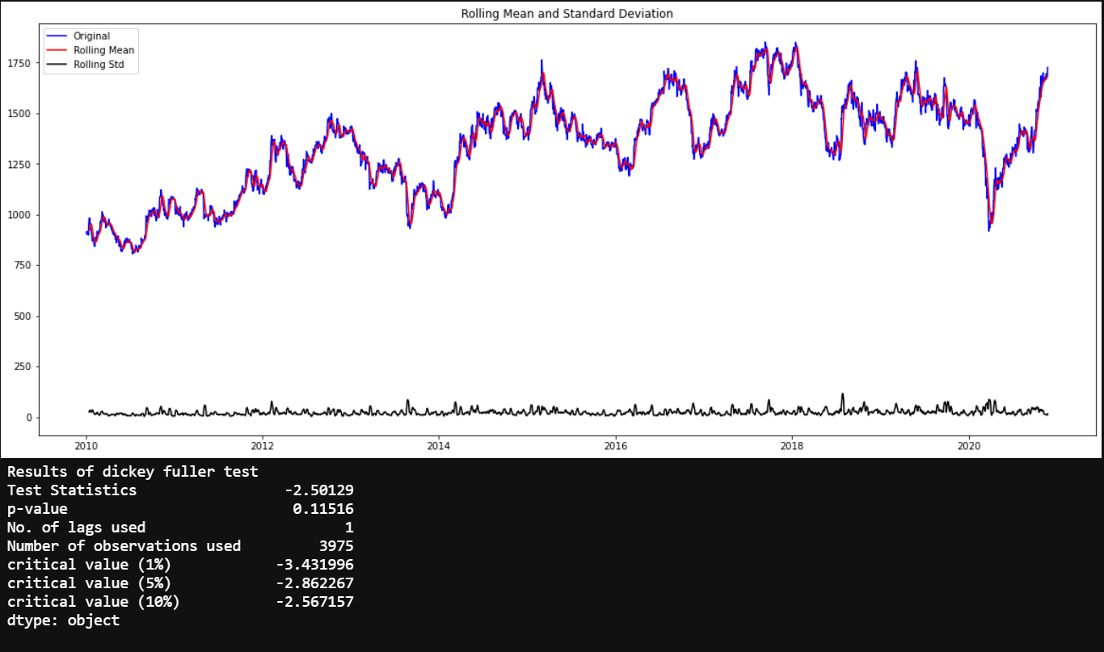
On original Dataset – not stationary

Slide 11
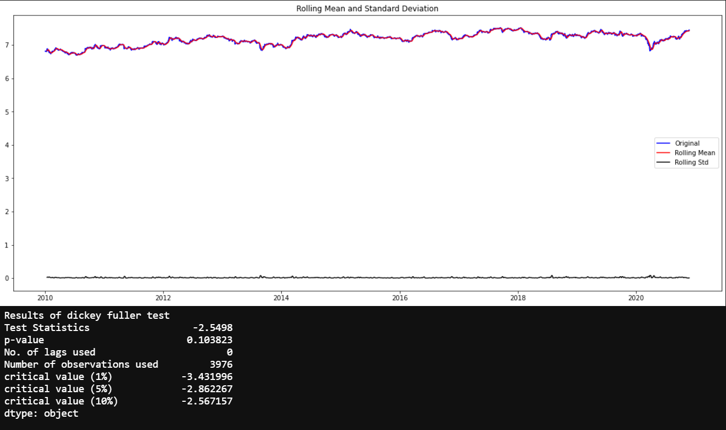
Logscale Improves Stationarity

Slide 12
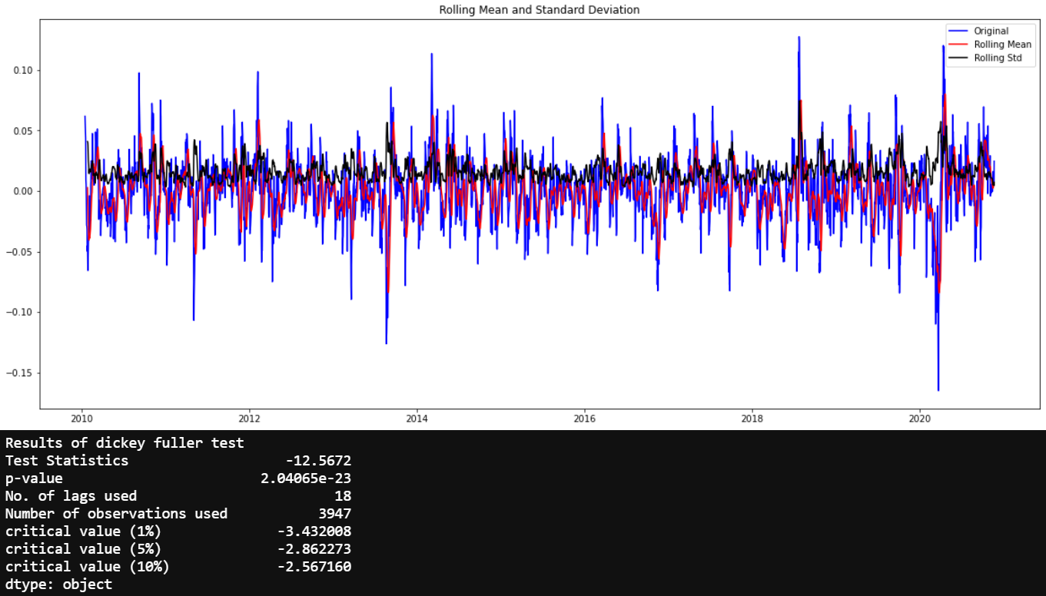
Moving Average Logscale Transformation
Further improvement with very low p value and test statistic below 1% critical value

Slide 13
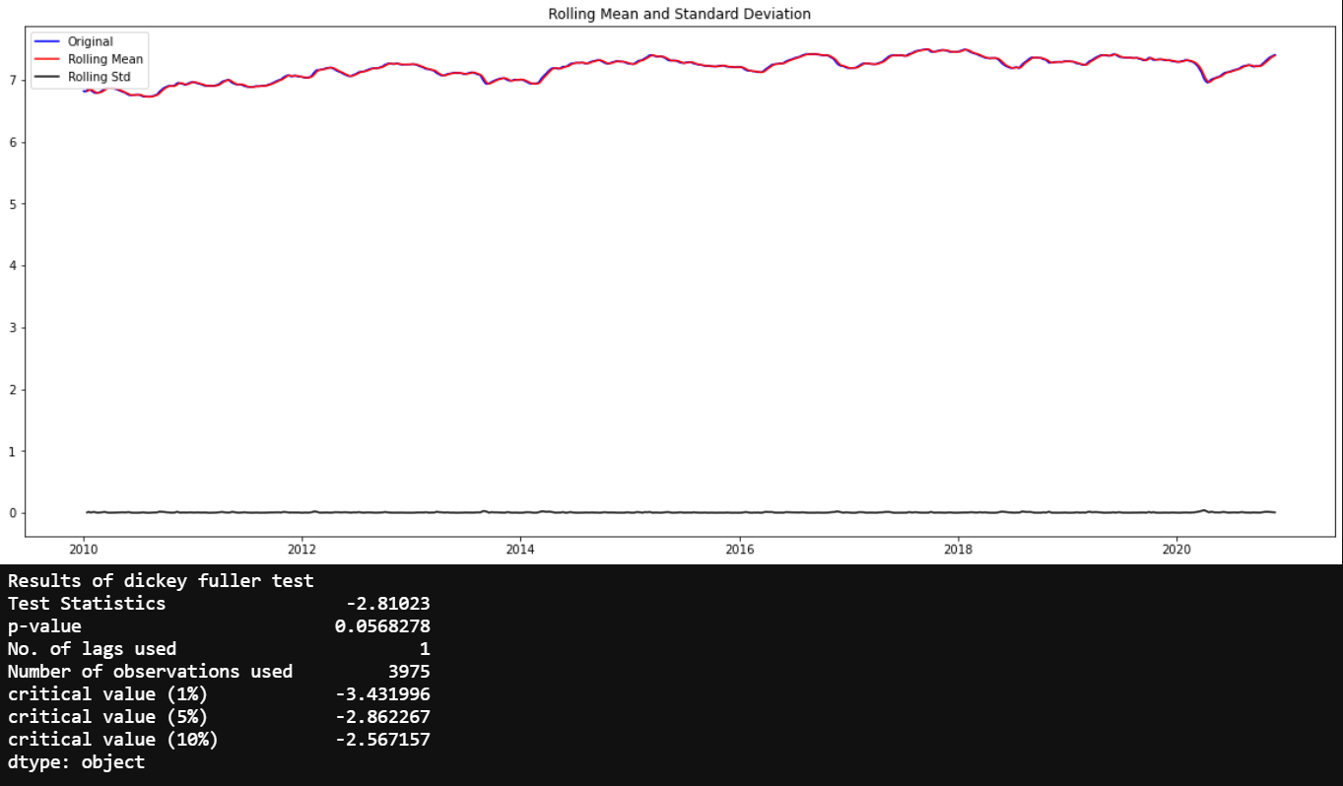
Exponential Decay Transformation
Performs worse than the moving average logscale transformation

Slide 14
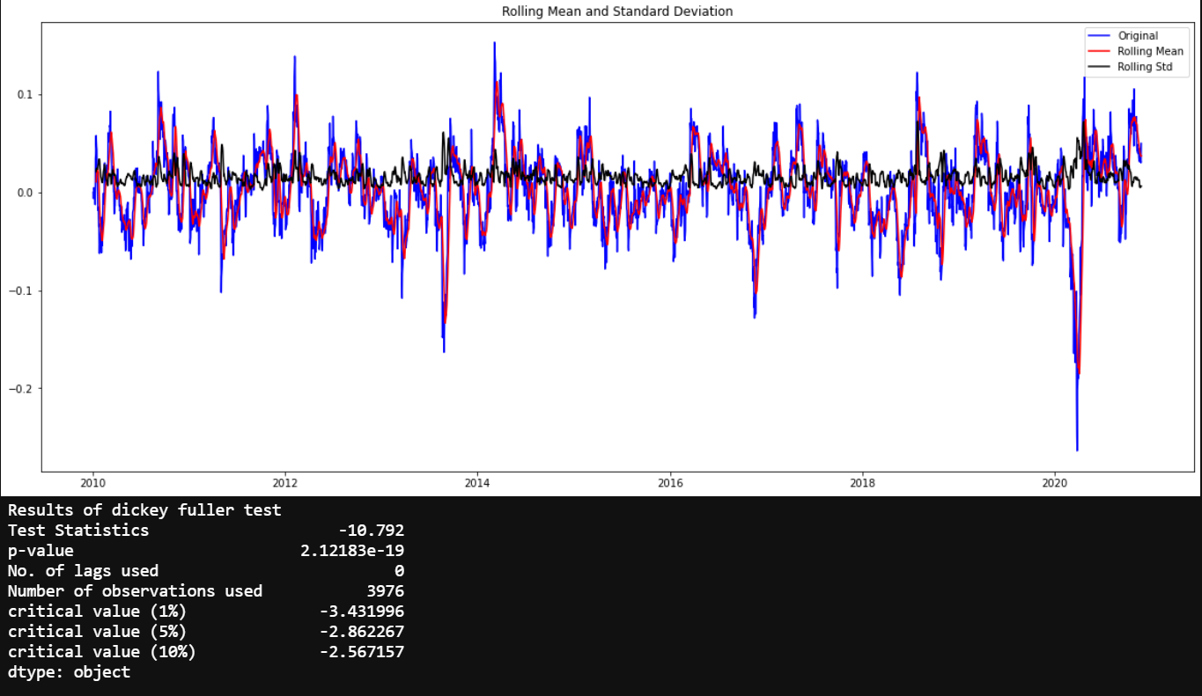
Logscale Minus Moving Average Transformation
Extremely good stationarity achieved but moving average transformation is the best yet!

Slide 15
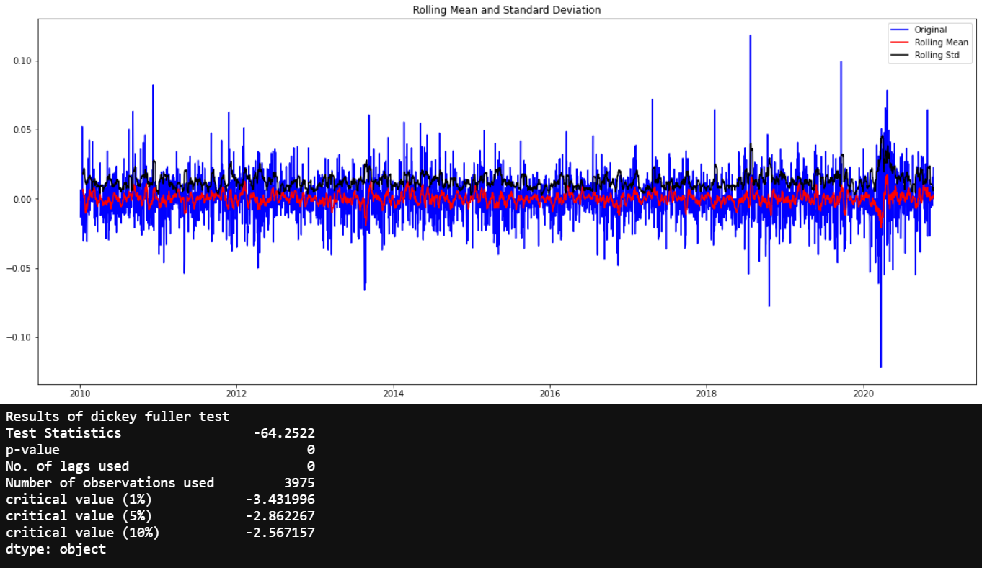
Time Shift Transformation
Best stationarity achieved basis the Dickey Fuller test with low p-value and
a test statistic better than 1%.
Proceeding with the time-shift transformation for the rest of the calculations.

Slide 16
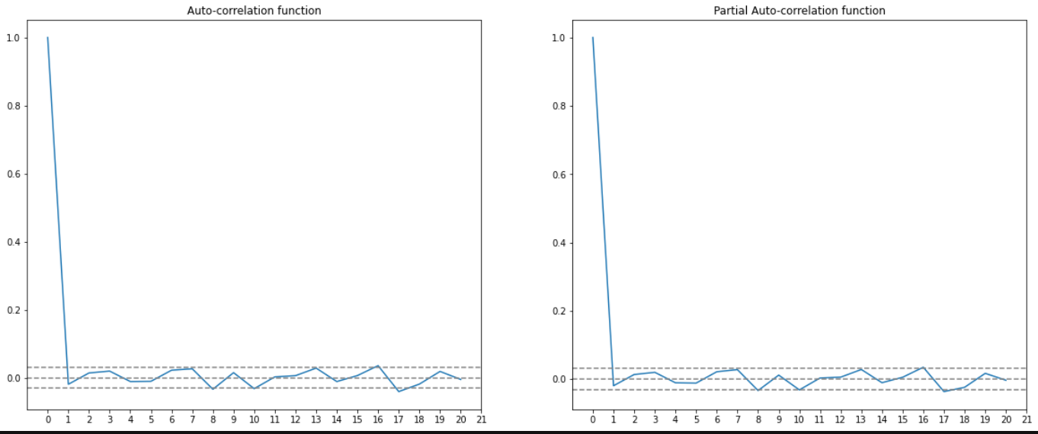
Plotting ACF and PACF
p –> 1
q –> 1

Slide 17
Building Models

Slide 18
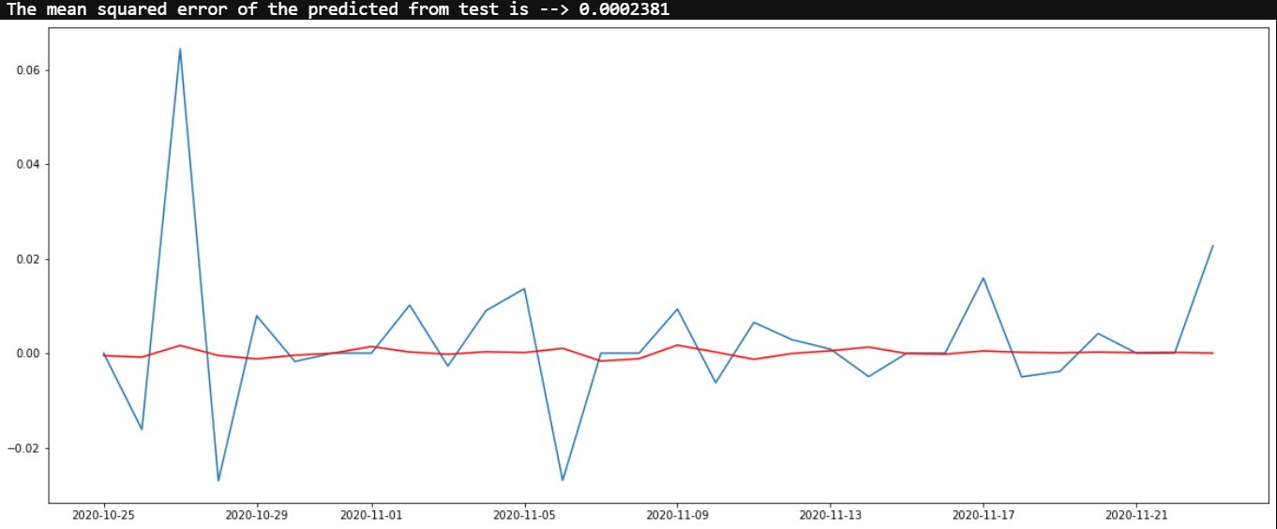
AR Model

Slide 19
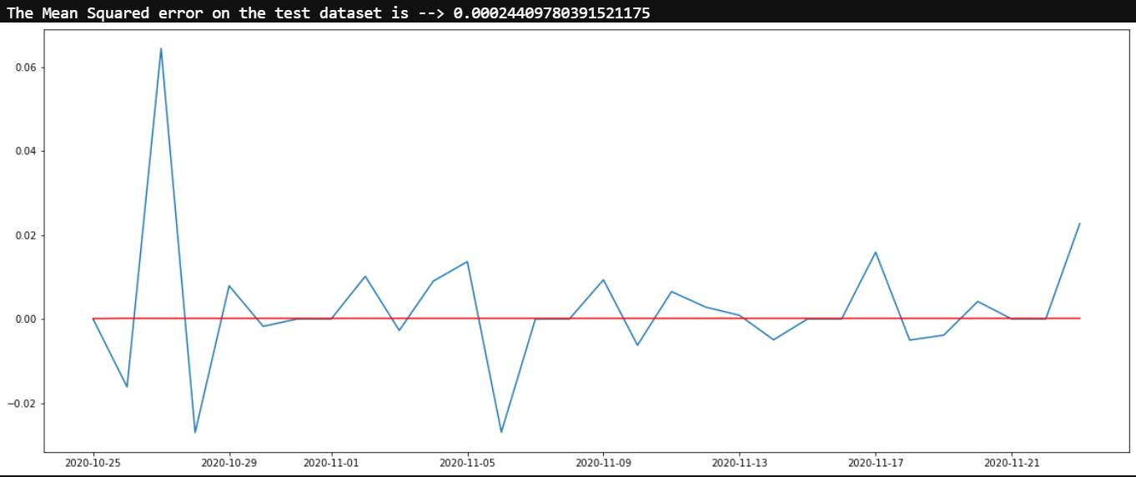
ARMA Model

Slide 20
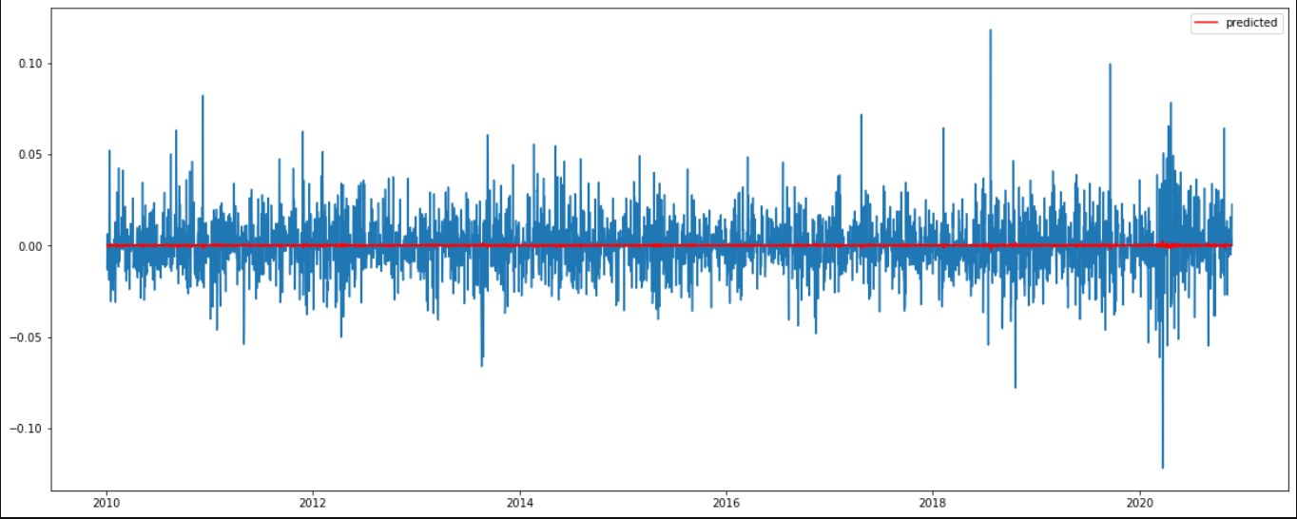
ARIMA Model
The ARIMA model has a similar static cross-section as the ARMA model

Slide 21
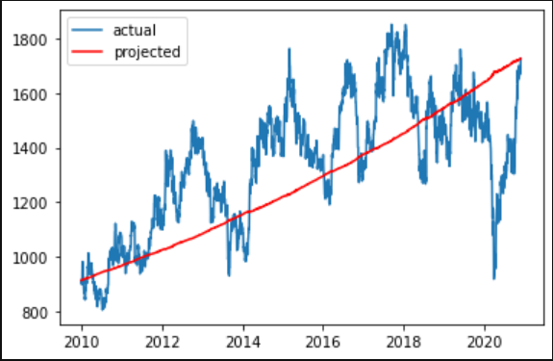
Reverse transformation of values
Basic upward trend of projected values not completely following the cycles

Slide 22
Automated Models Approach 2 & 3

Slide 23
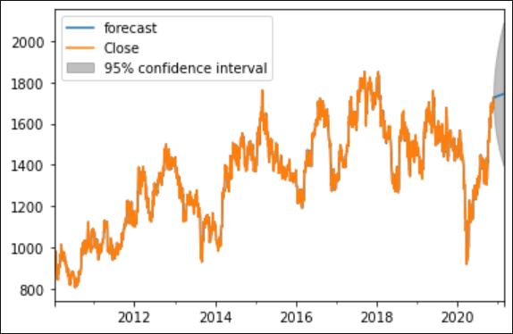
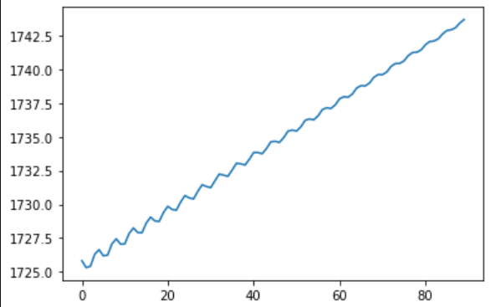
Approach 2 Using gridsearch for p,d,q
Optimal Model is:
p--> 2 d--> 1 q--> 2
Shows an expected upward trend for the stock for the next 90 days projection

Slide 24
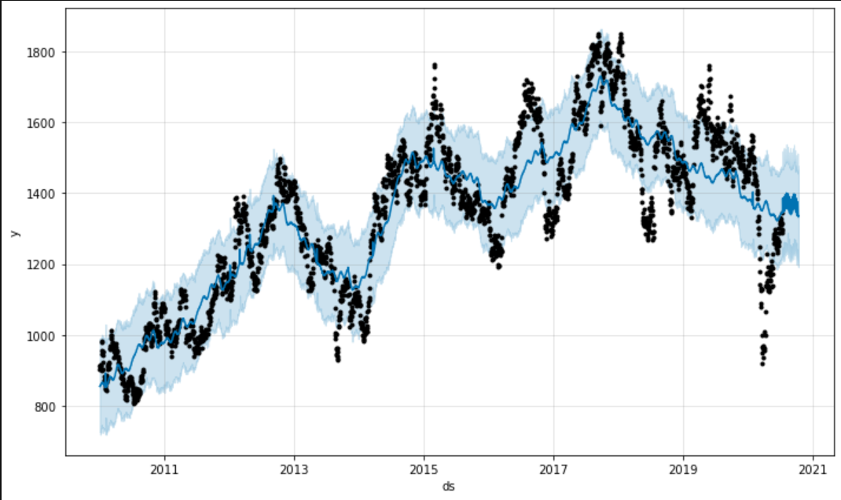
Approach 3 – Using fbprophet
Interestingly as per fbprophet the stock is not expected to rise currently. Fitting is best.

Slide 25
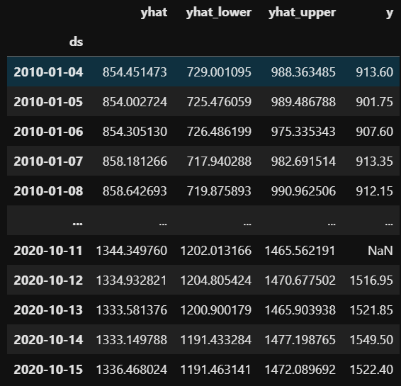
Model evaluation against last 30 days performance
MAPE % 3.865960988740403
MAE 55.64511588255785

Slide 26
Conclusion and way forward
Many people have tried to predict stock movement for profit. However it is a difficult task. The objective of this exercise was provide better than average returns - as compared to investing directly in NIFTY. I believe this tool can help in this objective.
We see that different methods provide different outputs - in fact the automated method using gridsearch to identify (p,d,q) provides divergent results as compared to FB Prophet. The output from FB Prophet - on ACC stock says that it should be operating at a lower level.
The way forward would be to look at the whole basket of stocks (as created from yahoo finance) and then consider those which are projected to have the highest rise in stock prices in the near future - say 7-10 day intervals and run accordingly - using the automated gridsearch or FB Prophet method.
This would need to be implemented in the real world to see what sort of value it can provide. I look forward to spending more time on this project to improve the analytic and build a system to take all stocks into account - though the time taken to extract individually all historical stock data would be extremely time consuming. Maybe a possibility to create a csv file with all historical data and then only update today's date data, effectively using that to project stock prices.

