Slide 1

Analysis Case Study Assessment :
Customer Retention Analysis

Slide 2

Business Objective, Understanding and Approach
Business Objective
Key Results
Business Objective
Data analysis of 6 months customer data to enable business in strategies to retain customers and increase customer wallet share penetration
Report customer attrition in past 6 months
Detail profiling of customers basis activity status to aid in business insights and business decisioning
Approach
Approach
Perform EDA of data extracted from Datawarehouse of customer details including activity level – active / inactive status across 6 months
Perform necessary data cleaning and data enrichment with objective to build detail customer profile analysis

Slide 3
Analysis/ Modeling Methodology
Data Preparation & EDA
Variable Creation and Selection
Model Development
Analysis Results
Review of 6 months of customer extracted
…
Extensive analysis across all variables
Correlation analysis across all variables to identify key parameters to aid in customer analysis
No missing data reported during EDA
Created new variable ‘New_Activations’ to group customers basis :
New Active: inactive at start but active at end
Existing Active: consistently active Existing Inactive: continued to be inactive
New Inactive: customer active at start but turned inactive at end of period
No model development required as the analysis only required extensive exploratory data analysis across the data for 6 months
Extensive customer analysis providing insights on key parameters having direct correlation with customer active status

Slide 4
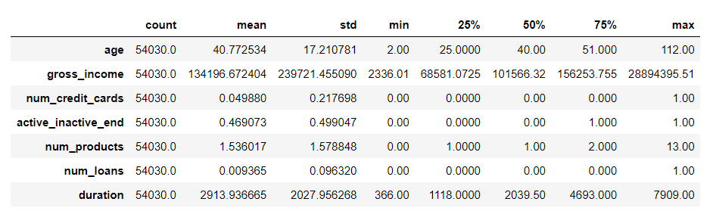
Extended Data Dictionary (EDD)

Slide 5
Feature Engineering – New variables created
Sr. No | Variable Name | Variable Type | Description
1 | New_Activations | String | Bifurcation of customer activity consolidating across 2 features of active_inactive_start and active_inactive_end status

Slide 6
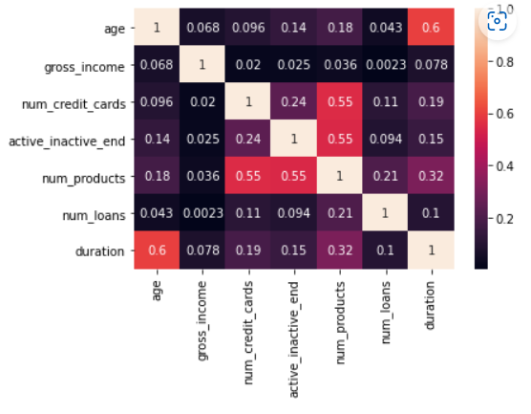
Analysis Results
Key Findings :
Comparatively high correlation between age of customer and duration as customer with the bank reveals customers tend to stick with the bank with more age
Moderate correlation between number of products availed and number of credit cards availed with customer active/inactive status reveals product and credit card as key parameters to determine customer activity behaviour

Slide 7
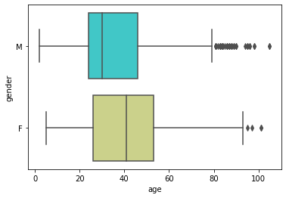
New Customer Activation: Gender Analysis
Key Findings :
39 years is the average age of customers activated during the analysis period
Average age of male customers newly activated is between 20-25 years
Average age of female customers newly activated shows 40-42 years of age

Slide 8
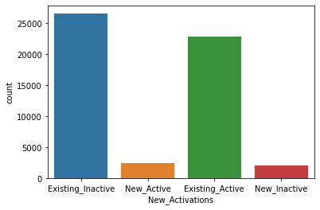
New Customer Activation: Gender Analysis
Key Findings :
Majority of customers continued to be in inactive status (>25k)
A minor fraction of customers (~2k-3k) customers became active during the 6 month under analysis but a little less number of customers became inactive during the period of analysis

Slide 9


