Slide 1

Analysis Case Study Assessment :
Customer Retention Analysis

Slide 2

Business Objective, Understanding and Approach
Business Objective
Key Results
Business Objective
Analysis of 6 months customer data to enable business in strategies to retain customers and increase customer wallet share penetration
Report customer attrition in past 6 months
Detail profiling of customers basis activity status to aid in business insights and business decisioning
Approach
Approach
Perform EDA of data extracted from Datawarehouse of customer details including activity level – active / inactive status across 6 months
Perform necessary data cleaning and data enrichment with objective to build detail customer profile analysis

Slide 3
Analysis/ Modeling Methodology
Data Preparation & EDA
Variable Creation and Selection
Analysis Results
Review of 6 months of customer data
Data attribute ‘active_inactive_start’ type changed from string/object to int64 to enable extensive analysis across all variables
Correlation analysis across all variables to identify key parameters to aid in customer analysis
No missing data reported during EDA
Created new variable ‘New_Activations’ to group customers basis :
New Active: inactive at start but active at end
Existing Active: consistently active Existing Inactive: continued to be inactive
New Inactive: customer active at start but turned inactive at end of period
Relatively high correlation (0.6) between customer age and duration as customer in the bank
High correlation between customer activation status and number of products / cards availed suggest number of products as a good feature for performing predictive analysis on customer activation status
Fairly balanced gender mix across customers not a determining factor in analyzing customer activation status

Slide 4
Exploratory Data Analysis - Summary
Total 54k customers were analysed as part of this data analysis on customer behaviour particularly on customer active / inactive status and any change in their behaviour
No blank values reported in source file
One data field ‘active_inactive_start’ which was in string format had to be converted to int64 format to enable further EDA with other data attribute
Created one additional data field to segregate customers basis their active inactive status during the analysis period of 6 months
Removed outliers existed in gross income which otherwise could impact predictive analysis
Customer Profile:
Average Age: 41 years; Male ~ 35 years; Female ~ 42 Years
Gender Ratio: Balanced across with female customers (29k) more than male (24k) customers
3 different segment of customers with majority as individuals, college graduates and a small proportion as VIPs

Slide 5
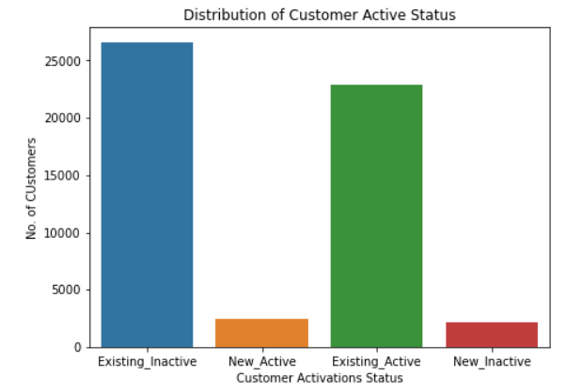
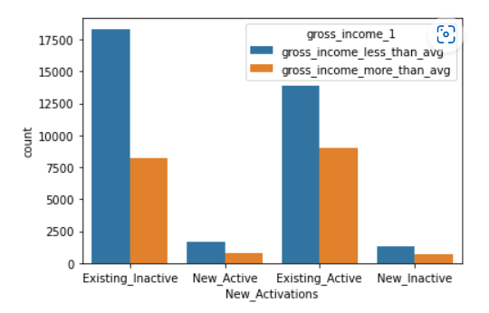
Customer Analysis Basis Active / Inactive Status
2438 customers got activated during the analysis period
However, almost an equal number (2098) customers became inactive during the analysis period
A large number of customers (~26k) remained inactive
~22k customers remained active during the period
Majority of inactive customers has their gross income below the average gross income of all customers in the bank indicating gross_income a possibly key parameter to predict which customers can turn inactive / active in future
The variation in number of customers with below average or above average gross income is not much in case of customers turned active and became inactive in the analysis period

Slide 6
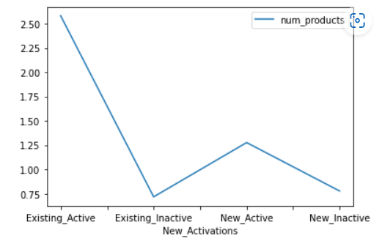
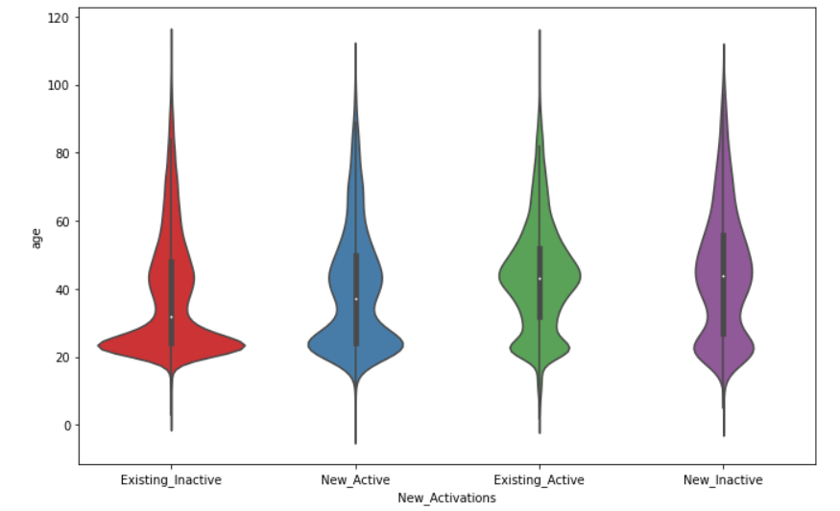
Customer Analysis Basis Active / Inactive Status
Number of products used by customer is a key attribute in retaining customer as active:
1. Existing customers have higher products in use vs customers existing inactive compared to other customers which can be a key parameter in predicting customer activation behaviour
2. Newly active customers have higher usage of products compared to customers who turned inactive
Avg age of existing active customers ~40yrs are more than customers that turned inactive (~35yrs)
Avg age of new inactive customers are ~40yrs as well
Customers that became inactive are a bit younger than customers who continue to remain active

Slide 7
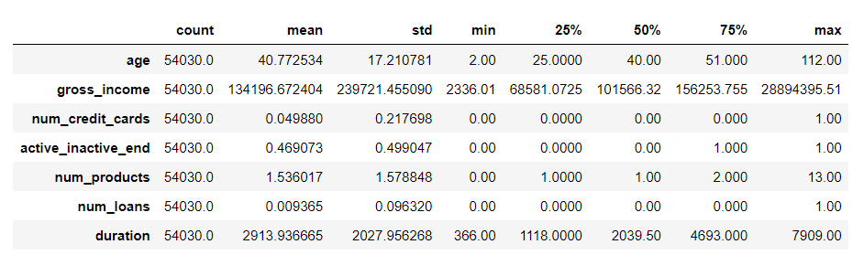
Extended Data Dictionary (EDD)

Slide 8
Feature Engineering – New variables created
Sr. No | Variable Name | Variable Type | Description
1 | New_Activations | String | Bifurcation of customer activity consolidating across 2 features of active_inactive_start and active_inactive_end status

Slide 9
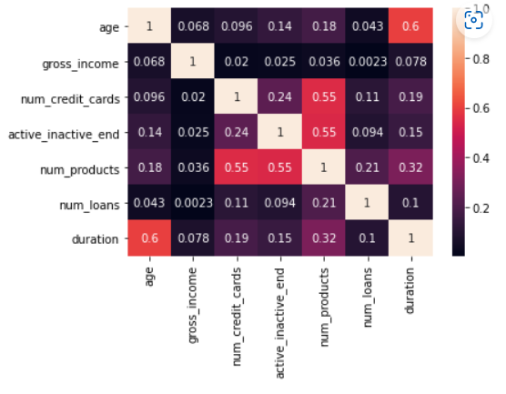
Analysis Results
Key Findings :
Comparatively high correlation between age of customer and duration as customer with the bank reveals customers tend to stick with the bank with more age
Moderate correlation between number of products availed and number of credit cards availed with customer active/inactive status reveals product and credit card as key parameters to determine customer activity behaviour

Slide 10
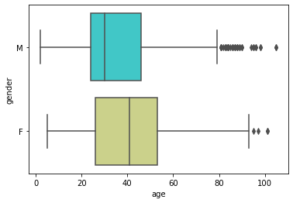
New Customer Activation: Gender Analysis
Key Findings :
39 years is the average age of customers activated during the analysis period
Average age of male customers newly activated is between 20-25 years
Average age of female customers newly activated shows 40-42 years of age

Slide 11


