Slide 1
FLY INDIA Airline Reservation Software

Slide 2
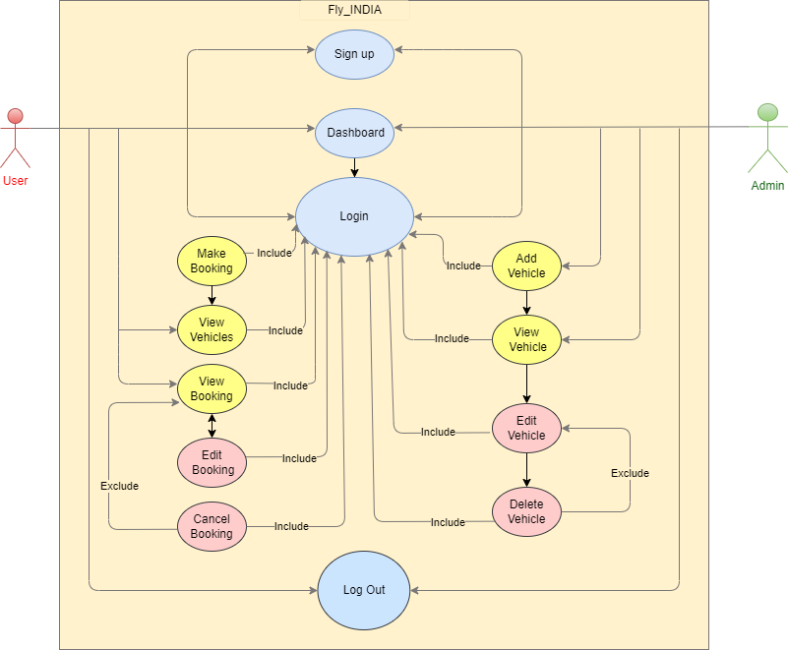
Use Case Diagram

Slide 3
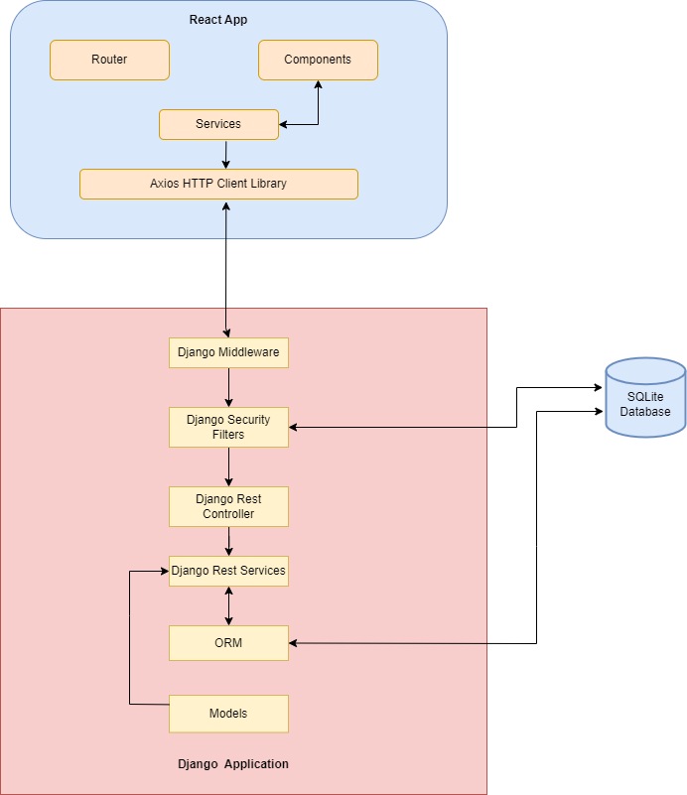
High Level Design Diagram

Slide 4
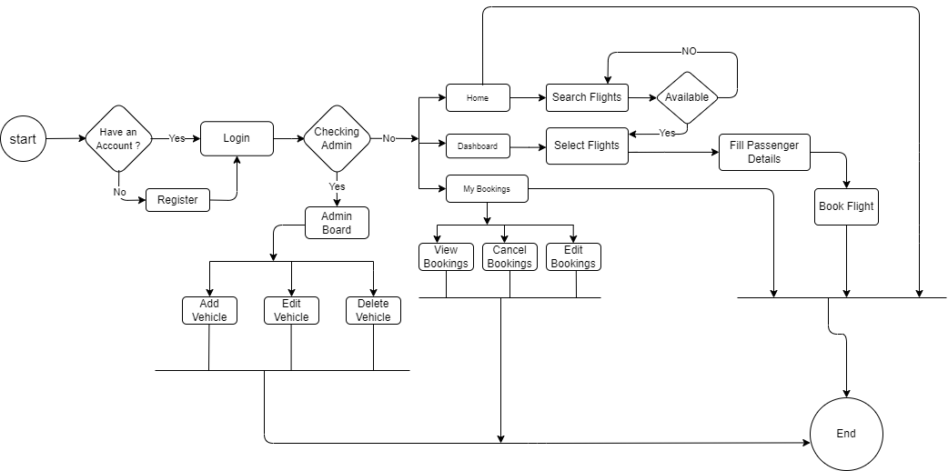
Activity Diagram

