Slide 1
Artificial Intelligence
Here is where your
Journey to the cyber world begins

Slide 2
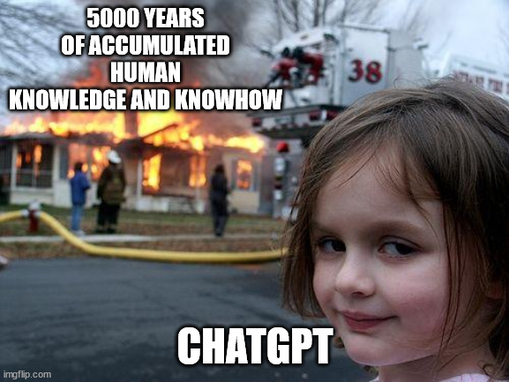
What ??
Artificial intelligence is the science of making machines that can think like humans. It can do things that are considered "smart.“

Slide 3

Why ??
Automation
Decision making
Efficiency
Personalization
Innovation
Insights
Accessibility
Safety

Slide 4
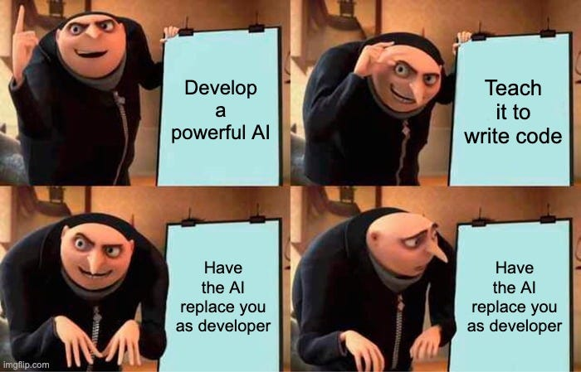
Where and how ??
EVERY WHERE!!!

Slide 5
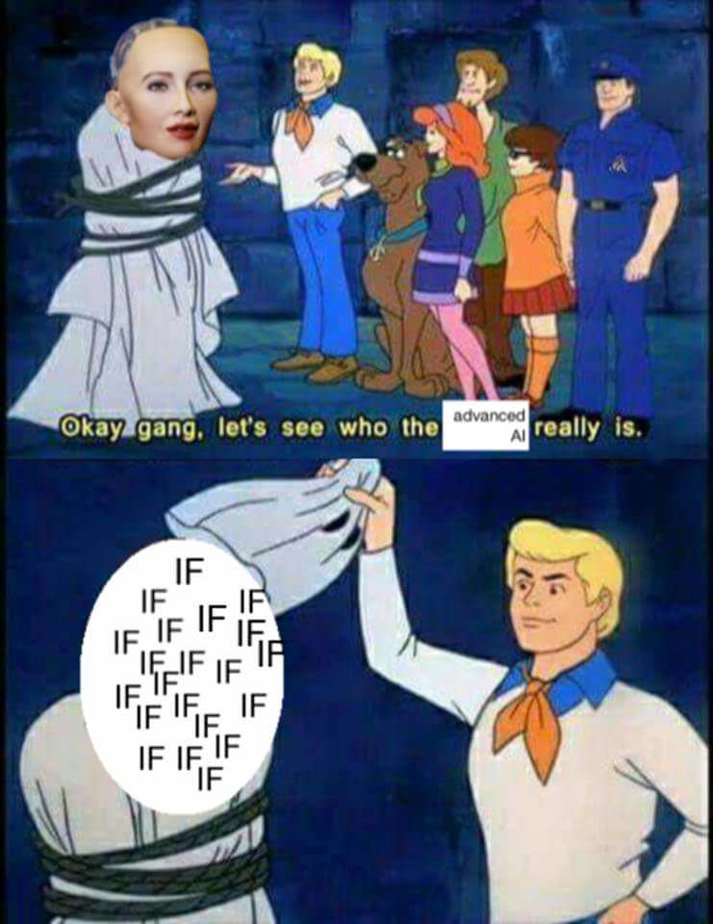
HOW?

Slide 6
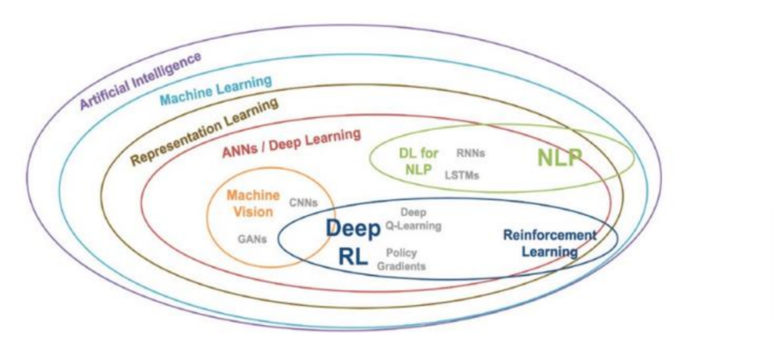
Ai vs ML vs DL vs all other Crazy terms

Slide 7
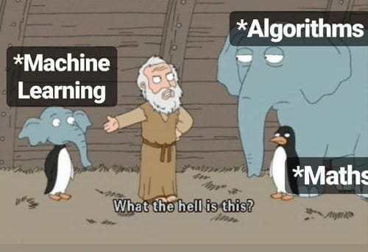

Slide 8
Machine learning is a subset of AI which provides Machines the ability to learn automatically & improve from experience without being explicitly programmed.ex-supervised,unsupervised
Representation Learning is a process in machine learning where algorithms extract meaningful patterns from raw data to create representations that are easier to understand and process.ex-PCA,SVM
Deep learning is a specific type of representation learning that uses neural networks with many layers to learn representations of data.
Artificial neural network (ANN) model involves computations and mathematics, which simulate the human–brain processes. Subsets-CNN,RNN
Machine vision is the ability to make the computers see .
Generative Adversarial Network (GAN) is a deep learning architecture. It trains two neural networks to compete against each other to generate more authentic new data from a given training dataset.
Natural language processing (NLP) is a machine learning technology that gives computers the ability to interpret, manipulate, and comprehend human language.
Reinforcement learning (RL) is a machine learning (ML) technique that trains software to make decisions to achieve the most optimal results.

Slide 9
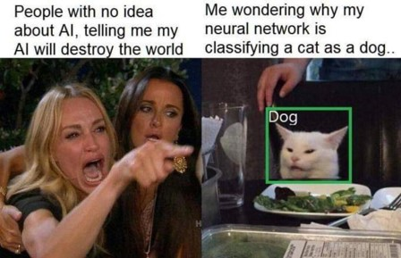

Slide 10
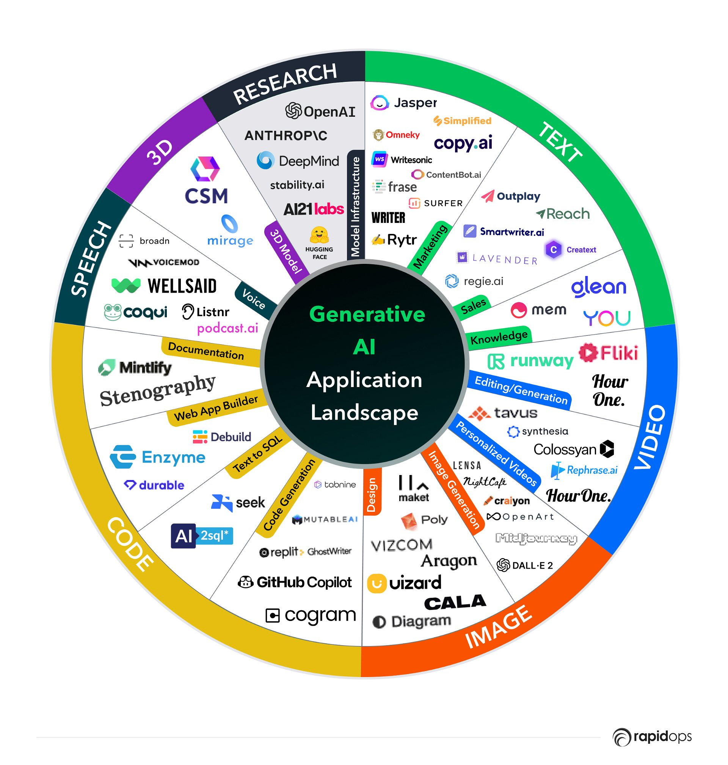
RECENT AI TECH
Generative ai
Artificial intelligence technology that can produce various types of content, including text, imagery, audio and synthetic data. The recent buzz around generative AI has been driven by the simplicity of new user interfaces for creating high-quality text, graphics and videos in a matter of seconds.

Slide 11
AI future infographics
The global AI market witnessed a significant valuation of USD 454.12 billion in 2022, By 2032, it is anticipated to soar to approximately USD 2,575.16 billion, reflecting a noteworthy compound annual growth rate (CAGR) of 19% from 2023 to 2032.
Cybersecurity:Anticipated to grow at a Compound Annual Growth Rate (CAGR) of 19.4% from 2023 to 2032, it is projected to reach $102.78 billion. Estimated at approximately $17.4 billion in 2022
Healthcare:The estimated size of the worldwide market for artificial intelligence (AI) in healthcare was USD 15.1 billion in 2022. Projections indicate substantial growth, with expectations to exceed USD 187.95 billion by 2030, exhibiting an impressive Compound Annual Growth Rate (CAGR) of 37%.
Entertainment:In 2021, the global market for AI in the media and entertainment industry achieved a substantial valuation of USD 10.87 billion. This dynamic sector is set for impressive growth, with an expected Compound Annual Growth Rate (CAGR) of 26.9% forecasted from 2022 to 2030.
Recruitment Industry:As per a Market Research Future report, the AI recruitment market worldwide is projected to achieve $942.3 million by the year 2030, with a compound annual growth rate of 6.9% anticipated from 2020 to 2030.

Slide 12
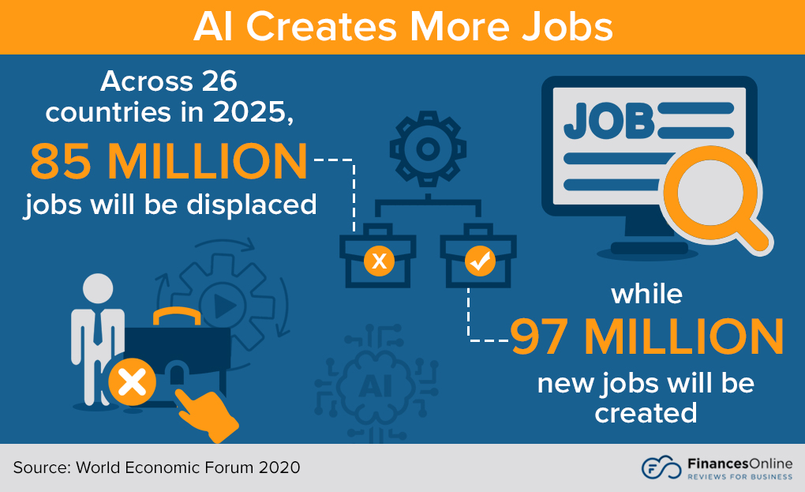
Robotic workshop infographics
2
3
1
Mars
Despite being red, Mars is cold
1
4
2
Mercury
Mercury is the smallest one
3
Saturn
Saturn has several rings
4
Venus
Venus is a very hot planet

Slide 13
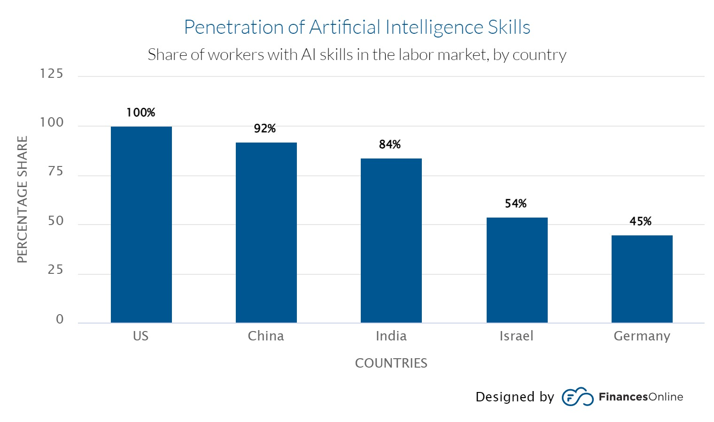

Slide 14
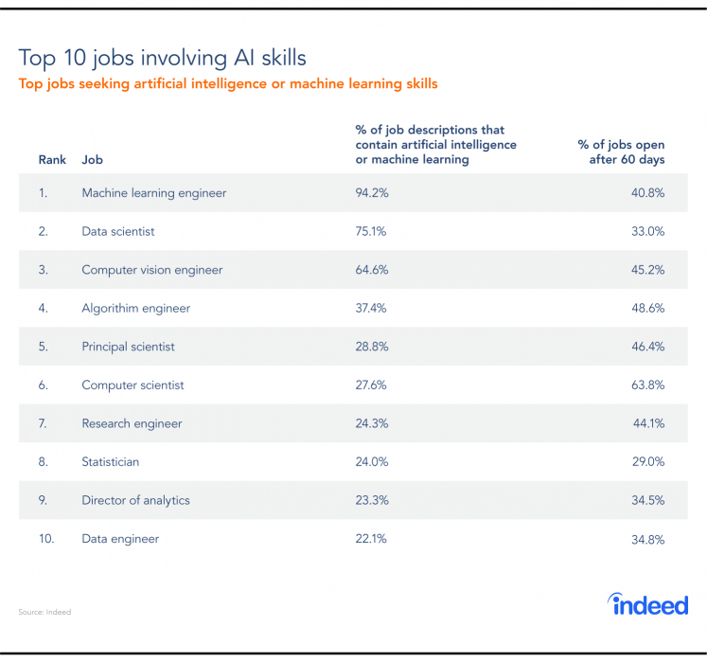
AI JOBS

Slide 15
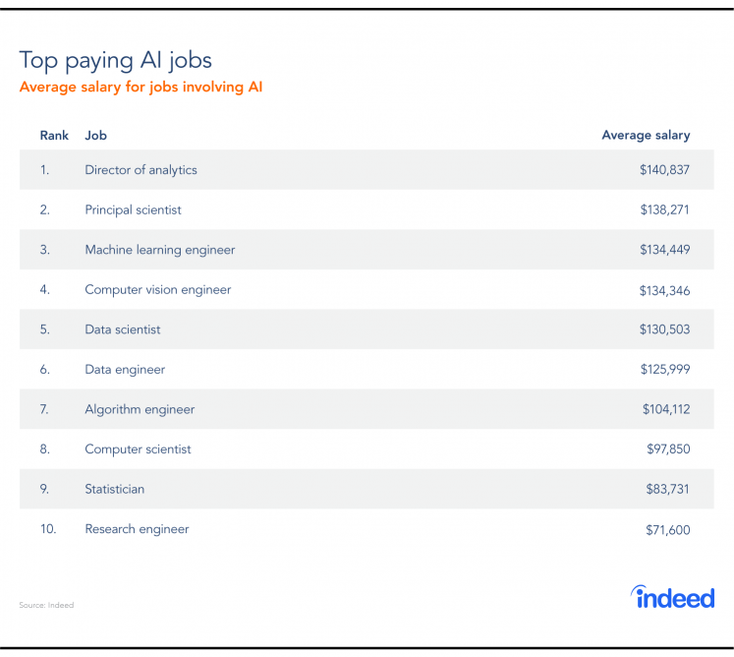
AI JOBS

Slide 16
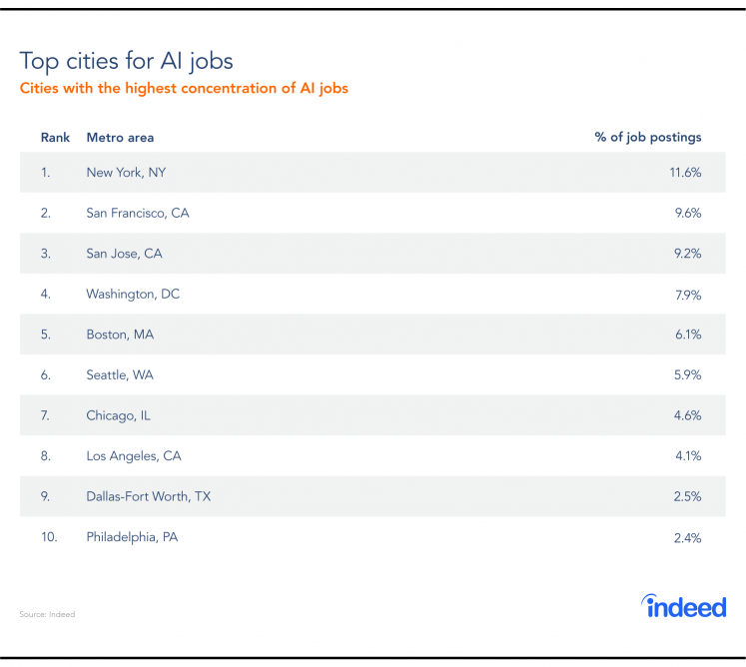
AI JOBS

Slide 17
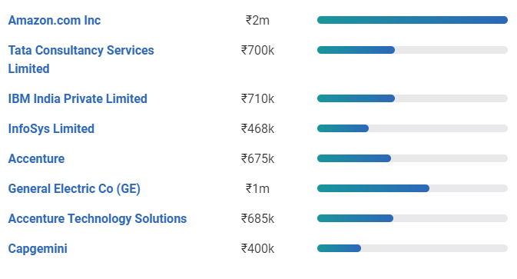
AI JOBS

Slide 18
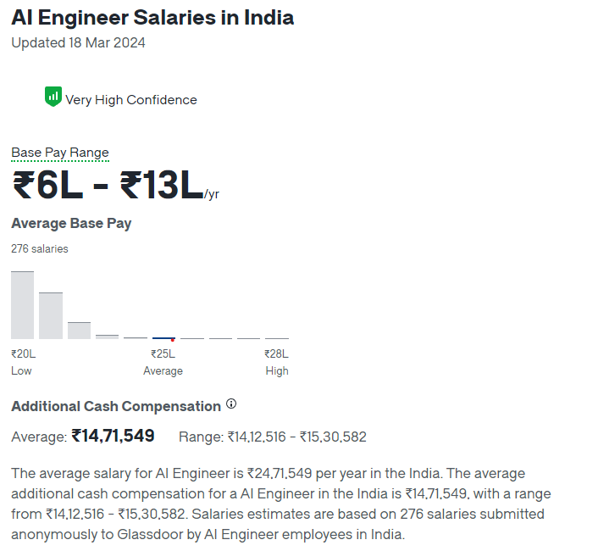
AI JOBS

Slide 19
Where to start?
Foundation in Mathematics and Statistics
Deep Learning
1
4
Programming Skills
Specialize in a Subfield
2
5
Understand Data Science and Machine Learning
Projects and Continuous Learning
3
6

Slide 20
End of session 1

Slide 21


Software Installation

Slide 22
Session 2: Computer vision

