Slide 1
SPEECH TECHNOLOGY PROJECT
From Voice to Text
and Back
ASR, CTC, WER and text-to-speech analysis
of a speech sample with disfluencies
Speech
>
Features
>
ASR
>
Text
>
TTS
MP3
Waveform + Mel
2 alternatives
CTC / WER
Synthesized audio
36.49-second English sample | Wav2Vec2 + Whisper | TTS
Educational demonstration - not a clinical assessment
01 / 15

Slide 2
The project in one minute
A complete speech-to-text-to-speech workflow
Speech
>
Features
>
ASR
>
Text
>
TTS
MP3
Waveform + Mel
2 alternatives
CTC / WER
Synthesized audio
Analyze
Recognize
Evaluate
Synthesize
Inspect amplitude and frequency structure.
Compare CTC-based Wav2Vec2 with Whisper.
Compute edit counts and word error rate.
Speak the selected transcript back as audio.
Key result: the current run reports 18.52% WER for Wav2Vec2 and 1.23% for Whisper - but the reference is provisional and biased toward Whisper.
STUTTER SPEECH ASR + TTS | Educational demonstration
02 / 15

Slide 3
Input recording and experiment scope
What was analyzed - and what the numbers represent
Recording
Processing
Scope
audio/new_stutter.mp3
37.64 seconds | 44,100 Hz
Mono analysis
Wav2Vec2 resampled to 16 kHz
One English speech sample
Educational pipeline demonstration
Research question
How do two popular ASR approaches transcribe the same disfluent speech sample, and how can their word-level differences be measured?
This single-sample exercise cannot diagnose a speaker or generalize model accuracy. WER depends on a verified reference transcript.
STUTTER SPEECH ASR + TTS | Educational demonstration
03 / 15

Slide 4
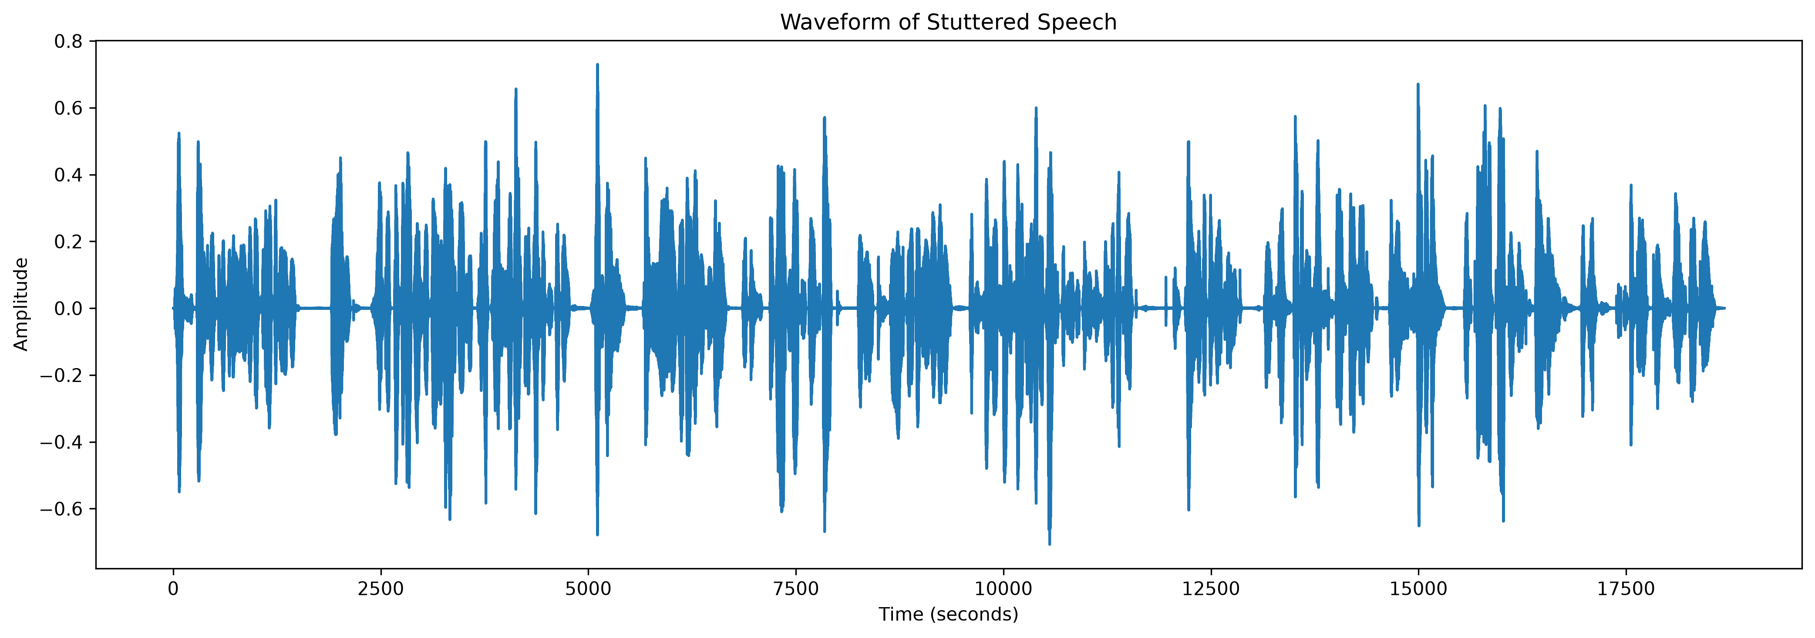
1 | Inspect the waveform
Amplitude and pauses over the recording timeline
Waveform is useful for locating activity and pauses. It does not reveal the words or diagnose a fluency disorder by itself.
STUTTER SPEECH ASR + TTS | Educational demonstration
04 / 15

Slide 5
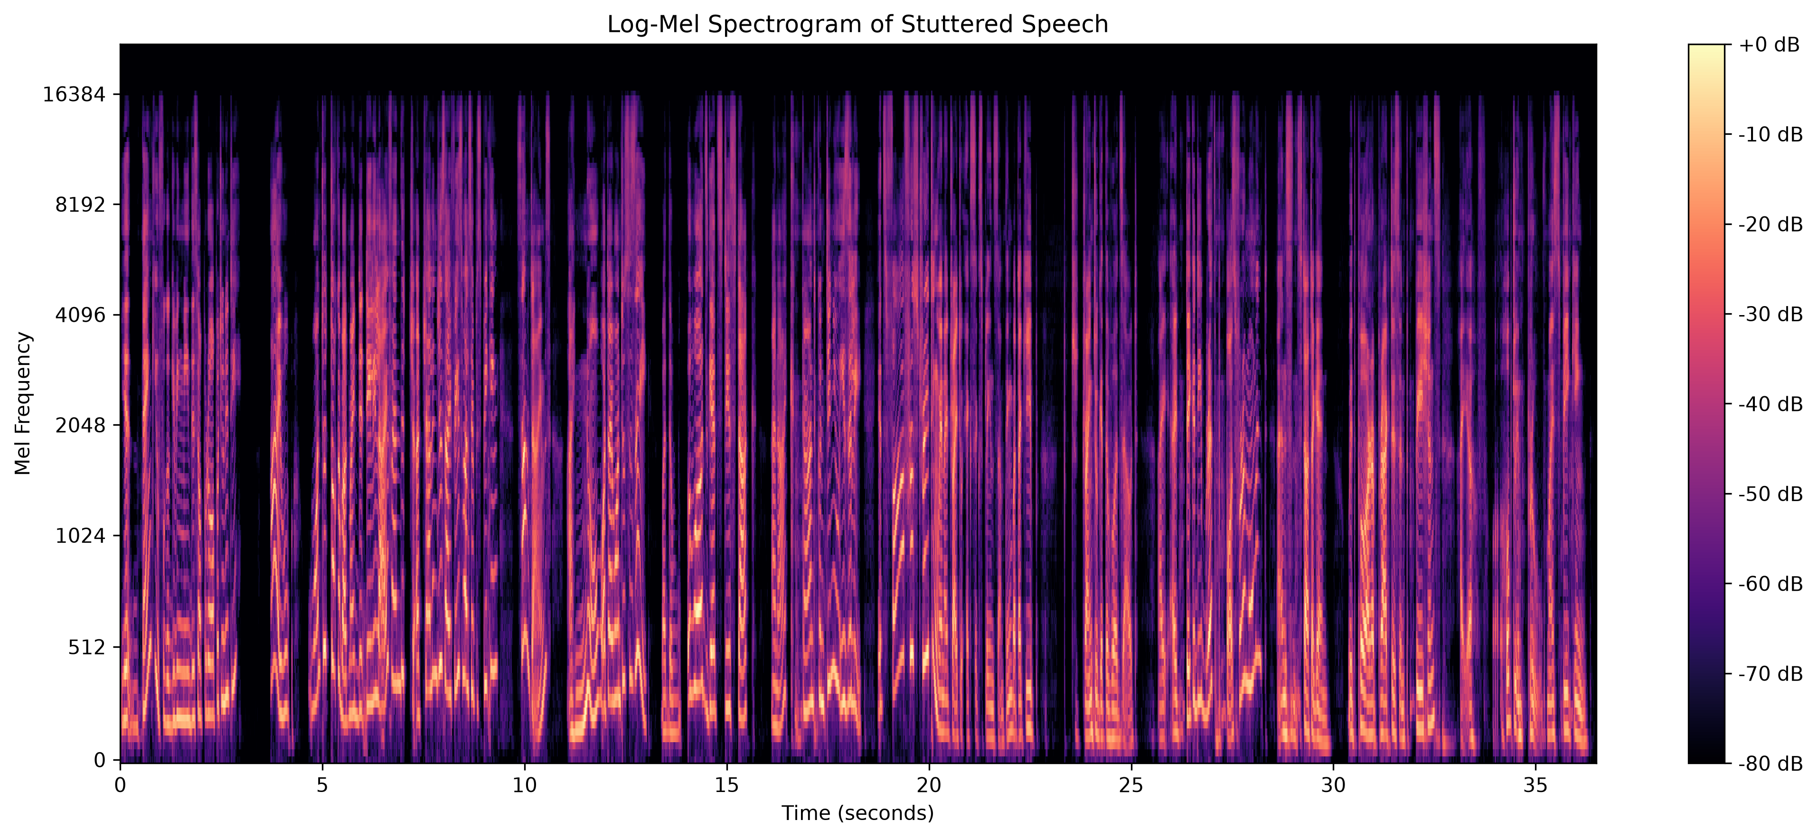
2 | Transform audio into log-Mel features
Short-time spectral energy represented on a perceptual frequency scale
Mel bands
FFT / hop
Scale
128
2048 / 512 samples
Power converted to dB
STUTTER SPEECH ASR + TTS | Educational demonstration
05 / 15

Slide 6
3 | Two ASR architectures
Parallel alternatives; not a single serial recognizer
Wav2Vec2 encoder
waveform -> character logits
CTC collapse
repeat + blank
Speech
MP3
Text -> WER -> TTS
Whisper encoder
log-Mel audio features
Text decoder
autoregressive
Important: Whisper is not a CTC model. The Wav2Vec2 branch is the one decoded with CTC.
STUTTER SPEECH ASR + TTS | Educational demonstration
06 / 15

Slide 7
4 | Wav2Vec2 with CTC
facebook/wav2vec2-base-960h - greedy token decoding
Input
Acoustic model
Decoder
Mono waveform resampled to 16 kHz
Convolutional features + Transformer context
Frame-wise argmax + CTC batch decode
Transcript excerpt
YE THANK YOU FOR GIVING ME THIS OPERA OPPORTUNITY I WANT TO TALK ABOUT MY DAILY LIFE AND THE CACHALLENGES I FACE WHILE SIP SPEAKING SOMETIMES I KNOW WHAT I WANT TO TSAY BUT THE WORDS GETS DISTUCK AND I CAN'T CONTINUE EASILY IT'S FAR FROM STRATING WHEN I TRY TO EX EXPLAIN SOMETHING BUT I KEEP SHE TRYING TO GET THE WORDS OUT I I TAKE A DEE...
Observed transcription contains substitutions and extra tokens; confirm errors against audio rather than assuming the reference is correct.
STUTTER SPEECH ASR + TTS | Educational demonstration
07 / 15

Slide 8
5 | CTC: align without frame-level labels
Collapse adjacent repeats first, then remove blank tokens
Frame predictions
blank | A | A | blank | A | B | B | blank
Merge adjacent repeats
blank | A | blank | A | B | blank
Remove blanks
A | A | B
Decoded output
AAB
A, blank, A -> AA; adjacent A, A -> A. The blank preserves repeated letters when separated.
STUTTER SPEECH ASR + TTS | Educational demonstration
08 / 15

Slide 9
6 | Whisper-base
Encoder-decoder ASR with autoregressive text token generation
Audio features
Model
Decoding
Whisper extracts log-Mel features internally
faster-whisper base; CPU int8
English hint; beam size 5
Transcript excerpt
Yeah, thank you for giving me this opportunity. I want to talk about my daily life and the challenges I face while speaking sometimes. I know what I want to say, but the words get stuck and I can't continue easily. It's far frustrating when I try to explain something but I keep trying to get the words out. I take a deep breath, pause for a moment and start again with poor practice and pa...
Fluent wording is not proof of verbatim transcription. The recognizer may normalize or omit disfluencies.
STUTTER SPEECH ASR + TTS | Educational demonstration
09 / 15

Slide 10
7 | Evaluation with word error rate
Word-level edit distance relative to a reference transcript
WER = (Substitutions + Deletions + Insertions) / Reference words
Reference
Normalize
Align
Count
81 words
case / punctuation
JiWER operations
S, D, I
WER is meaningful only if the reference is independently verified and transcription conventions are consistent.
STUTTER SPEECH ASR + TTS | Educational demonstration
10 / 15

Slide 11
8 | Results on the current reference
One sample; current reference transcript is provisional
Wav2Vec2 CTC
18.52%
Whisper
1.23%
0
20
40
60
80
100
WER (%) - lower is better only when the reference is trustworthy
Model | Hits | Sub | Del | Ins | Words | WER
Wav2Vec2 CTC | 74 | 7 | 0 | 8 | 81 | 18.52%
Whisper | 81 | 0 | 0 | 1 | 81 | 1.23%
STUTTER SPEECH ASR + TTS | Educational demonstration
11 / 15

Slide 12
9 | Critical evaluation caveat
The current comparison favors the model that shaped the reference
Current reference
Whisper hypothesis
81 words; not independently verified against the recording
Closely follows the provisional reference text
Therefore, 1.23% is not a fair accuracy benchmark.
Listen to the source audio, prepare a verbatim transcript independently, define a consistent policy for repetitions and fillers, review uncertain spans, then rerun both WER calculations.
These results describe one example only; do not infer general model superiority.
STUTTER SPEECH ASR + TTS | Educational demonstration
12 / 15

Slide 13
10 | Text-to-speech
Convert a recognized transcript back into an audio signal
Whisper text
>
TTS engine
>
WAV output
>
Listen
>
Caution
recognized words
Windows SAPI
PCM audio
quality check
synthetic voice
Generated artifact
Interpretation
outputs/tts_output.wav
28.7 seconds | 22,050 Hz | mono
Synthetic speech of the transcript; it does not recreate the original speaker or their disfluencies.
The notebook includes an optional gTTS alternative; it requires an internet connection.
STUTTER SPEECH ASR + TTS | Educational demonstration
13 / 15

Slide 14
11 | Reproducible run order
Repository scripts and generated artifacts
Scripts
Set-Location "D:\stutter project 191"
main.py | asr.py | whisper_asr.py | wer.py | tts.ps1
$py = ".\.venv\Scripts\python.exe"
& $py main.py
Artifacts
& $py asr.py
Waveform, log-Mel image, transcripts, WER CSV, synthesized WAV
& $py whisper_asr.py
& $py wer.py
Reproducibility
.\tts.ps1
Use same audio and a human-verified reference; record model versions and settings.
STUTTER SPEECH ASR + TTS | Educational demonstration
14 / 15

Slide 15
Takeaways and next steps
A useful pipeline demonstration - with evaluation caveats made explicit
What works
What needs validation
What comes next
Feature plots, two ASR paths, CTC explanation, WER, and TTS.
Reference transcript and the resulting accuracy comparison.
Independent transcript review and broader recordings.
Bottom line
A complete speech pipeline is demonstrated. Reliable ASR conclusions require an independent, carefully annotated reference and evaluation beyond one sample.
Selected reading: Graves et al. (2006), CTC; Baevski et al. (2020), wav2vec 2.0; Radford et al. (2023), Whisper.
STUTTER SPEECH ASR + TTS | Educational demonstration
15 / 15

