Slide 1


SMART INDIA HACKATHON 2024
TITLE PAGE
Problem Statement ID – 1670
Problem Statement Title – Develop a functional solution that incorporates the security of the ML model.
Theme – Smart Automation
PS Category – Software
Team ID – 31038
Team Name – ARTISYN

Slide 2
MODEL AUTHENTICATION & SECURITY SYSTEM
ARTISYN
IDEA / SOLUTION:
Implementation of a cryptography-based security solution for protecting the integrity of an ML Model in browser context.
Enables secure client-side authentication.
ML model is encrypted and then compressed in the server during frontend first run and sent to client.
Model is decompressed and cached in the client and subsequently the cached model is used.
Encryption using AESGCM-256 ensures the model binaries are not tampered with.
Compression/Decompression using DEFLATE ensures lossless data transmission over network.
Cryptographic hashing technique using SHA-256 used to ensure model integrity before execution.
Problem Resolution:
Client-side authentication allows for data processing by model in the client machine itself, thereby decreasing server load.
Suitable for use in poor network conditions due to reduction in network traffic.
Unique Value Propositions (UVP):
Dynamic ciphertext for every encryption.
Fast encryption due to efficiency of AESGCM-256.
Two-tier security via server-side hash verification that prevents tampered model from executing on the client and permanently blocks access to that client.

Slide 3
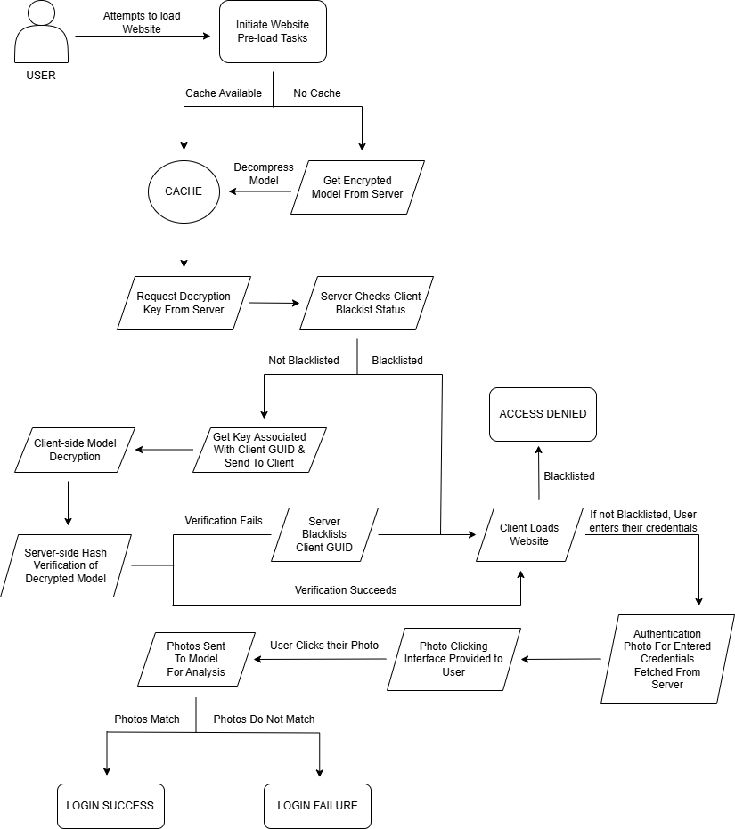
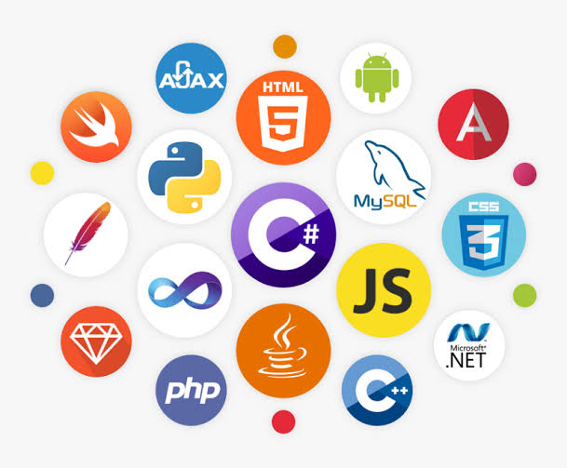
TECHNICAL APPROACH
ARTISYN
Technologies Used:
Client-side:
JavaScript
HTML
CSS
Server-side:
Python
Flask
Encryption:
AESGCM-256
Compression:
DEFLATE (gzip)
Hashing:
SHA-256
Product Status:
Product is currently in ALPHA stage of development.

Slide 4
FEASIBILITY AND VIABILITY
ARTISYN
Feasibility:
Technologies used for development are free and open-source, without major licensing restrictions.
Software product eradicates additional costs associated with components of hardware products.
Limited availability of authentication systems with secure client-side model processing, thereby making the product commercially viable.
Low operational costs due to automation and less human intervention.
Potential Challenges:
Cutting-edge technologies are prone to bugs and security vulnerabilities which may compromise the system.
Some useful sources of reference are available only via a premium subscription.
Varying customer/client demands and market competitons may pose a challenge for commercial availablity.
Server downtime can affect operational efficiency.
Strategies For Overcoming the Challenges:
Usage of libraries and packages that the regularly maintained and well-supported by their developers.
Referring to free and publicly-accessible sources of reference like documentations and sites like stackoverflow.com.
Make the product free and open-source for knocking off potential competition. The Linux Kernel is the best example of a free and open-source commercial success.

Slide 5
IMPACT AND BENEFITS
ARTISYN
Server operational efficiency is increased because the image authentication and its associated processing is handled by the model running in the client itself, thus reducing server load.
Allows for seamless usage over varying network conditions once the cache has been generated.
Uses the DEFLATE algorithm for compression of the model during transmission from server to client, thus eliminating any potential data loss due to compression.
Comes with the robust security of AES-256 in GCM mode, which is practically not feasible to be breached by brute force attacks with currently available technology.
SHA-256 hash verification of decrypted model files in the client by the server allows the server to determine if the client has a tampered model. Since model tampering is not usually done by a typical user, it is a sign of intrusion attempt and such clients are immediately blocked access to the system to prevent potential security breaches.

Slide 6
RESEARCH AND REFERENCES
ARTISYN
https://flask.palletsprojects.com/en/3.0.x/
https://cryptography.io/en/latest/hazmat/primitives/aead/#cryptography.hazmat.primitives.ciphers.aead.AESGCM
https://docs.python.org/3/library/hashlib.html
https://docs.python.org/3/library/gzip.html
https://stackoverflow.com
https://cryptography.stackexhange.com
Guidance from seniors and teachers

