Slide 1
BASE AREA – SWARM ROBOTICS
Obstacle Avoidance & Path Planning of a Terrestrial Swarm Robotic System
MASTERS IN CONTROL SYSTEMS ENGINEERING
JADAVPUR UNIVERSITY
ARIJIT KUMAR HALDAR
MCSE, FIRST YEAR, SECOND SEMESTER
ROLL NUMBER : 002010804015

Slide 2
Topics covered during First Semester
Introduction
  Swarm is a behaviour exhibited by an aggregation having a collective motion. Swarm systems can be both natural and using robotic agents [11].
  Swarm robotic system uses individual robots or agents that are relatively weak or inefficient to carry out a certain task as individual agents, but can work together to complete the task efficiently [11].
Advantages of Swarm Robotics
  Robustness – Swarm robotic systems are fault tolerant and are generally fail-safe than a single robot [11].
    Redundancy – Due to multiple number of agents equipped with the same hardware, where any robot can take up any other’s place, redundancy is maintained [11].
    No single point of failure – Due to agents being alike, in case of some failure in the system, the system as a whole continues to function as it was designed with very little changes to the system. So, momentary loss of coordination does not lead to mission failure [11].
  Flexibility – Due to agents being identical, every agent can take up any other agent’s task. Also, the coordination behaviour can be adapted easily to a wide variety of situations based on mission needs [11].
  Scalability – The size of the swarm can be increased or decreased as needed, with little or no change in the control algorithm. Also, in case of loss of some agents, the swarm system adapts to the new swarm size with no outside interaction [11].

Slide 3
Topics covered during First Semester (contd.)
Swarm size – Swarm robotic system may theoretically have an upper limit of less than Avogadro number of agents, due to being in the domain of statistical averages. But, Swarm Robotic systems are generally comprised of anything from more than 3 agents to some multiple of 1000 agents [11].
Basic capabilities required – local sensing of the environment, local communication between agents and capability to distinguish between an obstacle and other agents in its environment are some essential capabilities for each agents in the swarm [4].
Literature survey on multi-robot path planning based on Elliptical Fourier Analysis (EFA) [2]
Briefly discussed on the method of virtual boundary formation by distorting an ellipse [2] to closely resemble the narrow path through which to pass, and agent close packing.
Discussed on the advantages of path planning using this approach, as understood by me after reading the paper, though further study into EFA was not done.
Introduced the topics of leader follower implementation [4], attraction-repulsion function [5] and particle swarm optimization [14], though no mathematical modelling was done during the first semester. I discussed the literature, its approach and advantages of these methods in a swarm robotic system.

Slide 4
Simulation done during the first semester
The objective of the simulation was to demonstrate the formation and maintenance of a swarm system while avoiding obstacles.
The simulation was based on the equations for “boids” or bird-oids [6] by Craig Reynolds. Obstacle avoidance was made simply to calculate the distance of each agent from the walls of the obstacle, and if the distance becomes smaller than a certain threshold, then decrease the velocity and change the velocity vector to point away from the obstacle.
I was able to show swarm formation using this simulation, but leader-follower implementation was not possible, which I had claimed earlier in my proposal, because after the first few agents were introduced, the first agent, or the leader was not made unique from the other agents.
Also, attraction-repulsion functions were not fine-tuned here, which I corrected in the second semester, due to which my simulation solely depended on the distances calculated according to the cartesian coordinates of the agents and obstacles throughout the resource profile.
Any goal was not defined here, so the agents “wandered” around.

Slide 5
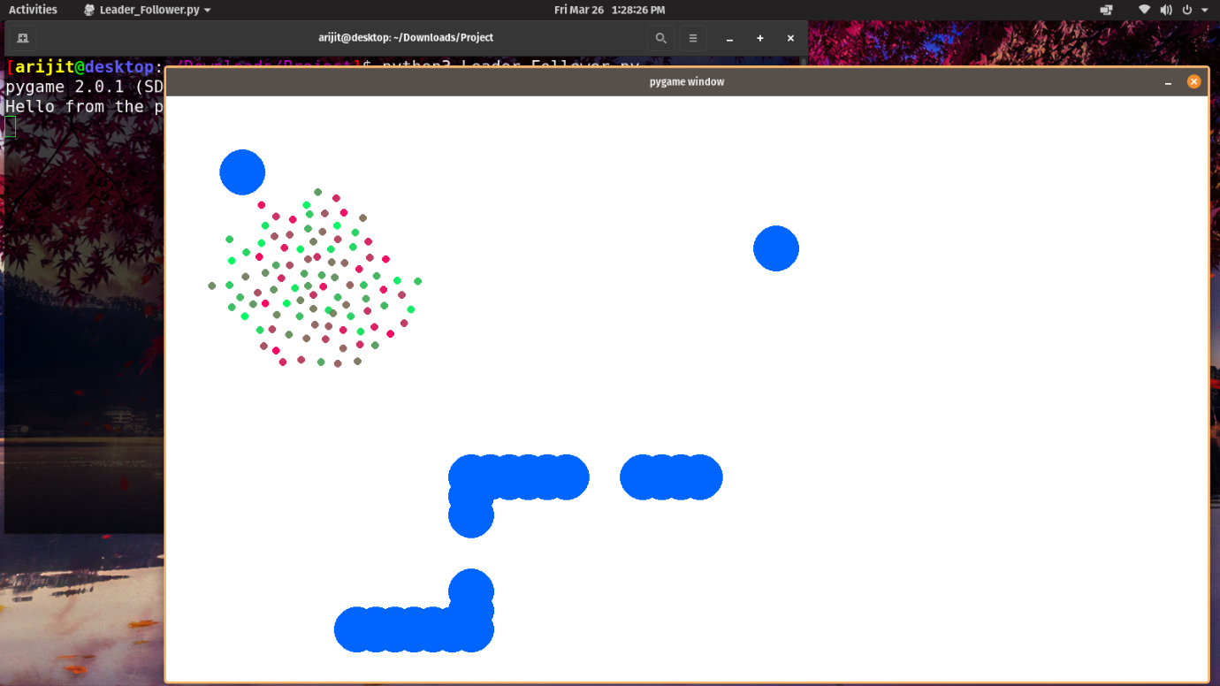
Screenshot of the simulation
Fig 1: Screenshot depicting swarming action

Slide 6
Topics covered during Second Semester
Continuing from the work done in the first semester, I started the work for second semester with some basic single robot path planning methodologies.
Bug Algorithms –
Bug-1 Algorithm [15]–
  This method allows the robot to move from the source coordinate to the destination coordinate in a straight line. This continues till any obstacle is encountered in the straight line path.
  As soon as the obstacle is encountered, the robot switches from line-of-sight following mode to obstacle-edge following mode. It moves around the edge of the obstacle, while calculating the distance between the present edge coordinate to the goal coordinate.
  As soon as the minimum distance is found, the robot leaves edge-following mode and moves in a straight line towards the goal, till any other obstacle is encountered.
Bug-2 Algorithm [15]–
  This method is similar to bug-1 algorithm, but differs in the edge-following state. In this method, the robot follows the edge of the obstacle till the coordinate of intersection with the line-of sight.
  As soon as the point of coordination is reached, the robot leaves edge-following and continues along the line of sight to the goal.

Slide 7
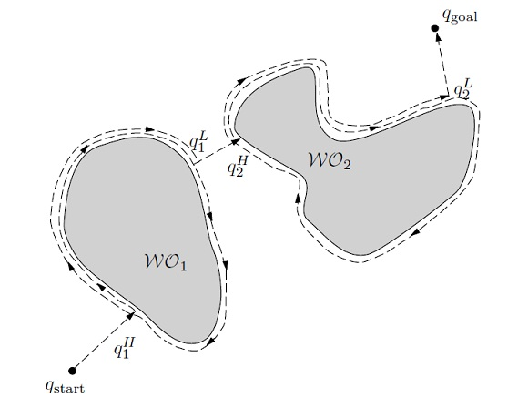
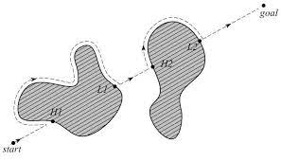
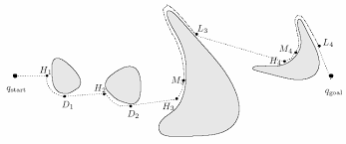
Topics covered during Second Semester (contd.)
Bug-tangent Algorithm [15] –
  Again, a variant of bug-2 algorithm, where the robot leaves edge-following as soon as the immediate coordinate of the obstacle edge has line of sight with the goal coordinate.
  This essentially makes the robot leave the edge of an obstacle at a tangent, and then follows along the new line of sight path.
The next literature survey included the method of Artificial Potential Field [12], its usage as a method to mathematically warp the resource profile for taking into account the obstacles and goal as potential functions, and its drawbacks if the swarm system do not have a defined attraction, repulsion function to counteract local minima conditions.
Fig 4: Bug-tangent Algorithm [15]
Fig 2: Bug-1 Algorithm [15]
Fig 3: Bug-2 Algorithm [15]

Slide 8
Swarm Modelling
Mathematical modelling
Swarm modelling [1] –
  Defining system variables for position, velocity, mass of agent, etc.
  Attraction function [1] :
  Repulsion function [1] :
  Formation control [1] :

Slide 9
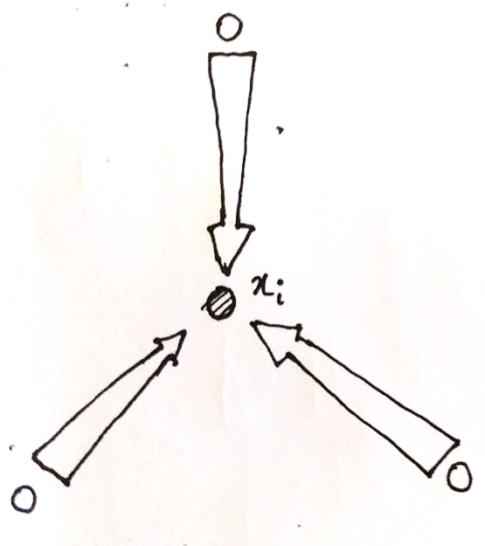
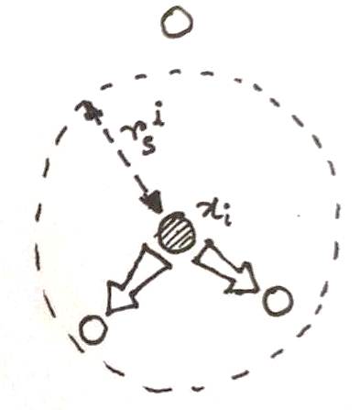
Visualization of attraction/repulsion function
Fig 5: Depicting Attraction function
Fig 6: Depicting Repulsion function

Slide 10
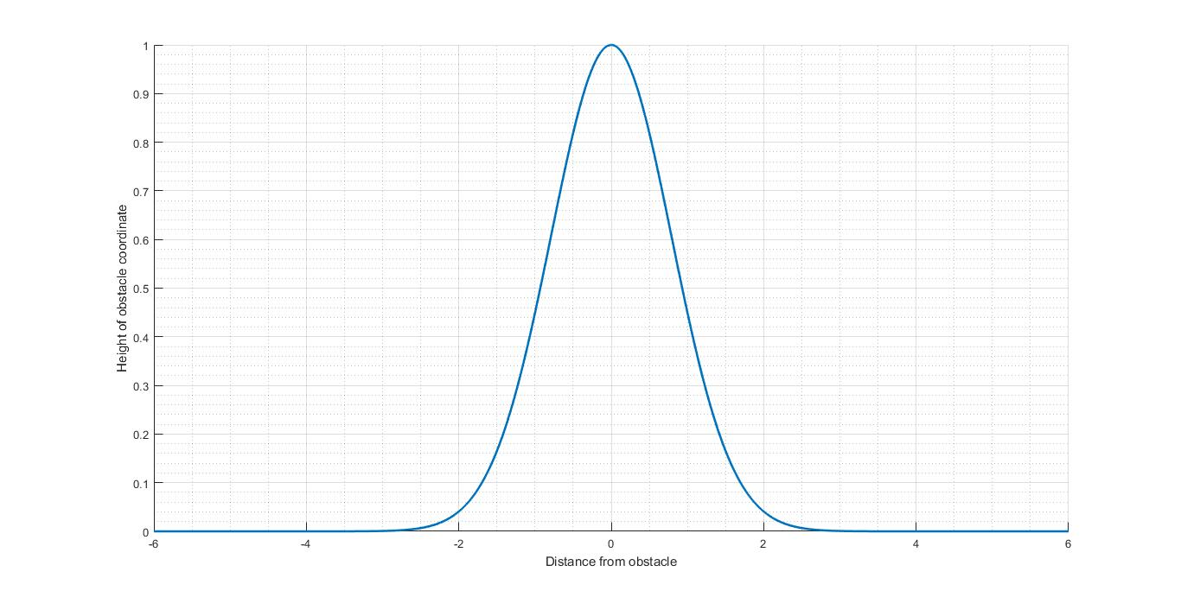
Environment Modelling
Mathematical modelling
Environment modelling –
  Defining resource profile as a function of distance from goal coordinate [1].
  Defining obstacles as individual gaussian functions of unit height, independent of each other [1].
Fig 7: Gaussian function for obstacle coordinate

Slide 11
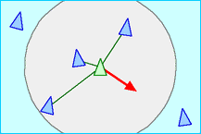
Swarm behaviour - Flocking
The Swarm modelling equations, namely attraction repulsion functions help in defining control rules for the agents in the swarm to maintain before and during actuation.
The environment modelling equations define how the resource profile would be visible to the swarm for avoiding obstacles and reach the goal by following negative gradient [7] of the resource profile.
Control rules to be imposed for swarm formation and flocking behaviour –
Separation : A repulsive interaction at close distances between each agents so that agents do not collide with each other is termed as separation of agents [6].
Fig 8: Visualisation of separation of agents [6]

Slide 12
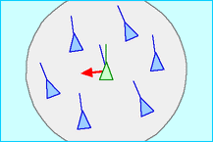
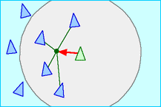
Swarm behaviour – Flocking (contd.)
Control rules to be imposed for swarm formation and flocking behaviour –
Alignment : Turning or aligning the agents towards the average direction or heading of the other agents is termed as alignment of agents in the swarm [6].
Cohesion : An attractive interaction which is directly proportional to the distance of separation between agents is termed as cohesion, which helps in maintaining the swarm flock when agents start going farther apart from the approximate centre of the swarm [6].
Fig 9: Visualisation of aligning of agents [6]
Fig 10: Visualisation of cohesion of agents [6]

Slide 13
Simulation done during the second semester
The objective of the simulation was to demonstrate the three control rules, namely cohesion, alignment and separation in action on a simple swarm system.
To begin, I started with 5 agents, so that the separation rule would be very much dominating to be noticeable. So, the agents move as far away from each other as possible.
As I keep adding agents, one at a time, the alignment and cohesion rules can be clearly seen, and after about 10 agents or more, a very prominent flocking action can be seen.
I also tried to explicitly switch off one control action at a time during the simulation, to see the effect of the control actions on a simple swarm system.
This simulation was like an extension from the simulation I made in the first semester, only, here I did not add obstacles, rather, I tried to demonstrate the control rules being imposed and its effects on the swarm.

Slide 14
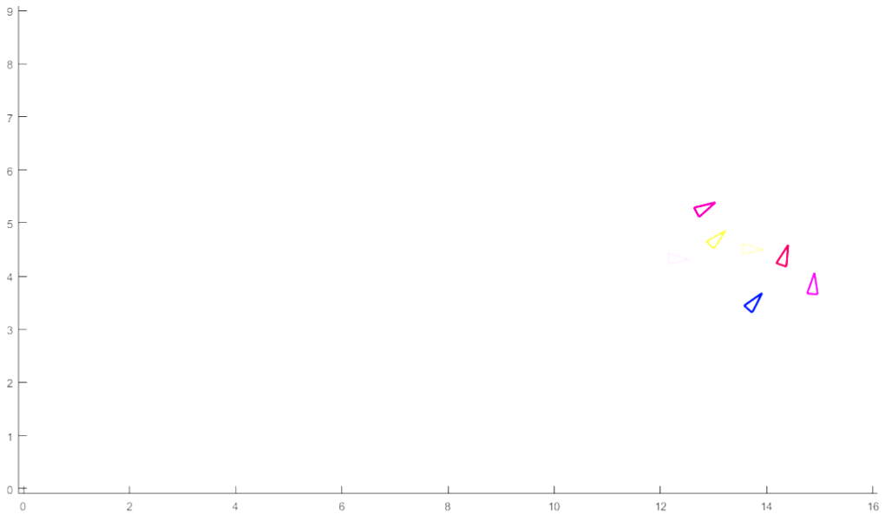
Screenshot of the simulation
Fig 11: Screenshot depicting swarming action

Slide 15
REFERENCES
[1] D. Roy, M. Maitra and S. Bhattacharya, "Study of formation control and obstacle avoidance of swarm robots using evolutionary algorithms“, IEEE International Conference on Systems, Man, and Cybernetics (SMC), pp. 003154-003159, 2016.
[2] D. Roy, A. Chowdhury, M. Maitra and S. Bhattacharya, "Virtual Region Based Multi-robot Path Planning In An Unknown Occluded Environment“, IEEE/RSJ International Conference on Intelligent Robots and Systems (IROS), pp. 588-595, 2019.
[3] V. Gazi and K. M. Passino, "Stability analysis of social foraging swarms: combined effects of attractant/repellent profiles“, Proceedings of the 41st IEEE Conference on Decision and Control, vol. 3, pp. 2848-2853, 2002.
[4] V. Gazi and K. M. Passino, “Swarm stability and optimization”, Springer Science & Business Media, 2011.
[5] V. Gazi and K. M. Passino, "A Class Of Attractions/Repulsion Functions For Stable Swarm Aggregations“, International Journal of Control, vol. 77, issue 18, pp. 1567-1579, 2004.
[6] C. W. Reynolds, "Flocks, herds and schools: A distributed behavioral model“, Proceedings of the 14th annual conference on Computer graphics and interactive techniques, pp. 25-34. 1987.
[7] Y. Liu and K. M. Passino, "Stable social foraging swarms in a noisy environment“, IEEE Transactions on Automatic Control, vol. 49, no. 1, pp. 30-44, 2004.

Slide 16
REFERENCES (contd.)
[8] C. Reynolds, “The boids steering behaviour”, https://www.red3d.com/cwr/boids/
[9] X. Liang, L. Li, J. Wu and H. Chen, "Mobile robot path planning based on adaptive bacterial foraging algorithm“, Journal of Central South University, vol. 20, no. 12, pp. 3391-3400, 2013.
[10] J. A. Oroko and G. N. Nyakoe, "Obstacle Avoidance and Path Planning Schemes for Autonomous Navigation of a Mobile Robot: A Review“, Proceedings of the 2012 Mechanical Engineering Conference on Sustainable Research and Innovation, vol. 4, pp. 314-318, 2012.
[11] H. Hamann, “Swarm Robotics: A Formal Approach”, 1st ed. Springer International Publications, 2018.
[12] M. C. Lee and M. G. Park, "Artificial Potential Field Based Path Planning For Mobile Robots Using A Virtual Obstacle Concept“, In Proceedings 2003 IEEE/ASME International Conference on Advanced Intelligent Mechatronics (AIM 2003), vol. 2, pp. 735-740. IEEE, 2003.
[13] D. Jayaraj, L. T. Vishwanath and O. V. S. Sarma "Path Planning In Swarm Robots Using Particle Swarm Optimization On Potential Fields“, International Journal of Computer Applications 60, no. 13, 2012.
[14] J. Kennedy and R. Eberhart, "Particle Swarm Optimization," Proceedings of ICNN'95 – International Conference on Neural Networks, Perth, WA, Australia, pp. 1942-1948 vol.4, 1995.
[15] H.M. Choset, “Bug Algorithm”, http://webhost.bridgew.edu/jsantore/Teaching-Archive/Fall2017/Robotics/Navigation_bugAlgos.pdf
[16] C. W. Reynolds, “The boids steering behaviour”, https://www.red3d.com/cwr/boids/

Slide 17
THANK YOU

