Slide 1
Personal finance tracker
Arijit Kumar Haldar
Employee Id: 2263388
Cohort Code: mdu23csdaj004

Slide 2
INTRODUCTION
Personal Finance Tracker application let’s the user log-in and enter income and expenditure details. It helps manage finances and provide a graphical way of viewing past transactions. It also has finance predictions.
INTRODUCE
This application is a single-actor application, with the user having sole access to his/her data. This is to prevent unauthorized access of personal financial data.
MENTION
CRUD operations are defined for handling income and expenditure data, and Non-CRUD operations are defined to perform calculations on the entered data. All operations are accessed from the Dashboard of the user.
MENTION

Slide 3
USER LOGIN
Income
Expenditure
Insert
View All
Update
Delete
View All
View By Month
View By Year
View By Month
View By Year
Insert
Update
Delete
View By Date

Slide 4
NON-CRUD OPERATIONS
Calculate Monthly & Yearly Savings Percentage
Predict Savings Amount of Next Month
Predict amount of Savings for the upcoming month based on the data present in the database for that user. Also shows an area chart visualizing Savings amount for the past months.
Calculate savings percentage for a selected month or a selected year, based on user’s choice and display the result in a pie-chart for visualization.
Calculate Percentage Completion of Financial Goal
Let user set a future date and an amount to be saved within that date. Then calculates percentage completion towards that goal. Also shows bar graph with highest expenditure categories each month.

Slide 5
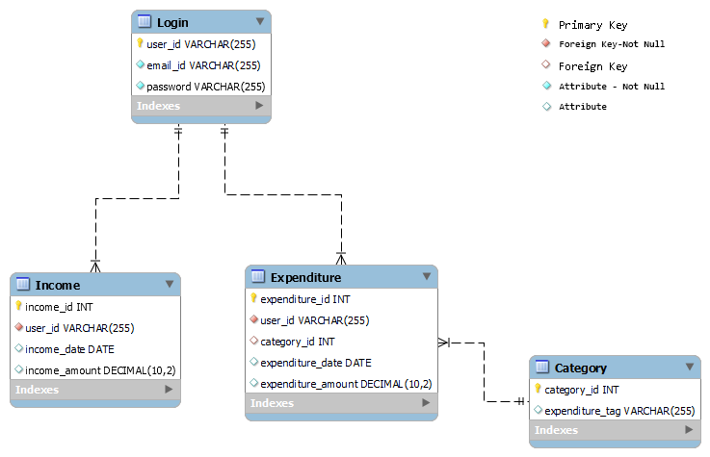
DATABASE SCHEMA DIAGRAM

Slide 6
APPLICATION ARCHITECTURE
UI: ReactJS & Bootstrap
Service Layer: Spring Boot with REST
Development IDE: Eclipse
Business Layer: Entities and service classes
Data Access Layer: Spring Data JPA
Back-end: MySQL

Slide 7
BACKEND STRUCTURE
Entity layer
Repository layer
Service layer
Controller layer

Slide 8
TESTING & LOGGING
Testing Framework: JUnit with Mockito
Logging Framework: SLF4J
API Testing and Debugging: Swagger
Lombok for reducing boilerplate code

Slide 9
Thank You

