Slide 1
Welcome to
PMSCS 670
Software Testing
Md. Rafsan Jani
Assistant Professor
Department of Computer Science and Engineering
Jahangirnagar University
Email: rafsan@juniv.edu

Slide 2
Course Overview
Objective: How to design effective tests, both at the unit and system level
Readings: Lecture materials and reference book.
Marks Distribution(In-Class[40]+Final[60])
Class Tests-25%
Assignments-5%
Attendance-10%
Final-60%
Tutorials:
There will be 3(Descriptive(1) + MCQ(2) ) tutorials
Assignments: 2 assignments
Should be submitted before the deadline
Final: Comprehensive closed-book

Slide 3
Learning Objectives
Students will become better testers
Knowledge and skills for creating high-quality tests at all levels
Students will become better programmers
More aware of potential problems in software
Knowledge and skills for creating high-quality developer tests
Students will become better engineers
A quality-first engineering mindset
Know how to both program and test in a seamless and unified manner
Students will become better thinkers
Encouragement to approach software problem solving in logical, analytical ways

Slide 4
Text Book
Introduction to Software Testing (2nd Edition)
By Paul Ammann and Jeff Offutt
Software Testing, A Craftsman’s Approach, 3rd Edition
By Paul C. Jorgensen

Slide 5
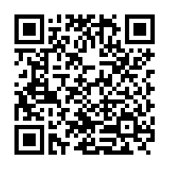
Google Classroom
Google Classroom Code: mtfdx6e
or
Google Classroom Invitation Link:
https://classroom.google.com/c/NDM3NDc1ODQwNzU5?cjc=mtfdx6e

Slide 6
PMSCS 670
Software Testing
Lecture 1
Md. Rafsan Jani

Slide 7
What is Software?
Software is a program that enables a computer to perform a specific task.
This includes:
application software such as a word processor, which enables a user to perform a task,
system software such as an operating system, which enables other software to run properly, by interfacing with hardware and with other software.
Practical computer systems divide software into three major classes:
system software,
programming software and
application software,
although the distinction is arbitrary, and often blurred.

Slide 8
What is Software Testing?
Software testing is a process, to evaluate the functionality of a software application with an intent to find whether the developed software met the specified requirements or not and to identify the defects to ensure that the product is defect free in order to produce the quality product.
According to ANSI/IEEE 1059 standard – Software testing is a process of analyzing a software item to detect the differences between existing and required conditions (i.e., defects) and to evaluate the features of the software item.

Slide 9
Software in the 21st Century
Software defines behavior
network routers, finance, switching networks, other infrastructure
Today’s software market :
is much bigger
is more competitive
has more users
Embedded Control Applications
airplanes, air traffic control
spaceships
watches
ovens
remote controllers
memory seats
PDAs
DVD players
garage door openers
cell phones

Slide 10
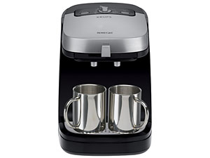
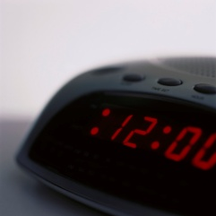
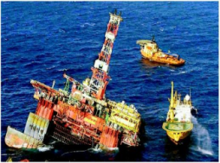
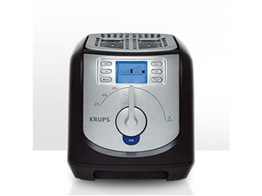
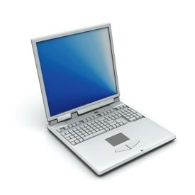
Software is a Skin that Surrounds Our Civilization
Quote due to Dr. Mark Harman

Slide 11
Quality Software
Quality software refers to a software which is reasonably bug or defect free, is delivered in time and within the specified budget, meets the requirements and/or expectations, and is maintainable.
In the software engineering context, software quality reflects both functional quality as well as structural quality.
Software Functional Quality − It reflects how well it satisfies a given design, based on the functional requirements or specifications.
Software Structural Quality − It deals with the handling of non-functional requirements that support the delivery of the functional requirements, such as robustness or maintainability, and the degree to which the software was produced correctly.

Slide 12
Quality Software Cont…
Software Quality Assurance − Software Quality Assurance (SQA) is a set of activities to ensure the quality in software engineering processes that ultimately result in quality software products. The activities establish and evaluate the processes that produce products. It involves process-focused action.
Software Quality Control − Software Quality Control (SQC) is a set of activities to ensure the quality in software products. These activities focus on determining the defects in the actual products produced. It involves product-focused action.

Slide 13
The Software Quality Challenges
In the software industry, the developers will never declare that the software is free of defects, unlike other industrial product manufacturers usually do.
This difference is due to the following reasons.
Product Complexity - It is the number of operational modes the product permits. Normally, an industrial product allows only less than a few thousand modes of operation with different combinations of its machine settings. However, software packages allow millions of operational possibilities. Hence, assuring of all these operational possibilities correctly is a major challenge to the software industry.
Product Visibility - Since the industrial products are visible, most of its defects can be detected during the manufacturing process. Also the absence of a part in an industrial product can be easily detected in the product but, the defects in software products which are stored on diskettes or CDs are invisible.

Slide 14
Software vs Other Products
Comparison software products vs industrial products:
Characteristic | Software Products | Other Industrial Products
Complexity | Millions of operational options | Thousand operational options
Visibility of product | Invisible Product. Difficult to detect defects by sight | Visible Product. Effective detection of defects by sight
Nature of development and production process | Can detect defects in only development phase | Can detect defects in all of the following phases Product development Product production planning Manufacturing

Slide 15
How we will get quality software?

Slide 16
Software Faults, Errors & Failures
Software Fault : A static defect in the software
Software Error : An incorrect internal state that is the manifestation of some fault
Software Failure : External, incorrect behavior with respect to the requirements or other description of the expected behavior
Faults in software are equivalent to design mistakes in hardware.
Software does not degrade.

Slide 17
Fault and Failure Example
A patient gives a doctor a list of symptoms
Failures
The doctor tries to diagnose the root cause of the ailment
Fault
The doctor may look for anomalous internal conditions (high blood pressure, irregular heartbeat, bacteria in the blood stream)
Errors
Most medical problems result from external attacks (bacteria, viruses) or physical degradation as we age.
Software faults were there at the beginning and do not “appear” when a part wears out.

Slide 18
A Concrete Example
Fault: Should start searching at 0, not 1
public static int numZero (int [ ] arr)
{ // Effects: If arr is null throw NullPointerException
// else return the number of occurrences of 0 in arr
int count = 0;
for (int i = 1; i < arr.length; i++)
{
if (arr [ i ] == 0)
{
count++;
}
}
return count;
}
Test 1
[ 2, 7, 0 ]
Expected: 1
Actual: 1
Error: i is 1, not 0, on the first iteration
Failure: none
Test 2
[ 0, 2, 7 ]
Expected: 1
Actual: 0
Error: i is 1, not 0
Error propagates to the variable count
Failure: count is 0 at the return statement

Slide 19


The Term Bug
Bug is used informally
Sometimes speakers mean fault, sometimes error, sometimes failure … often the speaker doesn’t know what it means !
This class will try to use words that have precise, defined, and unambiguous meanings
“an analyzing process must equally have been performed in order to furnish the Analytical Engine with the necessary operative data; and that herein may also lie a possible source of error. Granted that the actual mechanism is unerring in its processes, the cards may give it wrong orders. ” – Ada, Countess Lovelace (notes on Babbage’s Analytical Engine)
BUG
“It has been just so in all of my inventions. The first step is an intuition, and comes with a burst, then difficulties arise—this thing gives out and [it is] then that 'Bugs'—as such little faults and difficulties are called—show themselves and months of intense watching, study and labor are requisite. . .” – Thomas Edison

Slide 20
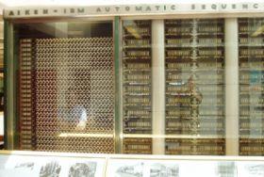
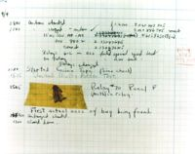
What is a computer bug?
In 1947 Harvard University was operating a room-sized computer called the Mark II.
mechanical relays
glowing vacuum tubes
technicians program the computer by reconfiguring it
Technicians had to change the occasional vacuum tube.
A moth flew into the computer and was zapped by the high voltage when it landed on a relay.
Hence, the first computer bug!
I am not making this up :-)

Slide 21
Bugs a.k.a. …
Defect
Fault
Problem
Error
Incident
Anomaly
Variance
Failure
Inconsistency
Product Anomaly
Product Incidence
Feature :-)
We will use the term in proper way.

Slide 22
Defective Software
We develop programs that contain defects
How many? What kind?
Hard to predict the future, however… it is highly likely, that the software we (including you!) will develop in the future will not be significantly better.

Slide 23
Sources of Problems
Requirements Definition: Erroneous, incomplete, inconsistent requirements.
Design: Fundamental design flaws in the software.
Implementation: Mistakes in chip fabrication, wiring, programming faults, malicious code.
Support Systems: Poor programming languages, faulty compilers and debuggers, misleading development tools.
Inadequate Testing of Software: Incomplete testing, poor verification, mistakes in debugging.
Evolution: Sloppy redevelopment or maintenance, introduction of new flaws in attempts to fix old flaws, incremental escalation to inordinate complexity.

Slide 24
Adverse Effects of Faulty S/W
Communications: Loss or corruption of communication media, non-delivery of data.
Space Applications: Lost lives, launch delays.
Defense and Warfare: Misidentification of friend or foe.
Transportation: Deaths, delays, sudden acceleration, inability to brake.
Safety-critical Applications: Death, injuries.
Electric Power: Death, injuries, power outages, long-term health hazards (radiation).

Slide 25
Adverse Effects of Faulty S/W Cont.
Money Management: Fraud, violation of privacy, shutdown of stock exchanges and banks, negative interest rates.
Control of Elections: Wrong results (intentional or non-intentional).
Control of Jails: Technology-aided escape attempts and successes, accidental release of inmates, failures in software controlled locks.
Law Enforcement: False arrests and imprisonments.

Slide 26
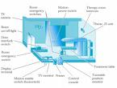
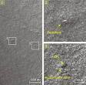

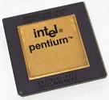
Spectacular Software Failures
NASA’s Mars lander: September 1999, crashed due to a units integration fault
THERAC-25 design
Mars Polar Lander crash site?
THERAC-25 radiation machine : Poor testing of safety-critical software can cost lives : 3 patients were killed
Ariane 5: exception-handling bug : forced self destruct on maiden flight (64-bit to 16-bit conversion: about 370 million $ lost)
Ariane 5 explosion : Millions of $$
Intel’s Pentium FDIV fault : Public relations nightmare
We need our software to be dependable.
Testing is one way to assess dependability.

Slide 27

Northeast Blackout of 2003
508 generating units and 256 power plants shut down
Affected 10 million people in Ontario, Canada
Affected 40 million people in 8 US states
Financial losses of
$6 Billion USD
The alarm system in the energy management system failed due to a software error and operators were not informed of the power overload in the system

Slide 28
Bank Generosity
A Norwegian bank ATM consistently dispersed 10 times the amount required.
Many people joyously joined the queues as the word spread.

Slide 29
Bank Generosity (Cont’d)
A software flaw caused a UK bank to duplicate every transfer payment request for half an hour.
The bank lost 2 billion British pounds!
The bank eventually recovered the funds but lost half a million pounds in potential interest.

Slide 30
Making Rupee!
An Australian man purchased $104,500 worth of Sri Lankan Rupees.
The next day he sold the Rupees to another bank for $440,258.
The first bank’s software had displayed a bogus exchange rate in the Rupee position!
A judge ruled that the man had acted without intended fraud and could keep the extra $335,758!

Slide 31
Bug in BoNY Software
The Bank of New York (BoNY) had a $32 billion overdraft as the result of a 16-bit integer counter that went unchecked.
BoNY was unable to process the incoming credits from security transfers, while the NY Federal Reserve automatically debited BoNY’s cash account.
BoNY had to borrow $24 billion to cover itself for one day until the software was fixed.
The bug cost BoNY $5 million in interest payments.

Slide 32
Costly Software Failures
NIST report, “The Economic Impacts of Inadequate Infrastructure for Software Testing”
Inadequate software testing costs the US alone between $22 and $59 billion annually
Better approaches could cut this amount in half
Huge losses due to web application failures
Financial services : $6.5 million per hour (just in USA!)
Credit card sales applications : $2.4 million per hour (in USA)
In Dec 2006, amazon.com’s BOGO offer turned into a double discount
2007 : Symantec says that most security vulnerabilities are due to faulty software
World-wide monetary loss due to poor software is shocking

Slide 33
Testing in the 21st Century
More safety critical, real-time software
Embedded software is ubiquitous … check your pockets
Enterprise applications means bigger programs, more users
Paradoxically, free software increases our expectations !
Security is now all about software faults
Secure software is reliable software
The web offers a new deployment platform
Very competitive and very available to more users
Web apps are distributed
Web apps must be highly reliable
Industry desperately needs our inventions !

Slide 34
What Does This Mean?
Software testing is getting more important
What are we trying to do when we test ?
What are our goals ?

Slide 35
Verification & Validation (IEEE)
Verification : The process of determining whether the products of a given phase of the software development process fulfill the requirements established during the previous phase
Validation : The process of evaluating software at the end of software development to ensure compliance with intended usage
IV&V stands for “independent verification and validation”

Slide 36
Testing Goals Based on Test Process Maturity
Level 0 : There’s no difference between testing and debugging
Level 1 : The purpose of testing is to show correctness
Level 2 : The purpose of testing is to show that the software doesn’t work
Level 3 : The purpose of testing is not to prove anything specific, but to reduce the risk of using the software
Level 4 : Testing is a mental discipline that helps all IT professionals develop higher quality software

Slide 37
Level 0 Thinking
Testing is the same as debugging
Does not distinguish between incorrect behavior and mistakes in the program
Does not help develop software that is reliable or safe
This is what we teach undergraduate CS majors

Slide 38
Level 1 Thinking
Purpose is to show correctness
Correctness is impossible to achieve
What do we know if no failures?
Good software or bad tests?
Test engineers have no:
Strict goal
Real stopping rule
Formal test technique
Test managers are powerless
This is what hardware engineers often expect

Slide 39
Level 2 Thinking
Purpose is to show failures
Looking for failures is a negative activity
Puts testers and developers into an adversarial relationship
What if there are no failures?
This describes most software companies.
How can we move to a team approach ??

Slide 40
Level 3 Thinking
Testing can only show the presence of failures
Whenever we use software, we incur some risk
Risk may be small and consequences unimportant
Risk may be great and consequences catastrophic
Testers and developers cooperate to reduce risk
It describes a few “enlightened” software companies

Slide 41
Level 4 Thinking
A mental discipline that increases quality
Testing is only one way to increase quality
Test engineers can become technical leaders of the project
Primary responsibility is to measure and improve software quality
Their expertise should help the developers
This is the way “traditional” engineering works

Slide 42
Where Are You?
Are you at level 0, 1, or 2 ?
Is your organization at work at level 0, 1, or 2 ?
Or 3?
We hope to teach you to become “change agents” in your workplace …
Advocates for level 4 thinking

Slide 43
Tactical Goals : Why Each Test ?
If you don’t know why you’re conducting each test, it won’t be very helpful
Written test objectives and requirements must be documented
What are your planned coverage levels?
How much testing is enough?
Common objective – spend the budget … test until the ship-date …
Sometimes called the “date criterion”

Slide 44

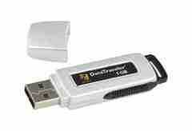
Here! Test This!
Big software program
MicroSteff – big
software system
for the mac
Jan/2011
V.1.5.1 Jan/2007
Verdatim
DataLife
MF2-HD
1.44 MB
A stack of computer printouts—and no documentation

Slide 45
Why Each Test ?
1980: “The software shall be easily maintainable”
Threshold reliability requirements?
What fact does each test try to verify?
Requirements definition teams need testers!
If you don’t start planning for each test when the functional requirements are formed, you’ll never know why you’re conducting the test

Slide 46
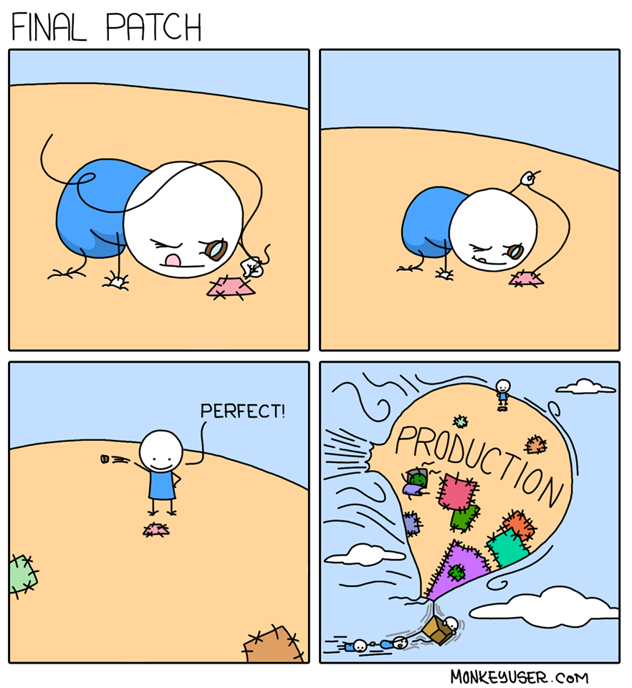
Testing

Slide 47
Cost of Not Testing
Testing is the most time consuming and expensive part of software development
Not testing is even more expensive
If we have too little testing effort early, the cost of testing increases
Planning for testing after development is prohibitively expensive
Poor Program Managers might say: “Testing is too expensive.”

Slide 48
Cost of Late Testing
60
Assume $1000 unit cost, per fault, 100 faults
$250K
50
40
$360K
30
Fault origin (%)
Fault detection (%)
Unit cost (X)
20
$20K
$100K
$13K
10
$6K
0
Requirements
Design
Prog / Unit Test
Integration Test
System Test
Post-Deployment
Software Engineering Institute; Carnegie Mellon University; Handbook CMU/SEI-96-HB-002
Notes:
28-Oct-2010, at GTAC, added the animation to demonstrate increasing the number of faults found early, thereby decreasing the number of faults found late, and finally saving money. Lots of it! This animation is fairly complicated … must practice first!!

Slide 49
Summary: Why Do We Test Software ?
A tester’s goal is to eliminate faults as early as possible
Improve quality
Reduce cost
Preserve customer satisfaction

Slide 50
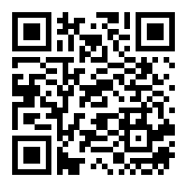
Survey- First Day
Please fill-out this form:
https://forms.gle/bK2eK9LySLan356S6
My email: rafsan@juniv.edu

