Slide 1
Image Segmentation

Slide 2
Introduction to image segmentation
In digital image processing and computer vision, image segmentation is the process of partitioning a digital image into multiple segments (sets of pixels, also known as image objects).
The goal of segmentation is to simplify and/or change the representation of an image into something that is more meaningful and easier to analyze.
Image segmentation is typically used to locate objects and boundaries (lines, curves, etc.) in images.
More precisely, image segmentation is the process of assigning a label to every pixel in an image such that pixels with the same label share certain characteristics.

Slide 3
Image segmentation
The purpose of image segmentation is to partition an image into meaningful regions with respect to a particular application
The segmentation is based on measurements taken from the image and might be greylevel, colour, texture, depth or motion

Slide 4
Introduction to image segmentation
Usually image segmentation is an initial and vital step in a series of processes aimed at overall image understanding
Applications of image segmentation include
Identifying objects in a scene for object-based measurements such as size and shape
Identifying objects in a moving scene for object-based video compression (MPEG4)
Identifying objects which are at different distances from a sensor using depth measurements from a laser range finder enabling path planning for a mobile robots.

Slide 5
Image Segmentation
Segmentation divides an image into its constituent regions or objects.
Segmentation of images is a difficult task in image processing. Still under research.
Segmentation allows to extract objects in images.
Segmentation is unsupervised learning.
Model based object extraction, e.g., template matching, is supervised learning.

Slide 6
Image Segmentation
Image segmentation is the operation of partitioning an
image into a collection of connected sets of pixels.
1. into regions, which usually cover the image
2. into linear structures, such as
- line segments
- curve segments
3. into 2D shapes, such as
- circles
- ellipses
- ribbons (long, symmetric regions)

Slide 7
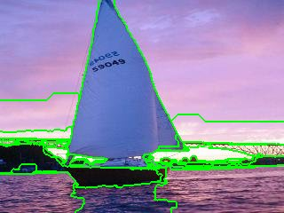
Example 1: Regions

Slide 8
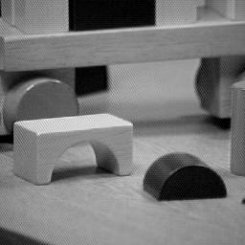
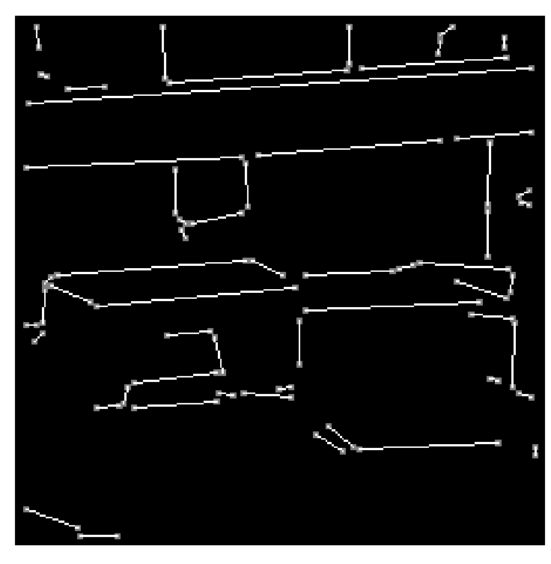
Example 2: Straight Lines

Slide 9
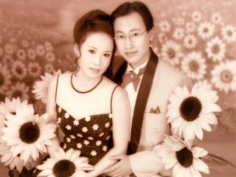
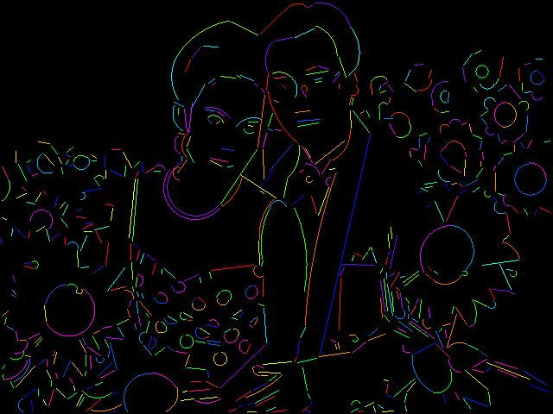






Example 3: Lines and Circular Arcs

Slide 10
Region Segmentation: Segmentation Criteria
From Pavlidis
A segmentation is a partition of an image I into
a set of regions S satisfying:
1. ∪ Si = S Partition covers the whole image.
2. Si ∩ Sj = φ, i ≠ j No regions intersect.
3. ∀ Si, P(Si) = true Homogeneity predicate is
satisfied by each region.
4. P(Si ∪ Sj) = false, Union of adjacent regions
i ≠ j, Si adjacent Sj does not satisfy it.

Slide 11
Main Methods of Region Segmentation
1. Region Growing
2. Clustering
3. Split and Merge

Slide 12
What it is useful for
After a successful segmenting the image, the contours of objects can be extracted using edge detection and/or border following techniques.
Shape of objects can be described.
Based on shape, texture, and color objects can be identified.
Image segmentation techniques are extensively used in similarity searches.

Slide 13
Segmentation Algorithms
Segmentation algorithms are based on one of two basic properties of color, gray values, or texture: discontinuity and similarity.
First category is to partition an image based on abrupt changes in intensity, such as edges in an image.
Second category are based on partitioning an image into regions that are similar according to a predefined criteria. Histogram thresholding approach falls under this category.

Slide 14
Domain spaces
spatial domain (row-column (rc) space)
histogram spaces
color space
texture space
other complex feature space

Slide 15
Clustering in Color Space
1. Each image point is mapped to a point in a color space, e.g.:
Color(i, j) = (R (i, j), G(i, j), B(i, j))
It is many to one mapping.
2. The points in the color space are grouped to clusters.
3. The clusters are then mapped back to regions in the image.

Slide 16
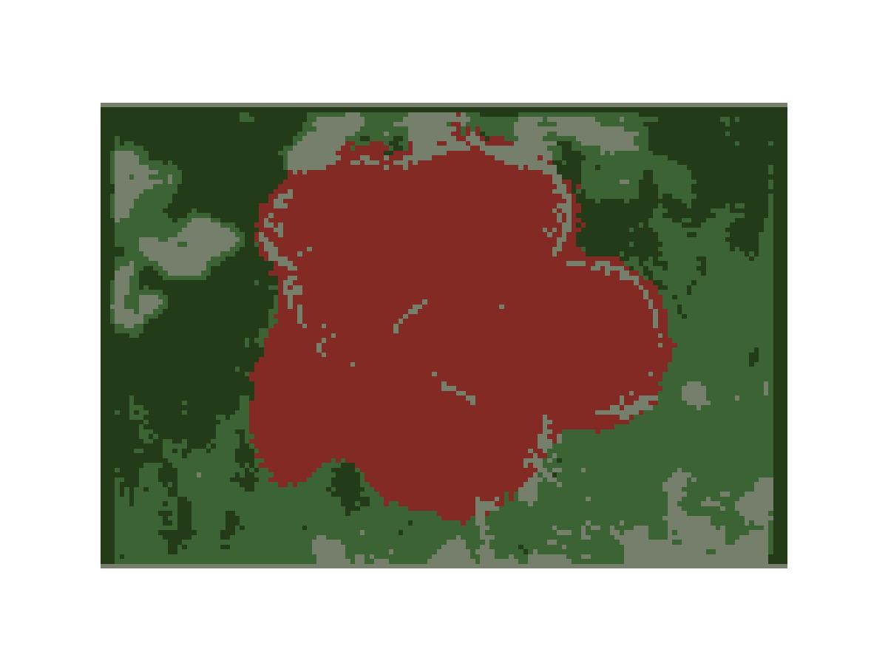
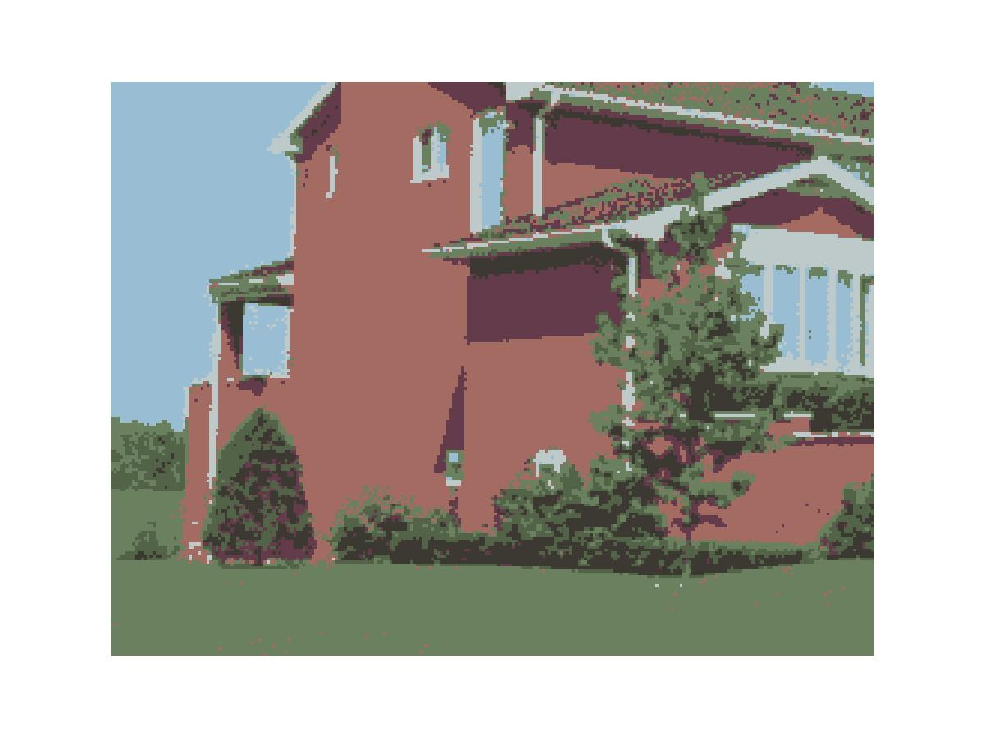
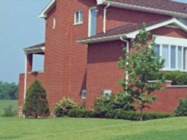

Examples
Original pictures segmented pictures
Mnp: 30, percent 0.05, cluster number 4
Mnp : 20, percent 0.05, cluster number 7

Slide 17
Displaying objects in the Segmented Image
The objects can be distinguished by assigning an arbitrary pixel value or average pixel value to the pixels belonging to the same clusters.

Slide 18
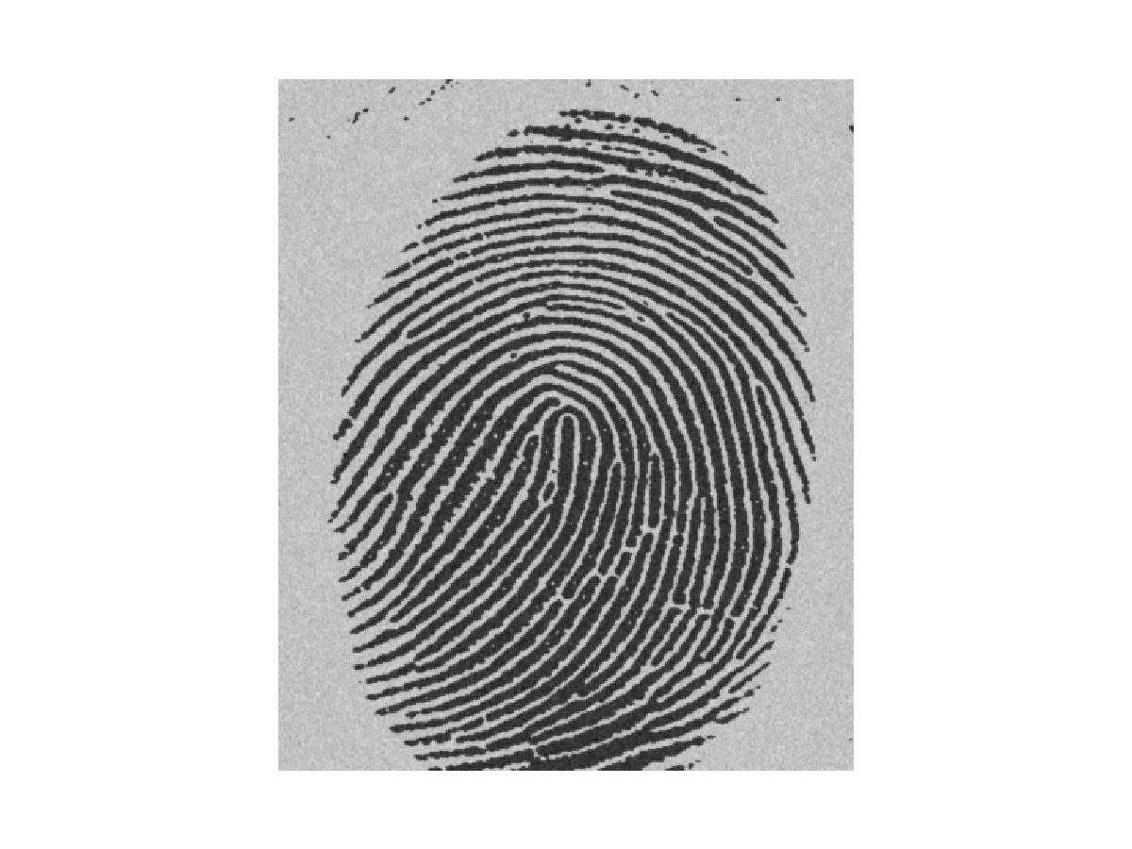
Gray Scale Image Example
Image of a Finger Print with light background

Slide 19
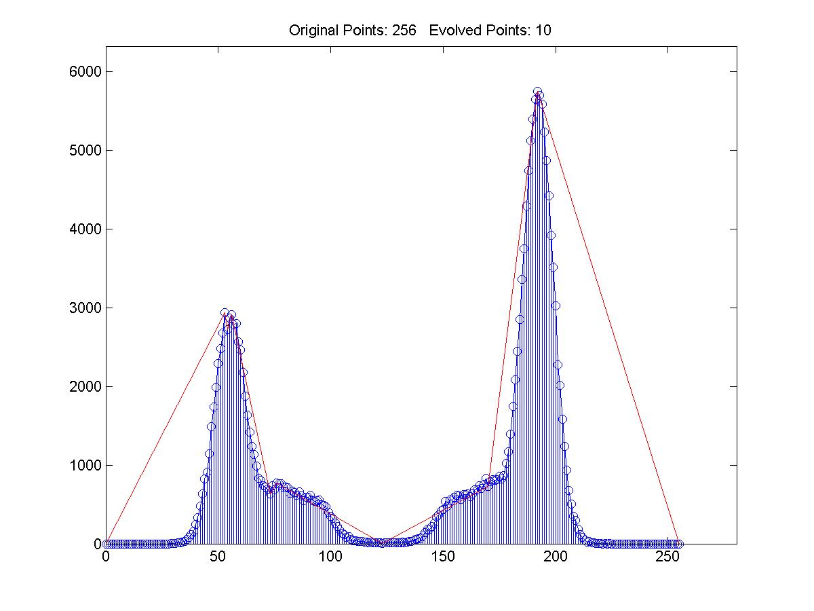
Histogram

Slide 20

Segmented Image
Image after Segmentation

Slide 21
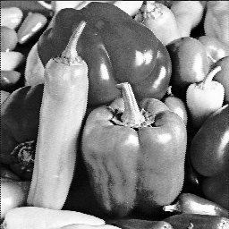

Image segmentation (Examples)
Example 1
Segmentation based on greyscale
Very simple ‘model’ of greyscale leads to inaccuracies in object labelling

Slide 22
Image segmentation (Examples)
Example 2
Segmentation based on texture
Enables object surfaces with varying patterns of grey to be segmented

Slide 23
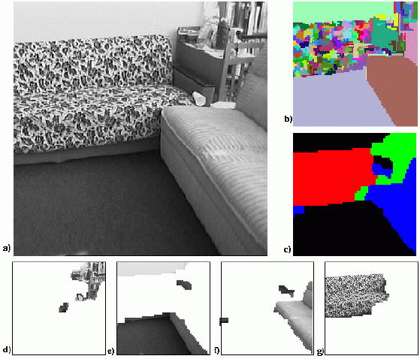
Image segmentation (Examples)

Slide 24
Image segmentation (Examples)
Example 3
Segmentation based on motion
The main difficulty of motion segmentation is that an intermediate step is required to (either implicitly or explicitly) estimate an optical flow field
The segmentation must be based on this estimate and not, in general, the true flow

Slide 25
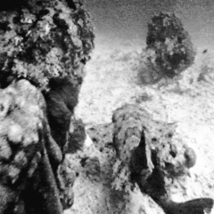

Image segmentation (Examples)

Slide 26
Image segmentation (Examples)
Example 4
Segmentation based on depth
This example shows a range image, obtained with a laser range finder
A segmentation based on the range (the object distance from the sensor) is useful in guiding mobile robots
Range imaging is the name for a collection of techniques that are used to produce a 2D image showing the distance to points in a scene from a specific point, normally associated with some type of sensor device.
The resulting image, the range image, has pixel values that correspond to the distance.
Range segmentation is the task of segmenting (dividing) a range image, an image containing depth information for each pixel, into segments (regions), so that all the points of the same surface belong to the same region, there is no overlap between different regions

Slide 27
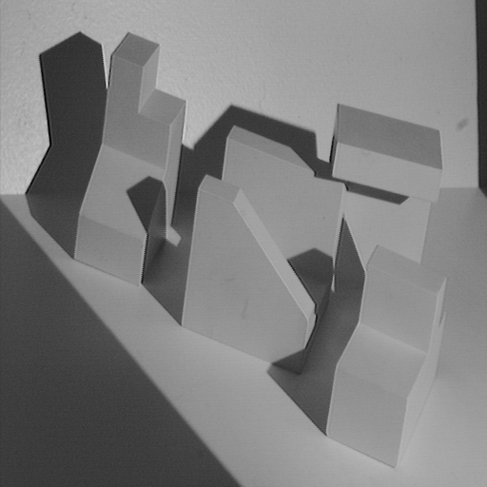
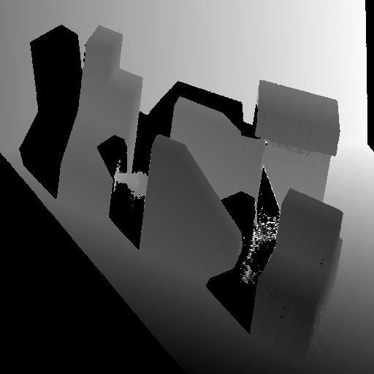
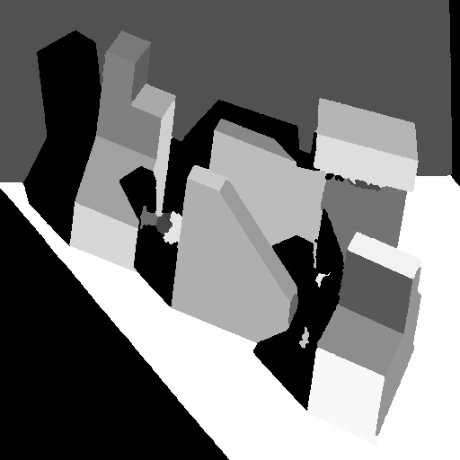
Image segmentation (Examples)
Range image
Original image
Segmented image

Slide 28
Greylevel histogram-based segmentation
We will look at two very simple image segmentation techniques that are based on the greylevel histogram of an image
Thresholding
Clustering
We will use a very simple object-background test image
We will consider a zero, low and high noise image

Slide 29

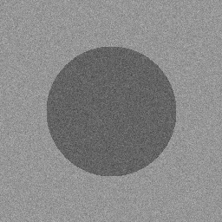
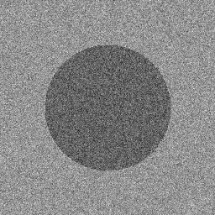
Greylevel histogram-based segmentation
Noise free
Low noise
High noise

Slide 30
Greylevel histogram-based segmentation
How do we characterise low noise and high noise?
We can consider the histograms of our images
For the noise free image, its simply two spikes at i=100, i=150
For the low noise image, there are two clear peaks centred on i=100, i=150
For the high noise image, there is a single peak – two greylevel populations corresponding to object and background have merged

Slide 31
Greylevel histogram-based segmentation

Slide 32
Greylevel histogram-based segmentation
We can define the input image signal-to-noise ratio in terms of the mean greylevel value of the object pixels and background pixels and the additive noise standard deviation

Slide 33
Greylevel histogram-based segmentation
For our test images :
S/N (noise free) = ∞
S/N (low noise) = 5
S/N (high noise) = 2

Slide 34
Greylevel thresholding
We can easily understand segmentation based on thresholding by looking at the histogram of the low noise object/background image
There is a clear ‘valley’ between to two peaks

Slide 35
Greylevel thresholding
Background
Object
T

Slide 36
Greylevel thresholding
We can define the greylevel thresholding algorithm as follows:
If the greylevel of pixel p <=T then pixel p is an object pixel
else
Pixel p is a background pixel

Slide 37
Greylevel thresholding
This simple threshold test begs the obvious question how do we determine the threshold ?
Many approaches possible
Interactive threshold
Adaptive threshold
Minimisation method

Slide 38
Greylevel thresholding
We will consider in detail a minimisation method for determining the threshold
Minimisation of the within group variance
Robot Vision, Haralick & Shapiro, volume 1, page 20

Slide 39
Greylevel thresholding
Idealized object/background image histogram
T

Slide 40
Greylevel thresholding
Any threshold separates the histogram into 2 groups with each group having its own statistics (mean, variance)
The homogeneity of each group is measured by the within group variance
The optimum threshold is that threshold which minimizes the within group variance thus maximizing the homogeneity of each group

Slide 41
Greylevel thresholding
Let group o (object) be those pixels with greylevel <=T
Let group b (background) be those pixels with greylevel >T
The prior probability of group o is p_{o}(T)
The prior probability of group b is p_{b}(T)

Slide 42
Greylevel thresholding
The following expressions can easily be derived for prior probabilities of object and background
where h(i) is the histogram of an N pixel image

Slide 43
Greylevel thresholding
The mean and variance of each group are as follows :

Slide 44
Greylevel thresholding
The within group variance is defined as :
We determine the optimum T by minimizing this expression with respect to T
Only requires 256 comparisons for and 8-bit greylevel image

Slide 45
Greylevel thresholding

Slide 46
Greylevel thresholding
We can examine the performance of this algorithm on our low and high noise image
For the low noise case, it gives an optimum threshold of T=124
Almost exactly halfway between the object and background peaks
We can apply this optimum threshold to both the low and high noise images

Slide 47
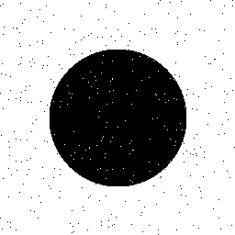
Greylevel thresholding
Low noise image
Thresholded at T=124

Slide 48
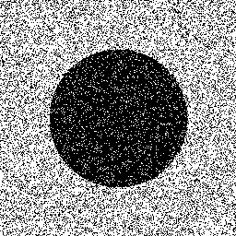
Greylevel thresholding
Low noise image
Thresholded at T=124

Slide 49
Greylevel thresholding
High level of pixel miss-classification noticeable
This is typical performance for thresholding
The extent of pixel miss-classification is determined by the overlap between object and background histograms.

Slide 50
Greylevel thresholding
Background
Object

Slide 51
Greylevel thresholding
Background
Object

Slide 52
Greylevel thresholding
Easy to see that, in both cases, for any value of the threshold, object pixels will be miss-classified as background and vice versa
For greater histogram overlap, the pixel miss-classification is obviously greater
We could even quantify the probability of error in terms of the mean and standard deviations of the object and background histograms

Slide 53
References
[1] https://www.geeksforgeeks.org

Slide 54
Thank You

