Slide 1
Machine learning for machine vision (Supervised Learning)

Slide 2
Machine Learning
Learning is any process by which a system improves performance from experience.
Learning denotes changes in a system that ... enable a system to do the same task more efficiently the next time.
Machine Learning is concerned with computer programs that automatically improve their performance through experience.
Machine learning is also used for systems which discover patterns without prior expected results.

Slide 3
Machine Learning: definition
Machine Learning is concerned with the development, the analysis, and the application of algorithms that allow computers to learn.
Two main goals: make prediction and better understand the system

Slide 4
Why Machine Learning?
Develop systems that can automatically adapt and customize themselves to individual users.
Personalized news or mail filter
Discover new knowledge from large databases (data mining).
Ability to mimic human and replace certain monotonous tasks - which require some intelligence.
like recognizing handwritten characters
Develop systems that are too difficult/expensive to construct manually because they require specific detailed skills or knowledge

Slide 5
Why now?
Flood of available data (especially with the advent of the Internet)
Increasing computational power
Growing progress in available algorithms and theory developed by researchers
Increasing support from industries
The concept of learning in a ML system
Learning = Improving with experience at some task

Slide 6
Machine learning: when ?
Learning is useful when:
Human expertise does not exist (navigating on Mars),
Humans are unable to explain their expertise (speech recognition)
Solution changes in time (routing on a computer network)
Solution needs to be adapted to particular cases (user biometrics)
Example: It is easier to write a program that learns to play checkers or backgammon well by self-play rather than converting the expertise of a master player to a program.

Slide 7
Applications
Machine learning has a wide spectrum of applications including:
Retail: Market basket analysis, Customer relationship management (CRM)
Finance: Credit scoring, fraud detection
Manufacturing: Optimization, troubleshooting
Medicine: Medical diagnosis
Telecommunications: Quality of service optimization, routing
Bioinformatics: Motifs, alignment
Web mining: Search engines

Slide 8
Related fields
Artificial Intelligence: smart algorithms
Statistics: inference from a sample
Computer Science: efficient algorithms and complex models
Systems and control: analysis, modeling, and control of dynamical systems
Data Mining: searching through large volumes of data

Slide 9
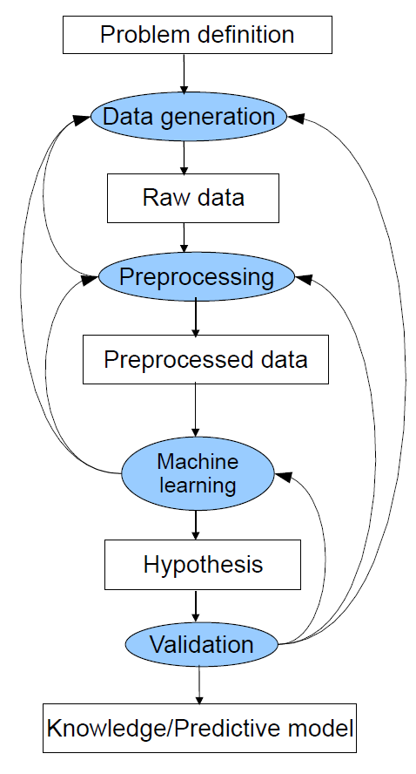
One part of the data mining process
Each step generates many questions:
Data generation: data types, sample size, online/offline...
Preprocessing: normalization, missing values, feature selection/extraction...
Machine learning: hypothesis, choice of learning paradigm/algorithm...
Hypothesis validation: cross validation, model deployment...

Slide 10
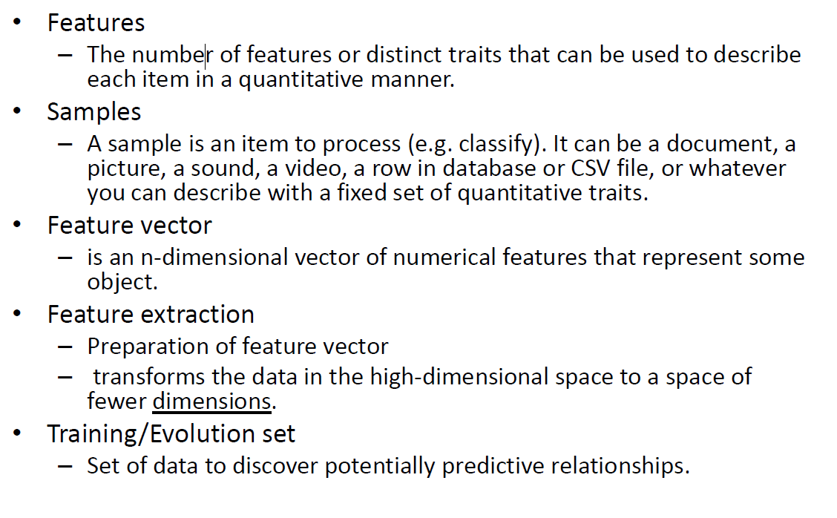
Terminology

Slide 11
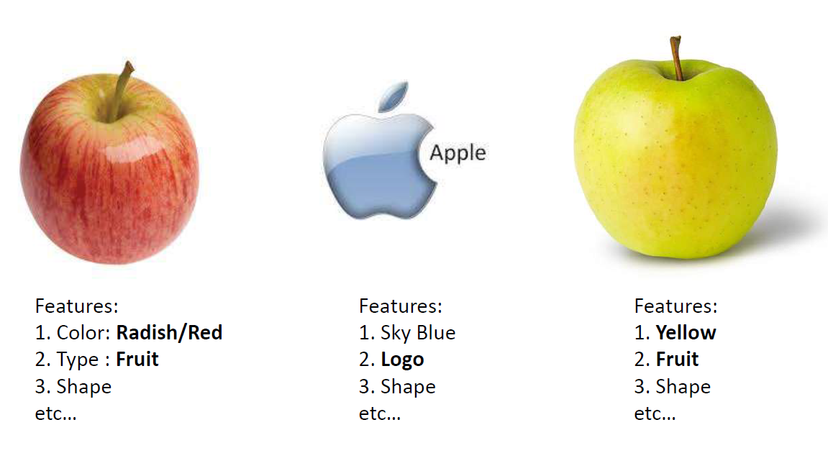
Learning (Training)

Slide 12
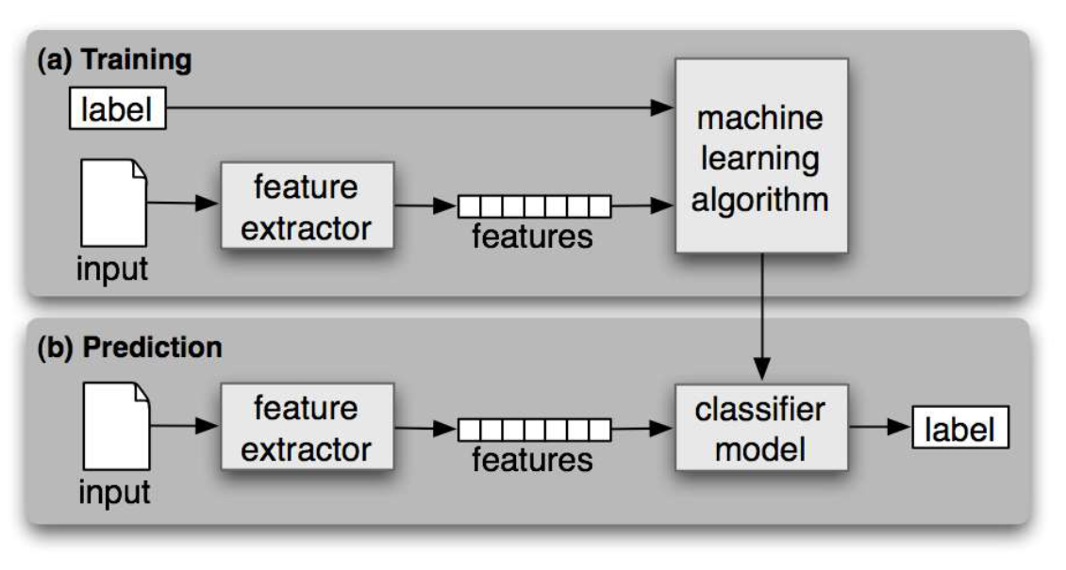
Workflow

Slide 13
Machine Learning - Categories
Initially, researchers started out with Supervised Learning. This is the case of housing price prediction discussed earlier.
This was followed by unsupervised learning, where the machine is made to learn on its own without any supervision.
Scientists discovered further that it may be a good idea to reward the machine when it does the job the expected way and there came the Reinforcement Learning.
Thus, came the deep learning where the human brain is simulated in the Artificial Neural Networks (ANN) created in our binary computers.

Slide 14
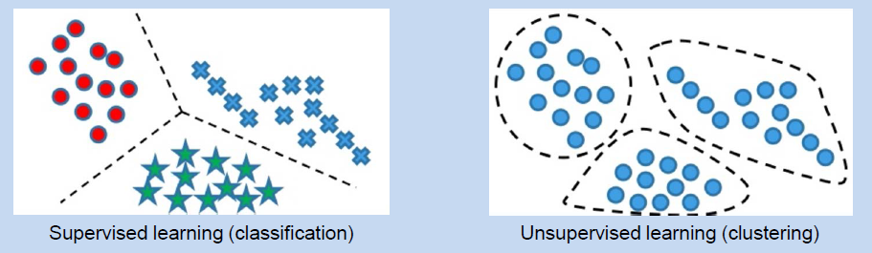
Machine Learning - Categories

Slide 15
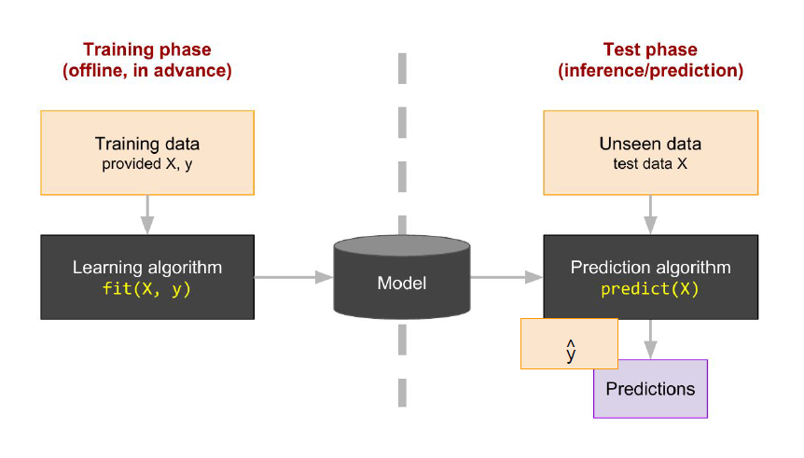
Supervised learning

Slide 16
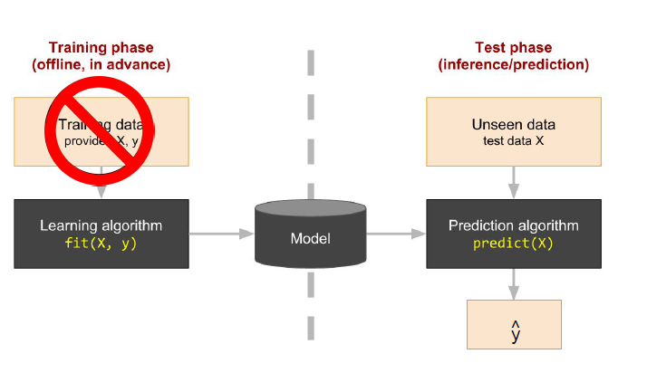
Unsupervised learning

Slide 17
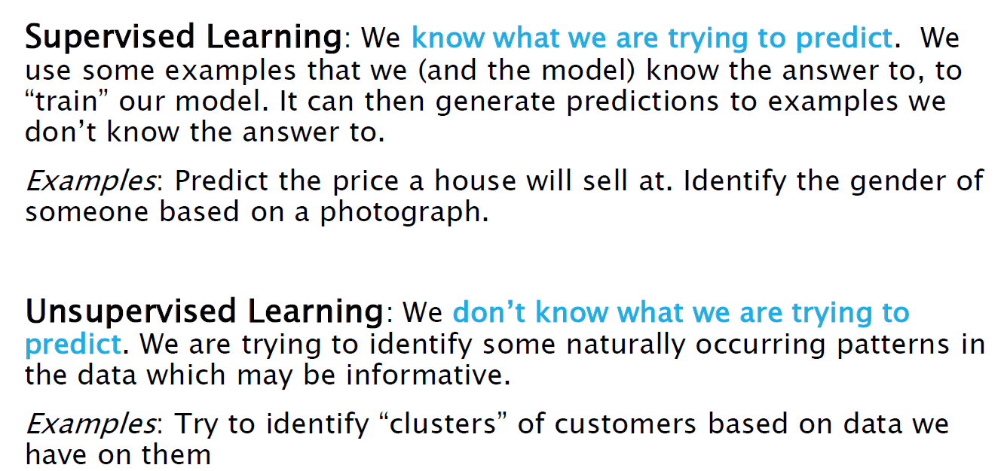
MACHINE LEARNING

Slide 18
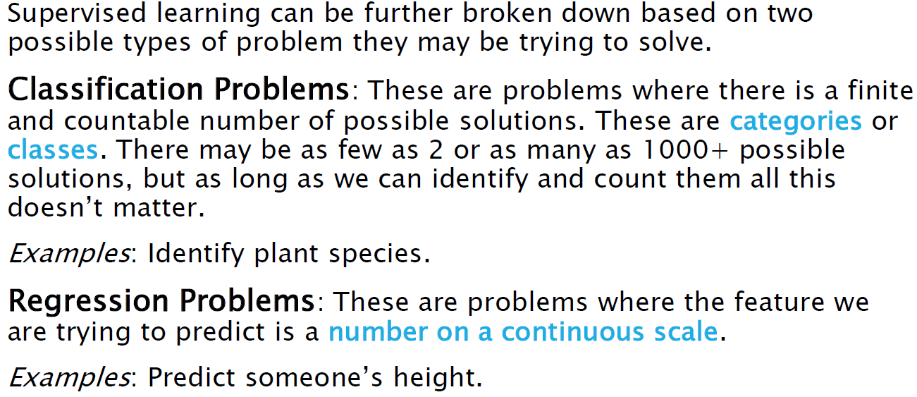
TYPES OF SUPERVISED LEARNING

Slide 19
Supervised vs. unsupervised Learning
Supervised learning: classification is seen as supervised learning from examples.
Supervision: The data (observations, measurements, etc.) are labeled with pre-defined classes. It is like that a “teacher” gives the classes (supervision).
Test data are classified into these classes too.
Unsupervised learning (clustering)
Class labels of the data are unknown
Given a set of data, the task is to establish the existence of classes or clusters in the data

Slide 20
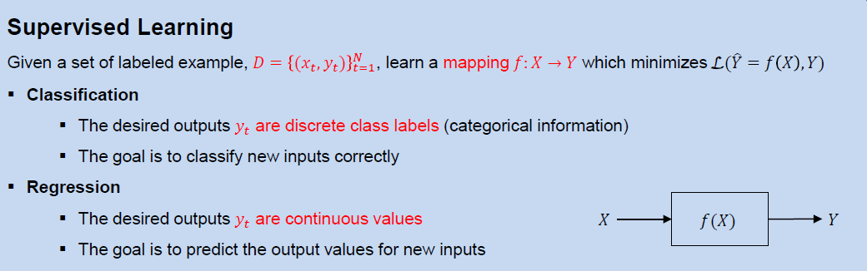
Supervised learning

Slide 21
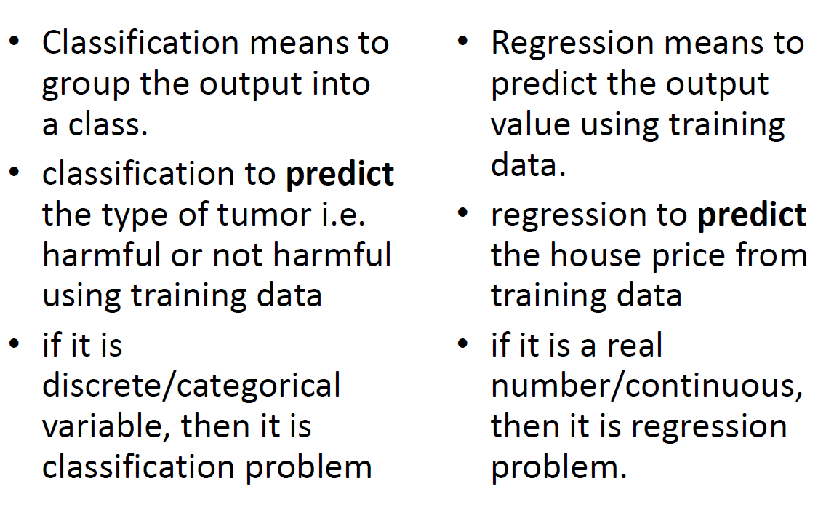
Classification vs Regression

Slide 22
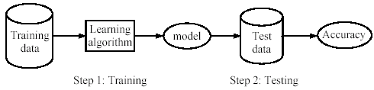
Supervised learning process: two steps
Learning (training): Learn a model using the training data
Testing: Test the model using unseen test data to assess the model accuracy

Slide 23
Supervised learning
Supervised learning is one of the important models of learning involved in training machines.
Algorithms for Supervised Learning
There are several algorithms available for supervised learning. Some of the widely used algorithms of supervised learning are as shown below −
k-Nearest Neighbours
Decision Trees
Naive Bayes
Logistic Regression
Support Vector Machines

Slide 24
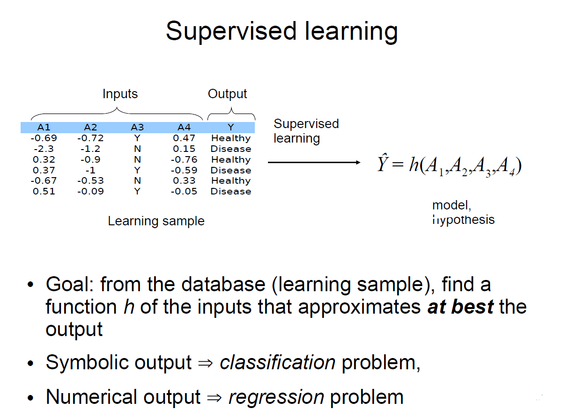
Supervised learning

Slide 25
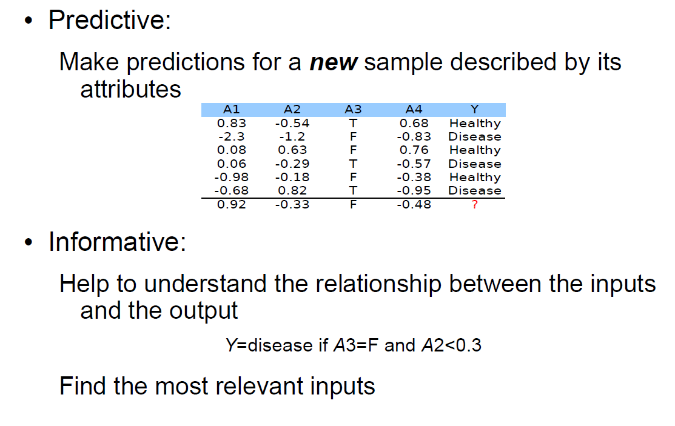
Two main goals

