Slide 1
Feature Detection

Slide 2
Types of image features
Edges
Edges are points where there is a boundary (or an edge) between two image regions.
In general, an edge can be of almost arbitrary shape, and may include junctions.
In practice, edges are usually defined as sets of points in the image which have a strong gradient magnitude.
Corners / interest points
The terms corners and interest points are used somewhat interchangeably and refer to point-like features in an image, which have a local two dimensional structure.
The name "Corner" arose since early algorithms first performed edge detection, and then analyzed the edges to find rapid changes in direction (corners).

Slide 3
Types of image features
Blobs / regions of interest points
Blobs provide a complementary description of image structures in terms of regions, as opposed to corners that are more point-like.
Blob detectors can detect areas in an image which are too smooth to be detected by a corner detector.
Ridges
For elongated objects, the notion of ridges is a natural tool.
A ridge descriptor computed from a grey-level image can be seen as a generalization of a medial axis.

Slide 4
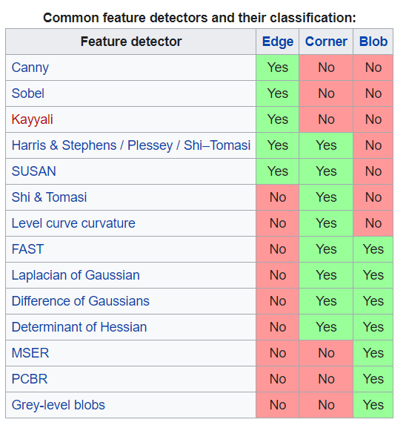
Feature detectors
Once features have been detected, a local image patch around the feature can be extracted.
This extraction may involve quite considerable amounts of image processing. The result is known as a feature descriptor or feature vector.

Slide 5
Global and Local Features
There are generally two methods to represent images, namely, global features and local features.
In the global feature representation, the image is represented by one multidimensional feature vector, describing the information in the whole image.
In other words, the local representation method produces a single vector with values that measure various aspects of the image such as color, texture or shape.

Slide 6
Global and Local Features
Global features describe the entire image, whereas local features describe the image patches (Image patch is a container of pixels in larger form. For example, let’s say you have a image of 100px by 100px. If you divide this images into 10x10 patches then you will have an image with 100 patches (that is 100px in each patch).
Features that are calculated over the entire image or just regular sub-area of an image that is global.
Local features refer to a pattern or distinct structure found in an image, such as a point, edge, or small image patch.
They are usually associated with an image patch that differs from its immediate surroundings by texture, color, or intensity. ... Examples of local features are blobs, corners, and edge pixels.

Slide 7
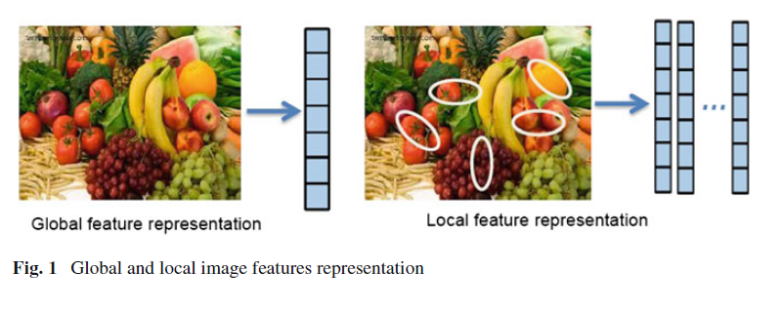
Global and Local Features
Relevant feature (global or local) contains discriminating information and is able to distinguish one object from others.

Slide 8
Advantages of local features
Locality: features are local, so robust to occlusion and clutter (no prior segmentation)
Distinctiveness: individual features can be matched to a large database of objects
Quantity: many features can be generated for even small objects
Efficiency: close to real-time performance
Extensibility: can easily be extended to wide range of differing feature types, with each adding robustness

Slide 9
Characteristics of Feature Detectors
The following properties are important for utilizing a feature detector in computer vision applications:
Robustness
The feature detection algorithm should be able to detect the same feature locations independent of scaling, rotation, shifting, photometric deformations, compression artifacts, and noise.
Repeatability
The feature detection algorithm should be able to detect the same features of the same scene or object repeatedly under variety of viewing conditions.

Slide 10
Characteristics of Feature Detectors
The following properties are important for utilizing a feature detector in computer vision applications:
Accuracy
The feature detection algorithm should accurately localize the image features (same pixel locations), especially for image matching tasks, where precise correspondences are needed to estimate the epipolar geometry.
Generality
The feature detection algorithm should be able to detect features that can be used in different applications.

Slide 11
Characteristics of Feature Detectors
The following properties are important for utilizing a feature detector in computer vision applications:
Efficiency
The Efficiency, the feature detection algorithm should be able to detect features in new images quickly to support real-time applications.
Quantity
The Quantity, the feature detection algorithm should be able to detect all or most of the features in the image. Where, the density of detected features should reflect the information content of the image for providing a compact image representation.

Slide 12
Image Feature Detectors
Feature detectors can be broadly classified into three categories:
single-scale detectors,
multi-scale detectors, and
affine invariant detectors.

Slide 13
Single-Scale Detectors
Moravec’s Detector
Moravec’s detector is specifically interested in finding distinct regions in the image that could be used to register consecutive image frames
Harris Detector
Harris and Stephens have developed a combined corner and edge detector to address the limitations of Moravec’s detector.
SUSAN Detector
Smith and Brady introduced a generic low-level image processing technique called SUSAN (Smallest Univalue Segment Assimilating Nucleus).
Harris corner detector

Slide 14

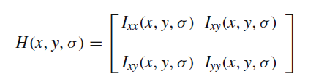
Single-Scale Detectors
FAST Detector
FAST (Features from Accelerated Segment Test) is a corner detector originally developed by Rosten and Drummondn. The used cornerness measure at this step is
Hessian Detector
The Hessian blob detector is based on a 2 × 2 matrix of second-order derivatives of image intensity I(x, y), called the Hessian matrix. This matrix can be used to analyze local image structures and it is expressed in the form

Slide 15
Harris Detector: Basic Idea
“flat” region: no change in all directions
“edge”: no change along the edge direction
“corner”: significant change in all directions

Slide 16
Properties of the Harris corner detector
Yes
Rotation invariant?
Scale invariant?
No
All points will be classified as edges
Corner !

Slide 17
Harris Detector: Mathematics
Change of intensity for the shift [u,v]:
Window function
Shifted intensity
Intensity
Window function w(x,y) =
or
1 in window, 0 outside
Gaussian

Slide 18
Harris Detector: Mathematics
For small shifts [u,v] we have a bilinear approximation:
where M is a 2×2 matrix computed from image derivatives:

Slide 19
Harris Detector: Mathematics
Intensity change in shifting window: eigenvalue analysis
λ₁, λ₂ – eigenvalues of M
direction of the fastest change
direction of the slowest change
Ellipse E(u,v) = const
(λ_{max})^{-1/2}
(λ_{min})^{-1/2}

Slide 20
Harris Detector: Mathematics
Classification of image points using eigenvalues of M:
λ₂
“Edge” λ₂ >> λ₁
“Corner” λ₁ and λ₂ are large, λ₁ ~ λ₂; E increases in all directions
λ₁ and λ₂ are small; E is almost constant in all directions
“Flat” region
“Edge” λ₁ >> λ₂
λ₁

Slide 21
Harris Detector: Mathematics
Measure of corner response:
(k – empirical constant, k = 0.04-0.06)

Slide 22
Harris Detector: Mathematics
λ₂
“Edge”
“Corner”
R depends only on eigenvalues of M
R is large for a corner
R is negative with large magnitude for an edge
|R| is small for a flat region
R < 0
R > 0
“Flat”
“Edge”
|R| small
R < 0
λ₁

Slide 23
Harris Detector
The Algorithm:
Find points with large corner response function R (R > threshold)
Take the points of local maxima of R

Slide 24
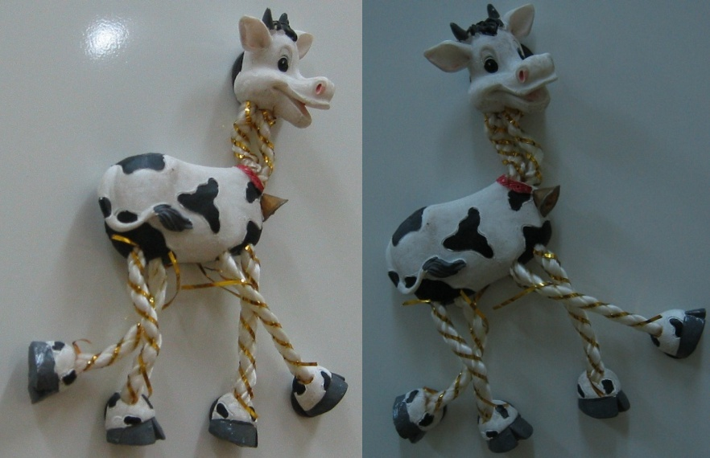
Harris Detector: Workflow

Slide 25
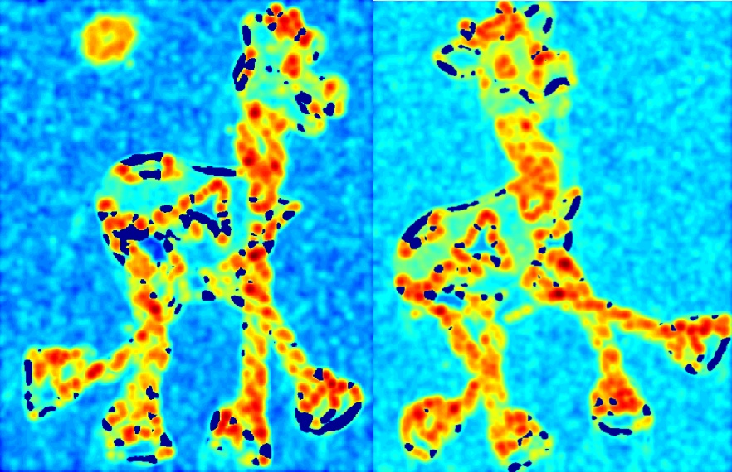
Harris Detector: Workflow
Compute corner response R

Slide 26
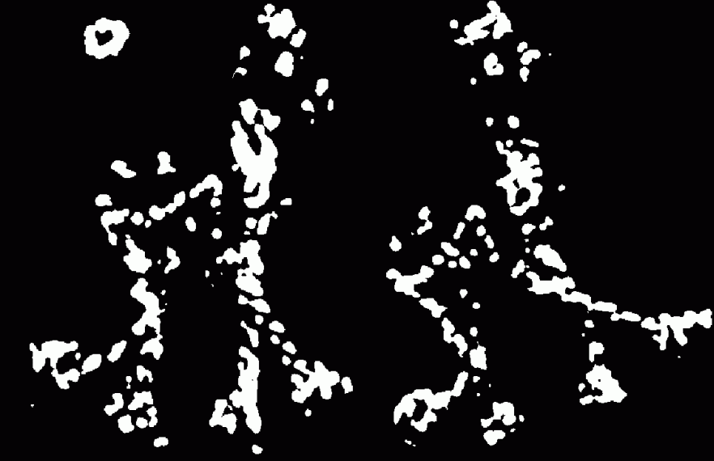
Harris Detector: Workflow
Find points with large corner response: R>threshold

Slide 27
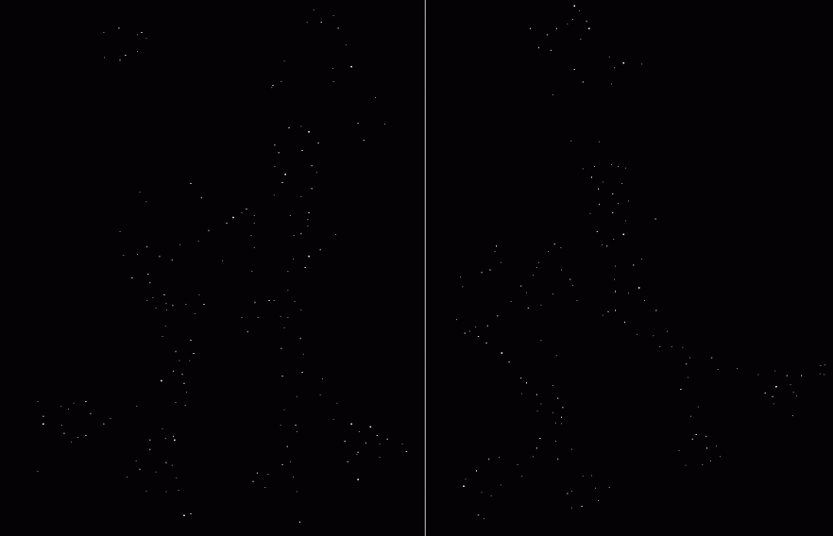
Harris Detector: Workflow
Take only the points of local maxima of R

Slide 28

Harris Detector: Workflow

Slide 29
Harris Detector: Summary
Average intensity change in direction [u,v] can be expressed as a bilinear form:
Describe a point in terms of eigenvalues of M: measure of corner response
A good (corner) point should have a large intensity change in all directions, i.e. R should be large positive

Slide 30
Harris Detector: Some Properties
Rotation invariance
Ellipse rotates but its shape (i.e. eigenvalues) remains the same
Corner response R is invariant to image rotation

Slide 31
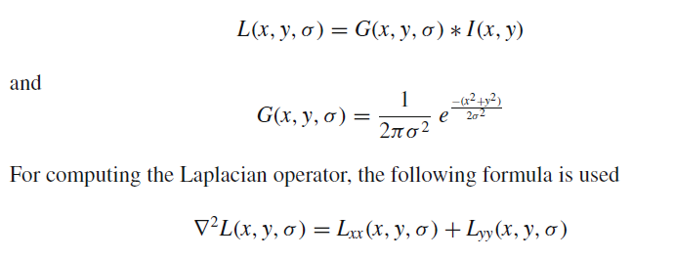
Multi-scale Detectors
Laplacian of Gaussian (LoG)
Laplacian-of-Gaussian (LoG), a linear combination of second derivatives, is a common blob detector.
Given an input image I(x, y), the scale space representation of the image defined by L(x, y, σ) is obtained by convolving the image by a variable scale Gaussian kernel G(x, y, σ) where

Slide 32
Multi-scale Detectors
Difference of Gaussian (DoG)
In fact, the computation of LoG operators is time consuming. To accelerate the computation, Lowe proposed an efficient algorithm based on local 3D extrema in the scale-space pyramid built with Difference-of-Gaussian (DoG) filters.
The DoG function D(x, y, σ) can be computed without convolution by subtracting adjacent scale levels of a Gaussian pyramid separated by a factor k.
D(x, y, σ) =(G(x, y, kσ) − G(x, y, σ)) ∗ I(x, y)
=L(x, y, kσ) − L(x, y, σ)

Slide 33
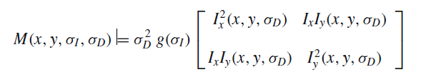
Multi-scale Detectors
Harris-Laplace
It relies on a combination of Harris corner detector and a Gaussian scale space representation.
The scale adapted second-moment matrix used in the Harris-Laplace detector is represented as

Slide 34

Multi-scale Detectors
Hessian-Laplace
Similar to Harris-Laplace, the same idea can also be applied to the Hessian-based detector, leading to a scale invariant detector termed, Hessian-Laplace.
Gabor-Wavelet detector
Yussof and Hitam proposed a multi-scale interest points detector based on the principle of Gabor wavelets. The Gabor wavelets are biologically motivated convolution kernels in the shape of plane waves restricted by a Gaussian envelope function. The Gabor wavelets take the form of a complex plane wave modulated by a Gaussian envelope function.

Slide 35
Affine Invariant Detectors
The feature detectors discussed so far exhibit invariance to translations, rotations and uniform scaling;
Assuming that the localization and scale are not affected by an affine transformation of the local image structures.

Slide 36
Affine Invariant Descriptors
Affine invariant color moments
Different combinations of these moments are fully affine invariant
Also invariant to affine transformation of intensity I → a I + b

Slide 37
Affine Invariant Descriptors
Find affine normalized frame
A
A₁
A₂
rotation
Compute rotational invariant descriptor in this normalized frame

Slide 38
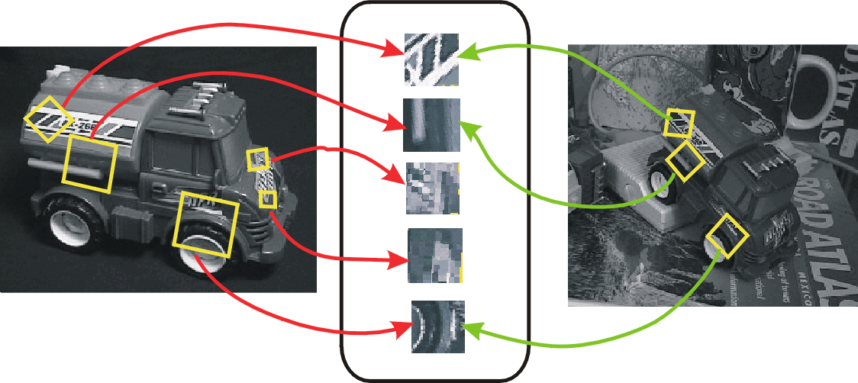
Scale Invariant Feature Transform (SIFT)
Lowe presented the scale-invariant feature transform (SIFT) algorithm, where a number of interest points are detected in the image using the Difference-of-Gaussian (DOG) operator.
The points are selected as local extrema of the DoG function.
At each interest point, a feature vector is extracted.
SIFT Features

Slide 39
Scale Invariant Detection
Consider regions (e.g. circles) of different sizes around a point
Regions of corresponding sizes will look the same in both images

Slide 40
Scale Invariant Detection
The problem: how do we choose corresponding circles independently in each image?

Slide 41
Scale invariance
Requires a method to repeatably select points in location and scale:
The only reasonable scale-space kernel is a Gaussian (Koenderink, 1984; Lindeberg, 1994)
An efficient choice is to detect peaks in the difference of Gaussian pyramid (Burt & Adelson, 1983; Crowley & Parker, 1984 – but examining more scales)
Difference-of-Gaussian with constant ratio of scales is a close approximation to Lindeberg’s scale-normalized Laplacian (can be shown from the heat diffusion equation)

Slide 42
Scale Invariant Detection
Solution:
Design a function on the region (circle), which is “scale invariant” (the same for corresponding regions, even if they are at different scales)
Example: average intensity. For corresponding regions (even of different sizes) it will be the same.
For a point in one image, we can consider it as a function of region size (circle radius)
f
Image 1
f
Image 2
scale = 1/2
region size
region size

Slide 43
Scale Invariant Detection
Common approach:
Take a local maximum of this function
Observation: region size, for which the maximum is achieved, should be invariant to image scale.
Important: this scale invariant region size is found in each image independently!
f
Image 1
f
Image 2
scale = 1/2
s₁
region size
s₂
region size

Slide 44
Scale Invariant Detection
A “good” function for scale detection: has one stable sharp peak
f
f
f
Good !
bad
bad
region size
region size
region size
For usual images: a good function would be a one which responds to contrast (sharp local intensity change)

Slide 45
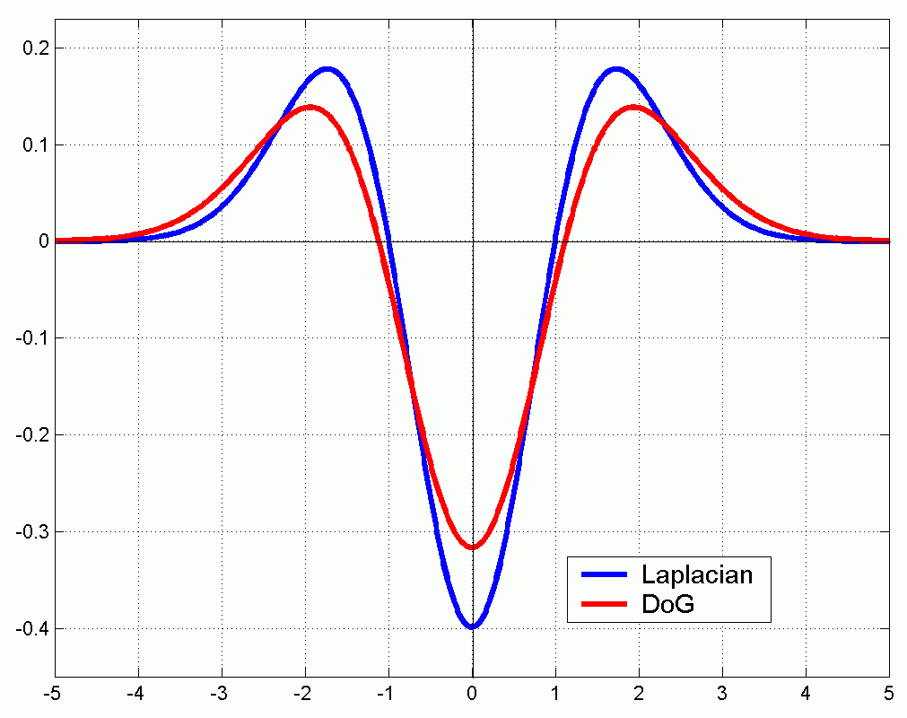
Scale Invariant Detection
Functions for determining scale
Kernels:
(Laplacian)
(Difference of Gaussians)
where Gaussian
Note: both kernels are invariant to scale and rotation

Slide 46
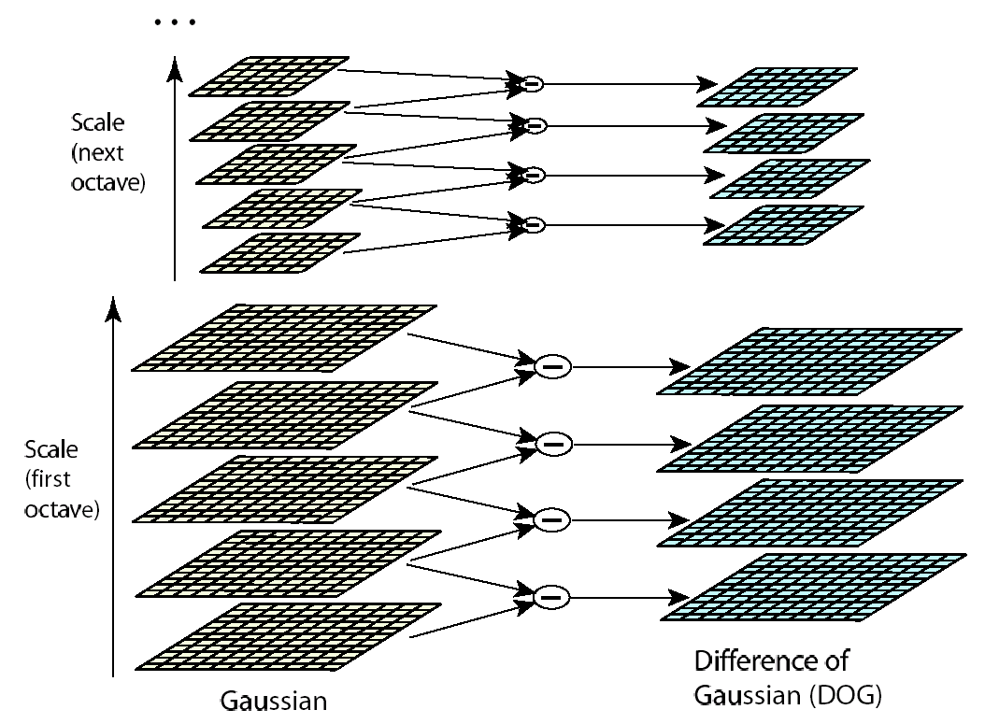
Scale space: one octave at a time

Slide 47
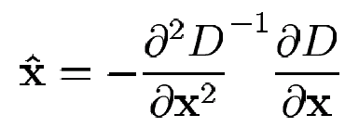
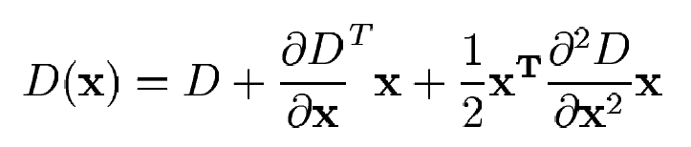
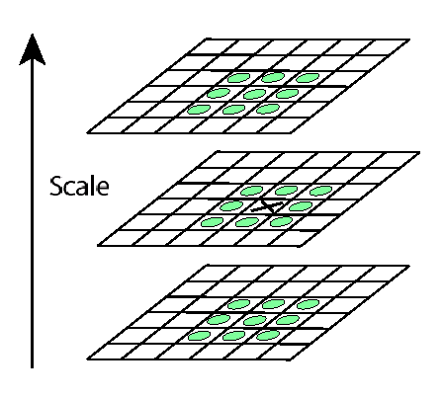
Key point localization
Detect maxima and minima of difference-of-Gaussian in scale space
Fit a quadratic to surrounding values for sub-pixel and sub-scale interpolation (Brown & Lowe, 2002)
Taylor expansion around point:
Offset of extremum (use finite differences for derivatives):

Slide 48
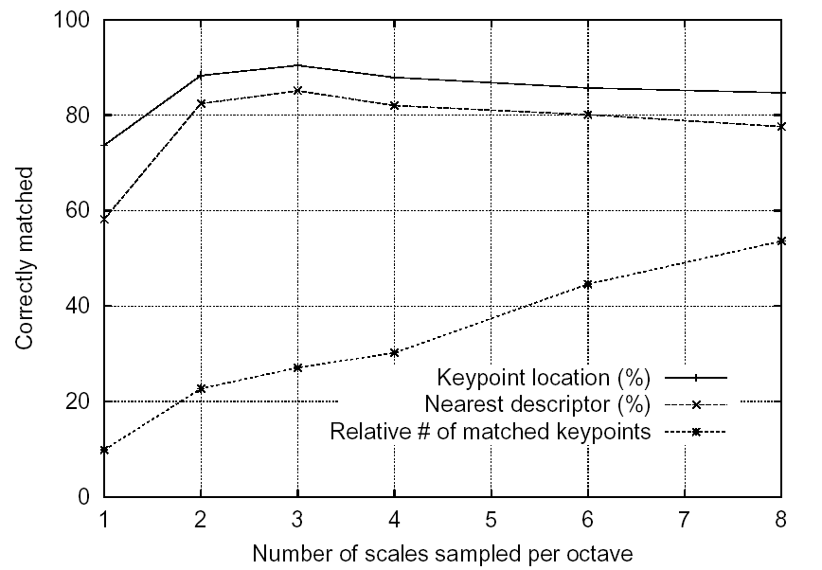
Sampling frequency for scale
More points are found as sampling frequency increases, but accuracy of matching decreases after 3 scales/octave

Slide 49
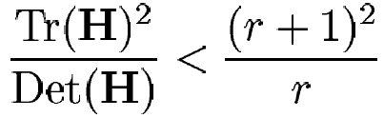
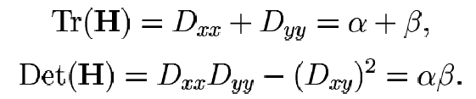
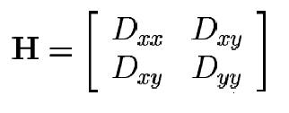
Eliminating unstable keypoints
Discard points with DOG value below threshold (low contrast)
However, points along edges may have high contrast in one direction but low in another
Compute principal curvatures from eigenvalues of 2x2 Hessian matrix, and limit ratio (Harris approach):

Slide 50
Scale Invariant Detectors
Harris-Laplacian¹ Find local maximum of:
Harris corner detector in space (image coordinates)
Laplacian in scale
scale
← Laplacian →
y
← Harris →
x
SIFT (Lowe)² Find local maximum of:
Difference of Gaussians in space and scale
scale
← DoG →
y
← DoG →
x
¹ K.Mikolajczyk, C.Schmid. “Indexing Based on Scale Invariant Interest Points”. ICCV 2001 ² D.Lowe. “Distinctive Image Features from Scale-Invariant Keypoints”. Accepted to IJCV 2004

Slide 51
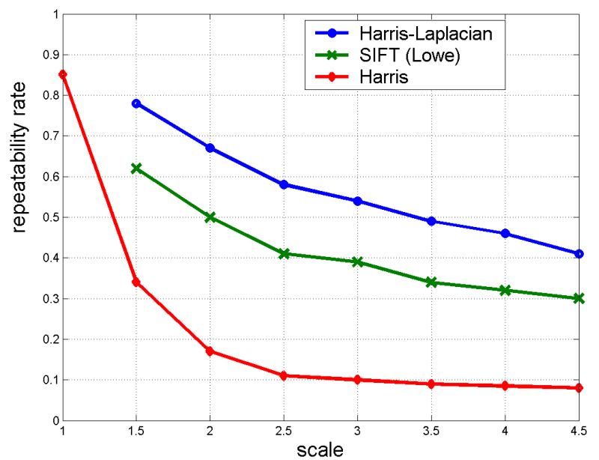
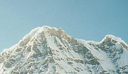

Scale Invariant Detectors
Experimental evaluation of detectors w.r.t. scale change
Repeatability rate:
# correspondences # possible correspondences
K.Mikolajczyk, C.Schmid. “Indexing Based on Scale Invariant Interest Points”. ICCV 2001

Slide 52
Scale Invariant Detection: Summary
Given: two images of the same scene with a large scale difference between them
Goal: find the same interest points independently in each image
Solution: search for maxima of suitable functions in scale and in space (over the image)
Methods:
Harris-Laplacian [Mikolajczyk, Schmid]: maximize Laplacian over scale, Harris’ measure of corner response over the image
SIFT [Lowe]: maximize Difference of Gaussians over scale and space

Slide 53
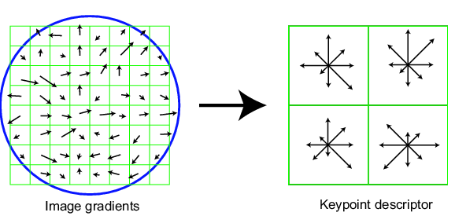
SIFT vector formation
Computed on rotated and scaled version of window according to computed orientation & scale
resample the window
Based on gradients weighted by a Gaussian of variance half the window (for smooth falloff)

Slide 54
SIFT vector formation
4x4 array of gradient orientation histograms
not really histogram, weighted by magnitude
8 orientations x 4x4 array = 128 dimensions
Motivation: some sensitivity to spatial layout, but not too much.
showing only 2x2 here but is 4x4

Slide 55
Reduce effect of illumination
128-dim vector normalized to 1
Threshold gradient magnitudes to avoid excessive influence of high gradients
after normalization, clamp gradients >0.2
renormalize

Slide 56
Tuning and evaluating the SIFT descriptors
Database images were subjected to rotation, scaling, affine stretch, brightness and contrast changes, and added noise. Feature point detectors and descriptors were compared before and after the distortions, and evaluated for:
Sensitivity to number of histogram orientations and subregions.
Stability to noise.
Stability to affine change.
Feature distinctiveness
56

Slide 57
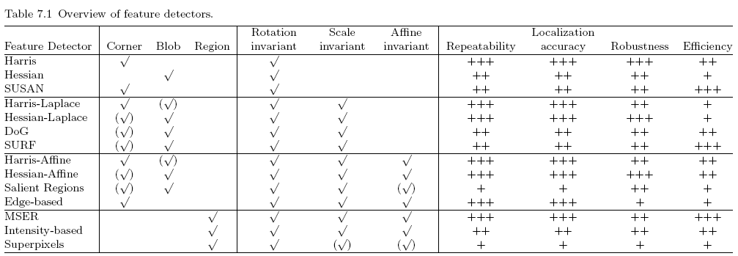
Comparison of Keypoint Detectors

Slide 58
Feature Extraction
In pattern recognition and in image processing, feature extraction is a special form of dimensionality reduction.
The main goal of feature extraction is to obtain the most relevant information from the original data and represent that information in a lower dimensionality space.

Slide 59
Thank You

