Slide 1

Bangladesh Army International University Of Science And Technology
Tentative Title : Improvise SegNet architecture with Canny edge detector algorithm for more boundary accurate image segmentation
Presented By: Arik Md. Isthiaque
ID – 1103096
Section – B
Department of CSE
Supervised By: Arifa Islam Champa Lecturer Department of CSE

Slide 2
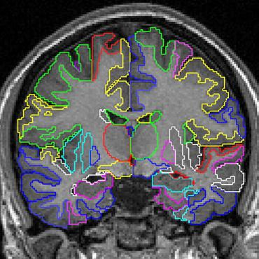
Introduction
Segmentation
Process that classify object in image
Used in
OCR
Automated vehicle
Medical image
Figure 1: Segmentation used in a brain image to classify different parts [1].

Slide 3
Motivation for Research
SegNet: A Deep Convolutional Encoder-Decoder Architecture for Image Segmentation
Build to understand road scenes
Model appearances and shapes
Understand the spatial resolution between classes
Used mostly for autonomous driving

Slide 4
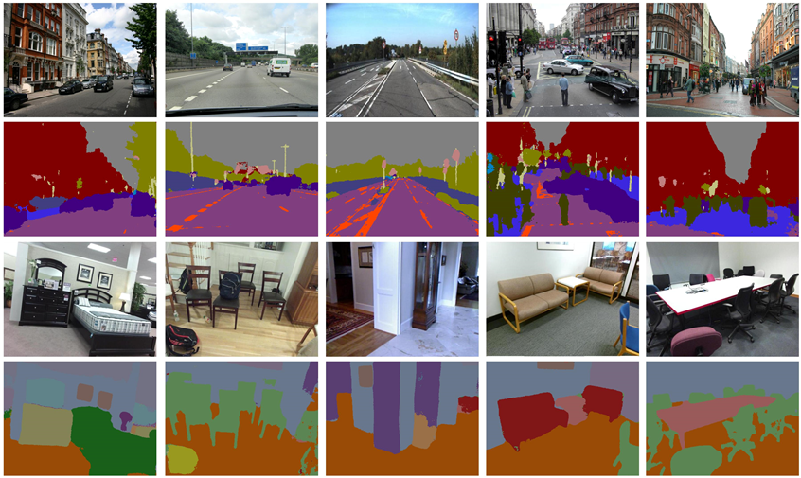
Background study
SegNet
Multi-class pixel-wise semantic segmentation
Predicts pixel wise class levels
Based on Supervised learning
Figure 2: SegNet input output [2] [3].

Slide 5
Background study
SegNet Architecture
13 encoder layer
13 decoder layer
Follow VGG network
Extract low resolution pixel information

Slide 6
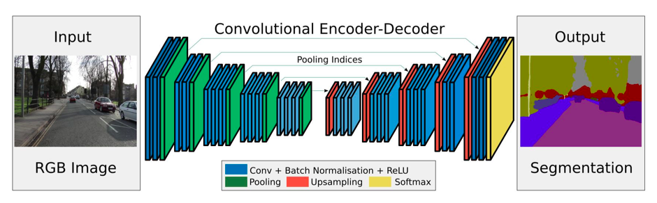
Background study
SegNet Architecture
Figure 3: SegNet Architecture [4].

Slide 7
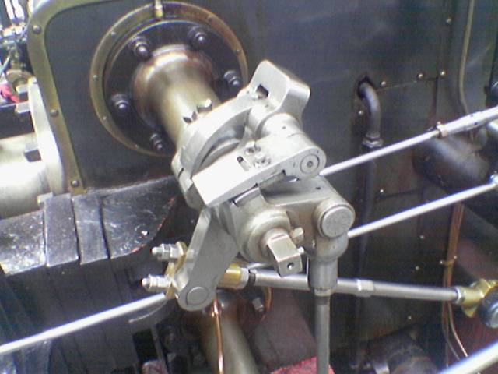
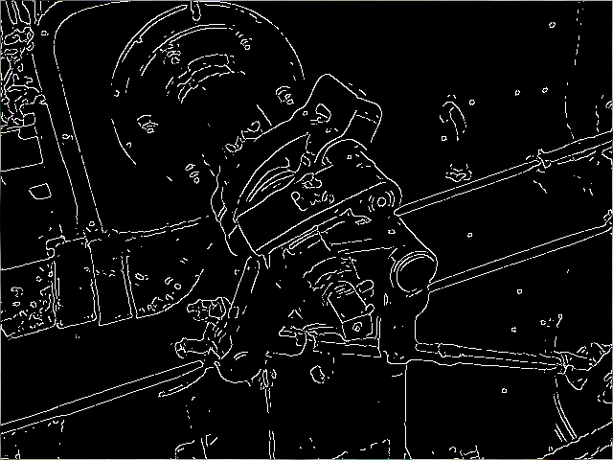
Background study
Canny edge detector algorithm
Multi-stage algorithm to detect wide range of edges
Extract structural information
Low error rate
Detect small details
(a) (b)
Figure 4: (a) original image, (b) After the algorithm applied [5].

Slide 8
Methodology
Encoder Network
Convolution
Batch normalization
Decoder Network
Upsampling
SoftMax
Boundary localization
Canny edge detector algorithm
ReLu
Max Pooling
Deconvolution
Figure 5: The proposed methodology.

Slide 9
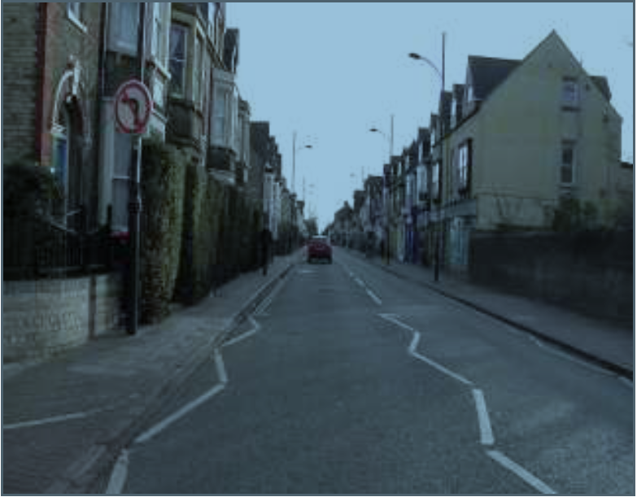
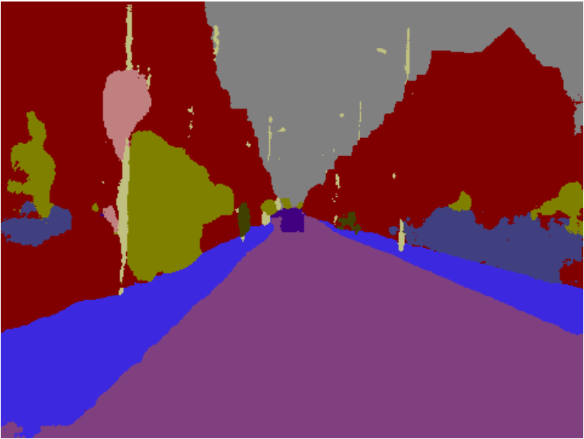
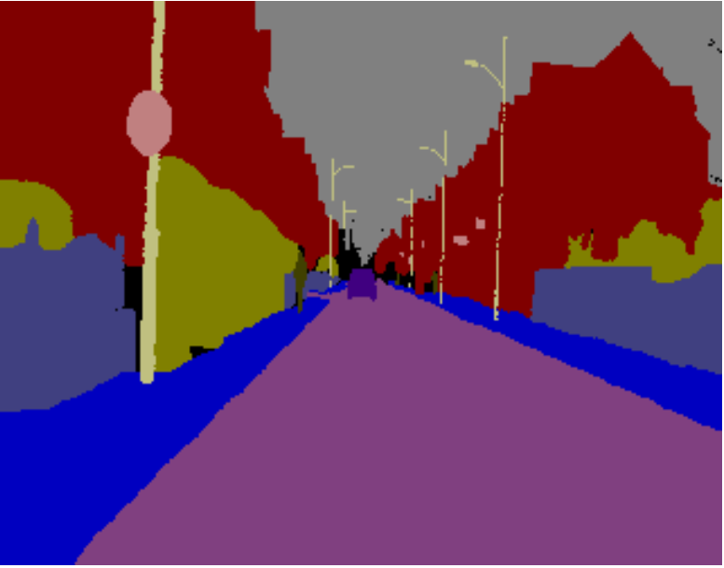
Outline
(a)
(b)
(c)
Figure 7: (a) Input RGB image, (b) Current SegNet output [1] ,
(c) Expected output [1].

Slide 10
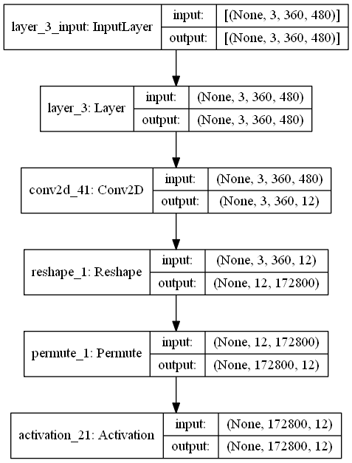
Implementation
Figure 6: Plotted Architecture output.

Slide 11
References
https://paperswithcode.com/task/medical-image-segmentation
V. Badrinarayanan, A. Kendall, R. Cipolla, Senior Member, IEEE, “SegNet: A Deep Convolutional Encoder-Decoder Architecture for Image Segmentation “ [2017 TPAMI] h ttps://arxiv.org/abs/1511.00561.
http://mi.eng.cam.ac.uk/projects/segnet
V. Badrinarayanan, A. Kendall, R. Cipolla, Senior Member, IEEE , “SegNet: A Deep Convolutional Encoder-Decoder Architecture for Robust Semantic Pixel-Wise Labelling”, https://arxiv.org/abs/1505.07293.

Slide 12
References
William McIlhagga "The Canny Edge Detector Revisited " International Journal of Computer Vision no.91 pp.251-261 2011
K. Simonyan and A. Zisserman, “Very deep convolutional networks for large-scale image recognition,” arXiv preprint arXiv:1409.1556, 2014.
O. Russakovsky, J. Deng, H. Su, J. Krause, S. Satheesh, S. Ma, Z. Huang, A. Karpathy, A. Khosla, M. Bernstein, A. C. Berg, and L. Fei-Fei, “ImageNet Large Scale Visual Recognition Challenge,” International Journal of Computer Vision (IJCV), pp. 1–42, April 2015.
https://www.quora.com/What-is-the-VGG-neural-network

Slide 13
Thank you…..

