Slide 1


Internship Program of Software Development (Laravel)
Submitted By
Pritilata Biswas
ID: 1103017
Mohammad Mehedi Hasan Bhuiyan
ID: 1103023
Tafsir Haque Arnob
ID: 1103080
Conducted By
ICT Wing, BAIUST

Slide 2









Outline
Motivation
Objective
BAIUST
ICT Wing
Assignment
Class Overview
Project
Conclusion

Slide 3
Motivation
To revitalize and strive with excellence into the future career field.
To cope with the job field having pieces of knowledge.
To be more confident with every step for developing sites by giving the best efforts and be patient.
To fulfill the requirement of CSE graduation.

Slide 4
Primary Objective
Toto fulfill the Bachelor of Science (B.Sc.) degree requirement under the CSE Faculty, Bangladesh Army International University of Science and Technology.

Slide 5
Secondary Objective
To give an overview of the program by which students gained theoretical and practical knowledge in Software Development.
To familiar with the web development framework like Laravel by which students could be able to build their own websites.
To help students focus on their career interests and potentials.
To give the opportunity to learn, observe, and determine one’s goals and aims.

Slide 6
BAIUST

Slide 7
ICT Wing
Provide networks in campus
Implementing IUMS
Conduct internships

Slide 8

Assignment
Implement a Simple input form using the following Specifications
Take Input
Create a Controller
Validate data
Create a Model
Store Data
Success Message
Define Migration

Slide 9
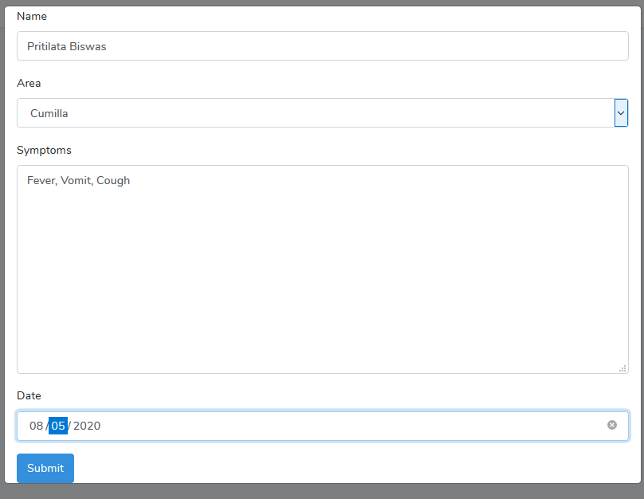
Assignment
Figure 1: Input Modal From.

Slide 10
Class 1
Installing
Composer
Node
Xampp
VS code
Git
Demonstrating Artisan Commands
Creating project in Laravel 5.8
Laravel project directories

Slide 11
Class 2
Creating Controllers
Editing Views
Using compact method
Setting Routes

Slide 12
Class 3
Connecting Database
Editing environment setting
Making Authentication
Migration

Slide 13
Class 4/1
Migrating database
tables
Data input
Creating
models

Slide 14

Class 4/2
Connecting
Controllers and models
Checking route table
Setting Routes

Slide 15
Class 5
Introduce
Laravel 6
Editing
AdminLTE3
Download
AdminLTE3
Integrate
AdminLTE3

Slide 16
Class 6
Making CRUD
Checking new routes
Integrate CRUD with DB
Editing CRUD
view

Slide 17
Class 7
Image input
Importing DB
File adding
Exporting DB

Slide 18

Project

Slide 19
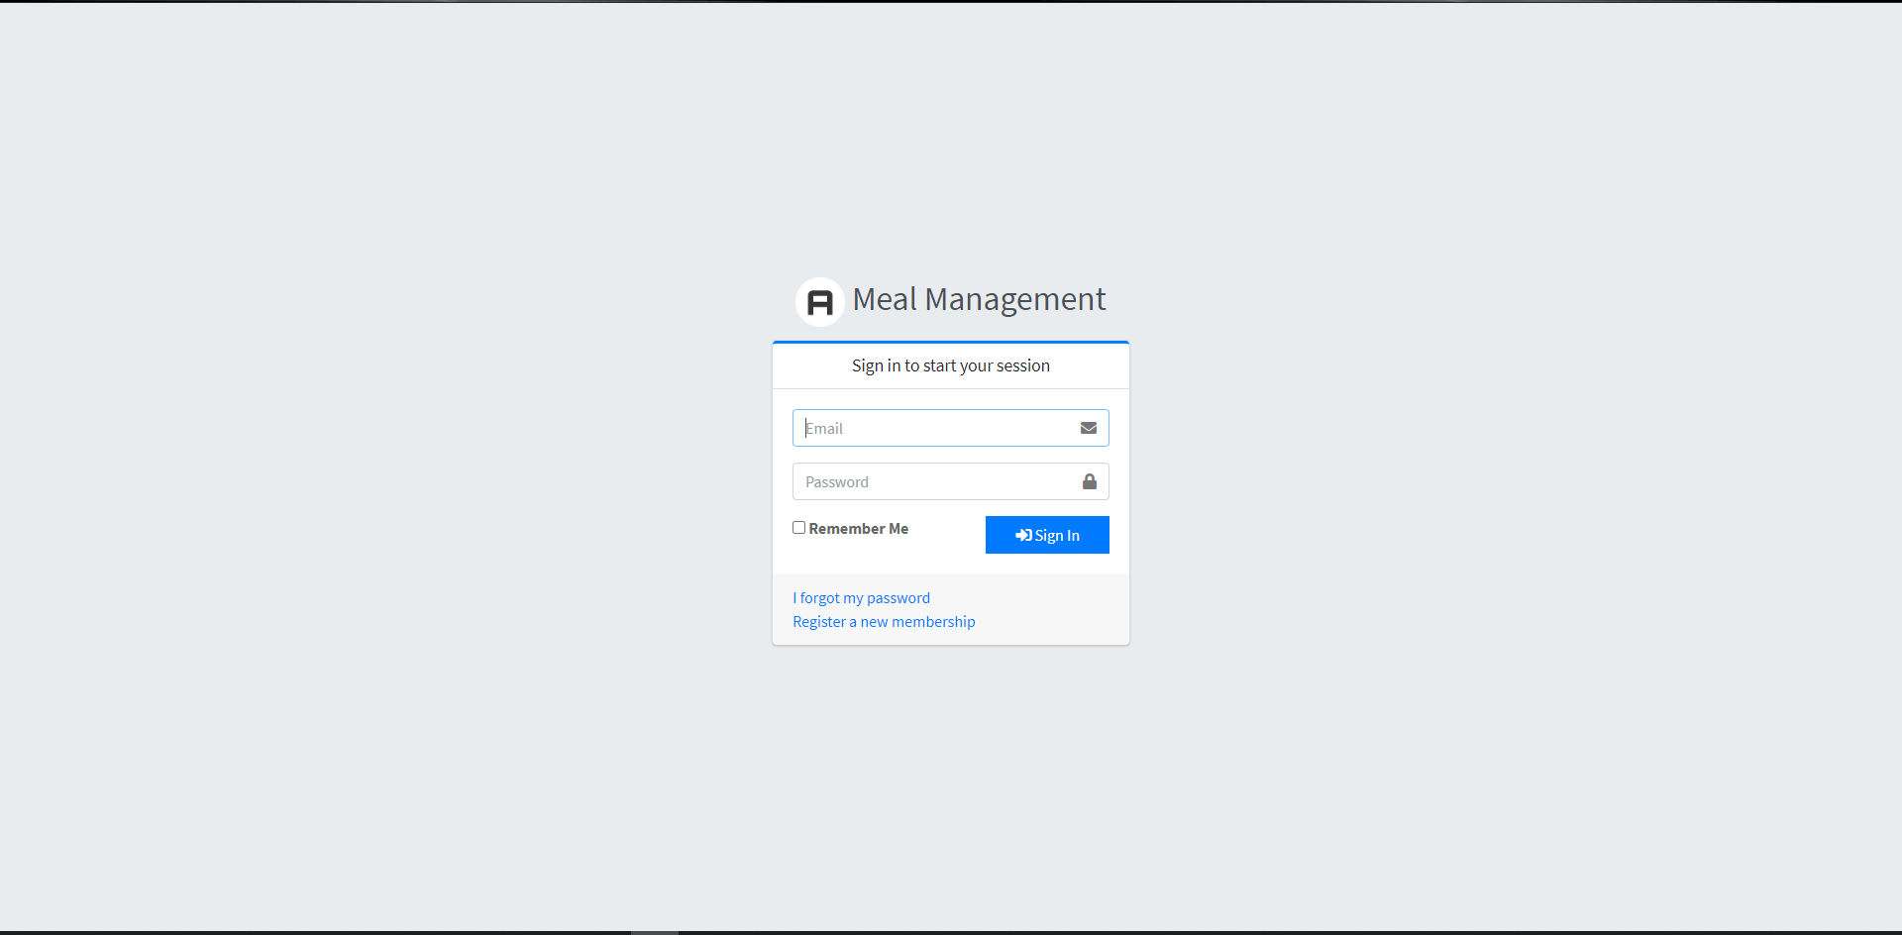
Project

Slide 20
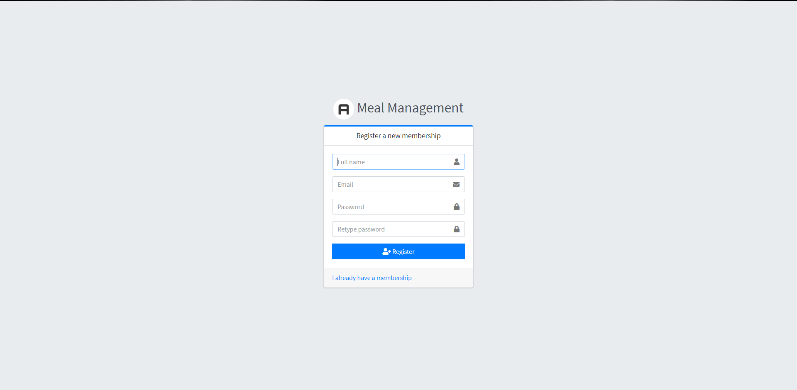
Project

Slide 21
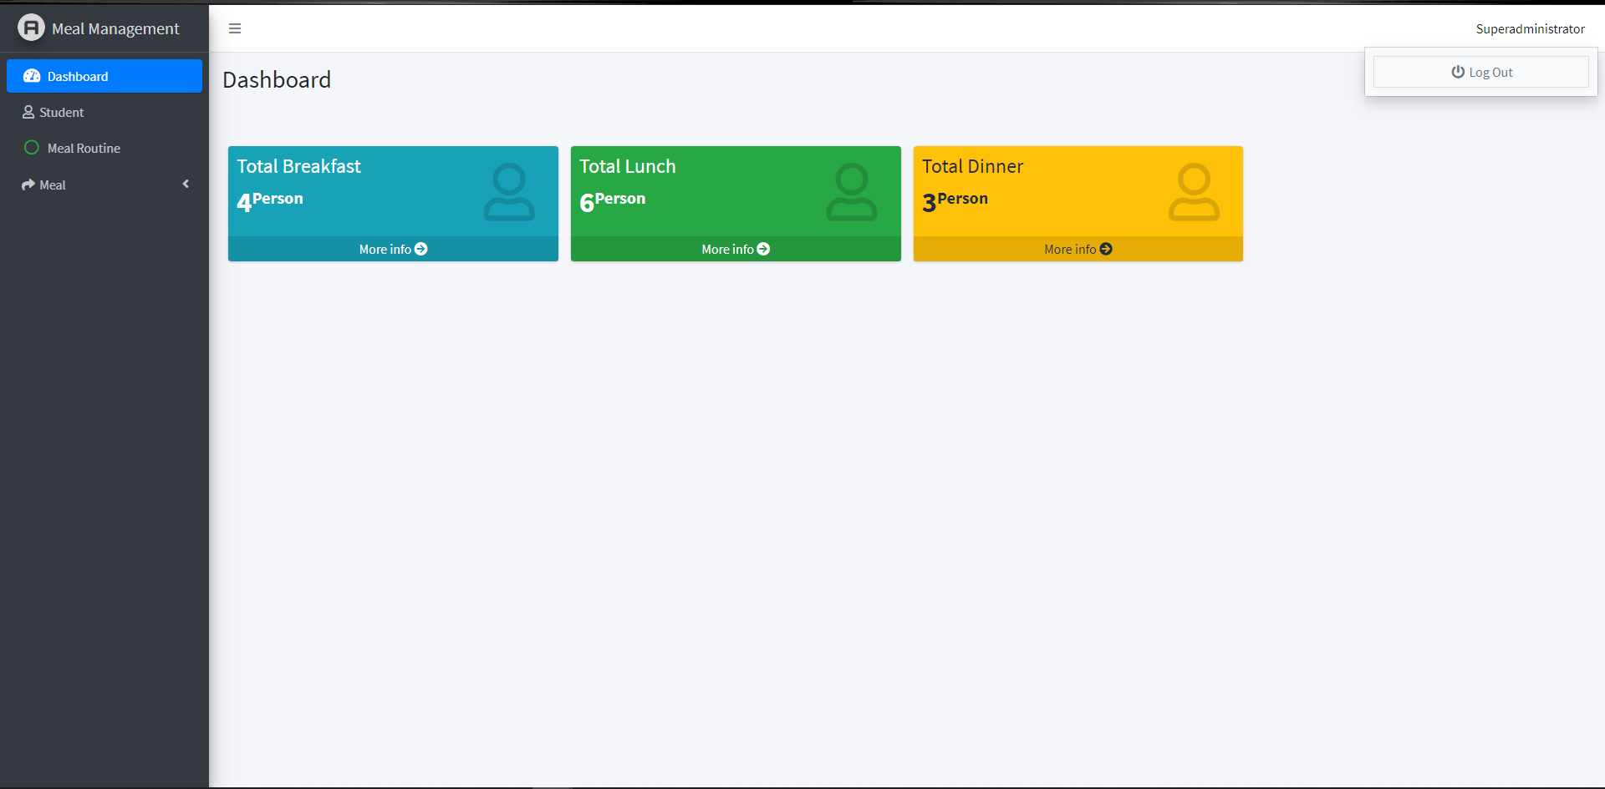
Project

Slide 22
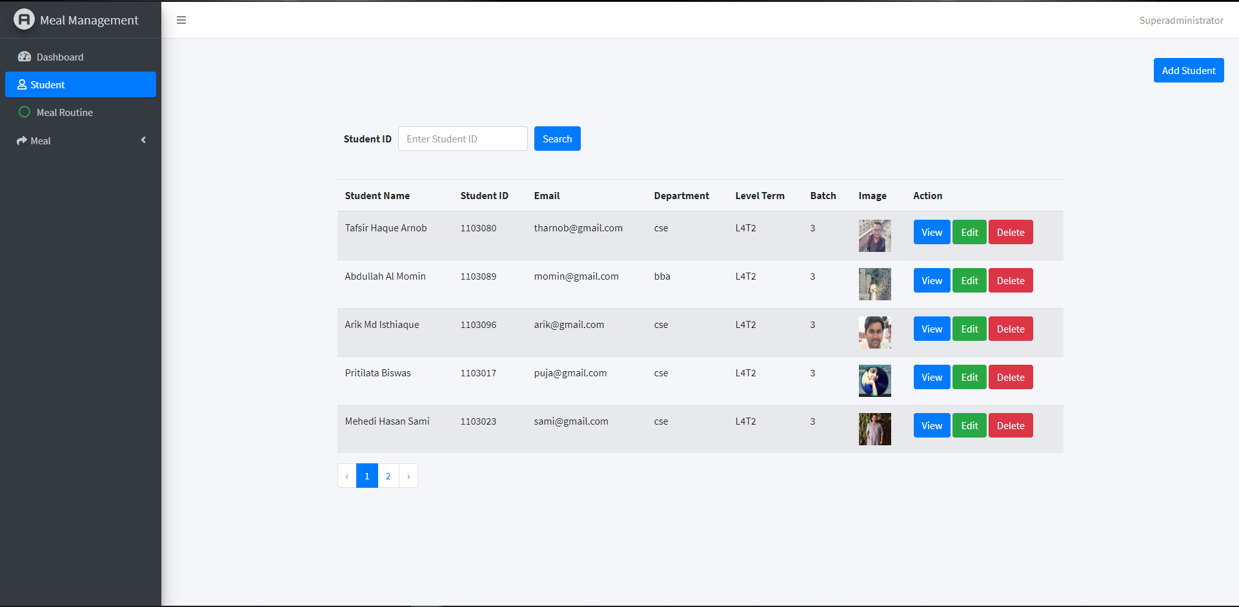
Project

Slide 23
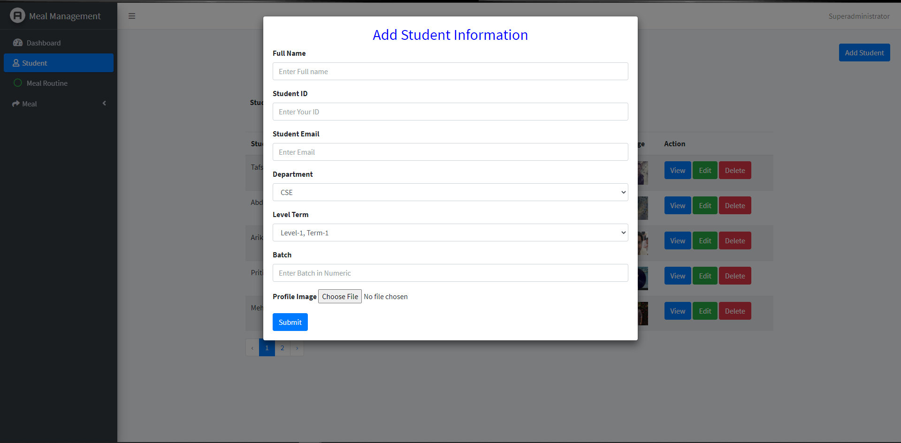
Project

Slide 24
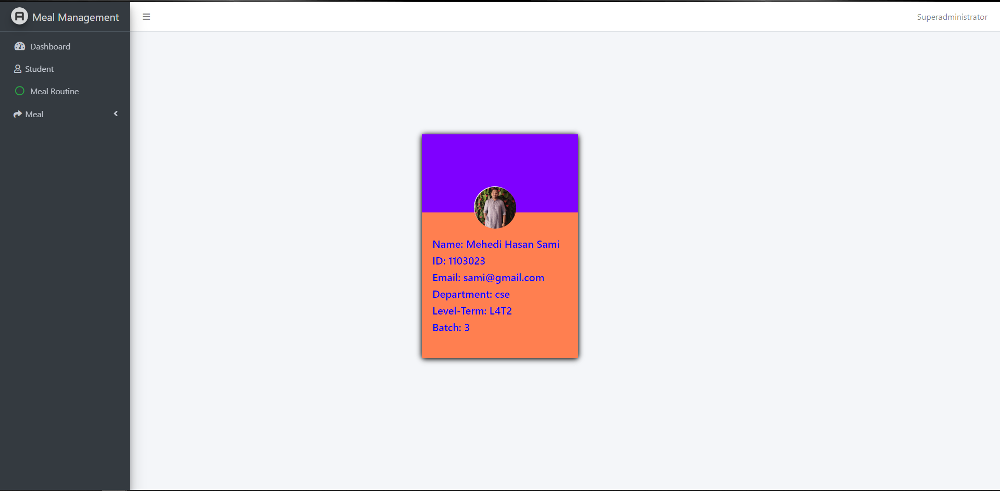
Project

Slide 25
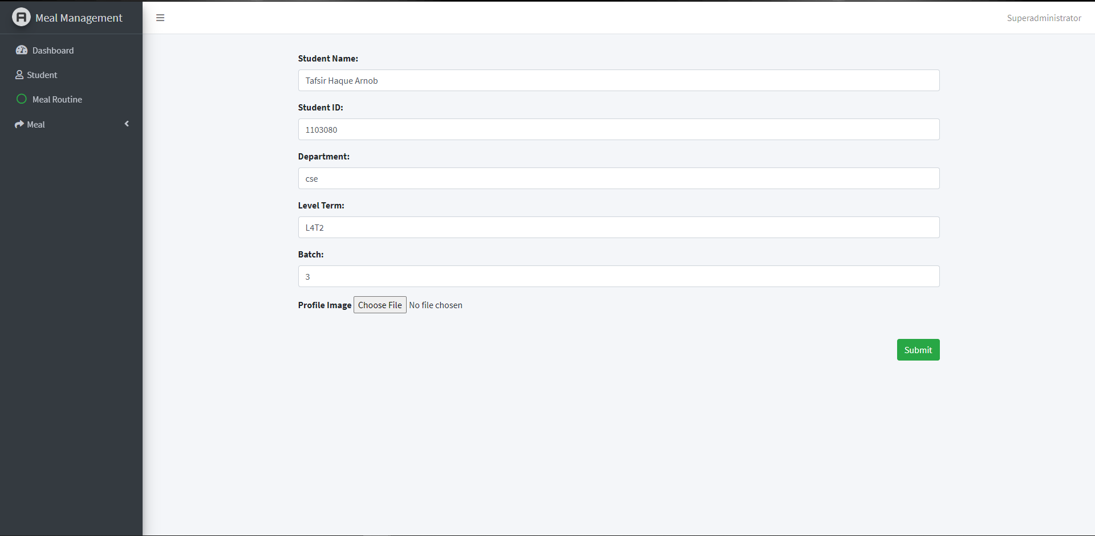
Project

Slide 26
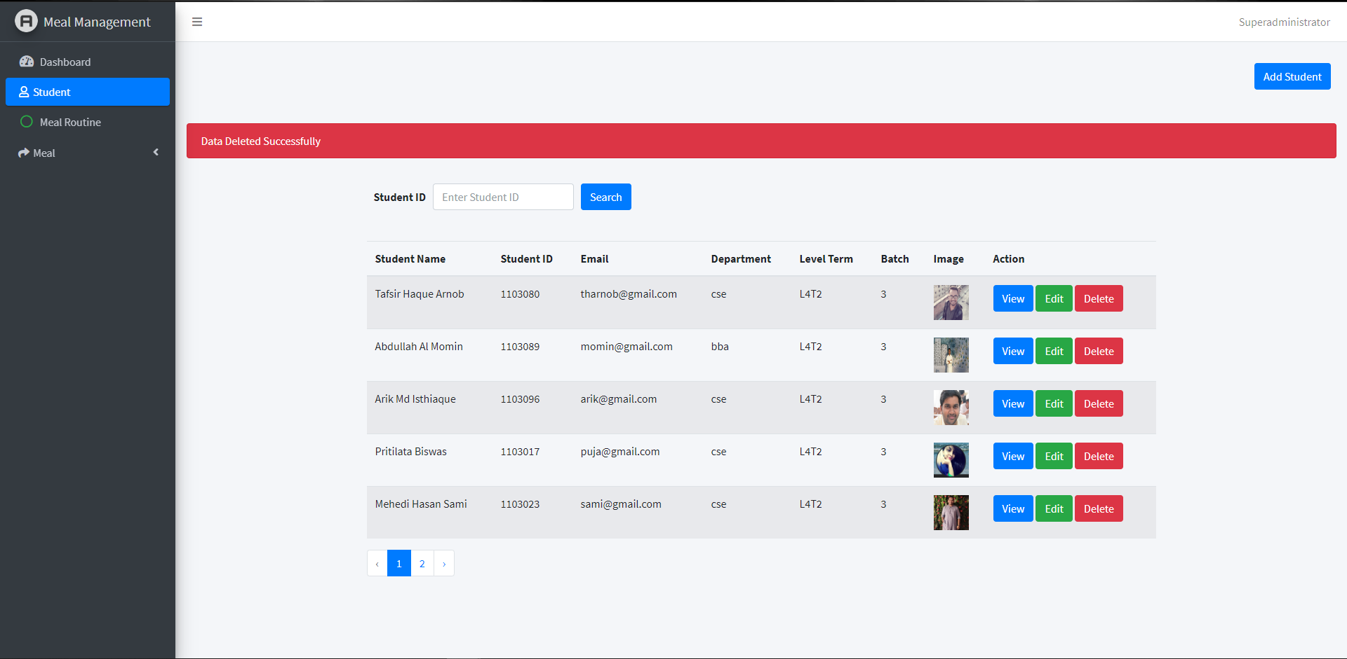
Project

Slide 27
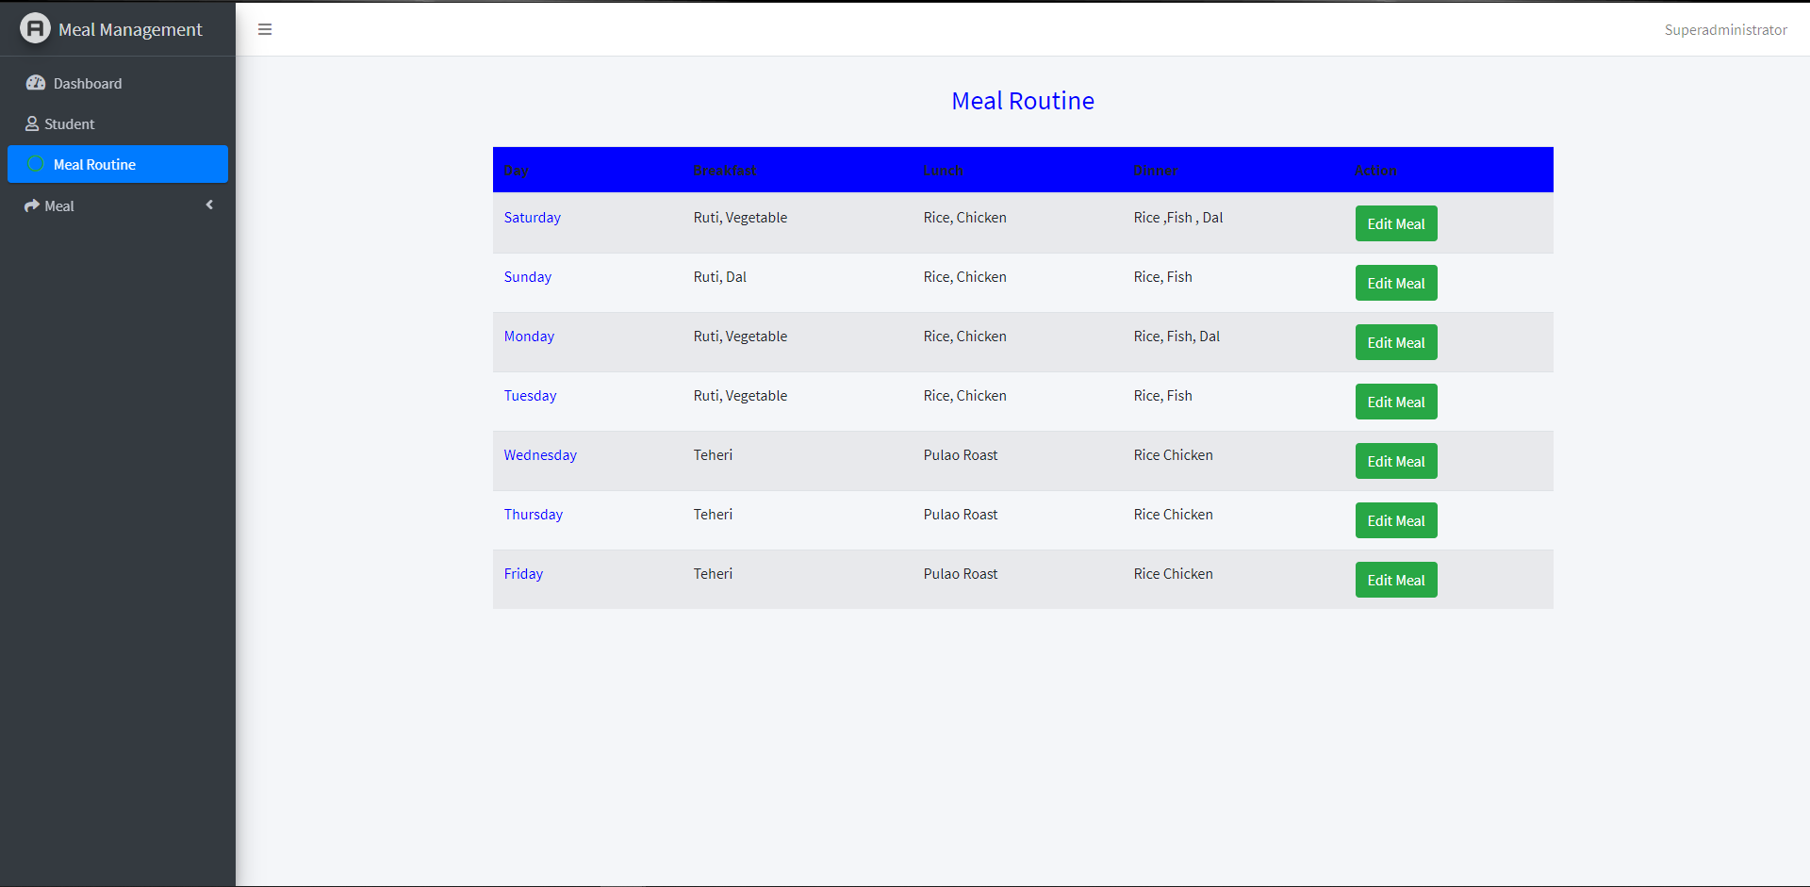
Project

Slide 28
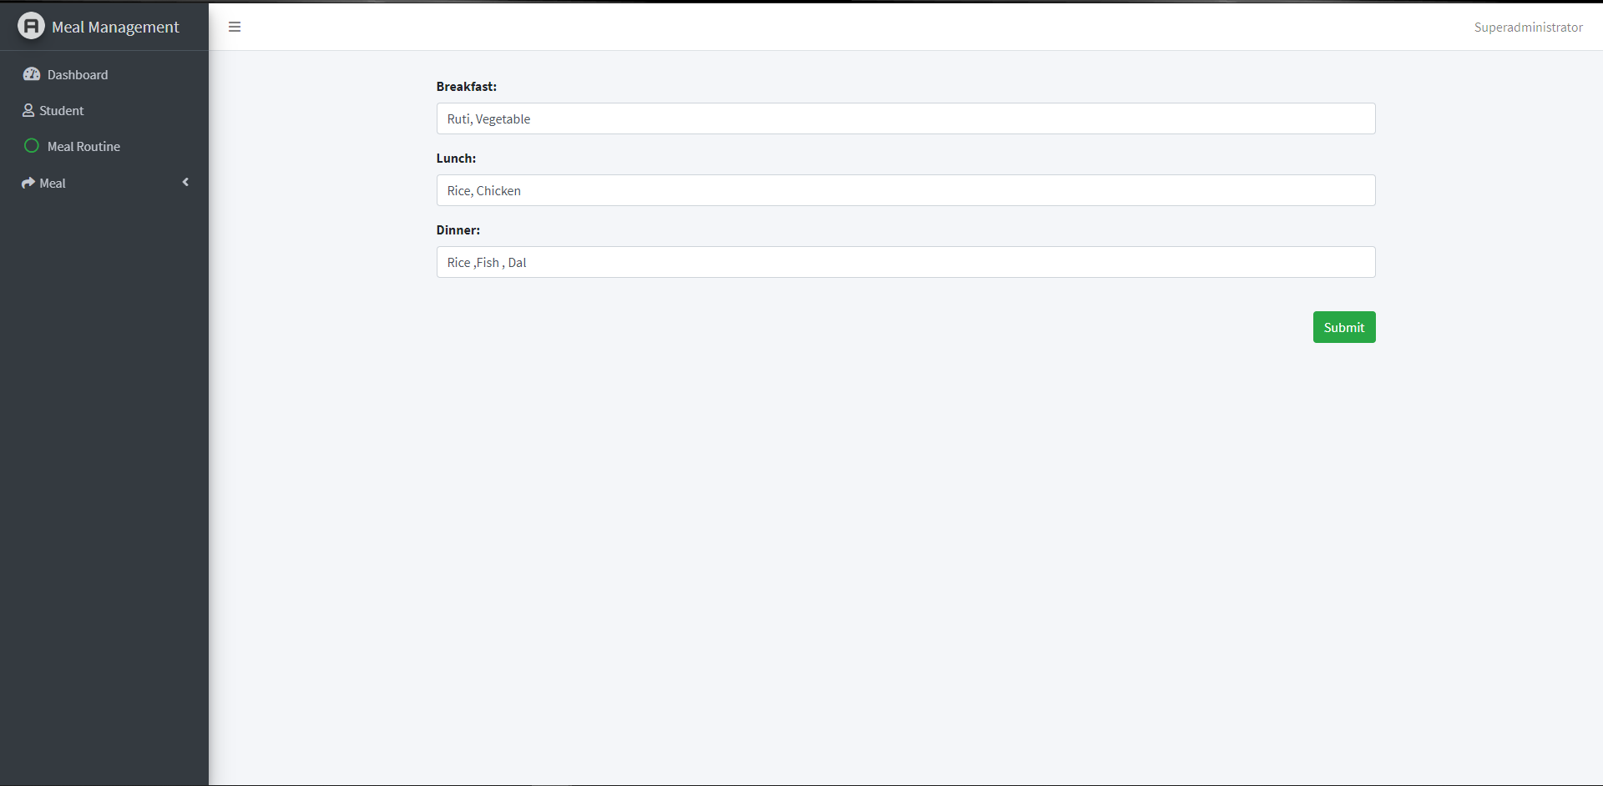
Project

Slide 29
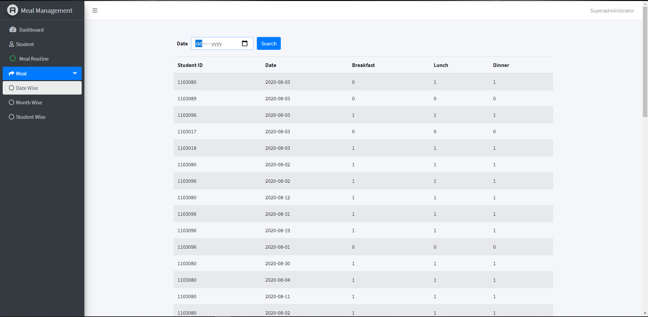
Project

Slide 30
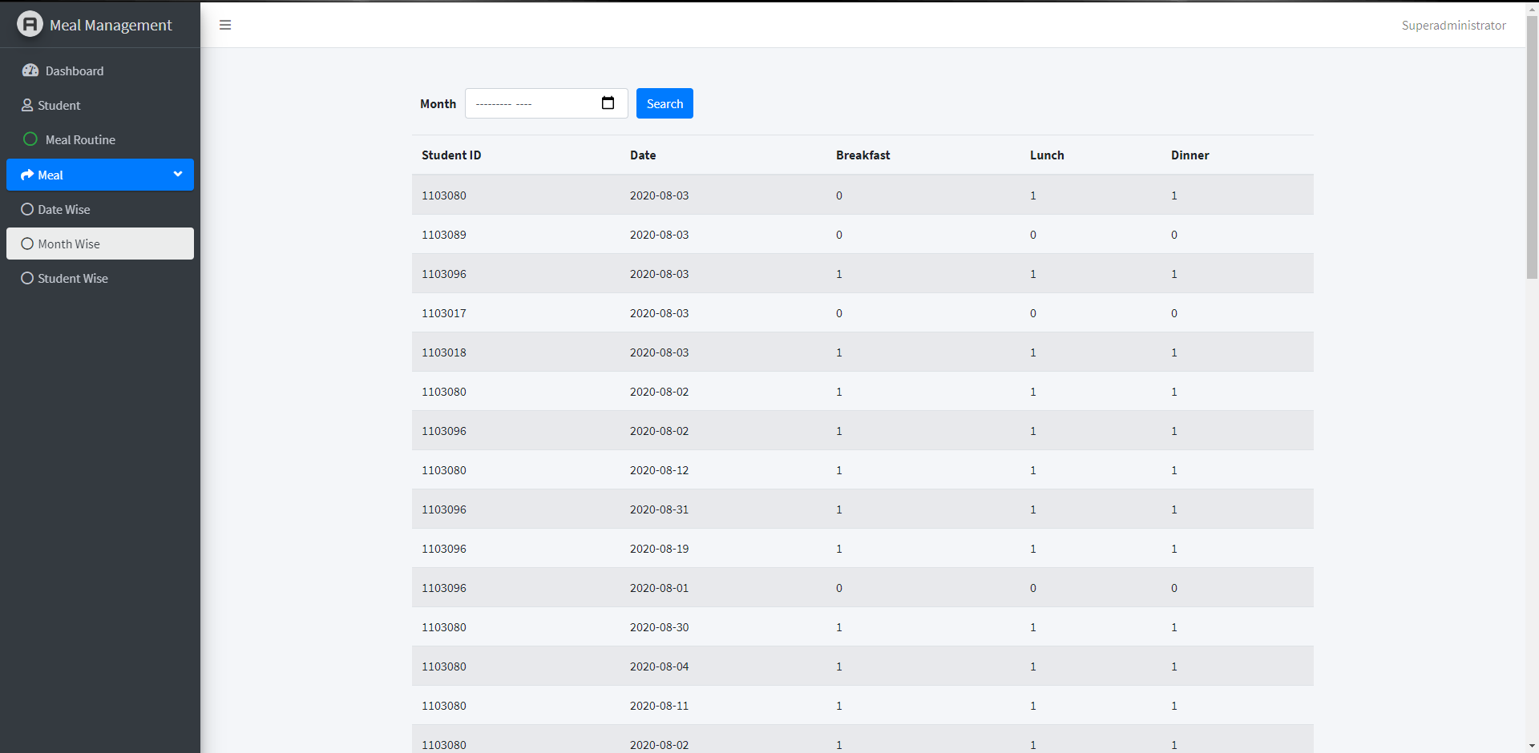
Project

Slide 31
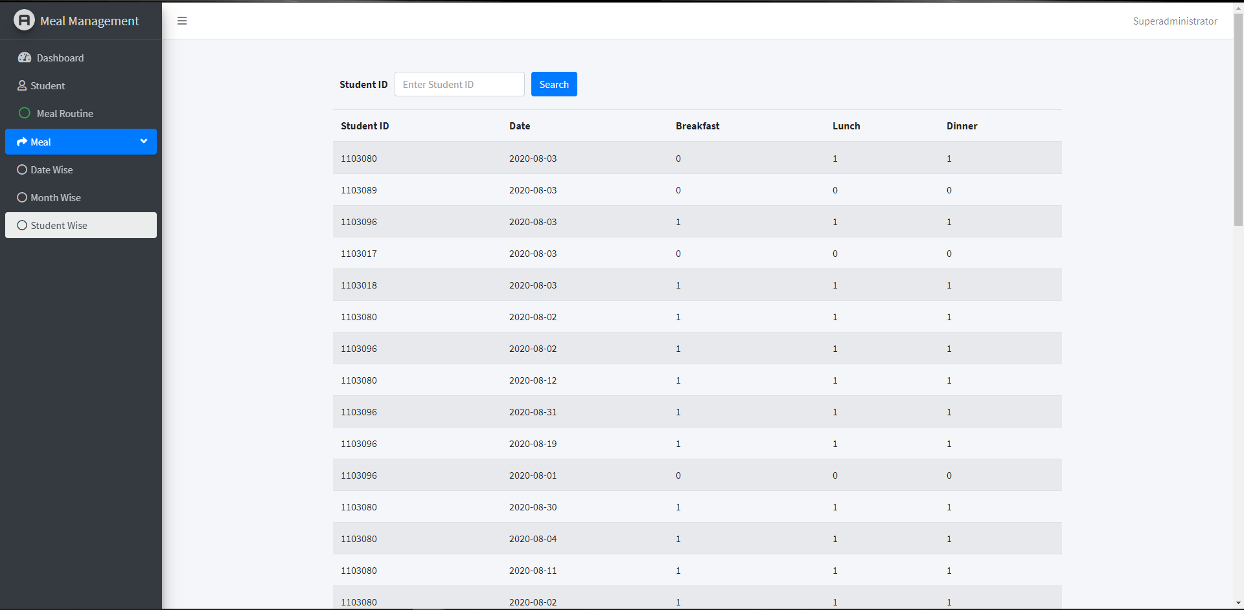
Project

Slide 32
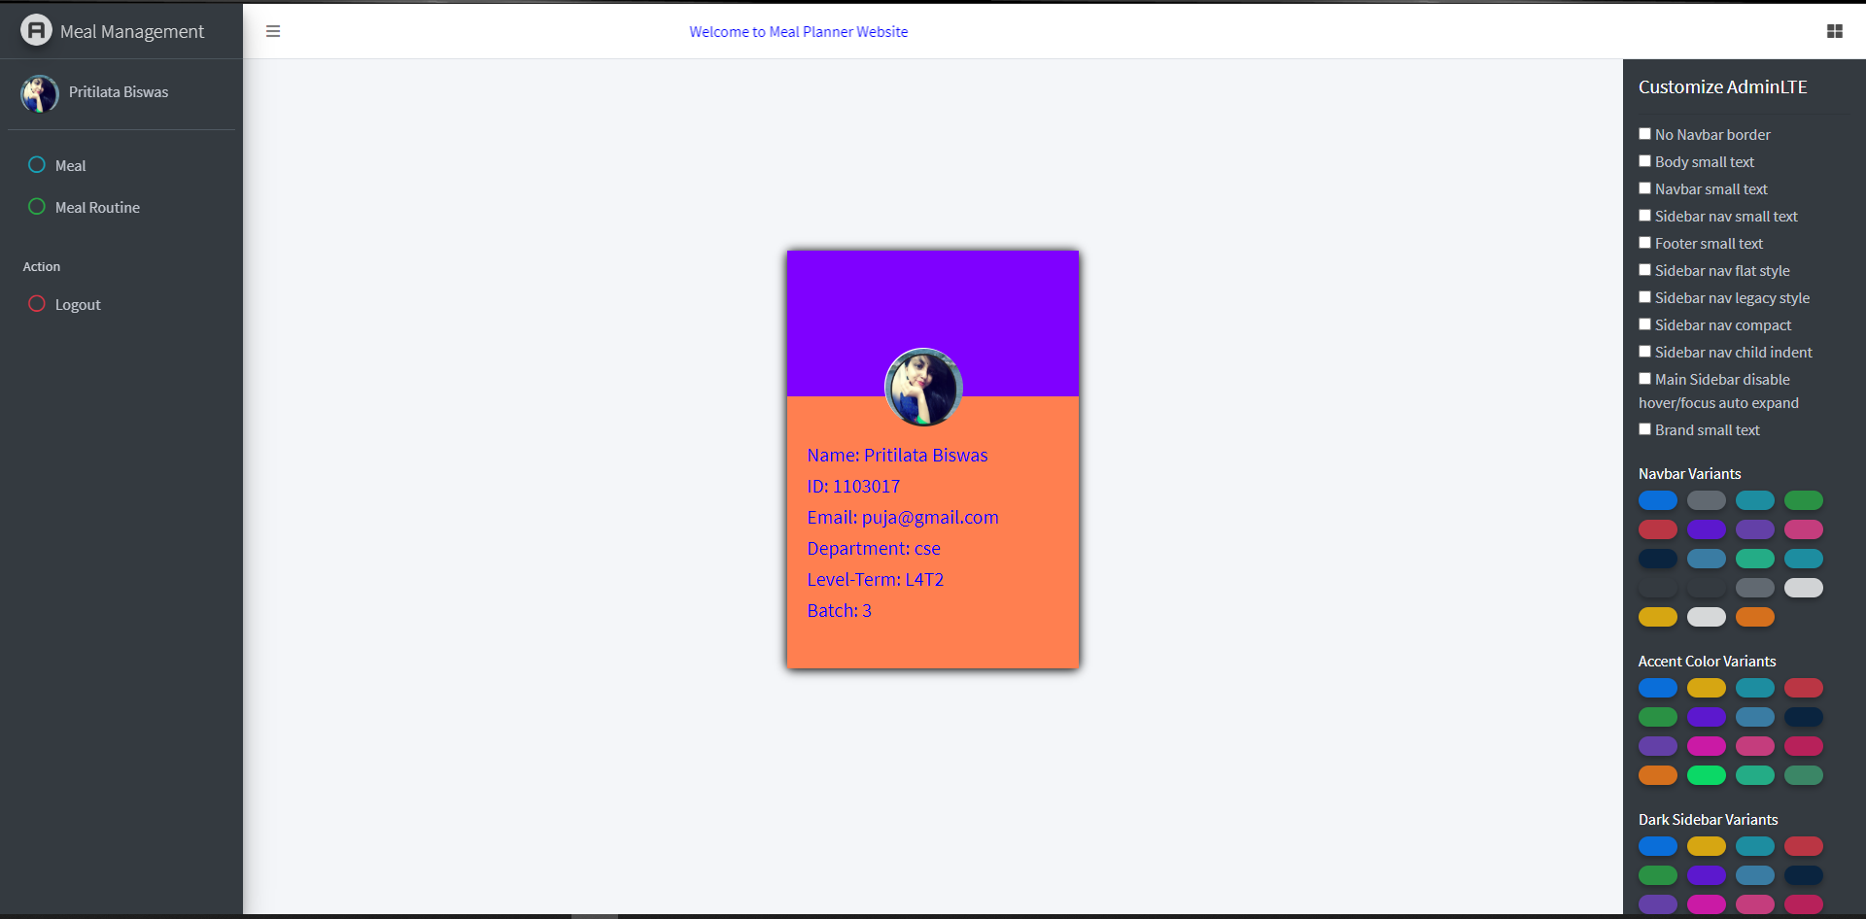
Project

Slide 33
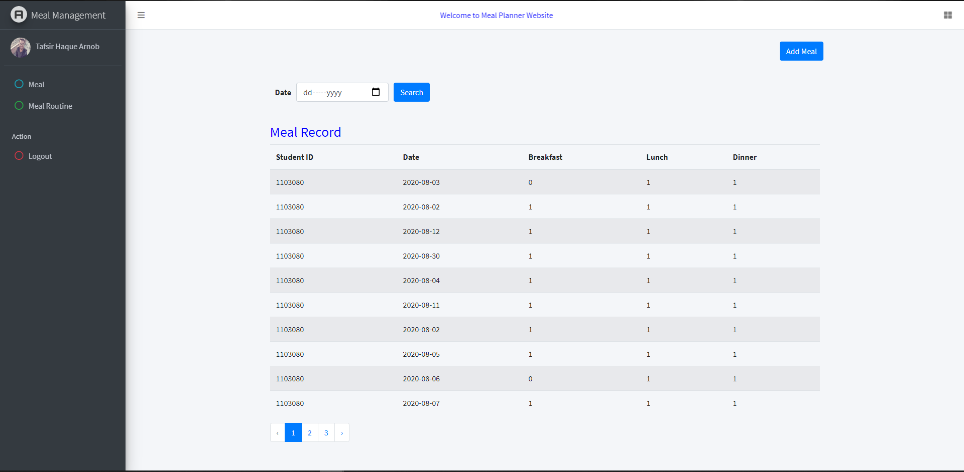
Project

Slide 34
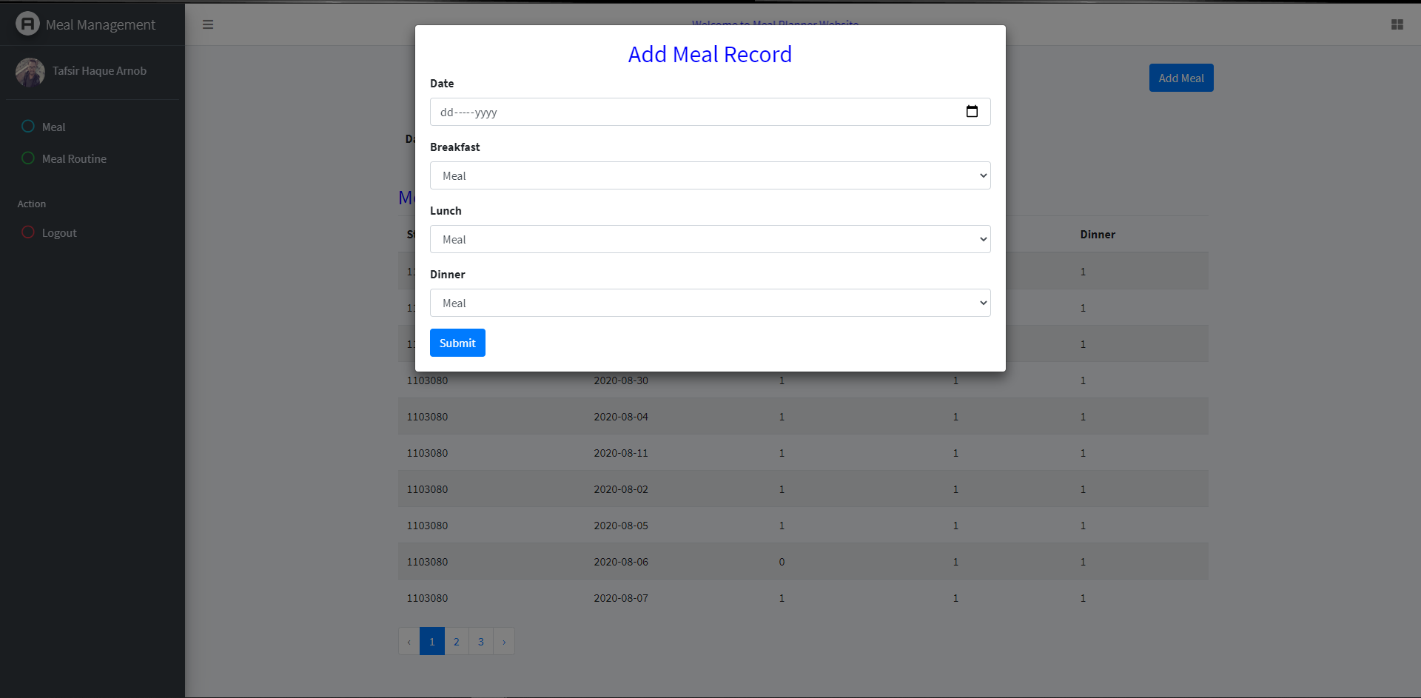
Project

Slide 35
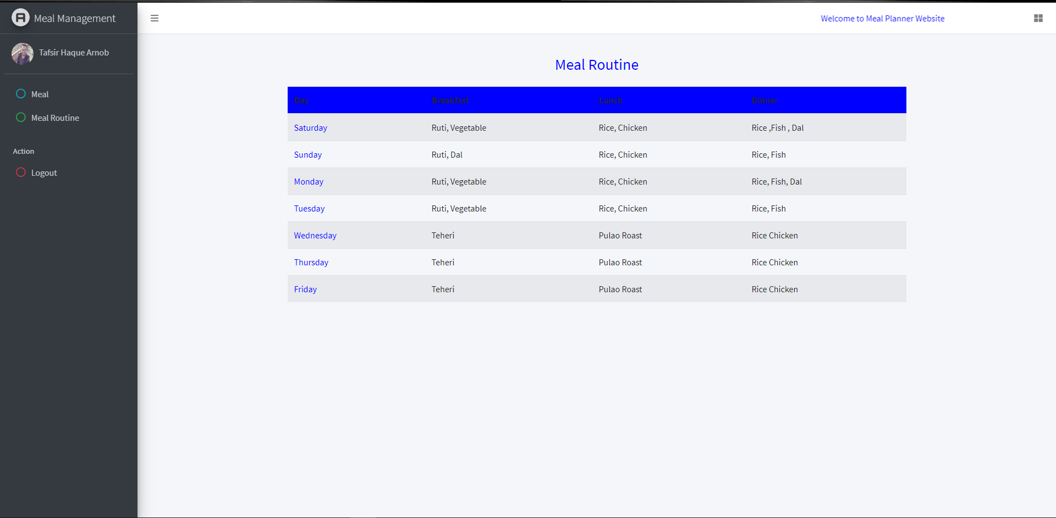
Project

Slide 36
Conclusion
Got skills and experience
Got familiar with hands on technology
Got familiar with MVC
Got SDLC overview

Slide 37
Thank You

