Slide 1

Bangladesh Army International University Of Science And Technology
Thesis Presentation
Title
Handwritten And Printed Bengali Script Character Segmentation Using Morphological Analysis
Supervised By: Arifa Islam Champa Lecturer Department of CSE,BAIUST
Presented By: Pritilata Biswas ID: 1103017
Sumaia Afrin Prity ID: 1103057
Parvez Abedin Siddique ID: 1103094
Department of CSE,BAIUST

Slide 2
Outline
Introduction
Motivation
Challenges
Objective
Literature Review
Methodology
Implementation
Result Analysis
Conclusion
Future Scope
References

Slide 3
Introduction
OCR is a major research area
Segmentation is the most challenging part
Need a robust technique for segmentation

Slide 4
Challenges
For Bengali script, there is no good OCR solution until now
To store a million pages of paper documents into electronic form, OCR is the key tool
To implement an OCR the foremost step in the recognition process is the script segmentation of the document image which is the most challenging task

Slide 5
Motivation
Printed text OCR have a huge success but handwritten still need to improved
Major problem – removing connectedness

Slide 6
Objective
Effective strategy for segmenting Bengali scripts
Reduce the segmentation error and time

Slide 7
Literature Review
Got fairly good results if the sequent characters are not touching in the zone of contour following [1]
Examined the width of a single character sufficiently [2]

Slide 8

Methodology
Bengali Script
Word Segmentation
Line Segmentation
Preprocessing
Character Segmentation
Figure 1: Methodology.

Slide 9
Implementation Preprocessing
Bilateral Filtering
Gray Scale Filtering
Binarization
&
Skew Angle Correction
Figure 2: Preprocessing steps.

Slide 10
Implementation Line Segmentation
Horizontal Projection
Profile
Projection profile of a image along horizontal axis
Calculated for every row
Sum of all column pixel values inside the row
Figure 3: Line Segmentation using HPP [3].

Slide 11
Implementation Word Segmentation
Vertical
Projection
Profile
Projection profile of a image along vertical axis
Calculated for every column
Sum of all row pixel values inside the column
Figure 4: Word Segmentation using VPP [3].

Slide 12
Implementation Character Segmentation
Morphological Opening Operation
Morphological Closing Operation
Vertical
Projection
Profile
Figure 5: Character segmentation steps.

Slide 13
Morphological Image Processing
Binary images may contain numerous imperfections
Removes these imperfections
Collection of non-linear operations
Erosion, Dilation, Opening, Closing
Related to the shape [4]
Vertical
Projection
Profile

Slide 14



Morphological Image Processing
Opening Operation
Closing Operation
Removes pixels from the edge
Adds pixels from the edge
(a) Input Image
(a) After opening[5]
(a) After closing[6]
Figure 6: Morphological Image Processing.

Slide 15
Result Analysis Preprocessing (Printed Script)
(a) Input Image
(b) Applying Grayscale filter
(c) Applying Bilateral filter
(d) Image Binarization & Skew Angle Correction
Figure 7: Preprocessing for Bengali printed script.

Slide 16
Result Analysis Preprocessing (Handwritten Script)
(a) Input Image
(b) Applying Grayscale filter
(c) Applying Bilateral filter
(d) Image Binarization & Skew Angle Correction
Figure 8: Preprocessing for Bengali handwritten script.

Slide 17
Result Analysis Line Segmentation
(a) Handwritten Script
(b) Printed Script
Figure 9: Line segmentation of Bengali script using HPP.

Slide 18
Result Analysis Word Segmentation
(a) Handwritten Script
(b) Printed Script
Figure 10: Word segmentation of Bengali script using VPP.

Slide 19
Result Analysis Character Segmentation
(a) Handwritten Script
(b) Printed Script
Figure 11: Character segmentation of Bengali script using VPP.

Slide 20
Tesseract OCR Engine
Works in various environments
Developed by the HP
Supported in 100+ languages
Widely used in most complicated OCR tasks

Slide 21
Result Analysis Comparison with Tesseract OCR Engine
(a) Output from our system
(b) Output from the Tesseract OCR engine
Figure 12: Comparing of character segmentation with Tesseract OCR engine.

Slide 22
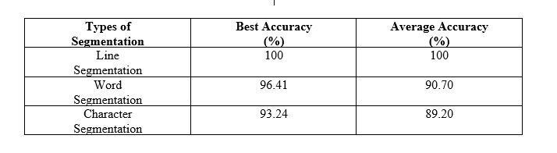
Accuracy
Table 1: Overall best accuracy and average accuracy of our system on printed script.

Slide 23
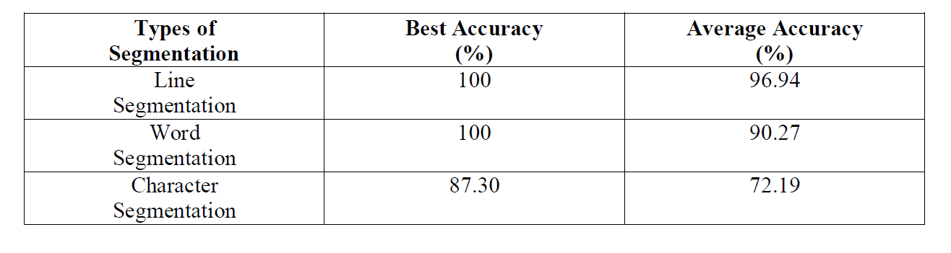
Accuracy
Table 2: Overall accuracy and average accuracy of our system of handwritten script.

Slide 24
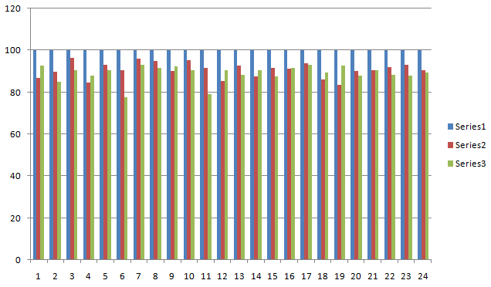
Accuracy Graph
Figure 12: Series1 shows line segmentation, series2 shows word segmentation and series3 shows character segmentation of printed script.

Slide 25
Accuracy Graph
Figure 12: Series1 shows line segmentation, series2 shows word segmentation and series3
shows character segmentation of handwritten script.

Slide 26
Discussion
Bengali character recognition has become a vital issue in the last few years.
It is a huge challenge.
We mainly focused on the segmentation process.
We used some basic operations.
We tried to segment the Bengali script that solves the problem of making a good Optical Character Recognition system.

Slide 27
Future Scope
We have a plan to use HMM (Hidden Markov model).
We also have plans to use our system for other recognition based research.

Slide 28
Conclusion
Performed some methodologies for segmenting Bengali characters.
Applied the morphological image processing operations.
Finally, we got a good accuracy of our system and we are hoping to work with our system to get better accuracy.

Slide 29
References
A. Bishnu, B.B. Chaudhuri (1999) “Segmentation of Bangla handwritten text into characters by recursive contour following”, Proceedings of the Fifth International Conference on Document Analysis and Recognition. ICDAR '99: IEEE.
Md. Abdus Sattar, Khaled Mahmud, Humayun Arafat and A. F. M.Noor Uz Zaman, “Segmenting Bangla Text for Optical Recognition, ”ICCIT, 2007. ISBN: 978-1-4244-1550-2, pp. 1-6.
T. Zahan, M.R. Selim, M.S. Rahman, M.Z. Iqbal, (2018). “Connected Component Analysis Based Two Zone Approach for Bangla Character Segmentation.” 1-4.10.1109/ICBSLP.2018.8554684.

Slide 30
References
J. H. Bosworth, S. T. Acton, “Morphological scale-space in image processing”, Digital Signal Processing, Volume 13, Issue 2, 2003, Pages 338-367, ISSN 1051-2004, https://doi.org/10.1016/S1051-2004(02)00033-7.
https://homepages.inf.ed.ac.uk/rbf/HIPR2/open.html
https://homepages.inf.ed.ac.uk/rbf/HIPR2/close.html

Slide 31
Thank you
Any Questions?

