Slide 1

Thesis Presentation
Bangladesh Army International University Of Science And Technology
Title
Handwritten and printed Bengali script character segmentation using morphological analysis
Presented By: Pritilata Biswas
Sumaia Afrin Prity
Parvez Abedin Siddique
ID: 1103017
ID: 1103057
ID: 1103094
Supervised By: Arifa Islam Champa Lecturer Department of CSE

Slide 2
Outline
Introduction
Motivation
Challenges
Objective
Literature Review
Methodology
Implementation
Result Analysis
Conclusion
Future Scope
Reference

Slide 3
Introduction
Since 1950, Optical Character Recognition is a major research area.
In the field of OCR, segmentation is one of the most challenging tasks of Bengali character recognition.
There are a large number of characters in Bengali. So we need a robust technique for our research.

Slide 4
Motivation
Printed text OCR have a huge success but handwritten still need to improved
Major problem – removing connectedness

Slide 5
Challenges
For Bengali script, there is no good OCR solution until now.
To store a million pages of paper documents into electronic form, OCR is the key tool.
To implement an OCR the foremost step in the recognition process is the script segmentation of the document image which is the most challenging task.

Slide 6
Objective
Develop an effective strategy for segmenting Bengali scripts
Reduce the segmentation error and time
Define the structuring element properly
Determine the matra line by the morphological opening operation

Slide 7
Literature Review
Segmentation of Bengali handwritten text into characters by recursive contour following by Bishnu and Choudhury. Their algorithm gives fairly good results if the sequent characters are not touching in the zone of contour following [1].
Segmenting Bangla Text for Optical Recognition by Sattar. Their proposal is a condition-based methodology for overlapped character segmentation. They examine the width of a single character, on the off chance that it is sufficiently large, at that point check for the overlapped character ‘ekar’. They didn't discuss other sorts of overlapping problems [2].

Slide 8

Methodology
Bengali Script
Line Segmentation
Word Segmentation
Preprocessing
Character Segmentation
Figure 1: System Methodology .

Slide 9
Preprocessing
Bilateral Filtering
Gray Scale Filtering
Binarization
&
Skew Angle Correction
Figure 2: Preprocessing processes.

Slide 10
Line & Word Segmentation
Horizontal Projection
Profile
Vertical
Projection
Profile
Figure 3: Line Segmentation using HPP [3].
Figure 4: Word Segmentation using VPP [3].

Slide 11
Character Segmentation
Morphological Opening Operation
Morphological Closing Operation
Vertical
Projection
Profile
Figure 5: Character segmentation process.

Slide 12
Result Analysis – Preprocessing (Printed Script)
(a) Input Image
(b) Applying Grayscale filter
(c) Applying Bilateral filter
(d) Image Binarization & Skew Angle Correction
Figure 6: Preprocessing for Bengali printed script.

Slide 13
Result Analysis – Preprocessing (Handwritten Script)
(a) Input Image
(b) Applying Grayscale filter
(c) Applying Bilateral filter
(d) Image Binarization & Skew Angle Correction
Figure 7: Preprocessing for Bengali handwritten script.

Slide 14
Result Analysis – Line Segmentation
(a) Handwritten Script
(b) Printed Script
Figure 8: Line segmentation Bengali script using HPP.

Slide 15
Result Analysis – Word Segmentation
(a) Handwritten Script
(b) Printed Script
Figure 9: Word segmentation Bengali script using VPP.

Slide 16
Result Analysis – Character Segmentation
(a) Handwritten Script
(b) Printed Script
Figure 10: Word segmentation Bengali script using VPP.

Slide 17
Tesseract OCR Engine
OCR works in various environments
Developed by the HP
Supported in 100+ languages
Widely used in most complicated OCR tasks

Slide 18
Comparison with Tessarect OCR Engine
(a) Output from our system
(b) Output from the Tessarect OCR engine
Figure 11: Comparing of character segmentation with Tessarect OCR engine.

Slide 19
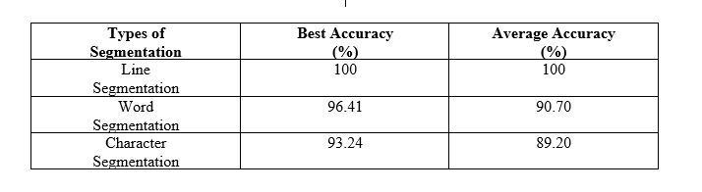
Accuracy
Table 1: Overall best accuracy and average accuracy of our system on printed script.

Slide 20
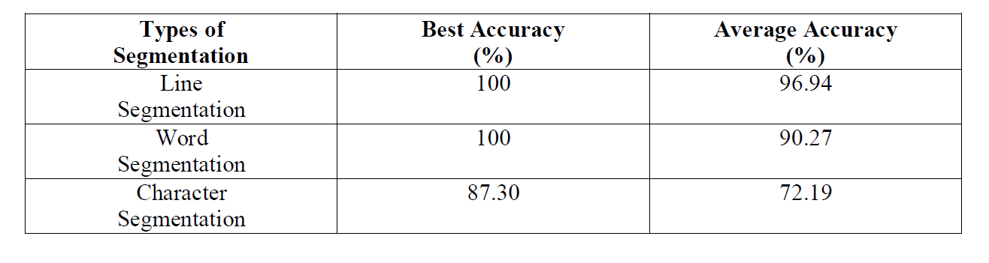
Accuracy
Table 2: Overall accuracy and average accuracy of our system of handwritten script.

Slide 21
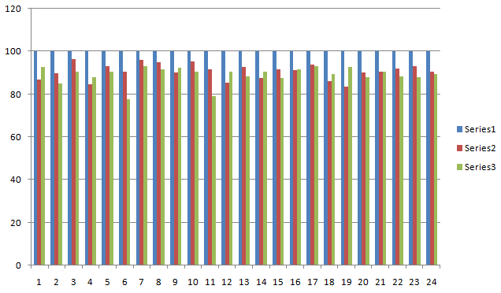
Accuracy Graph
Figure 12: Series1 shows line segmentation, series2 shows word segmentation and series3 shows character segmentation of printed script.

Slide 22
Accuracy Graph
Figure 12: Series1 shows line segmentation, series2 shows word segmentation and series3
shows character segmentation of handwritten script.

Slide 23
Discussion
Bengali character recognition has become a vital issue in the last few years.
It is a huge challenge.
We mainly focused on the segmentation process.
We used some basic operations.
We tried to segment the Bengali script that solves the problem of making a good Optical Character Recognition system.

Slide 24
Conclusion
Performed some methodologies for segmenting Bengali characters.
Applied the morphological image processing operations.
Finally, we got a good accuracy of our system and we are hoping to work with our system to get better accuracy.

Slide 25
Future Scope
We have a plan to use HMM (Hidden Markov model).
We also have plans to use our system for other recognition based research.

Slide 26
Reference
A. Bishnu, B.B. Chaudhuri (1999) “Segmentation of Bangla handwritten text into characters by recursive contour following”, Proceedings of the Fifth International Conference on Document Analysis and Recognition. ICDAR '99: IEEE.
Md. Abdus Sattar, Khaled Mahmud, Humayun Arafat and A. F. M.Noor Uz Zaman, “Segmenting Bangla Text for Optical Recognition, ”ICCIT, 2007. ISBN: 978-1-4244-1550-2, pp. 1-6.
T. Zahan, M.R. Selim, M.S. Rahman, M.Z. Iqbal, (2018). “Connected Component Analysis Based Two Zone Approach for Bangla Character Segmentation.” 1-4.10.1109/ICBSLP.2018.8554684.

Slide 27
Thank you
Any Questions?

