Slide 1


Array CRDTs Using Delta Mutations –
PaPoC 2021
Arik Rinberg (Technion), Tomer Solomon (IBM), Guy Khazma (IBM), Gal Lushi (IBM), Roee Shlomo (IBM), Paula Ta-Shma (IBM)

Slide 2


What’s a CRDT?
Conflict-free Replicated Data Type
Supports strong eventual consistency
Replicas can be modified simultaneously
Examples:
Multi Value Register (MVReg)
Last Writer Wins (LWW)
Grow-only Counter (GC)
Used by NoSQL databases: Redis, Riak, Cosmos DB, etc

Slide 3


Types of CRDTs
State-based – transmits the entire state
The state is a join-semilattice
Op-based – transmits an operation to be performed for synchronization
Delta-based – transmits a delta
Represent changes to the state by a delta
Deltas are “partial state”, typically small

Slide 4


Delta-based CRDT
Dots – tuples of (replica-id, event-number), for example $\left(R1, 1\right), (R2,19)$, etc
Conceptually, the dot $(i, n)$ identifies the $n$-th event that occurred in replica $i$
Dot Store – a data structure for storing the current dots in the replica
Causal Context – contains all dots ever observed by the replica
compact version vector

Slide 5
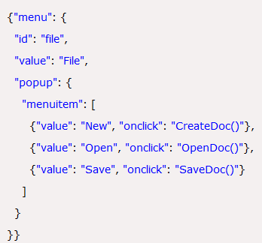
Motivation
Semi structured documents: JSON, XML, NoSQL databases, etc
Today maps are the main nested delta-based CRDT object
Not sufficient to construct all semi-structured documents
Need also arrays
Requirements for array in semi-structured documents:
Arbitrary nesting
Moving elements around

Slide 6

Main contributions
We construct two new delta-based CRDT arrays
Remove-Wins Array (RWArray)
Observed-Remove Array (ORArray)
Properties:
Arbitrary nesting
Moving elements around
No tombstones
Main difference - semantics
Concurrent array operations: Update, Move, Remove
Also, we construct a new dot store data structure (CompDotFun)
Main building block in the array constructions

Slide 7
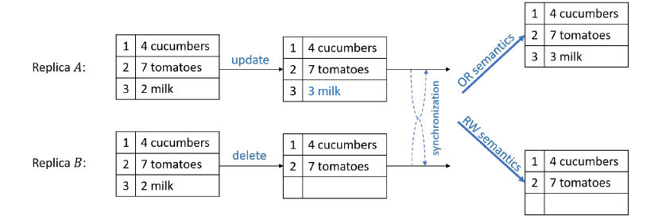
Our arrays
RWArray – Remove Wins Array
Remove > Move, Update
A remove overrides concurrent moves and updates
An update and a move are both preserved when performed concurrently
ORArray – Observed Remove Array
Update > Remove > Move
An update overrides concurrent removes and moves
A remove overrides concurrent moves

Slide 8
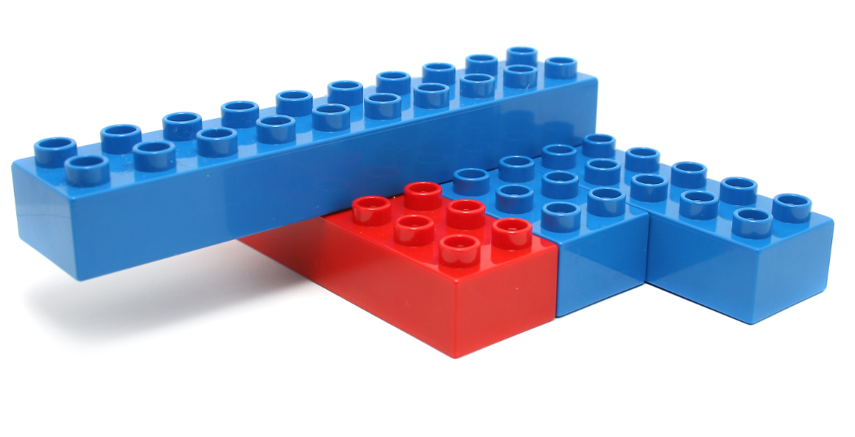
Main building blocks
Existing dot stores from Almeida at. el:
DotMap: maps arbitrary keys to some dot store
DotFun: maps dots to some join-semilattice
New dot store – CompDotFun (Composable DotFun)
Conceptually a combination of DotMap and DotFun

Slide 9
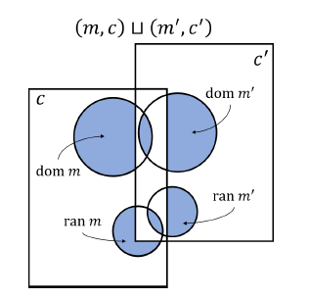
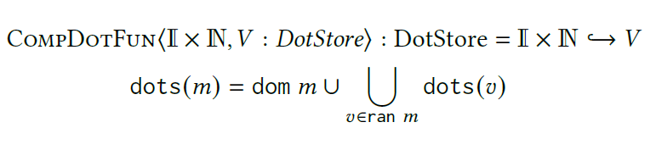
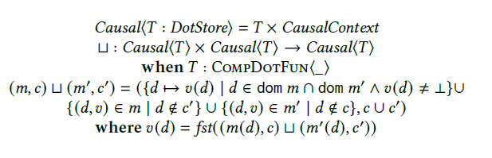
CompDotFun
State: a mapping from dots to some dot store
Main property – a concurrent update of an element to its removal results in the item being deleted

Slide 10
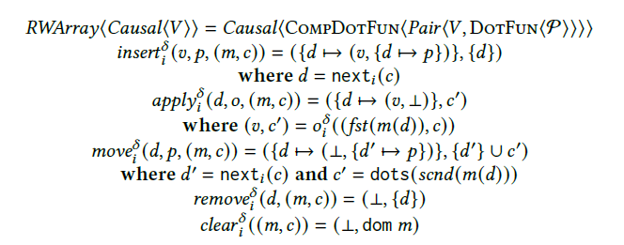
RWArray
Remove > Update, Move
The CompDotFun is the top-level dot store
An array element is uniquely identified by the creation event (i.e., a dot)

Slide 11
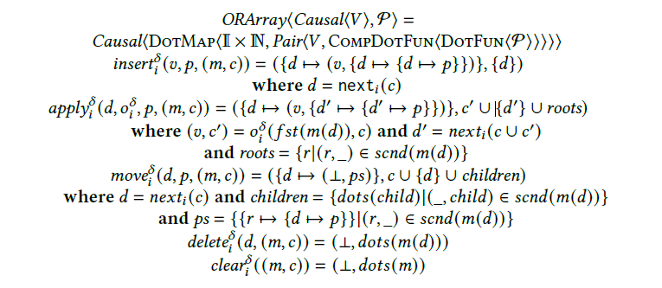
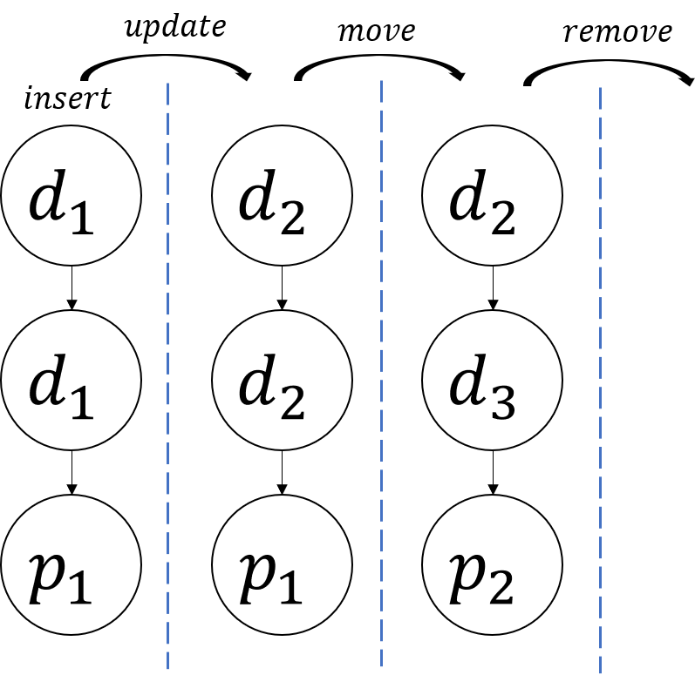
ORArray
Update > Remove > Move
Top-level dot store is DotMap
An array element is uniquely identified by the creation event (i.e., a dot)
The position identifiers are stored in a forest structure inside a CompDotMap
Trees are of height 3
Insert: a new root is added
Update: a new root is added, and previous ones are removed
Move: middle level of existing trees are updated
Remove: all roots are removed

Slide 12


Slide 13
Conclusion and next steps
We’re implementing a delta-based CRDT JSON library
MVReg
ORMap
ORArray
Benchmarking the library and comparing to existing solutions: Automerge, Yjs, etc

