Slide 1



Intermediate Value Linearizability
Arik Rinberg and Idit Keidar
Technion, Israel

Slide 2
Motivation
Batched Counters
Statistical Summaries
Data Sketches
Big Data
Scalable processing in large distributed systems, multi-core servers

Slide 3
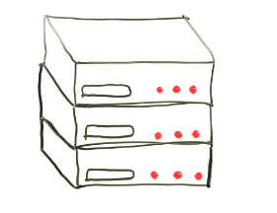

Simple Example: Counting Events
A
Is another server needed?
B

Slide 4




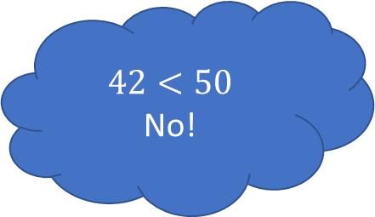
Simple Example: Counting Events
A
$$42<50$$
No!
B
$$24$$
$$18$$
$$read$$
$$read$$

Slide 5
Simple Example: Counting Events
A
Is another server needed?
6 more people
B

Slide 6
Simple Example: Counting Events
A
Is another server needed?
6 more people
B
$$24$$
$$read$$

Slide 7

Simple Example: Counting Events
A
Is another server needed?
6 more people
B
10 more people
$$24$$
$$read$$

Slide 8

Simple Example: Counting Events
A
Is another server needed?
6 more people
B
10 more people
$$24$$
$$read$$
$$read$$

Slide 9

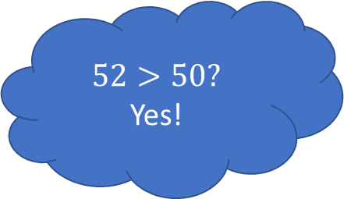
Simple Example: Counting Events
A
$$52>50?$$
Yes!
6 more people
B
10 more people
$$24$$
$$28$$
$$read$$
$$read$$

Slide 10





Simple Example: Counting Events
$$counter=42$$
$$counter=58$$
$$inc(6)$$
$$inc(10)$$
$$read()→52$$

Slide 11
Simple Example: Counting Events
$$counter=42$$
$$counter=58$$
$$inc(6)$$
$$inc(10)$$
$$read()→52$$
Under linearizability: Either 42, or 48 or 58

Slide 12
Simple Example: Counting Events
$$counter=42$$
$$counter=58$$
$$inc(6)$$
Not Linearizable
$$inc(10)$$
$$read()→52$$
Under linearizability: Either 42, or 48 or 58

Slide 13
Simple Example: Counting Events
$$counter=42$$
$$counter=58$$
$$inc(6)$$
$$inc(10)$$
$$read()→52$$
What’s wrong with 52?

Slide 14
Simple Example: Counting Events
$$counter=42$$
$$counter=58$$
$$inc(6)$$
$$inc(10)$$
$$read()→52$$
What’s wrong with 52?
Or any number between 42 and 58?

Slide 15
IVL Intuition
$$counter=42$$
$$counter=58$$
$$inc(6)$$
$$inc(10)$$
$$read()→52$$
Allow the return of any number between 42 and 58!

Slide 16

Skeleton Histories
$$counter=42$$
$$counter=58$$
$$inc(6)$$
$$inc(10)$$
$$read()→52$$
$$?$$
Skeleton history of H – replace read returns values by $?$

Slide 17



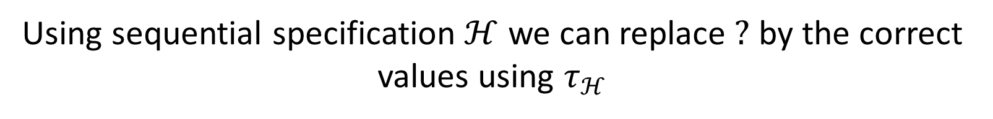






Skeleton Histories
Using sequential specification $ℋ$ we can replace $?$ by the correct values using $τ_{ℋ}$
$$counter=42$$
$$inc(6)$$
$$read()→?$$
$$inc(10)$$
$$τ_{ℋ}$$
$$counter=42$$
$$inc(6)$$
$$read()→48$$
$$inc(10)$$

Slide 18


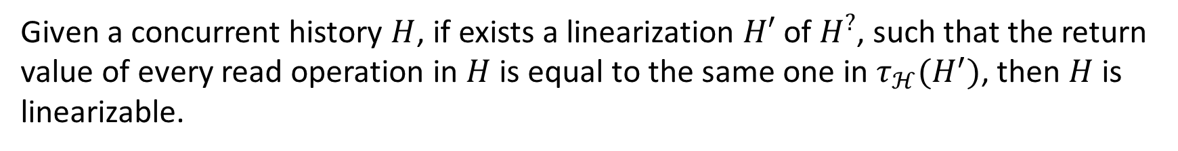



Skeleton Histories – Defining Linearizability
Given a concurrent history $H$, if exists a linearization $H′$ of $H^{?}$, such that the return value of every read operation in $H$ is equal to the same one in $τ_{ℋ}(H^{′})$, then $H$ is linearizable.
$$counter=42$$
$$58$$
$$inc(6)$$
$$inc(10)$$
$$read()→52$$

Slide 19

Skeleton Histories – Defining Linearizability
Given a concurrent history $H$, if exists a linearization $H′$ of $H^{?}$, such that the return value of every read operation in $H$ is equal to the same one in $τ_{ℋ}(H^{′})$, then $H$ is linearizable.
$$counter=42$$
$$58$$
$$inc(6)$$
$$inc(10)$$
$$read()→52$$
$$?$$

Slide 20



Skeleton Histories – Defining Linearizability
Given a concurrent history $H$, if exists a linearization $H′$ of $H^{?}$, such that the return value of every read operation in $H$ is equal to the same one in $τ_{ℋ}(H^{′})$, then $H$ is linearizable.
$$counter=42$$
$$58$$
$$inc(6)$$
$$inc(6)$$
$$inc(10)$$
$$inc(10)$$
$$read()→?$$
$$read()→52$$
$$?$$

Slide 21



Skeleton Histories – Defining Linearizability
Given a concurrent history $H$, if exists a linearization $H′$ of $H^{?}$, such that the return value of every read operation in $H$ is equal to the same one in $τ_{ℋ}(H^{′})$, then $H$ is linearizable.
$$counter=42$$
$$58$$
$$read()→?$$
$$inc(6)$$
$$inc(10)$$
$$inc(6)$$
$$inc(6)$$
$$inc(10)$$
$$inc(10)$$
$$read()→?$$
$$read()→52$$
$$?$$

Slide 22



Skeleton Histories – Defining Linearizability
Given a concurrent history $H$, if exists a linearization $H′$ of $H^{?}$, such that the return value of every read operation in $H$ is equal to the same one in $τ_{ℋ}(H^{′})$, then $H$ is linearizable.
$$counter=42$$
$$58$$
$$read()→?$$
$$inc(6)$$
$$inc(10)$$
$$inc(6)$$
$$inc(6)$$
$$inc(10)$$
$$inc(10)$$
$$inc(6)$$
$$read()→?$$
$$inc(10)$$
$$read()→?$$
$$read()→52$$
$$?$$

Slide 23



Skeleton Histories – Defining Linearizability
Given a concurrent history $H$, if exists a linearization $H′$ of $H^{?}$, such that the return value of every read operation in $H$ is equal to the same one in $τ_{ℋ}(H^{′})$, then $H$ is linearizable.
$$counter=42$$
$$58$$
$$read()→?$$
$$inc(6)$$
$$inc(10)$$
$$inc(6)$$
$$inc(10)$$
$$inc(6)$$
$$read()→?$$
$$inc(10)$$
$$read()→52$$
$$?$$
$$inc(6)$$
$$inc(10)$$
$$read()→?$$

Slide 24







Skeleton Histories – Defining Linearizability
Given a concurrent history $H$, if exists a linearization $H′$ of $H^{?}$, such that the return value of every read operation in $H$ is equal to the same one in $τ_{ℋ}(H^{′})$, then $H$ is linearizable.
$$τ_{ℋ}$$
$$counter=42$$
$$58$$
$$read()→?$$
$$inc(6)$$
$$inc(10)$$
$$read()→42$$
$$inc(6)$$
$$inc(10)$$
$$inc(6)$$
$$read()→?$$
$$inc(10)$$
$$read()→48$$
$$?$$
$$inc(6)$$
$$inc(10)$$
$$read()→?$$
$$read()→52$$
$$read()→58$$

Slide 25

Skeleton Histories – Defining Linearizability
Given a concurrent history $H$, if exists a linearization $H′$ of $H^{?}$, such that the return value of every read operation in $H$ is equal to the same one in $τ_{ℋ}(H^{′})$, then $H$ is linearizable.
$$counter=42$$
$$58$$
$read()→4$2
$$inc(6)$$
$$inc(10)$$
$$inc(6)$$
$$inc(10)$$
$$inc(6)$$
$$read()→48$$
$$inc(10)$$
$$read()→52$$
$$inc(6)$$
$$inc(10)$$
$$read()→58$$

Slide 26
Skeleton Histories – Defining Linearizability
Given a concurrent history $H$, if exists a linearization $H′$ of $H^{?}$, such that the return value of every read operation in $H$ is equal to the same one in $τ_{ℋ}(H^{′})$, then $H$ is linearizable.
$$counter=42$$
$$58$$
$read()→4$2
$$inc(6)$$
$$inc(10)$$
$$inc(6)$$
$$inc(10)$$
$$inc(6)$$
$$read()→48$$
$$inc(10)$$
$$read()→52$$
$$inc(6)$$
$$inc(10)$$
$$read()→58$$

Slide 27

Skeleton Histories – Defining Linearizability
Given a concurrent history $H$, if exists a linearization $H′$ of $H^{?}$, such that the return value of every read operation in $H$ is equal to the same one in $τ_{ℋ}(H^{′})$, then $H$ is linearizable.
$$counter=42$$
$$58$$
$read()→4$2
$$inc(6)$$
$$inc(10)$$
$$inc(6)$$
$$inc(10)$$
$$inc(6)$$
$$read()→48$$
$$inc(10)$$
$$read()→52$$
$$inc(6)$$
$$inc(10)$$
$$read()→58$$

Slide 28
Skeleton Histories – Defining Linearizability
Given a concurrent history $H$, if exists a linearization $H′$ of $H^{?}$, such that the return value of every read operation in $H$ is equal to the same one in $τ_{ℋ}(H^{′})$, then $H$ is linearizable.
$$counter=42$$
$$58$$
$read()→4$2
$$inc(6)$$
$$inc(10)$$
$$inc(6)$$
$$inc(10)$$
$$inc(6)$$
$$read()→48$$
$$inc(10)$$
$$read()→52$$
$$inc(6)$$
$$inc(10)$$
$$read()→58$$

Slide 29
Skeleton Histories – Defining Linearizability
Given a concurrent history $H$, if exists a linearization $H′$ of $H^{?}$, such that the return value of every read operation in $H$ is equal to the same one in $τ_{ℋ}(H^{′})$, then $H$ is linearizable.
$$counter=42$$
$$58$$
$read()→4$2
$$inc(6)$$
$$inc(10)$$
$$inc(6)$$
$$inc(10)$$
$$inc(6)$$
$$read()→48$$
$$inc(10)$$
$$read()→52$$
$$inc(6)$$
$$inc(10)$$
$$read()→58$$

Slide 30
Skeleton Histories – Defining Linearizability
Given a concurrent history $H$, if exists a linearization $H′$ of $H^{?}$, such that the return value of every read operation in $H$ is equal to the same one in $τ_{ℋ}(H^{′})$, then $H$ is linearizable.
$$counter=42$$
$$58$$
$read()→4$2
$$inc(6)$$
$$inc(10)$$
$$inc(6)$$
Not Linearizable
$$inc(10)$$
$$inc(6)$$
$$read()→48$$
$$inc(10)$$
$$read()→52$$
$$inc(6)$$
$$inc(10)$$
$$read()→58$$

Slide 31
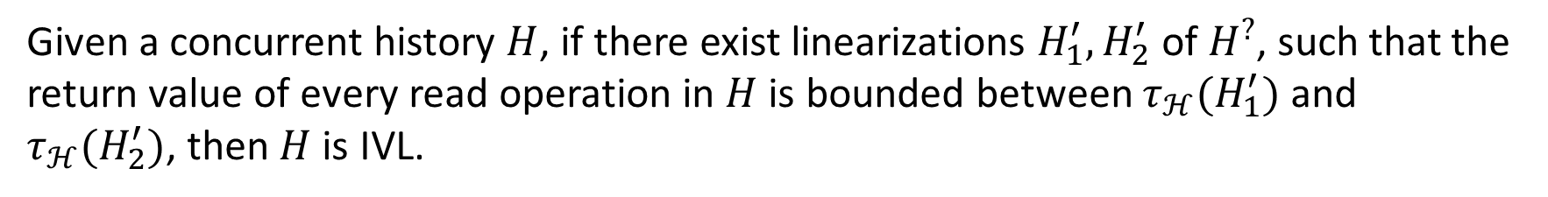
Defining IVL
Given a concurrent history $H$, if there exist linearizations $H_{1}^{′},H_{2}^{′}$ of $H^{?}$, such that the return value of every read operation in $H$ is bounded between $τ_{ℋ}(H_{1}^{′})$ and $τ_{ℋ}(H_{2}^{′})$, then $H$ is IVL.
$$counter=42$$
$$58$$
$$inc(6)$$
$$inc(10)$$
$$read()→52$$

Slide 32
Defining IVL
Given a concurrent history $H$, if there exist linearizations $H_{1}^{′},H_{2}^{′}$ of $H^{?}$, such that the return value of every read operation in $H$ is bounded between $τ_{ℋ}(H_{1}^{′})$ and $τ_{ℋ}(H_{2}^{′})$, then $H$ is IVL.
$$counter=42$$
$$58$$
$read()→4$2
$$inc(6)$$
$$inc(10)$$
$$inc(6)$$
$$inc(10)$$
$$inc(6)$$
$$read()→48$$
$$inc(10)$$
$$read()→52$$
$$inc(6)$$
$$inc(10)$$
$$read()→58$$

Slide 33
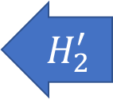

Defining IVL
Given a concurrent history $H$, if there exist linearizations $H_{1}^{′},H_{2}^{′}$ of $H^{?}$, such that the return value of every read operation in $H$ is bounded between $τ_{ℋ}(H_{1}^{′})$ and $τ_{ℋ}(H_{2}^{′})$, then $H$ is IVL.
$$counter=42$$
$$58$$
$read()→4$2
$$inc(6)$$
$$inc(10)$$
$$inc(6)$$
$$inc(10)$$
$$inc(6)$$
$$read()→48$$
$$inc(10)$$
$$H_{1}^{′}$$
$$read()→52$$
$$inc(6)$$
$$inc(10)$$
$$read()→58$$
$$H_{2}^{′}$$

Slide 34
Defining IVL
Given a concurrent history $H$, if there exist linearizations $H_{1}^{′},H_{2}^{′}$ of $H^{?}$, such that the return value of every read operation in $H$ is bounded between $τ_{ℋ}(H_{1}^{′})$ and $τ_{ℋ}(H_{2}^{′})$, then $H$ is IVL.
$$counter=42$$
$$58$$
$read()→4$2
$$inc(6)$$
$$inc(10)$$
$$inc(6)$$
$$inc(10)$$
$$inc(6)$$
$$read()→48$$
$$inc(10)$$
$$H_{1}^{′}$$
H is IVL
$$read()→52$$
$$inc(6)$$
$$inc(10)$$
$$read()→58$$
$$H_{2}^{′}$$

Slide 35
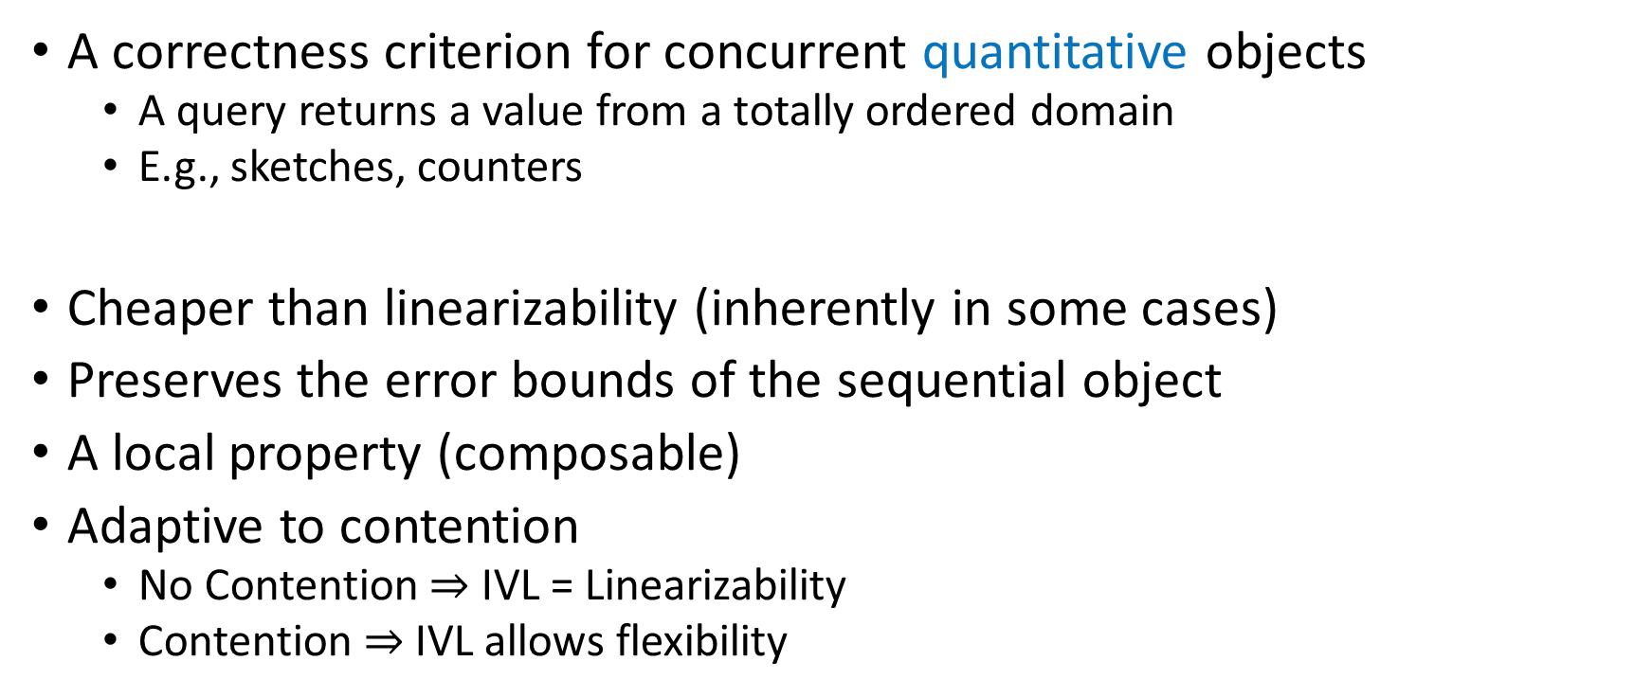
Intermediate Value Linearizability (IVL)
A correctness criterion for concurrent quantitative objects
A query returns a value from a totally ordered domain
E.g., sketches, counters
Cheaper than linearizability (inherently in some cases)
Preserves the error bounds of the sequential object
A local property (composable)
Adaptive to contention
No Contention $⇒$ IVL = Linearizability
Contention $⇒$ IVL allows flexibility

Slide 36
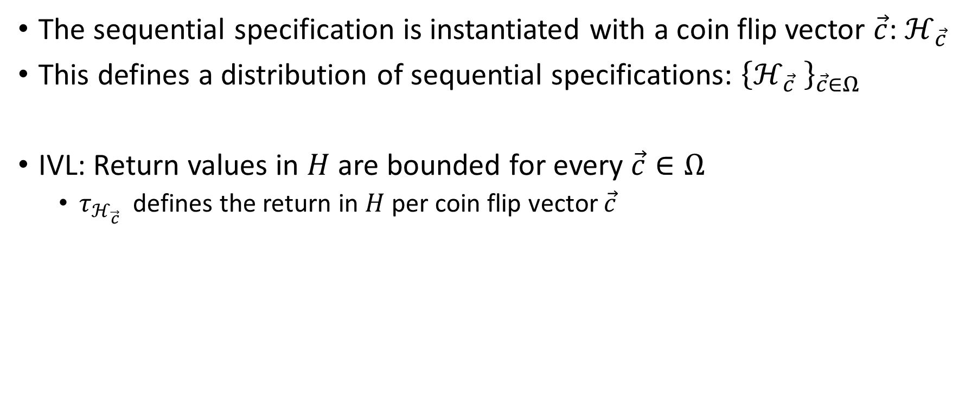
IVL For Randomized Objects
The sequential specification is instantiated with a coin flip vector $\vec{c}$: $ℋ_{\vec{c}}$
This defines a distribution of sequential specifications: ${\left\{ℋ_{\vec{c}} \right\}}_{\vec{c}∈Ω}$
IVL: Return values in $H$ are bounded for every $\vec{c}∈Ω$
$τ_{ℋ_{\vec{c}}}$ defines the return in $H$ per coin flip vector $\vec{c}$

Slide 37
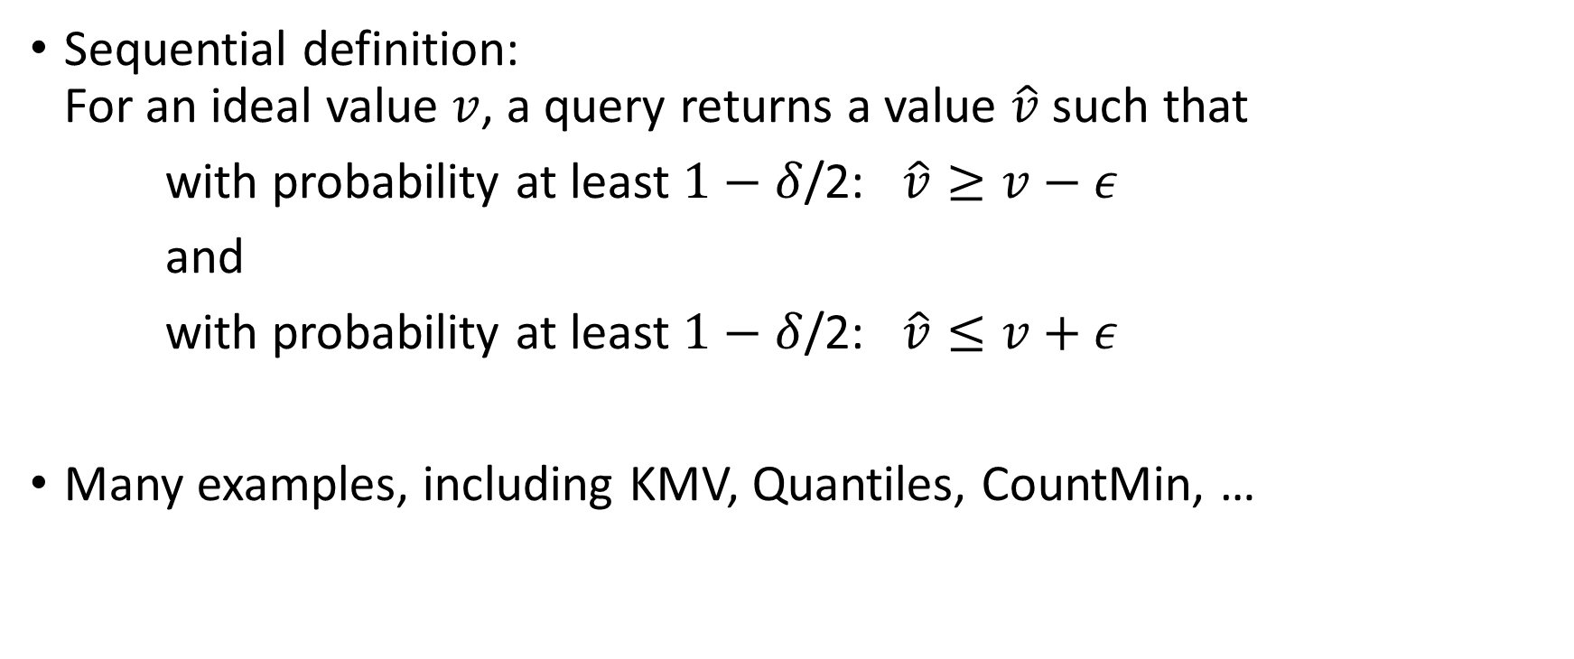
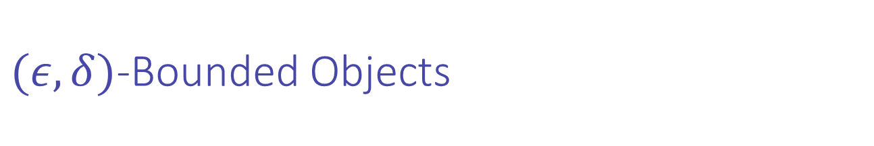
$(ε,δ)$-Bounded Objects
Sequential definition: For an ideal value $v$, a query returns a value $\hat{v}$ such that
with probability at least $1−δ$/2: $\hat{v}≥v−ε$
and
with probability at least $1−δ$/2: $\hat{v}≤v+ε$
Many examples, including KMV, Quantiles, CountMin, …

Slide 38
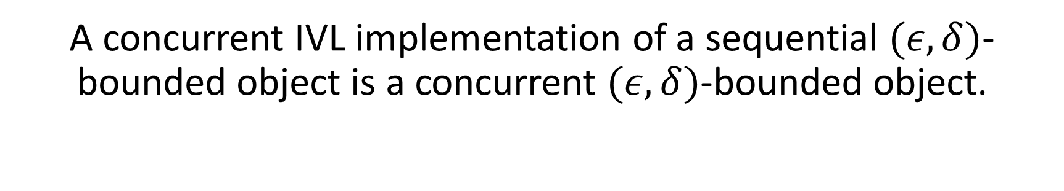
Main Theorem
A concurrent IVL implementation of a sequential $(ε,δ)$-bounded object is a concurrent $(ε,δ)$-bounded object.

Slide 39
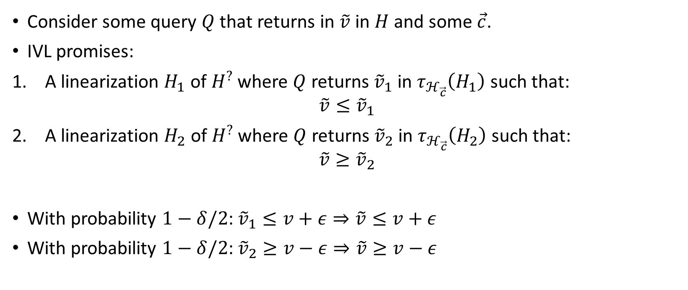
Main Theorem – Proof Idea
Consider some query $Q$ that returns in $\tilde{v}$ in $H$ and some $\vec{c}$.
IVL promises:
1. A linearization $H_{1}$ of $H^{?}$ where $Q$ returns${\tilde{v}}_{1}$ in $τ_{ℋ_{\vec{c}}}\left(H_{1}\right)$ such that:
$$\tilde{v}≤{\tilde{v}}_{1}$$
2. A linearization $H_{2}$ of $H^{?}$ where $Q$ returns${\tilde{v}}_{2}$ in $τ_{ℋ_{\vec{c}}}\left(H_{2}\right)$ such that:
$$\tilde{v}≥{\tilde{v}}_{2}$$
With probability $1−δ/2$: ${\tilde{v}}_{1}≤v+ε⇒\tilde{v}≤v+ε$
With probability $1−δ/2$: ${\tilde{v}}_{2}≥v−ε⇒\tilde{v}≥v−ε$

Slide 40
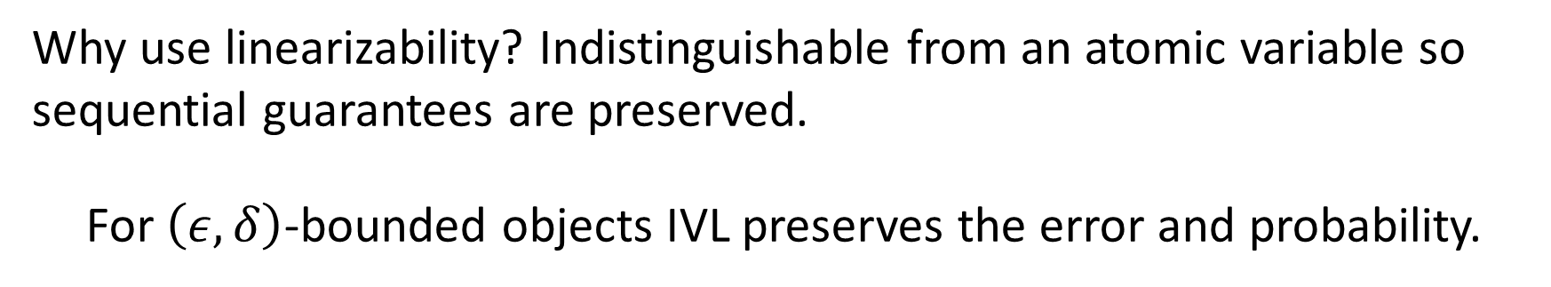
Main Theorem
A concurrent IVL implementation of a sequential $(ε,δ)$-bounded object is a concurrent $(ε,δ)$-bounded object.
Why use linearizability? Indistinguishable from an atomic variable so sequential guarantees are preserved.
For $\left(ε,δ\right)$-bounded objects IVL preserves the error and probability.

Slide 41

Main Theorem
A concurrent IVL implementation of a sequential $(ε,δ)$-bounded object is a concurrent $(ε,δ)$-bounded object.
IVL is sufficient for $(ε,δ)$-bounded objects
Why use linearizability? Indistinguishable from an atomic variable so sequential guarantees are preserved.
For $\left(ε,δ\right)$-bounded objects IVL preserves the error and probability.

Slide 42
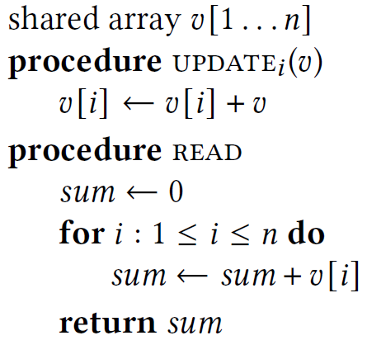
Example – IVL Batched Counter

Slide 43
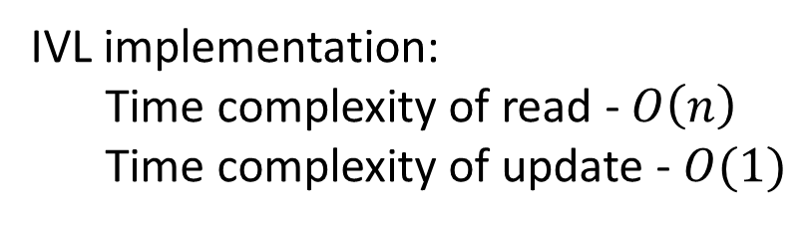
Example – IVL Batched Counter
IVL implementation:
Time complexity of read - $O\left(n\right)$
Time complexity of update - $O(1)$

Slide 44
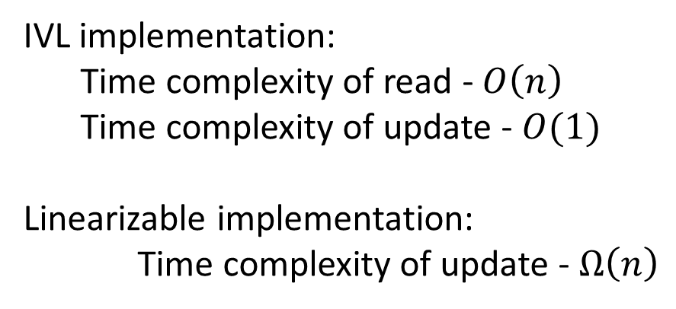
Example – IVL Batched Counter
IVL implementation:
Time complexity of read - $O\left(n\right)$
Time complexity of update - $O(1)$
Linearizable implementation:
Time complexity of update - $Ω\left(n\right)$

Slide 45
Example – IVL Batched Counter
IVL implementation:
Time complexity of read - $O\left(n\right)$
Time complexity of update - $O(1)$
Linearizable implementation:
Time complexity of update - $Ω\left(n\right)$
Proof by reduction from batched counter to snapshot

Slide 46
Example – IVL Batched Counter
IVL implementation:
Time complexity of read - $O\left(n\right)$
Time complexity of update - $O(1)$
Linearizable implementation:
Time complexity of update - $Ω\left(n\right)$
IVL is cheaper
Proof by reduction from batched counter to snapshot

Slide 47
Conclusion
IVL:
An intuitive correctness criterion
Values observed in concurrent executions are bounded between legal ones (with respect to linearizability)
Main theorem – IVL implementations of randomized objects with bounded error, have a bounded error
Example: CountMin sketch
Allows cheaper implementations (than linearizability)

