Slide 1








Brief Announcement: Fast Concurrent Data Sketches
Arik Rinberg, Alexander Spiegelman, Edward Bortnikov, Eshcar Hillel, Idit Keidar, Hadar Serviansky

Slide 2
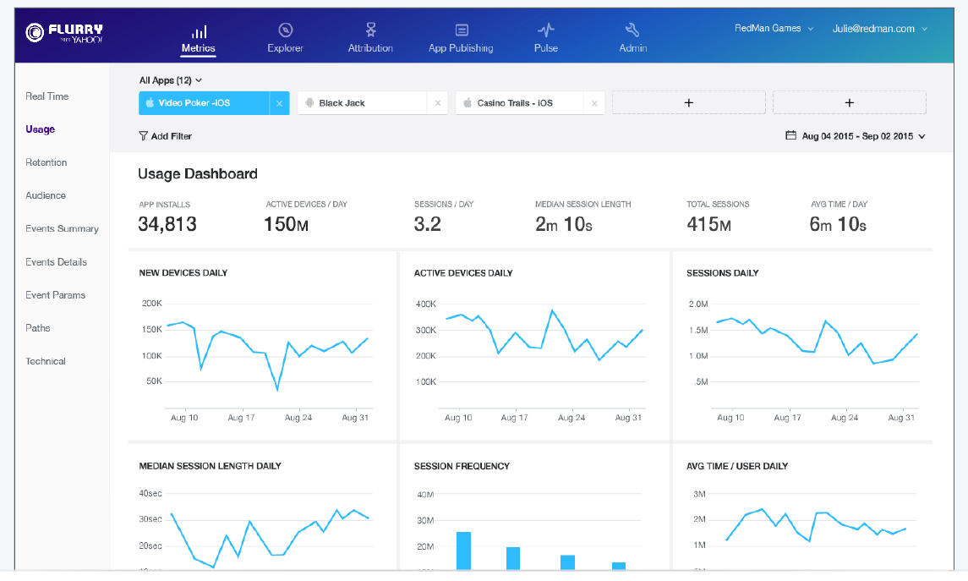
Motivation: Massive Real-Time Analytics
Real-time reports ~830,000 mobile apps on ~1.6 billion user devices

Slide 3
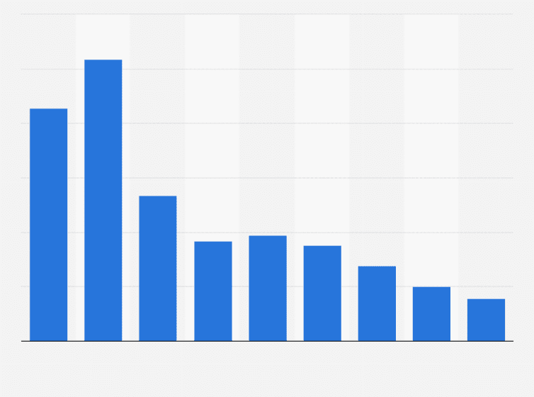
Hardware Trends: Scale Processing & Memory
Multi-core servers
Performance via parallelism, not sequential speed
Cheaper DRAM
In-memory processing of bigger data
Average selling price of 1Gb
DRAM 2009 to 2017

Slide 4


Sketches: Lean & Mean Aggregation
Fast
Small memory footprint
Statistical summary of large stream
Estimates some aggregate
#uniques
quantiles
heavy-hitters

Slide 5

Context: Open-Source DataSketches Library
Apache Incubating

Slide 6



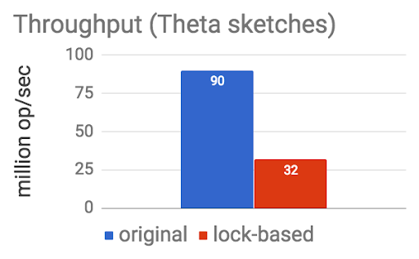




Parallelization Challenges
Sketches aren’t thread safe
Can’t query while updating
Current approach:
Use lock, or
Update in epochs
query
New
Data Store
Old
Data Store
update

Slide 7

Concurrent Sketches - Features
Generic solution
High ingestion throughput
Concurrent updates
Harness multi-cores for multi-threaded stream processing
Query freshness
Allow queries during updates
Enjoy sketch’s benefits
Fast
Provably bounded estimation error
Small memory footprint
Main challenge

Slide 8
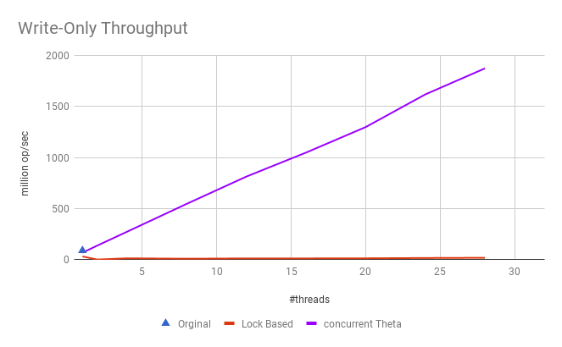

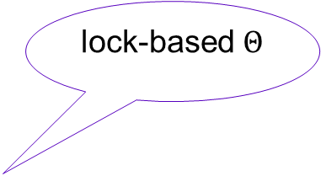
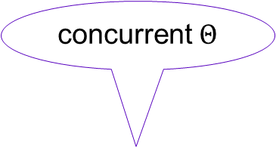
Concurrent $Θ$ Sketch: Update Throughput
concurrent $Θ$
Throughput (million ops\ sec)
original (not thread-safe)
lock-based $Θ$

Slide 9
Correctness: Challenges
Traditional approach for concurrent data structures: prove linearizability relative to sequential specification
But …
Sequential algorithm’s guarantees are statistical – has no sequential specification
Concurrency does introduce an additional error – does not perfectly simulate sequential algorithm
Linearizability not good enough for randomized algorithms

Slide 10
Overcoming the Challenges
Sequential algorithm’s guarantees are statistical – has no sequential specification
De-randomize algorithm using randomness oracle, use resulting algorithm as reference sequential specification
Concurrency does introduce an additional error – does not perfectly simulate sequential algorithm
Prove relaxed consistency [Henzinger et al. 2013]
Analyze error bound of relaxed sketch
Linearizability not good enough for randomized algorithms
Prove strong linearizability [Golab et al. 2011]

Slide 11
Summary: Concurrent Sketches
Generic solution based on composable sketches
Rigorous correctness proof using relaxed consistency
High ingestion throughput via concurrent updates
Harness multi-cores
Query freshness
Allow queries during updates
Enjoy sketches’ benefits
Fast
Bounded estimation error
Small memory footprint
Now Available

Slide 12
Challenge 1: Sketches Aren’t Thread-Safe
Need protection:
But locks are costly:

Slide 13

Challenge 2: Can’t Query While Updating
Current approach:
Use locks or
Update in epochs, query previous epoch
query
New
Data Store
Old
Data Store
update
Notes:
Merge with previous

